Slide 1
Rotary Club of Moscow Club President’s Vision 2024-25

Slide 2
Agenda
Mission
Club Leaders
Club Goals taken from Club Action Plan
President’s Goals
Budget
Grant Programs
Avenues of Service & Committee Volunteering Opportunities
Membership Initiatives
Summary

Slide 3
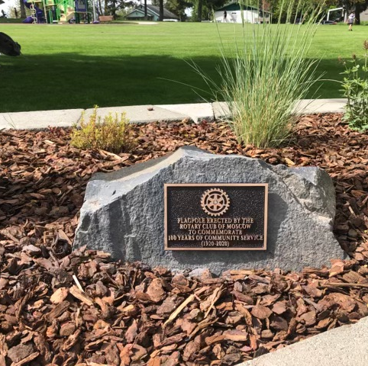
Mission
Mission Statement: The Rotary Club of Moscow is a growing, vibrant club known for its comradery, outreach, and generous contributions to the Moscow and Latah County community.

Slide 4
Club Leadership
President Tim Thomson
President-Elect David Nelson
Treasurer Renee Magee
Secretary Brenda Helbling
Club Service Jackie Coan
Community Service Beau Melton
Vocation Service Nancy Lyle/Connie Hall
International Service (new) Carol Bennett
Youth Exchange David Nelson
Foundation Dave Ostrom
Public Image Marisa Lloyd
Past President Joy Lunsford
Programs Mona Roach

Slide 5
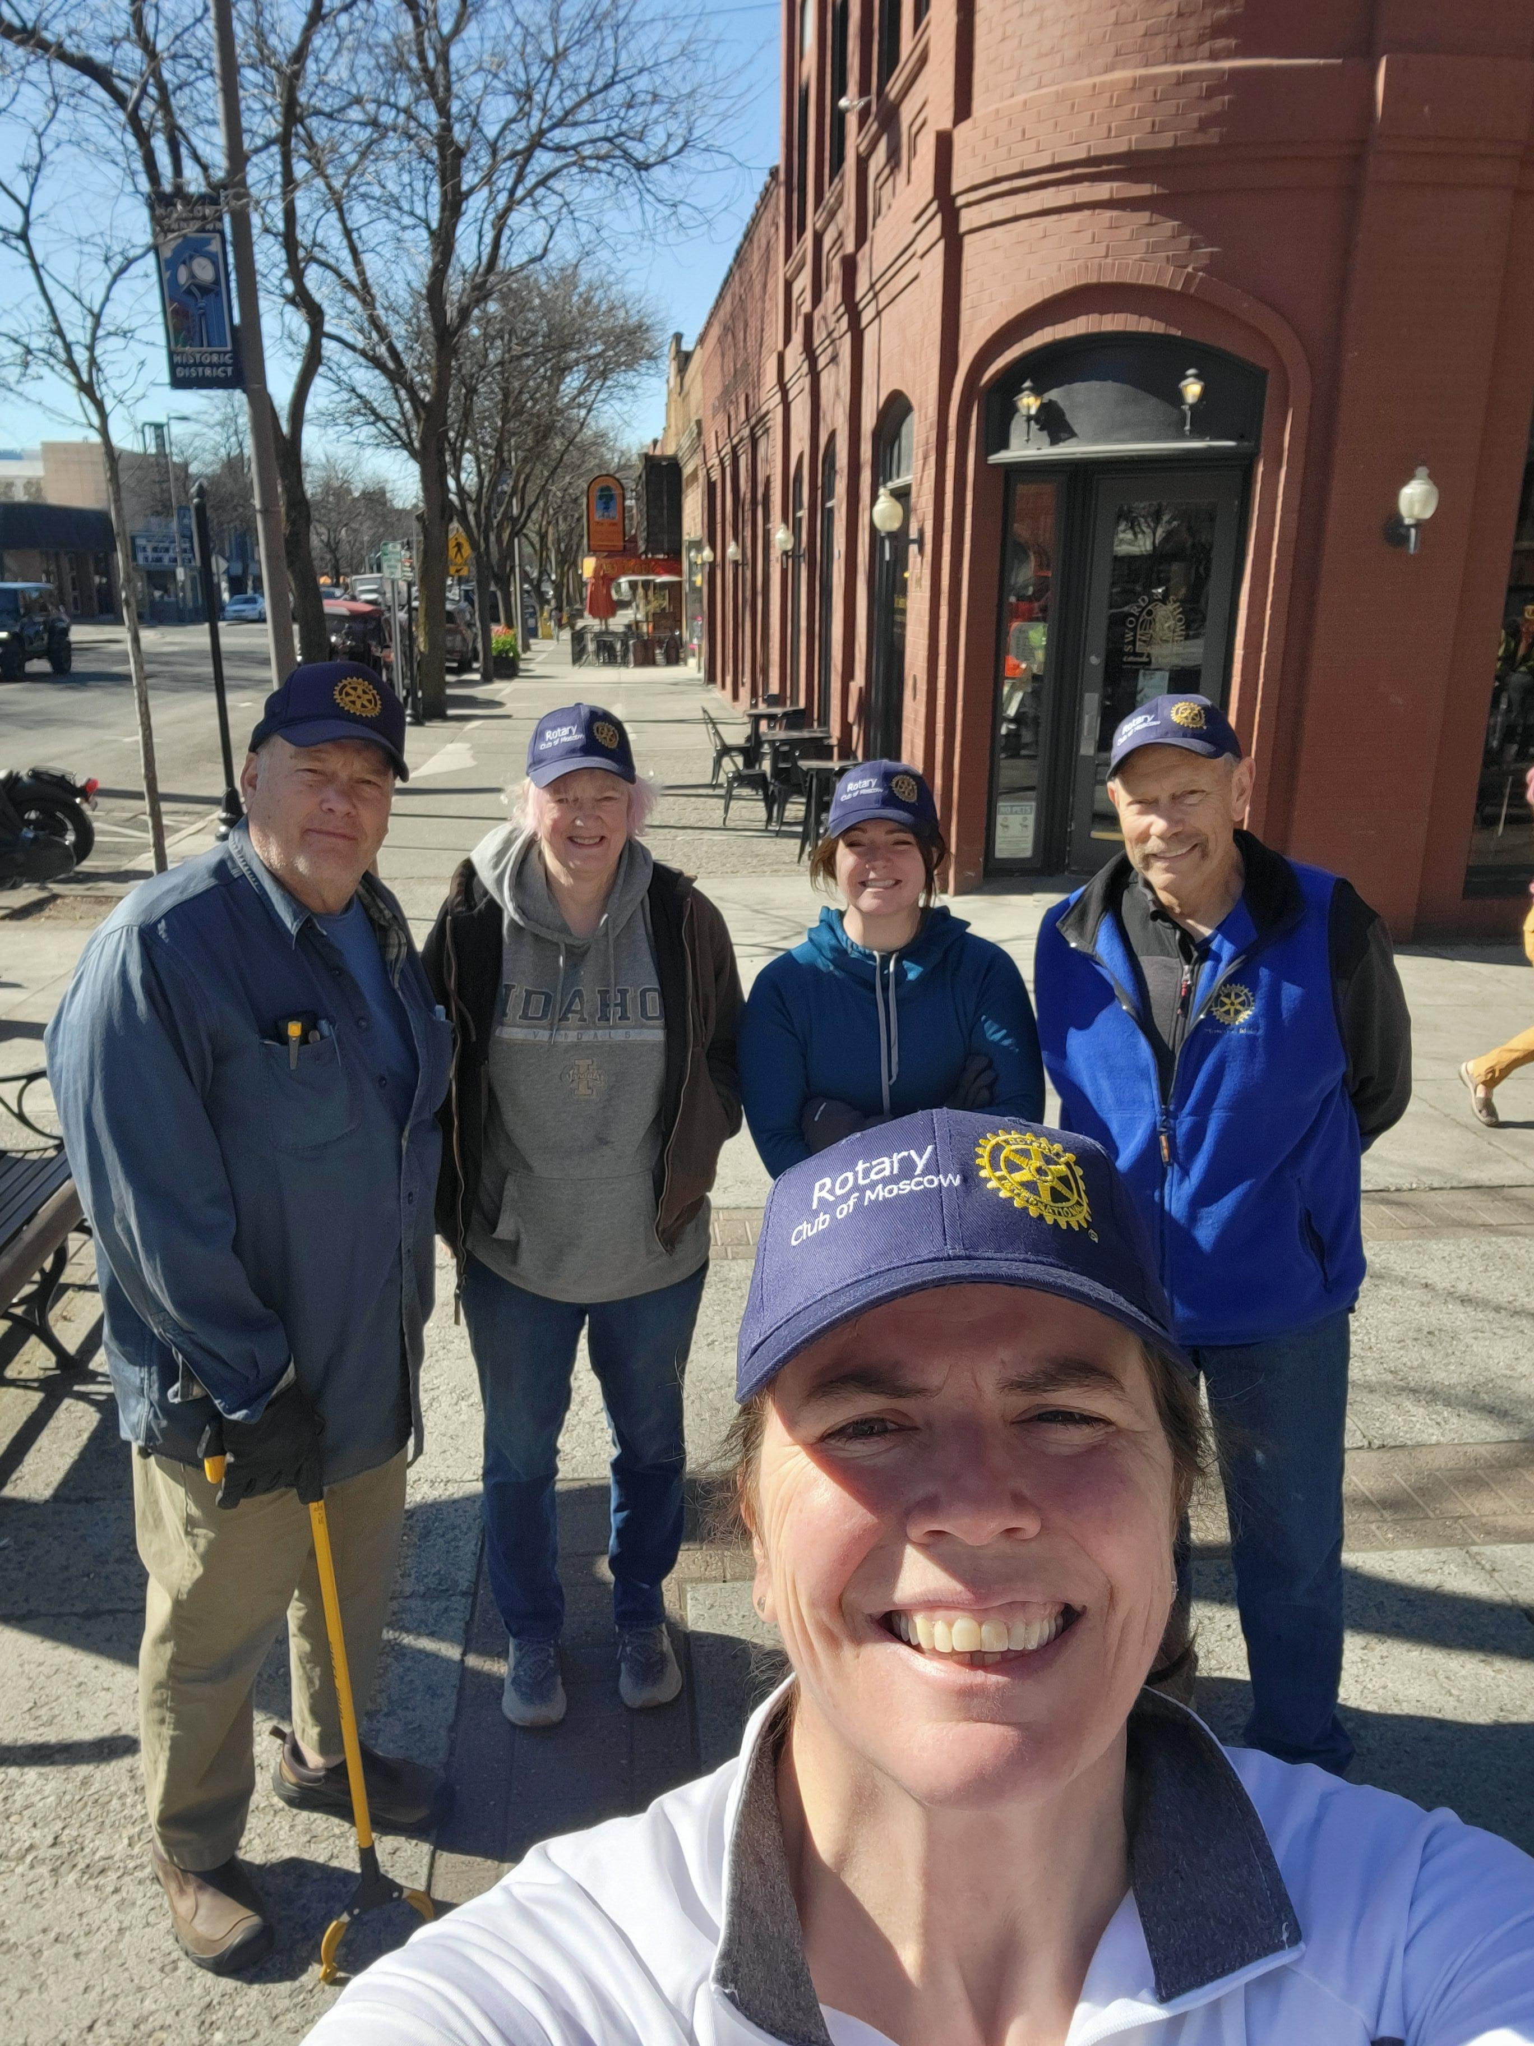
Club Goals
1. Increase the presence of our Rotary Club in the community.
2. Increase the membership of our club.
3. Provide multiple and different opportunities for member participation.
4. Contribute to housing, food, and youth programs in our community.
5. Expand the service projects of our club.
6. Maintain the friendliness, comradery of our Moscow Club.

Slide 6
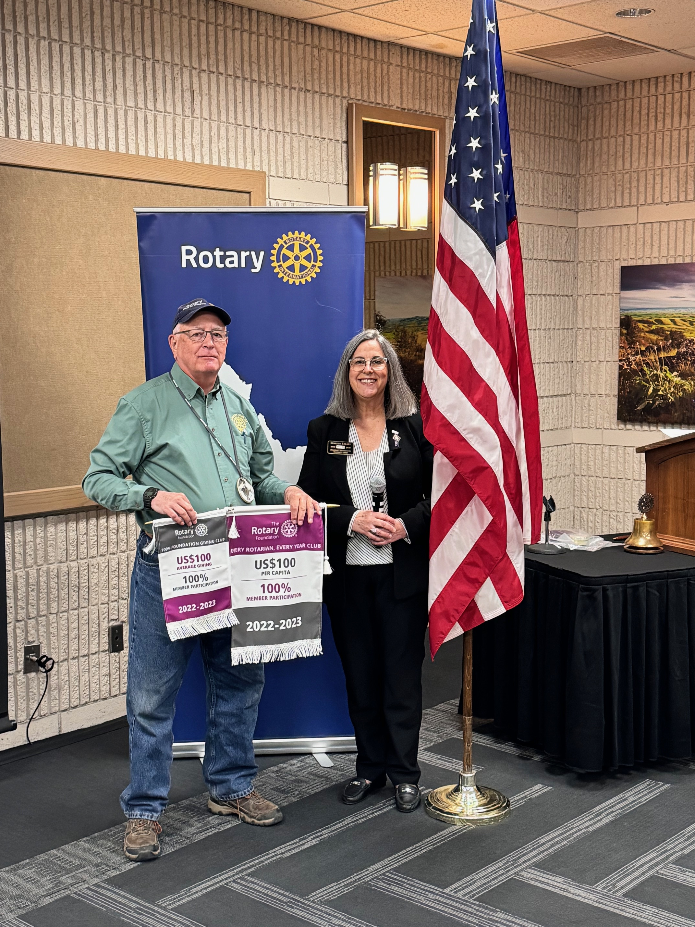
President’s Goals
Membership & Engagement
Increase members to 43 (6 new)
5 Members’ Sponsorships
5 Members at District Training Events
35 Members to participate in Club Service Activities/Projects
Update Club Action (Strat) Plan
Foundation/Giving from members
$6,000 for Annual Fund
$1,000 for Polio Plus
$100 per Year “Every Rotarian Every Year” (EREY)
$250 Per Capita average of giving

Slide 7
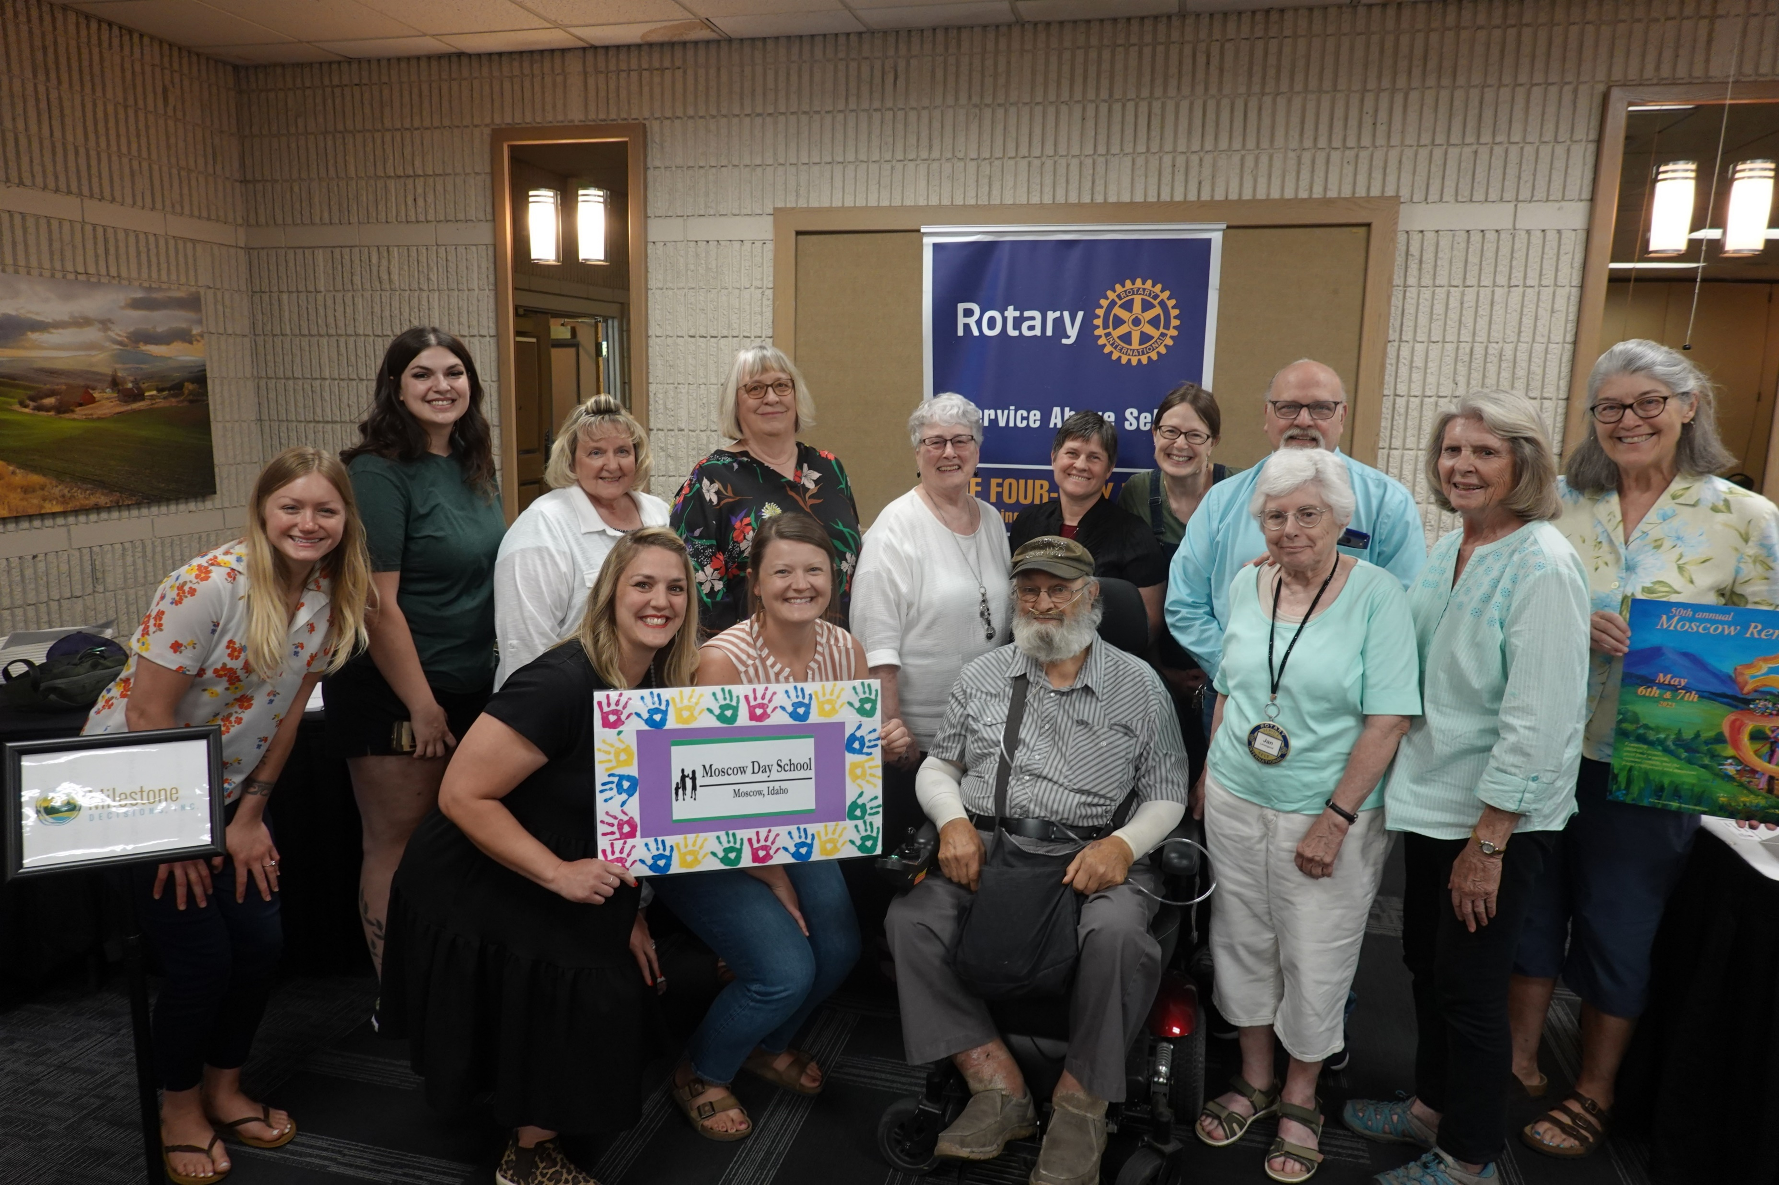
President’s Goals (cont’d)
8 Service Projects (Plus Up of 2)
Young Leaders
Sponsor One Outbound and Inbound Exchange Student (RYE)
Sponsor two RYLA students
Public Image
Strategic Plan (update this year)
Online Presence: 10 Media Stories
5 Social Activities
2 Website and Social Media monthly updates
Community Competitive Grant???
1 Designated District Grant
RI President Gordon McInally

Slide 8
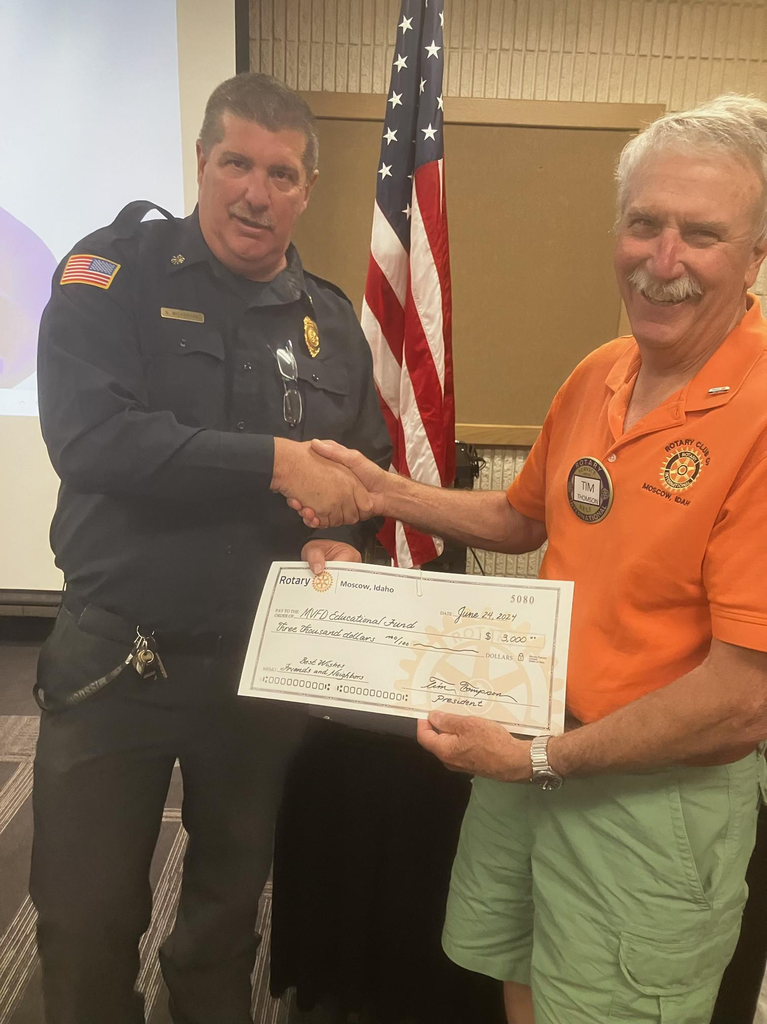
Club Budget
Budget Summary:
OPERATIONS ACCOUNT
Operations Income (Dues, Happy $$, Polio +, etc.):
Total Ops Income: $19,850
Operations Expenses:
Club Admin expense (District Dues, DACdb,
Guest Meals, Assemblies, Conferences, etc.): $19,000
Club Service (Parties) $1,500
Membership (COC BAH, Brochures, etc.) $700
Public Relations (advertising, etc.) $750
Total Ops Expenses $21,900
Projected Carry Over $2,299.

Slide 9
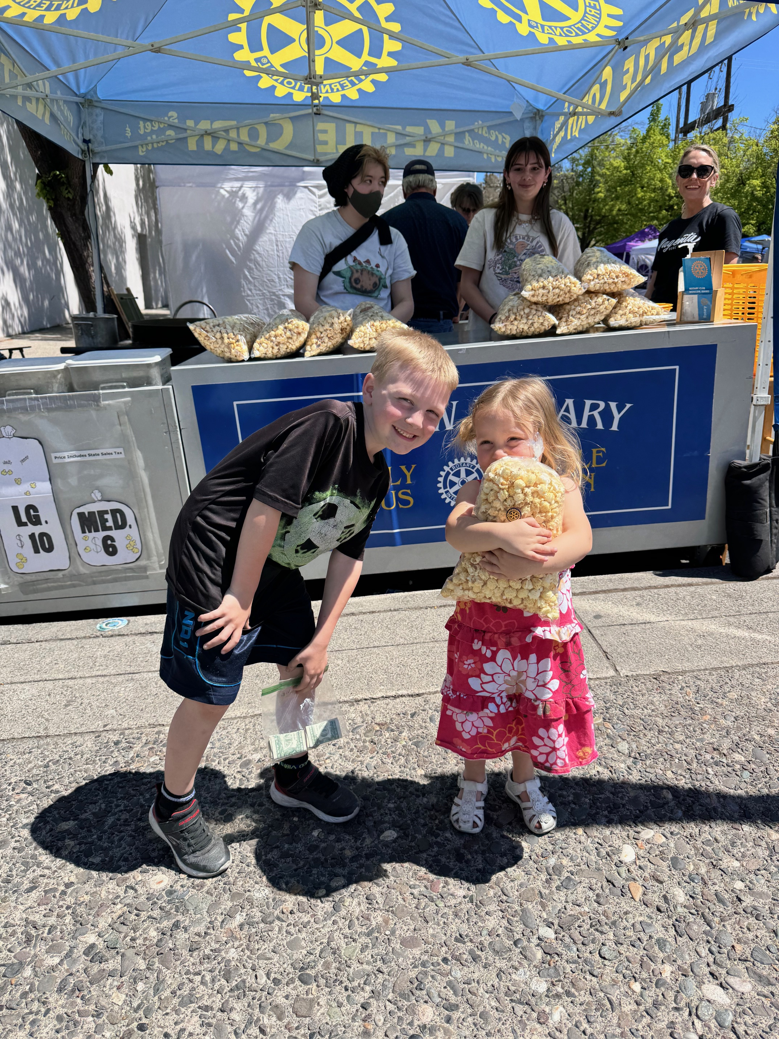
Club Budget (cont’d)
FUNDRAISING ACCOUNT
Fundraising Income
Kettle Corn Sales: $55,000
Total Income: $55,000
Fundraising Expenses
Fundraising (KC Equip, Corn, Oil, etc.) $22,100
Community Service $16,000
Grant Management $2,100
Special Projects (Rotary Park etc.) $3,500
International Service $3,500
Youth Services (RYE, RYLA) $5,450
Vocation $3,000
Total Expense $55,600
Projected Carryover $27,523
New this last year: Edward Jones Invst: $10,257

Slide 10
Grant Programs
$4,200 District Grant
“Learning With Lucky” in partnership with MSD 250; Lena Whitmore Elem
FUNDED!
New District Grant Planning
Community Grants
Subject to our fundraising accounts, the board will decide after our Kettle Corn fundraiser whether to fund another round of competitive community grants.

Slide 11
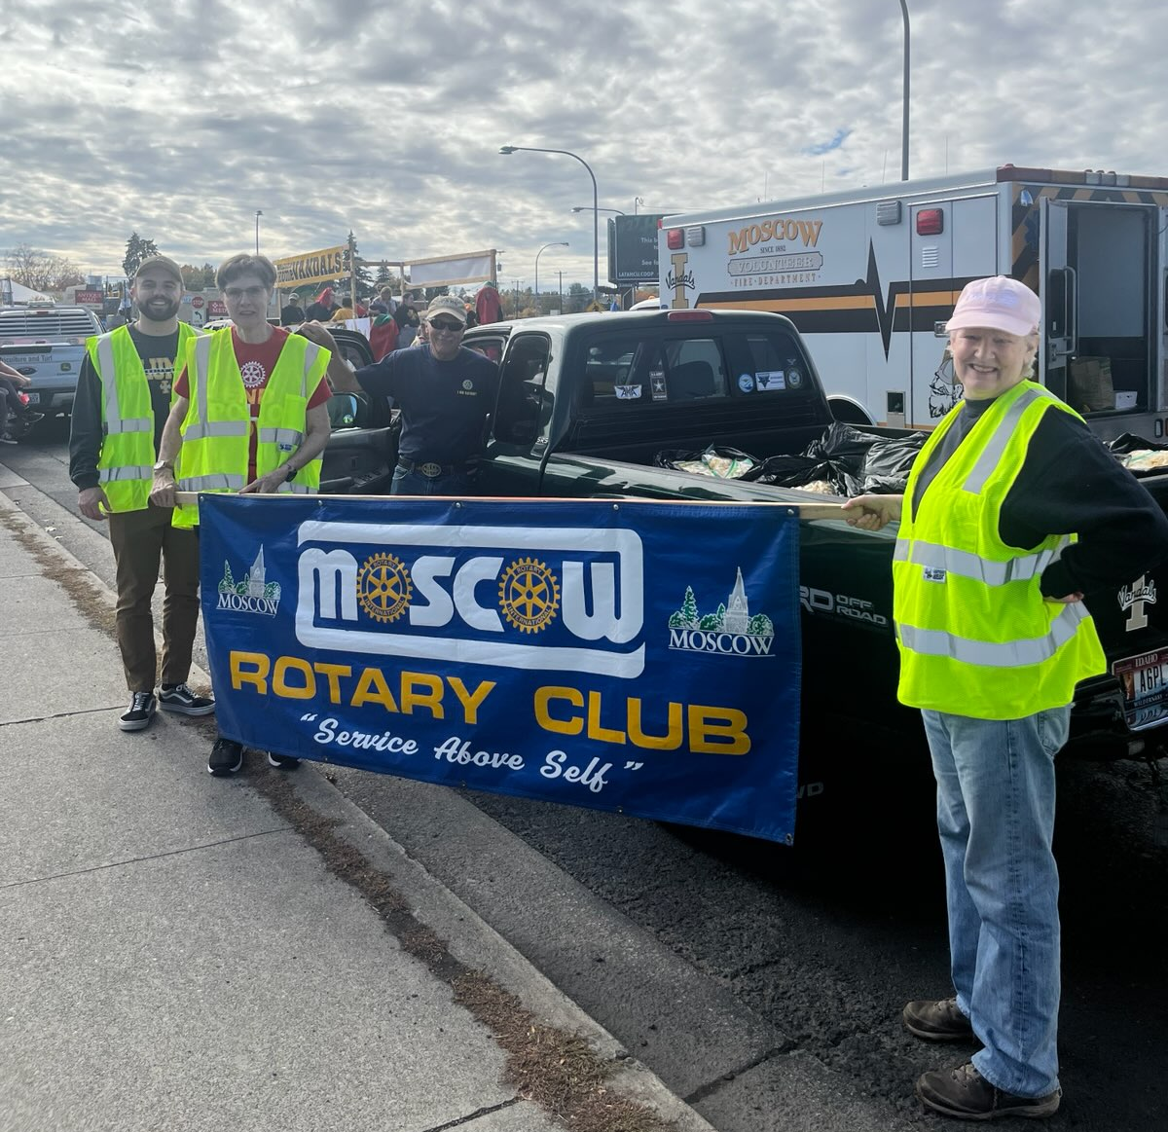
Committee Volunteering Opportunities
Community
Club
International
Youth
Vocational
Finance
Kettle Corn Logistics
Programs

Slide 12
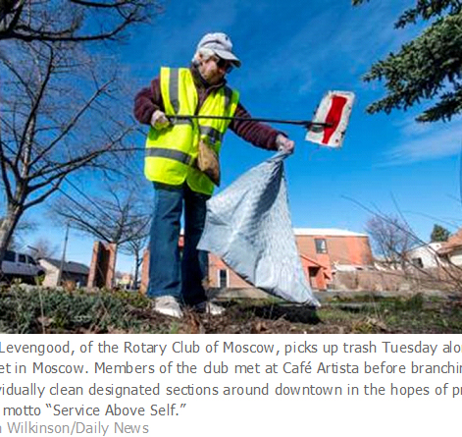
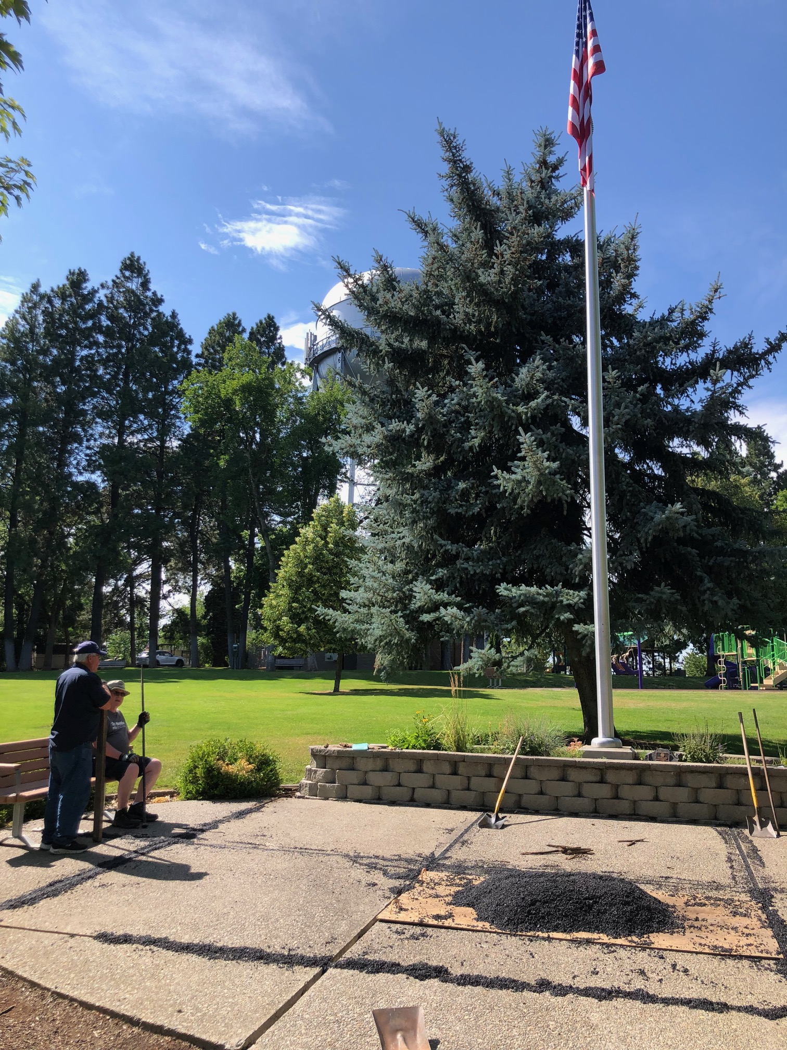
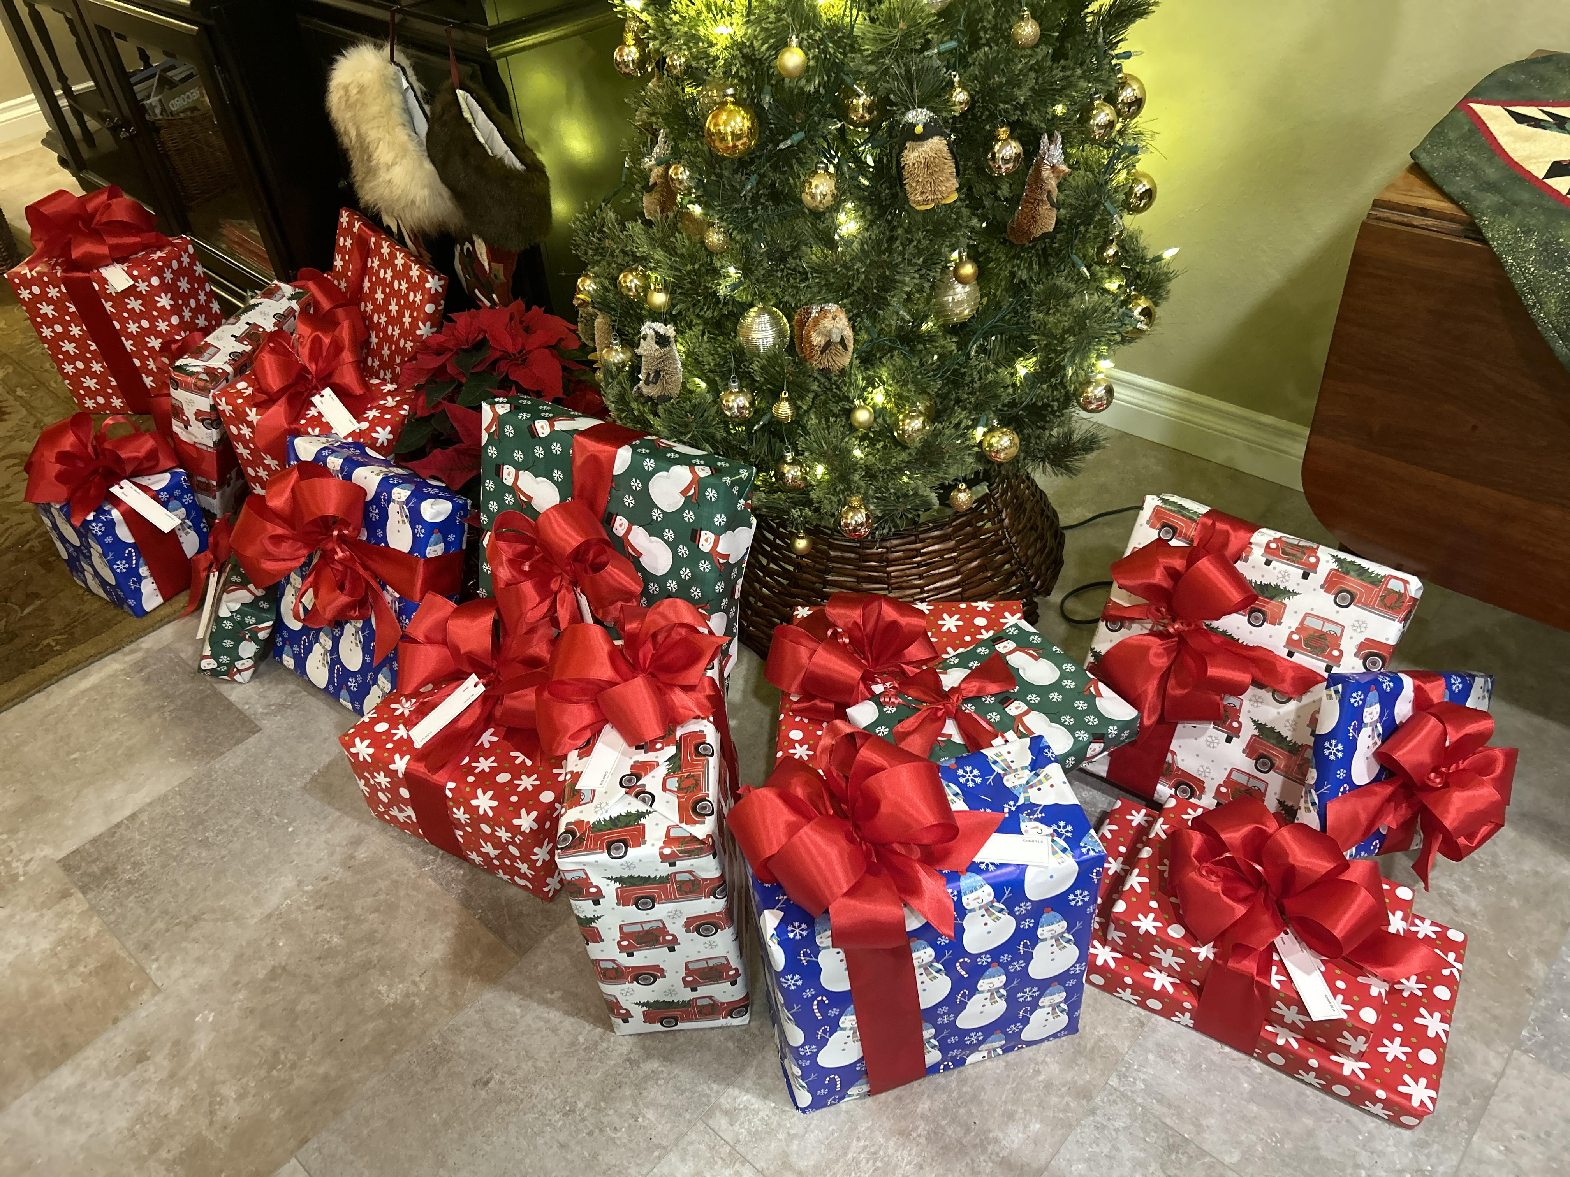
Projects
Not just a check writing club
More Diverse opportunities
Potential Partnerships
Special Projects:
Rotary Park Centennial Plaza Development
Shelter Panting
Arbor Day Tree Planting

Slide 13
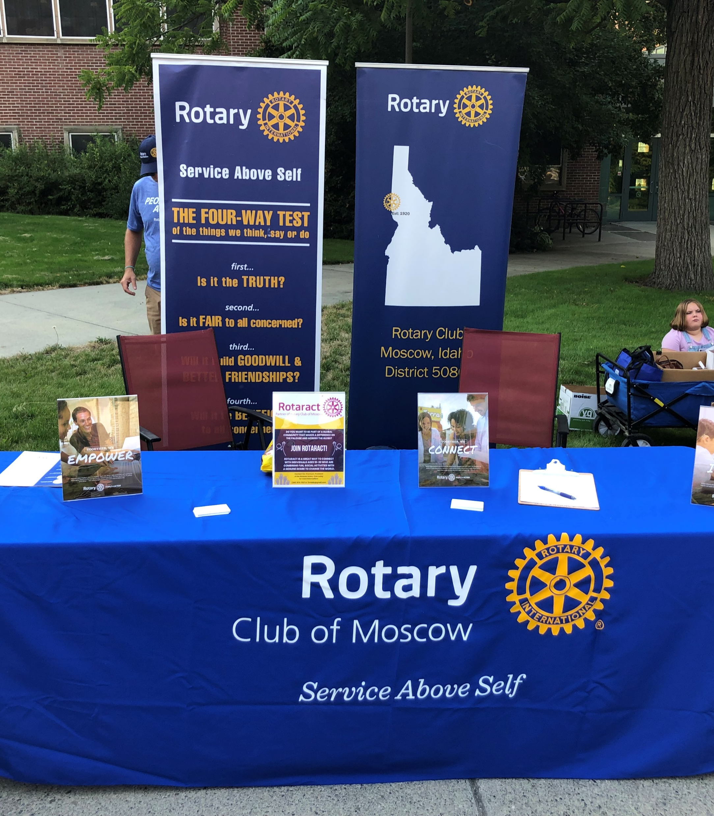
Membership Initiatives
Information Table in Friendship Square at the Moscow Farmers Market
Chamber of Commerce monthly meeting
Rotary Bingo
Another Chamber Business Afterhours
Your Ideas are welcomed!

Slide 14
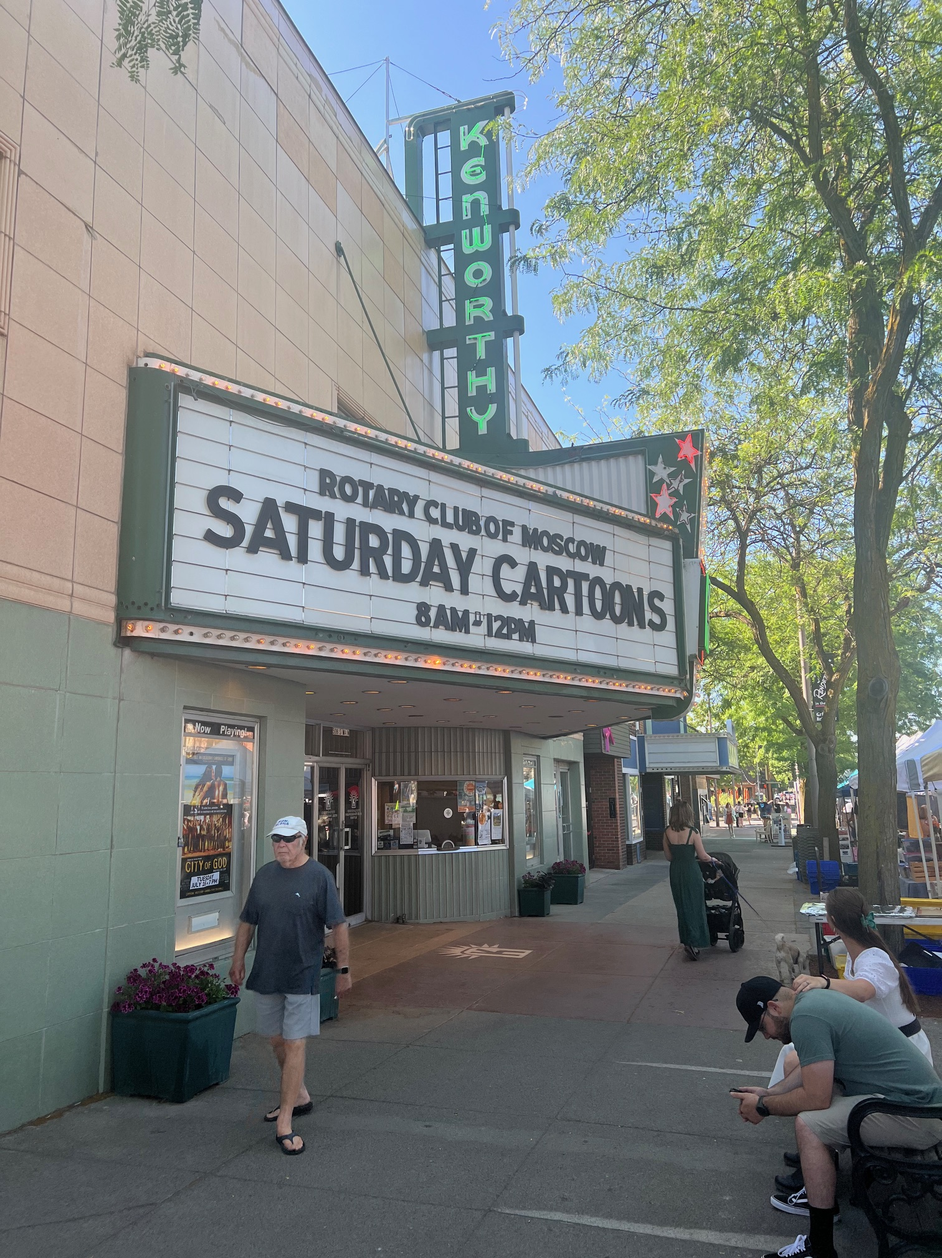
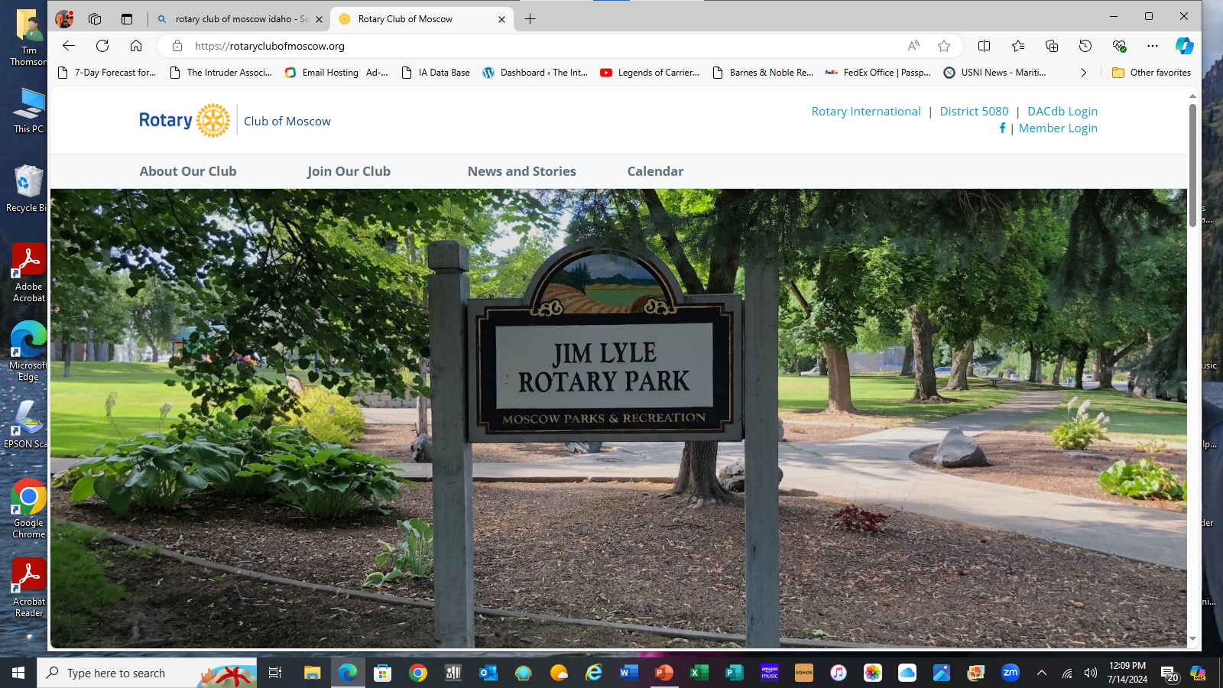
Public Image
Website/Webmaster
Alys Lease
Media Releases
Marissa Melton
Social Media
Marissa Melton
Graphics
Marissa Melton
Brochures
Tim and Marissa

Slide 15
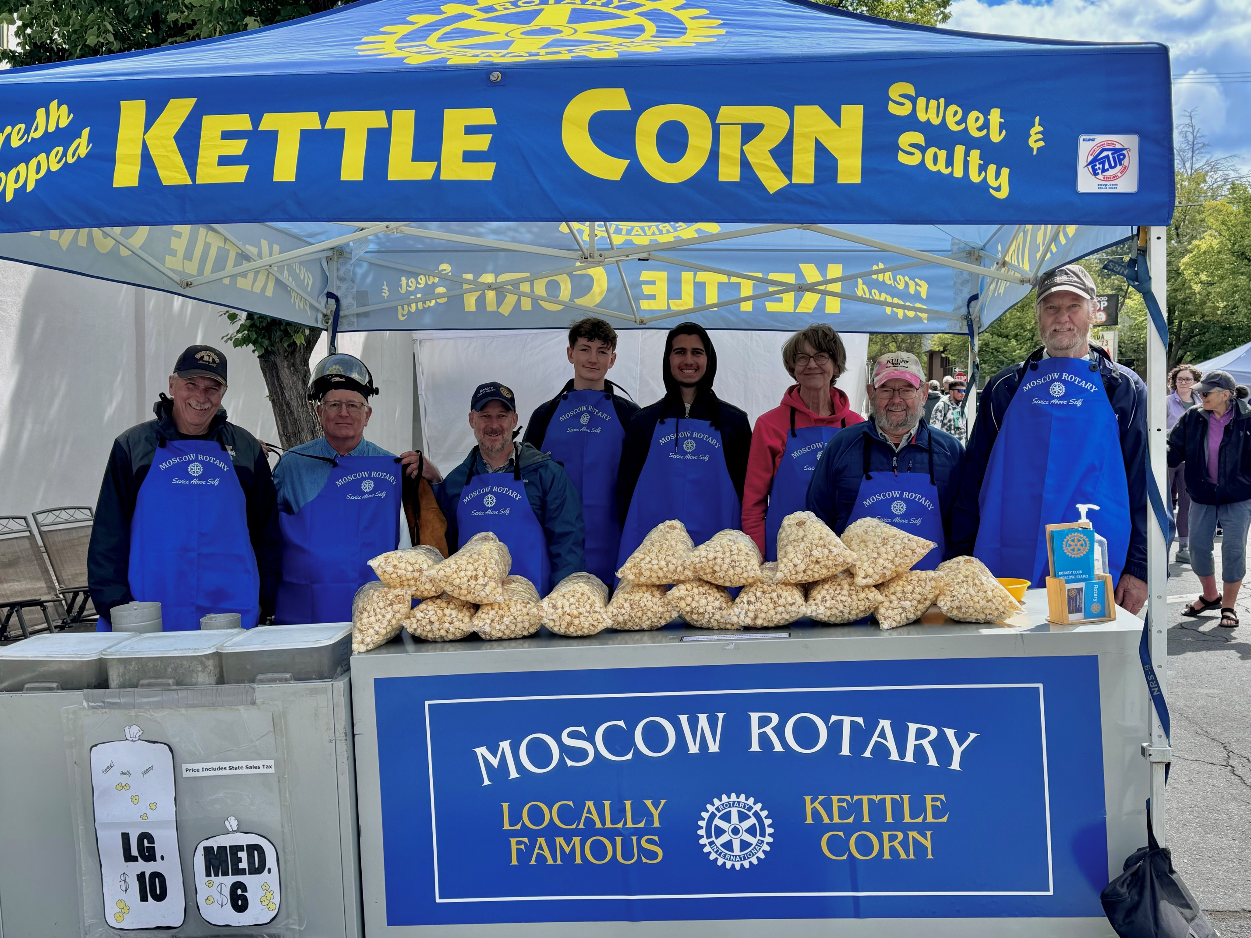
Summary
More Members
More ways to serve
More Projects
More Funds
More Philanthropy
More Visibility
MORE FUN!

Slide 16
The End!

