Slide 1
Rotary Club of Oregon City (Annual Report as of 26JUN24)
Leah R Sundquist
President 2023-2024

Slide 2
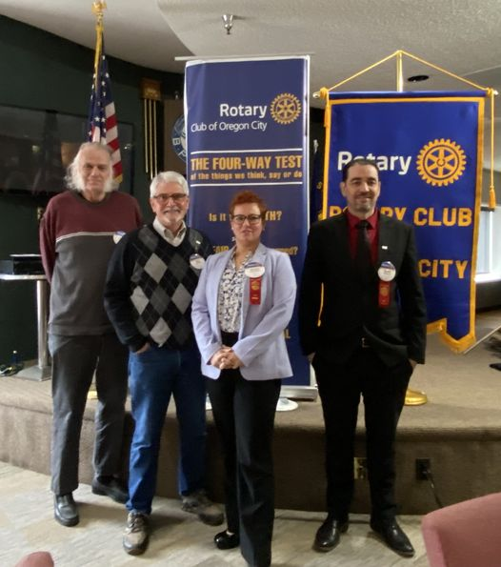
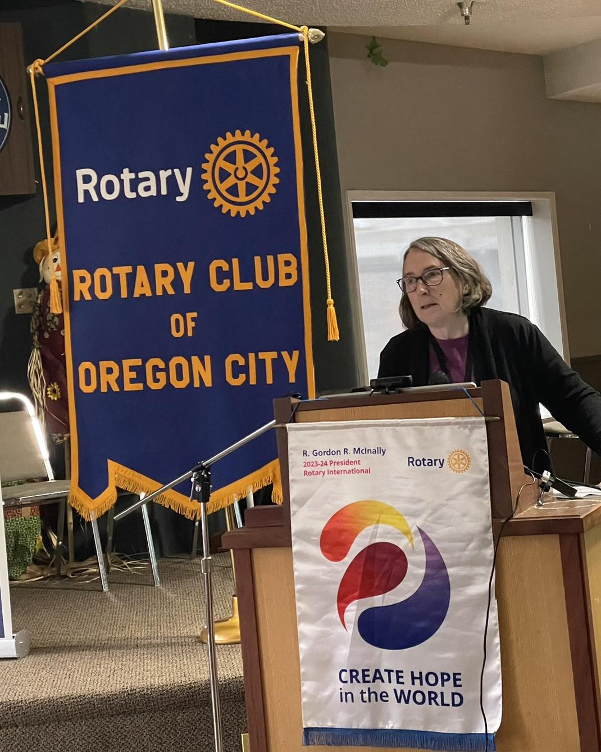
Membership
Goal: 51 members/ As of 26JUN- 55 (of all combinations- R85, Honorary, etc)
We currently have 54 w/ 1 Honorary
Satellite Club: 10
26% Growth this year

Slide 3
New Member Sponsors
Goal: 5/ 5
Achieved Goal by MAR
(Leah , Craig, Vicki, John A, Greg G)

Slide 4
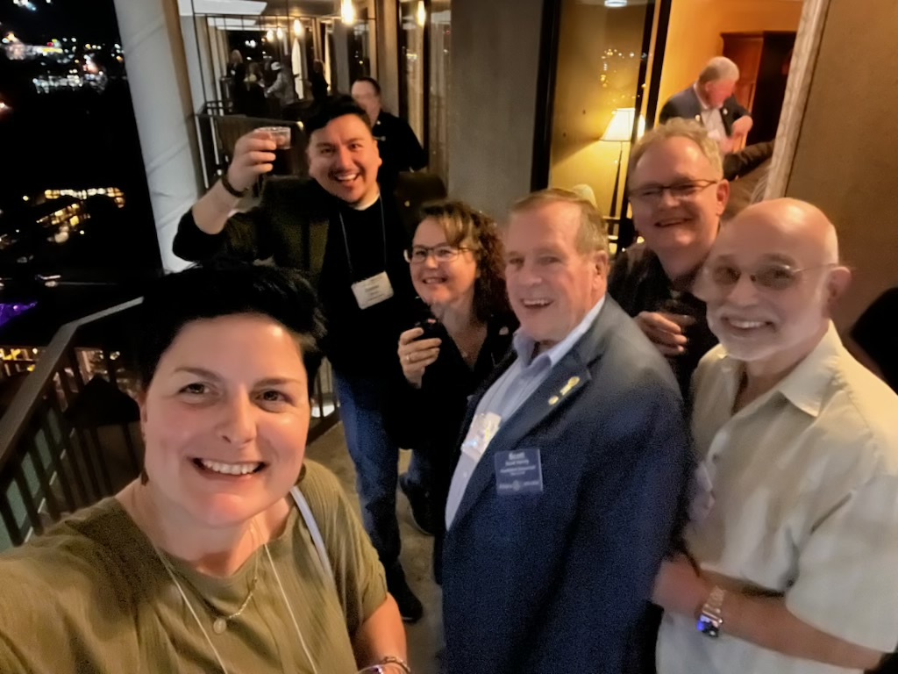
Leadership Development
Goal for this year is 8 (includes the District Training, PE and other training
We are currently at: 100%
2 for Image Trng- Leah and Gil,
1 for PE training- Gil
1 for YEX training- Leah
2 for In Person YEX training –APR- Leah/ Mimi
4 at the conference for position training
10 total attended Leader Development training

Slide 5
District Training
Goal is 8 to attend trainings/ 10 attended training this year
District training is online, in person or at the actual District training day
As of MAR we have had 5 attend training/ EOM APR= 9
Leah and Gil to Image training
Gil to PE online training
Leah to all of YEX training
Mimi to do YEX
As of JUN with District Training Day April 26-28 we met the Goal (Conference is the same weekend) We had Leah, Gil, Mark, Trieste, Cindy, Alexa, and Chris,)

Slide 6
District Conference
Goal is 5 to attend- 8+ attended (Goal is met)
President, PE, PEN, new Bd members, new Committee Members
and 2 members

Slide 7
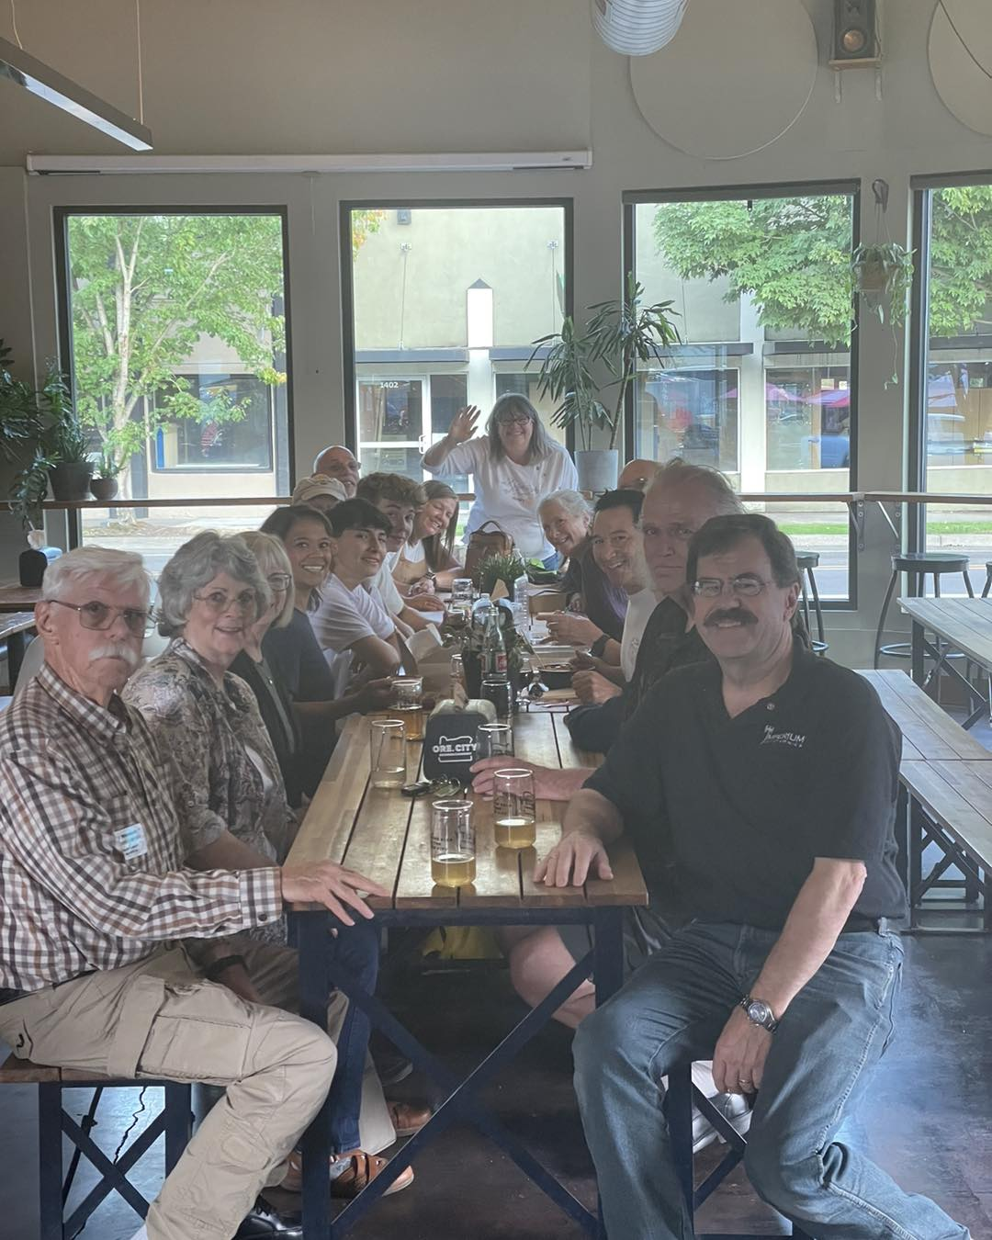
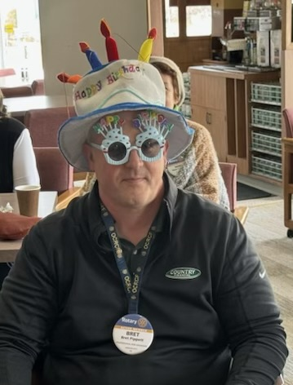
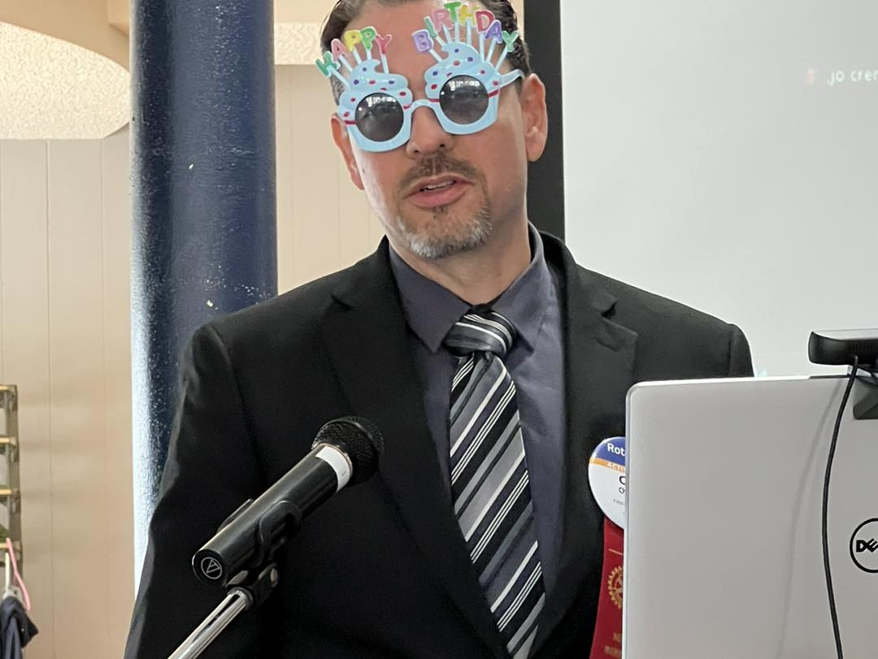
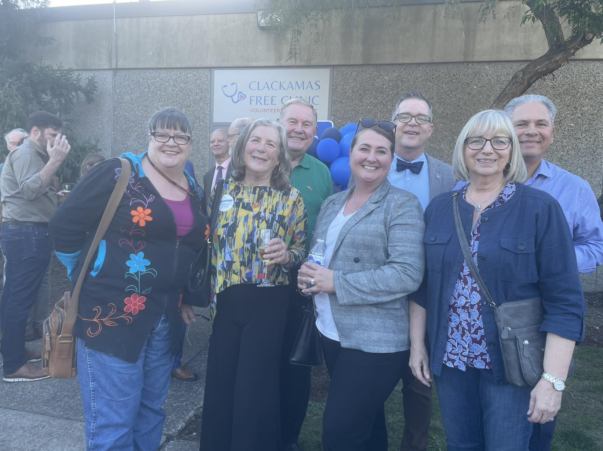
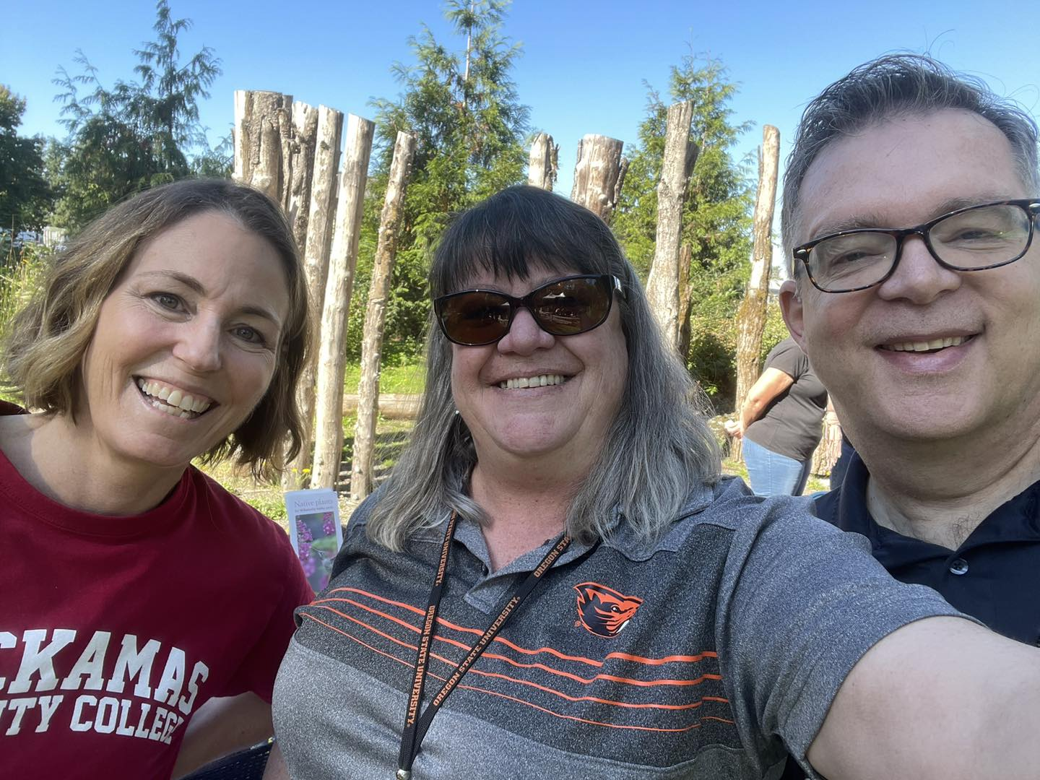
Social/ Fellowship Activities
Goal for this year is 5 Social Activities to include the Fundraising event = 6 by end of May
Currently we have had 7 activities w/the Handover party with 22who have RSVP’d

Slide 8
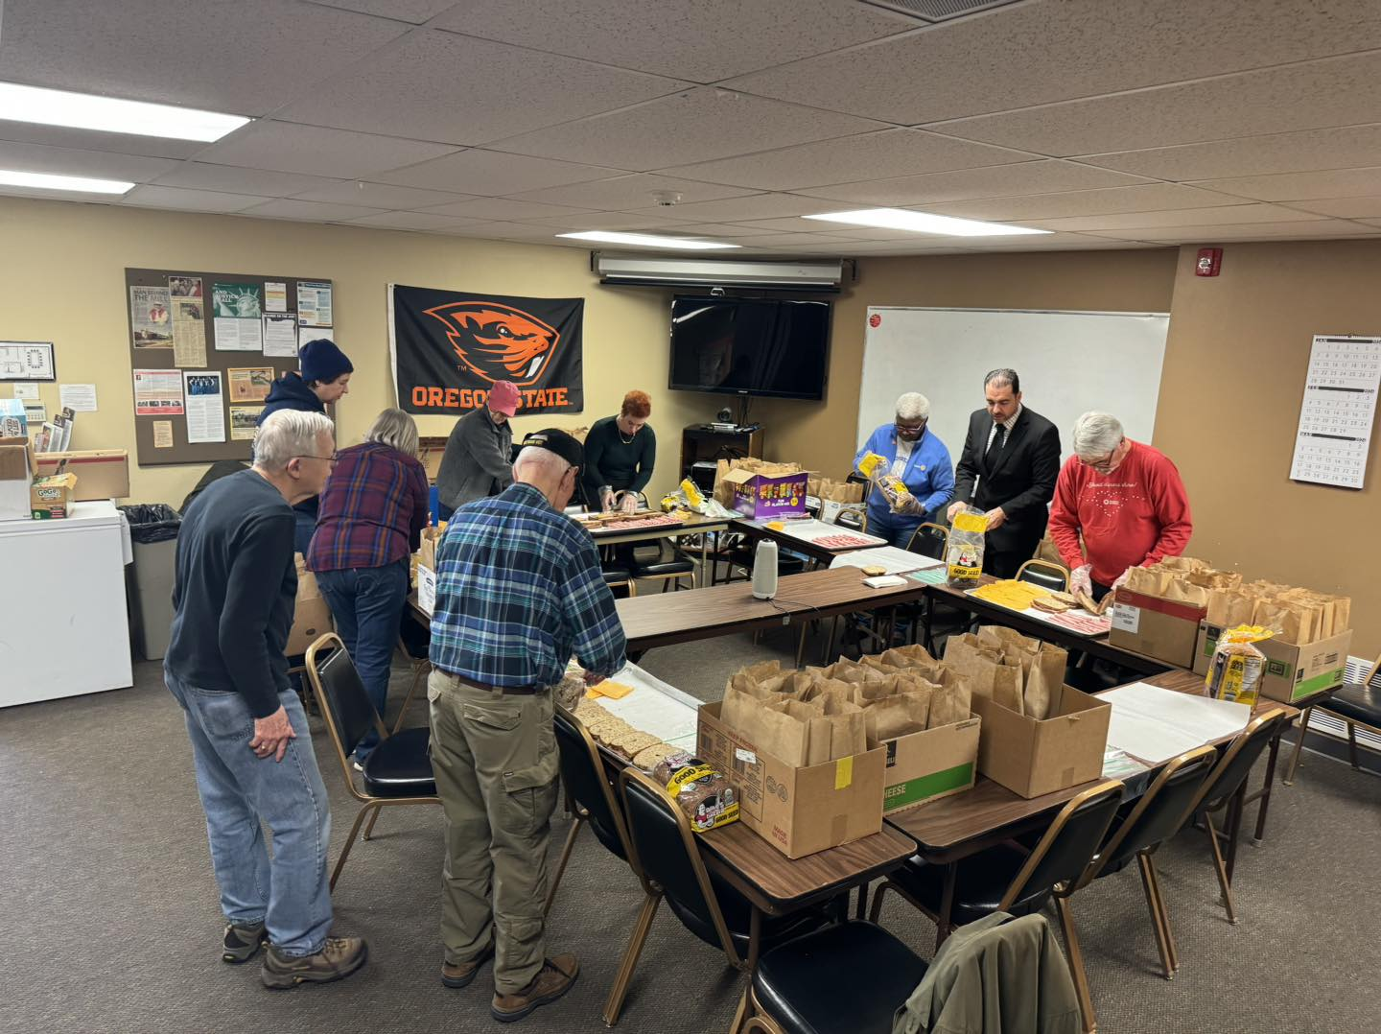
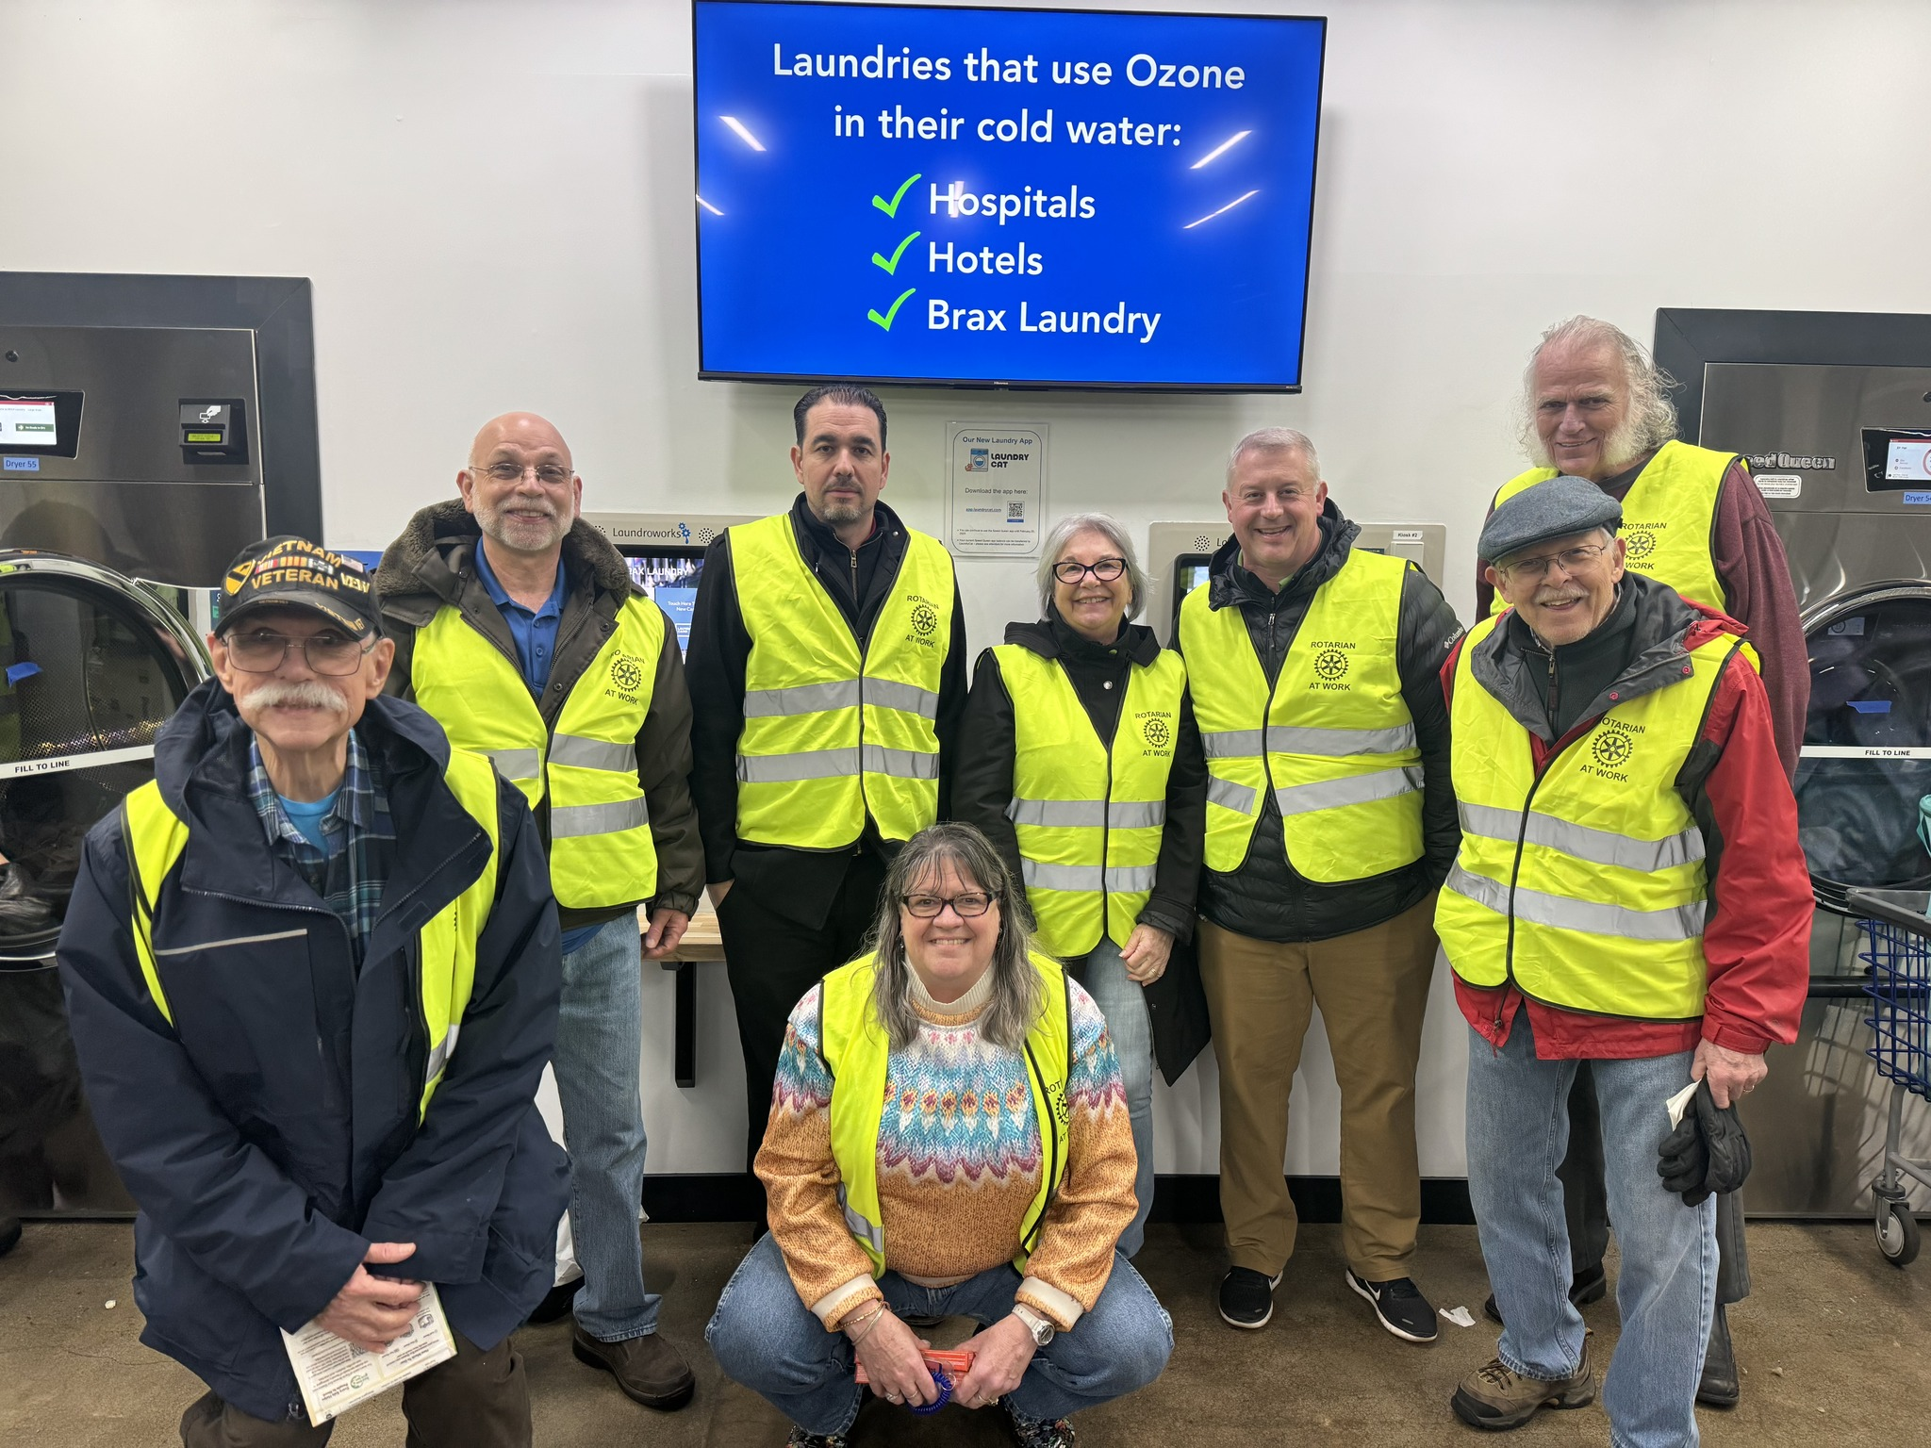
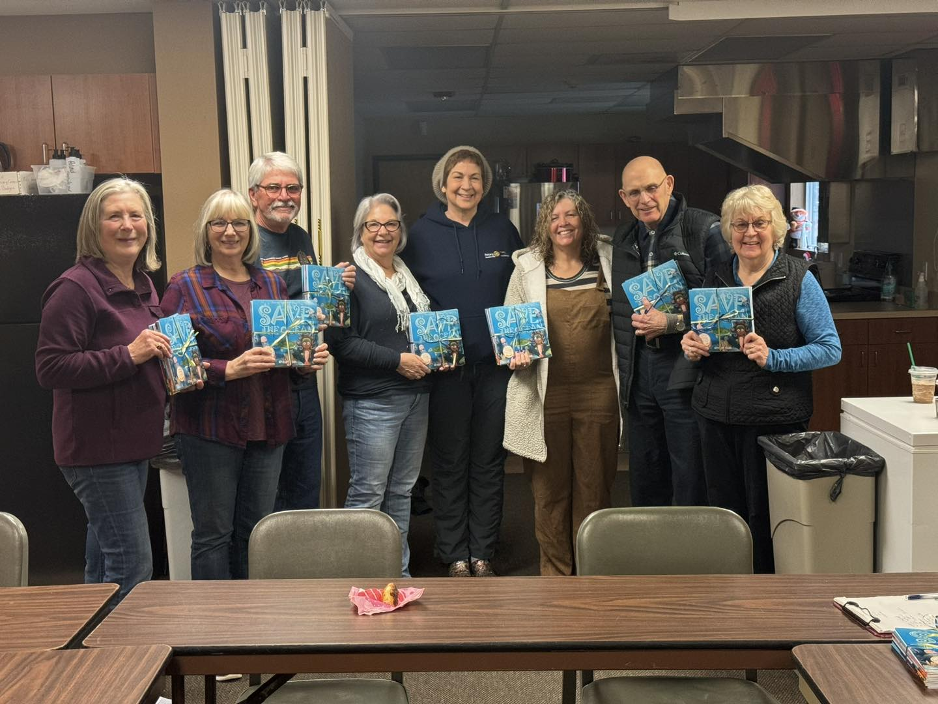
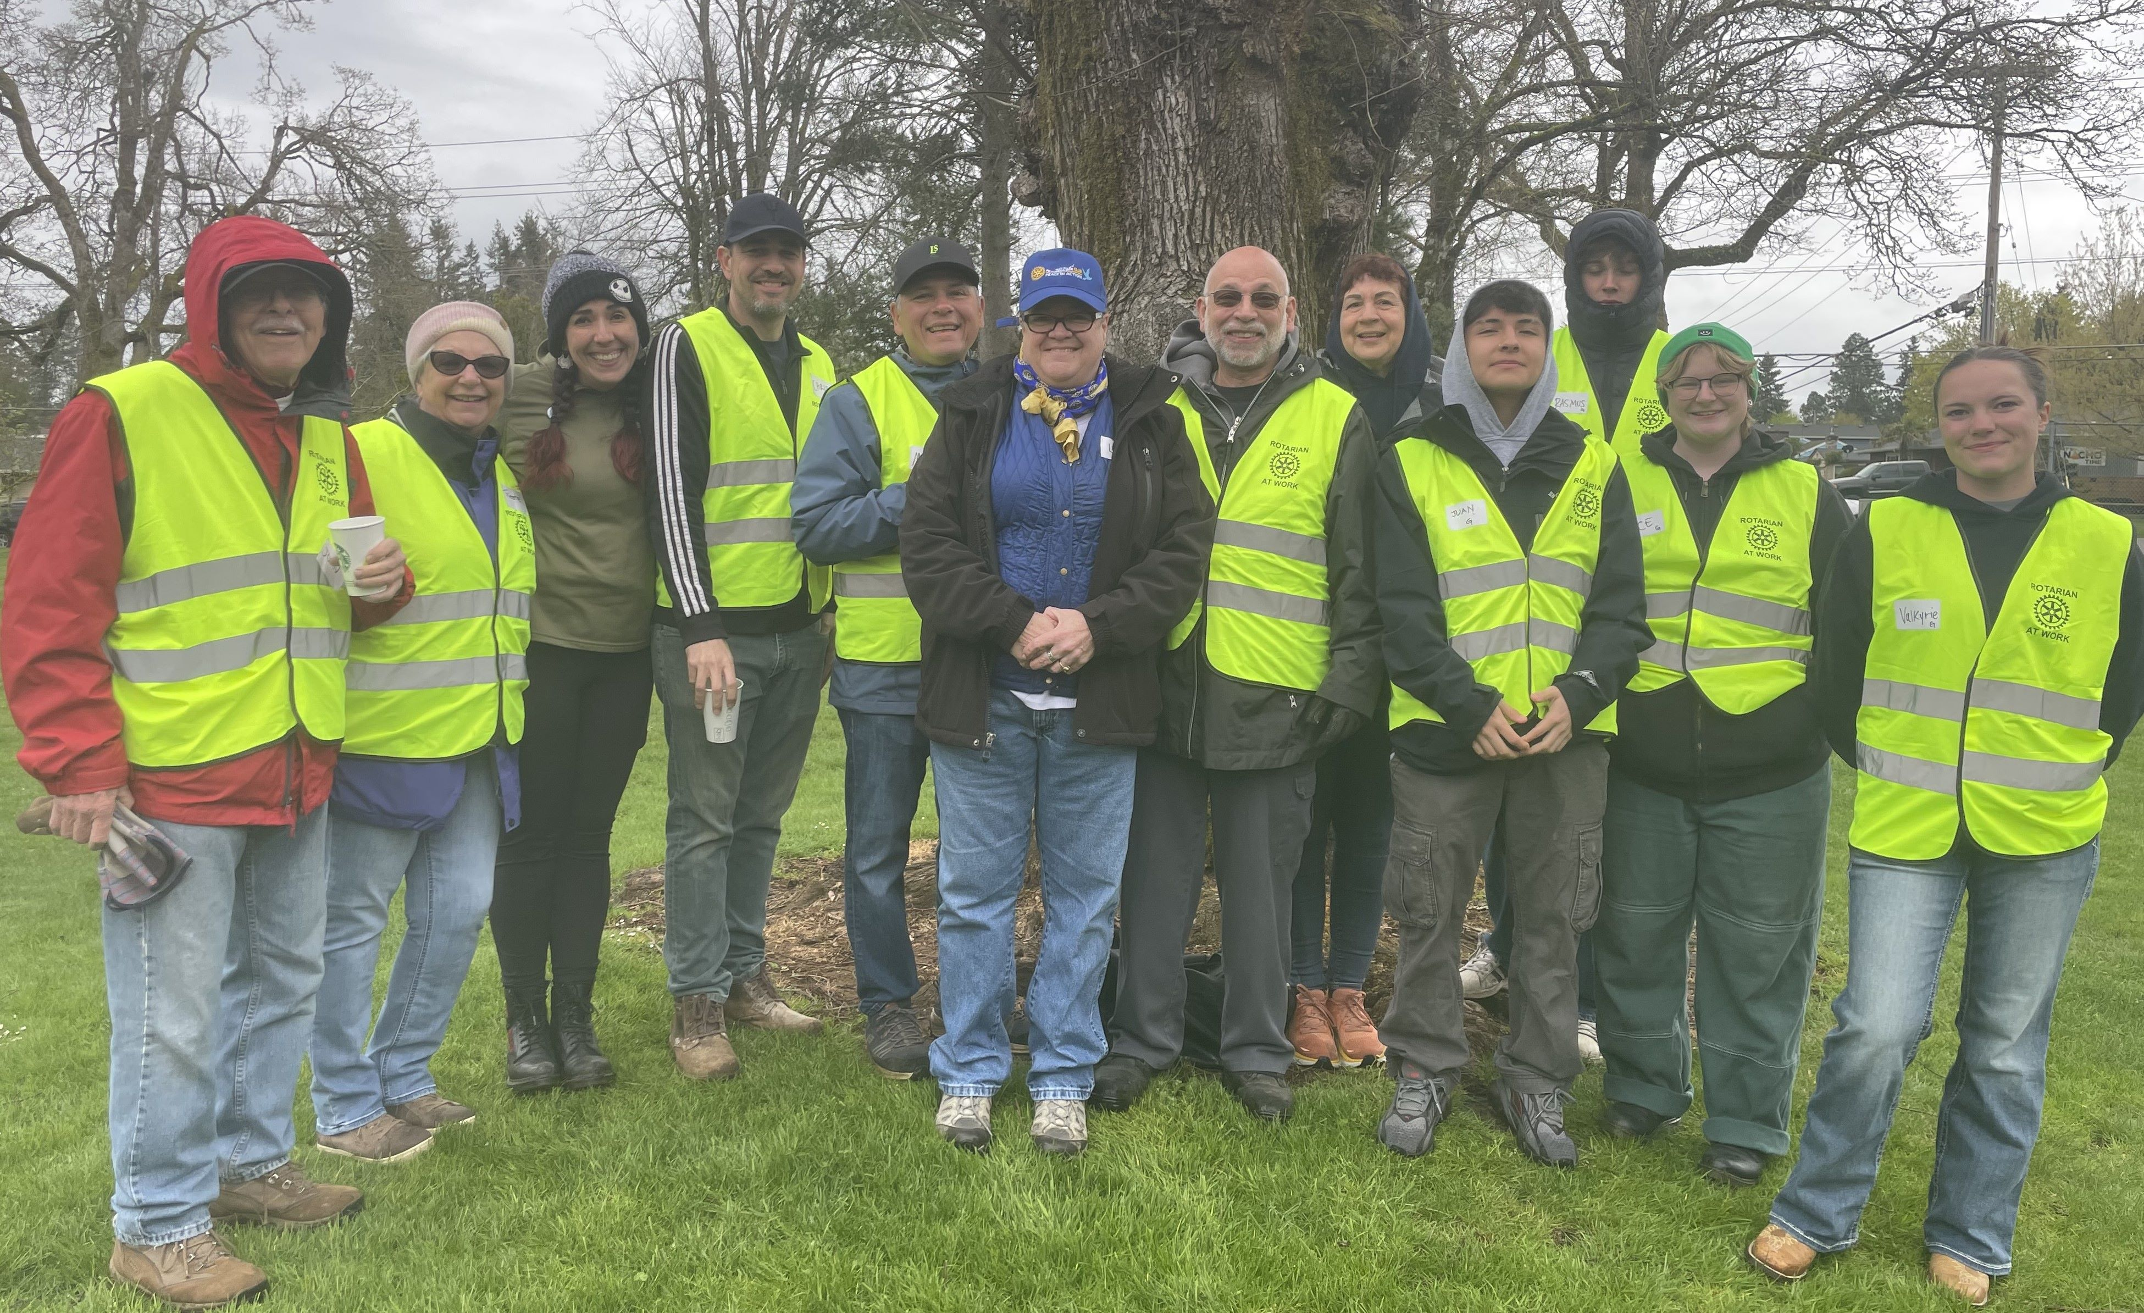
Community Service Projects
Goal: 1 Service Project a month= 12 for the year
We have completed 12 projects (JUL-JUN)
First City celebration-JUL
Canby Rodeo-AUG
Love One Sundry packets-SEP
Blood Drive with Red Cross- OCT (1 pint= $180-$300)
Pioneer Pantry Food Security (Grant funded)- NOV
Supporting the Elks Food Drive/Delivery- DEC (2 wkends)
Fathers Heart Sandwich making monthly (Grant funded)- JAN
Brax Laundry service event- FEB
Environmental/ Literacy books delivered to 3rd gr classes- MAR
Friend of Trees
BRAX laundry- 2nd one
Cleaning of Art Sculpture in downtown OC.

Slide 9
Derby Day Fundraising Event
Goal: $20K from the Club Action plan
Final event raised $16, 848 (for Community engagement/support)
Over 20 volunteers and approximately 120 guests
Over 900 volunteer hours

Slide 10
Total Club Volunteer Hours
We completed the 12 project and the fundraising event this year and had many members helping more at more than 1 event so the total volunteer hours could be from several members “helping hands” at many events.
We had 282 volunteers not including the 29 volunteers for the Derby days event. 311 volunteers (some repeats events)
Total Volunteer Hours this year: 1740 hours from 1 JUL to 30 JUN
(not including the Board Meeting and Committee meeting hours monthly)

Slide 11
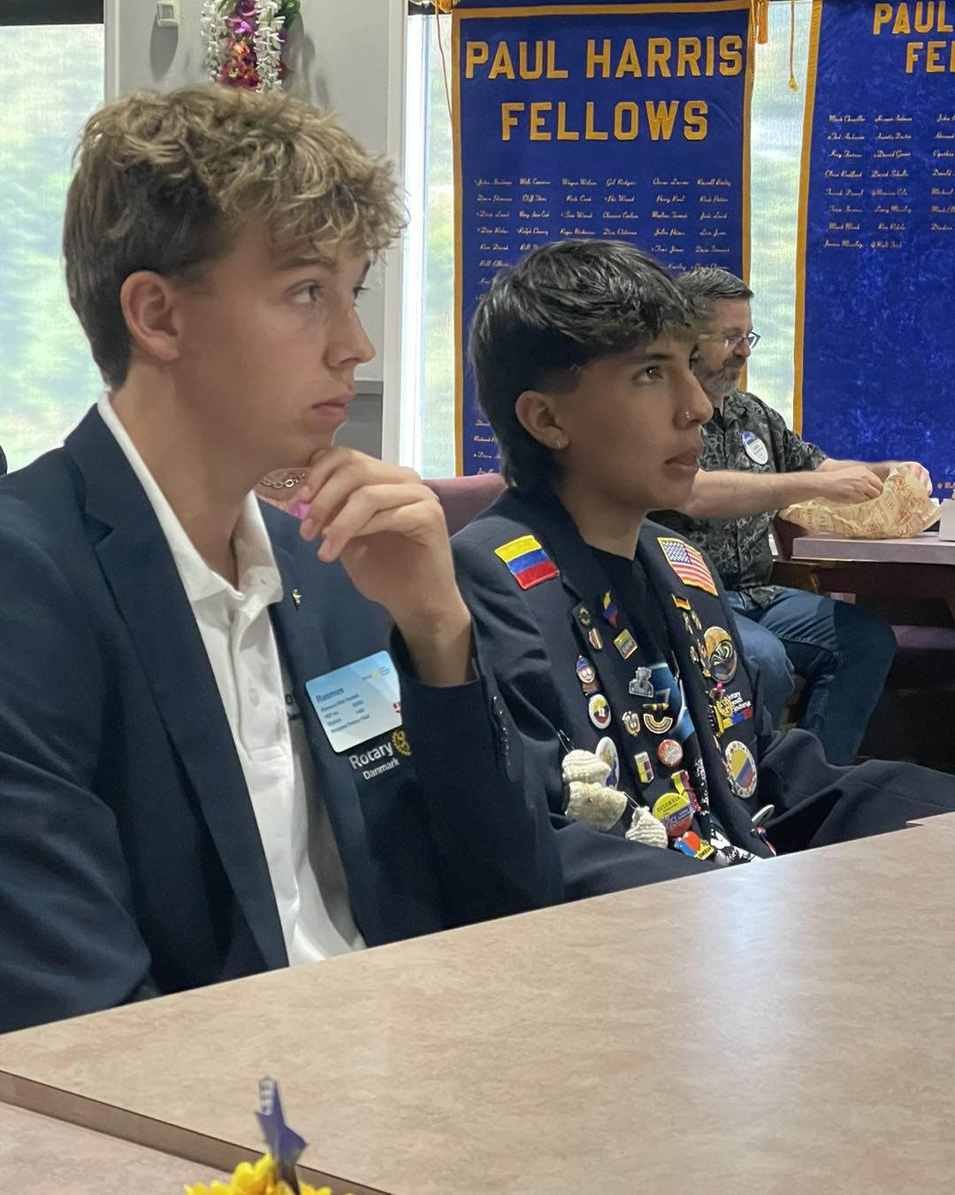
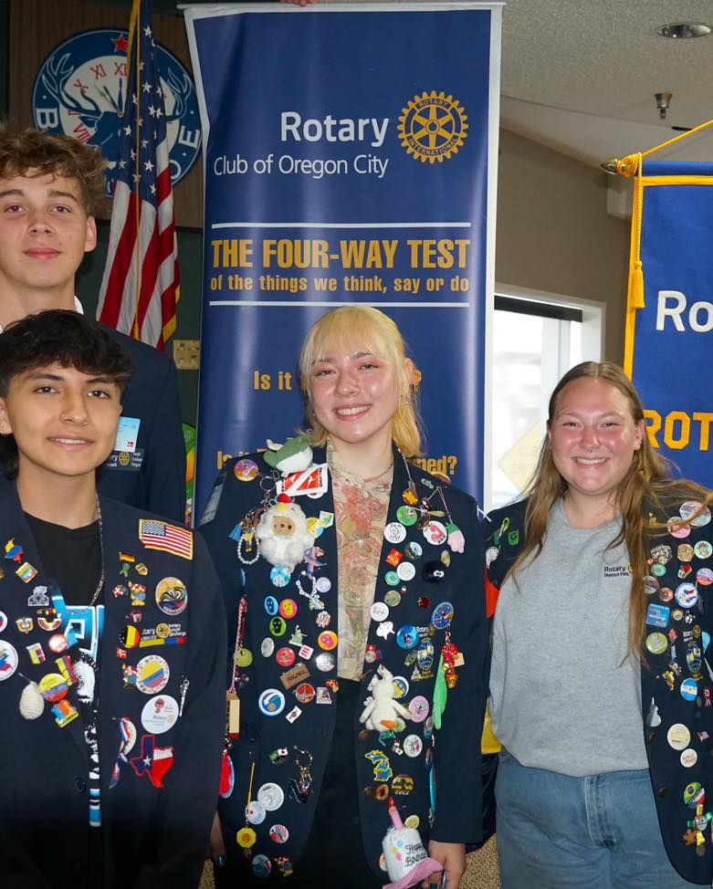
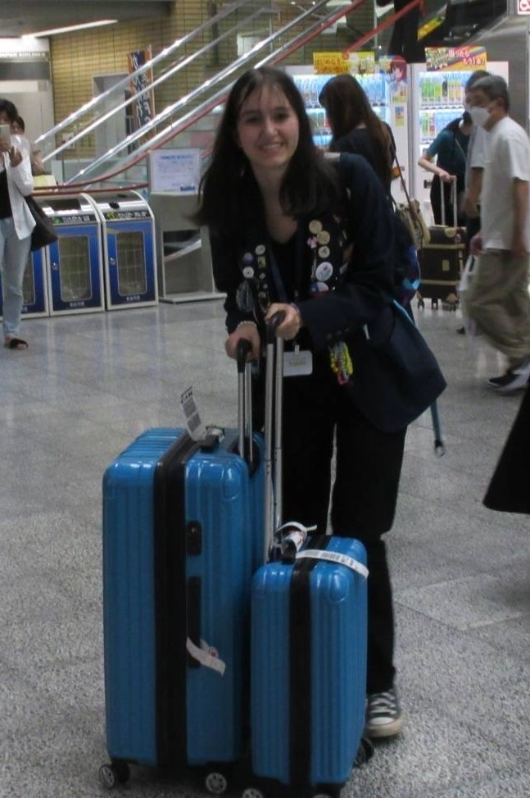
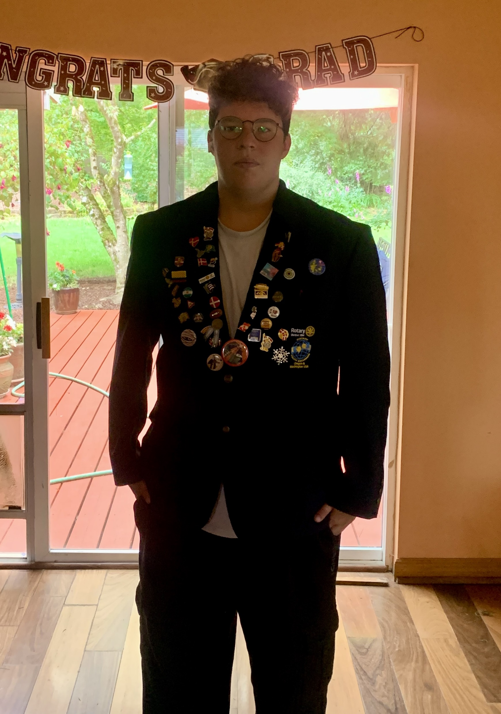
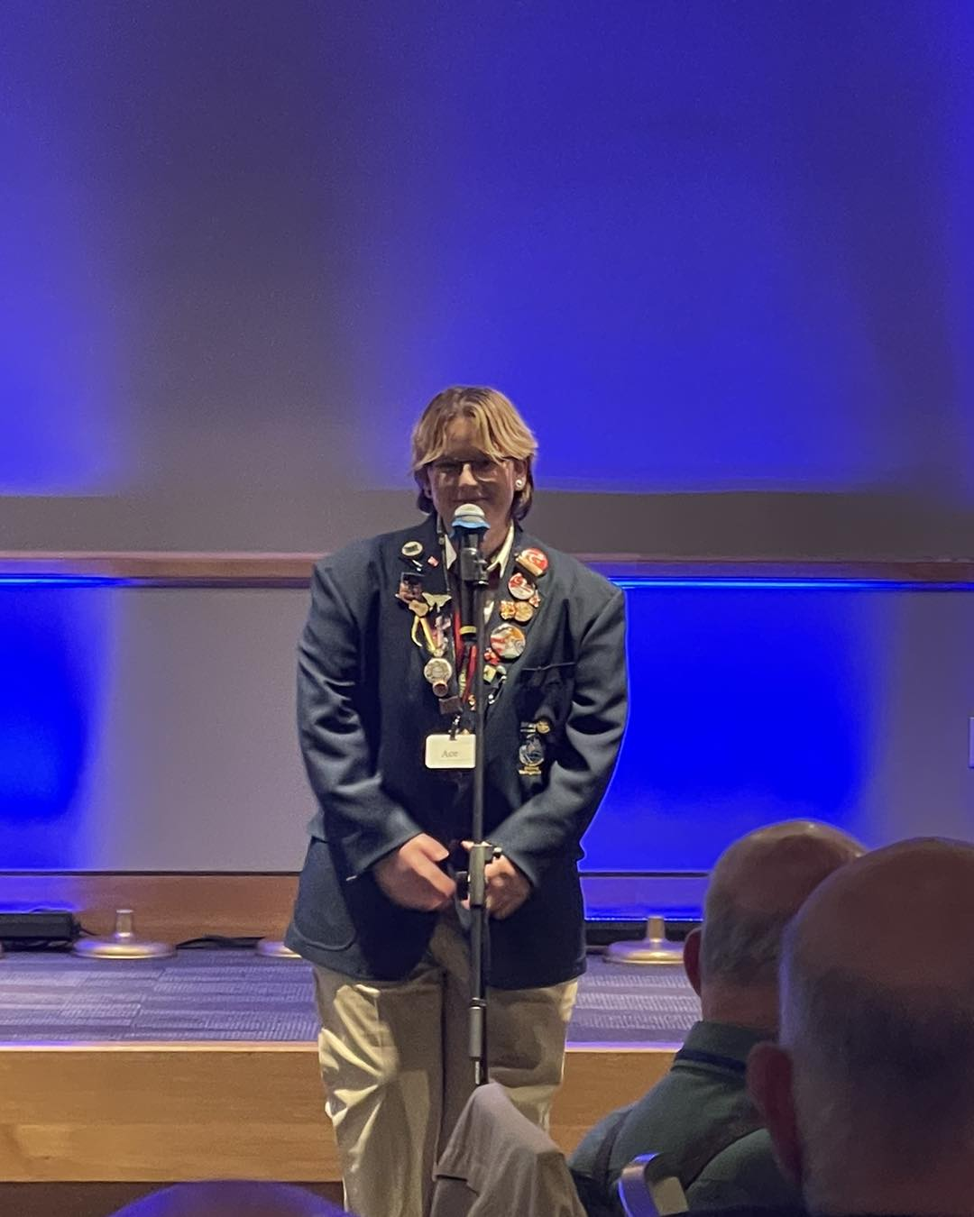
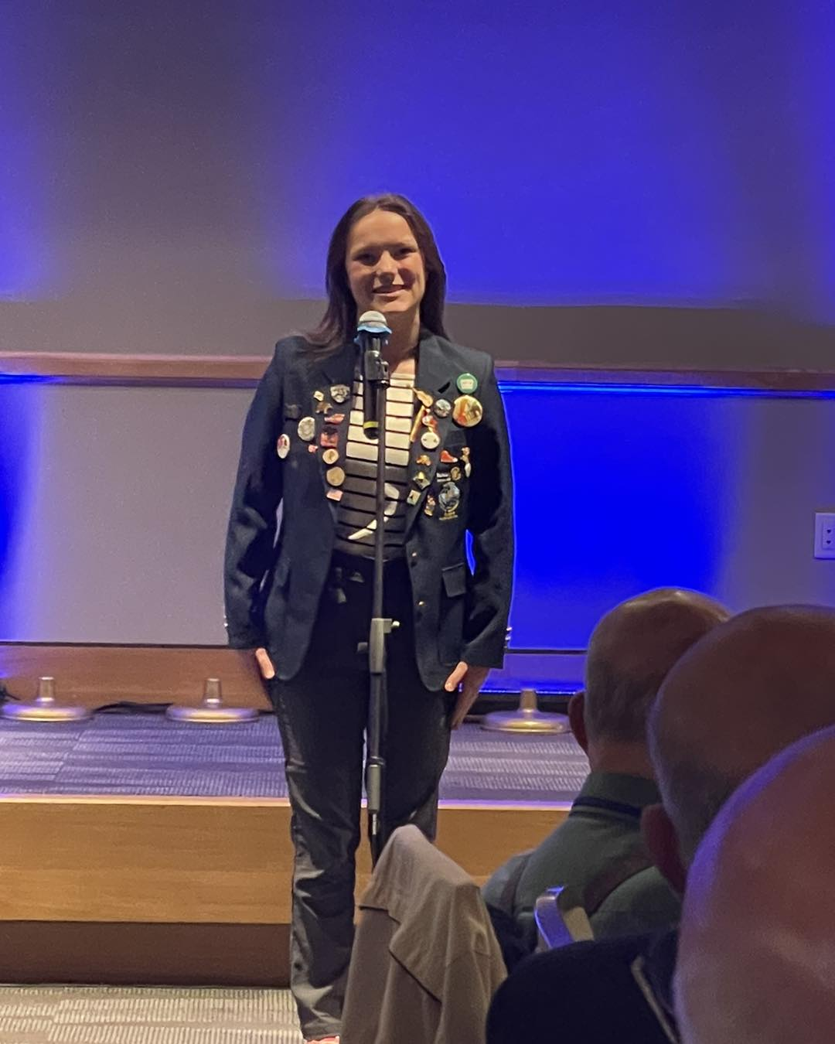
Youth Exchange Program
Goal: 2 for the year (Inbound and Outbound)/ 2 accomplished
We currently have 2 here this year- Juan and Rasmus
We currently have 2 out of country- Natalie in Japan and Carver in Denmark
We have 2 outbound- Valkyrie and Ace

Slide 12
RYLA participation
Goal: 1 for this year/ 1 attended
Hoping for another to attend this next year

Slide 13
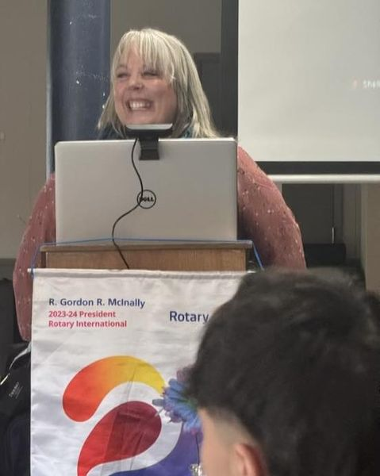
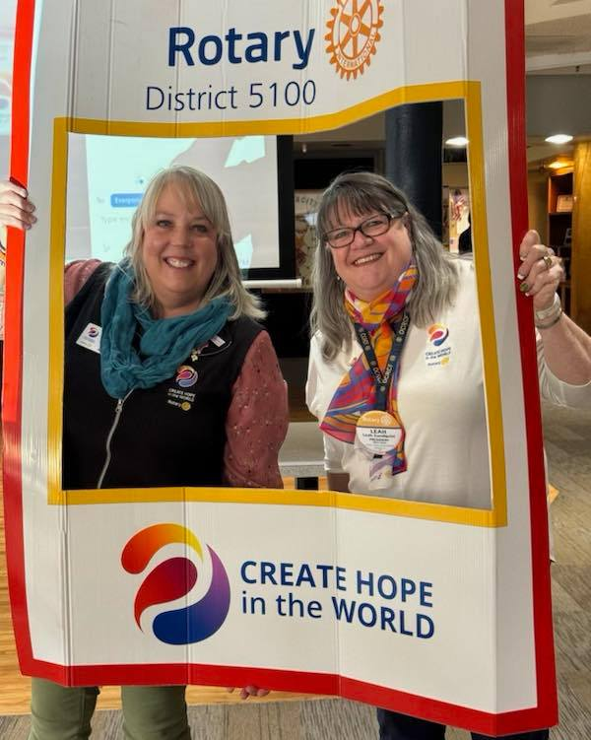
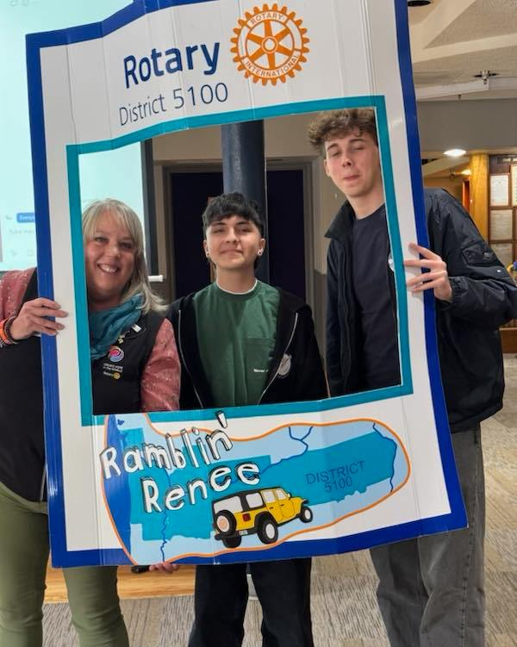
Media Stories
Goal: 4 for this year (Includes Social media)
Currently at over 50 since JUL(only online via Facebook and autolinked to Instagram)
Website is updated with meetings, events, and articles of community service the club as done and fundraising events.

Slide 14
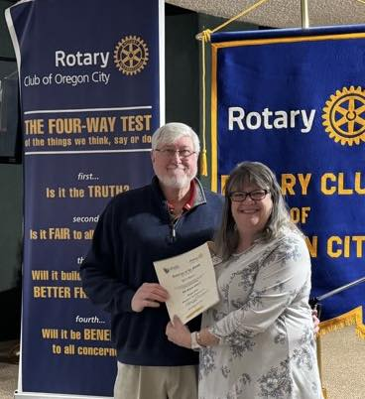
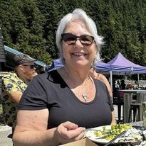
On line Presence
Goal: to have branding, promotional materials, website and social media accounts current and with correct branding of logo’s and naming conventions
Also, naming People of Action
New Webmaster.
New Webpage and updated
Speakers posted weekly on line
Community service projects posted
Fundraising event advertised

Slide 15
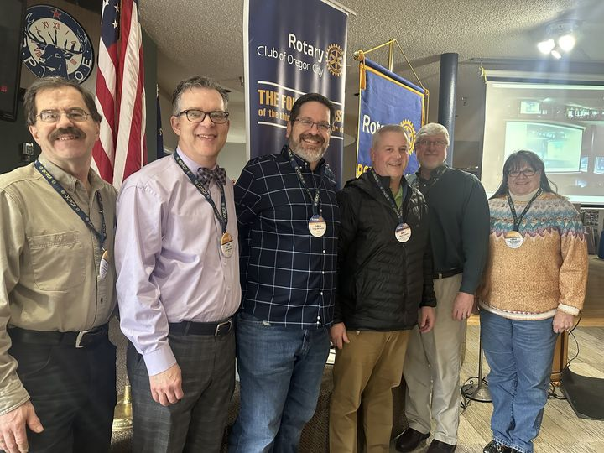
Annual Fund Contributions
Goal: $6,000- (Include Every Rotarian contributing $25, Polio Fund, etc)
Current Contribution is $7, 039 as of 26JUN
We exceeded the goal by $1039
Every Rotarian to give $25 or more to RI.
Thank you to everyone who contributed.

Slide 16
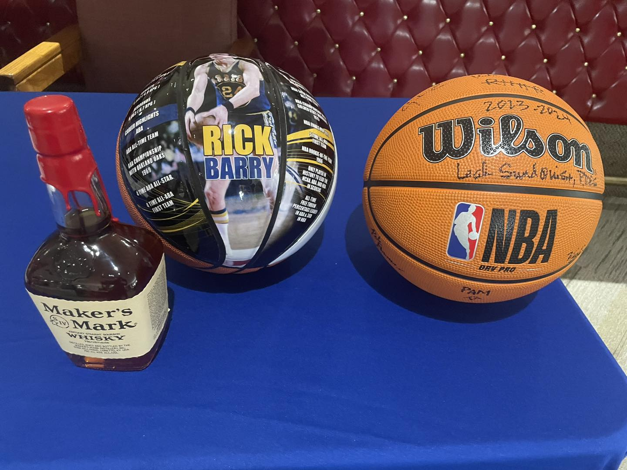
Polio Plus Contributions
Goal: $1500
Currently at $2,270 (as of 23JUN)

Slide 17
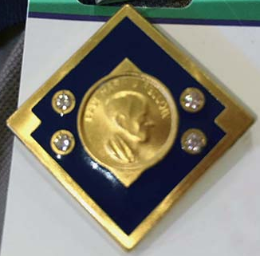
Paul Harris Society members
We currently have 8 members
Major Donors, Arch Klumph Society and Bequest Society
We currently have 6 members

Slide 18
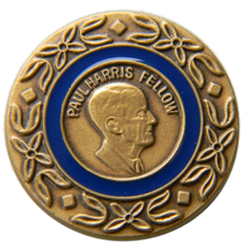
Paul Harris Fellow and Benefactor
We have 27 who are Paul Harris Fellow members
Over half the club
1 Benefactor

Slide 19
2024- 2025 Leadership
President- Gil Crowell
President Elect- Mark Meek
Secretary- Vicki Yates
Treasurer- Brian Nava
Directors (Committee Chairs)
Club Service- Dave Sumpter
Speaker/ Programs- Greg Williams/ Karen Martini
Community Service- Leah Sundquist
Fundraising- Cindy Crowell
Membership- Marcia Wimmer
YEO- Mimi Cogswell
RYLA- Kevin Bartel
Vocational/ New Generations- Tim Cook
International Projects- Marilyn Morrissey
Publicity/ Public Image- Trieste Andrews
Satellite Committee/ Club- Greg Geist
Foundation Chair- TBD

Slide 20
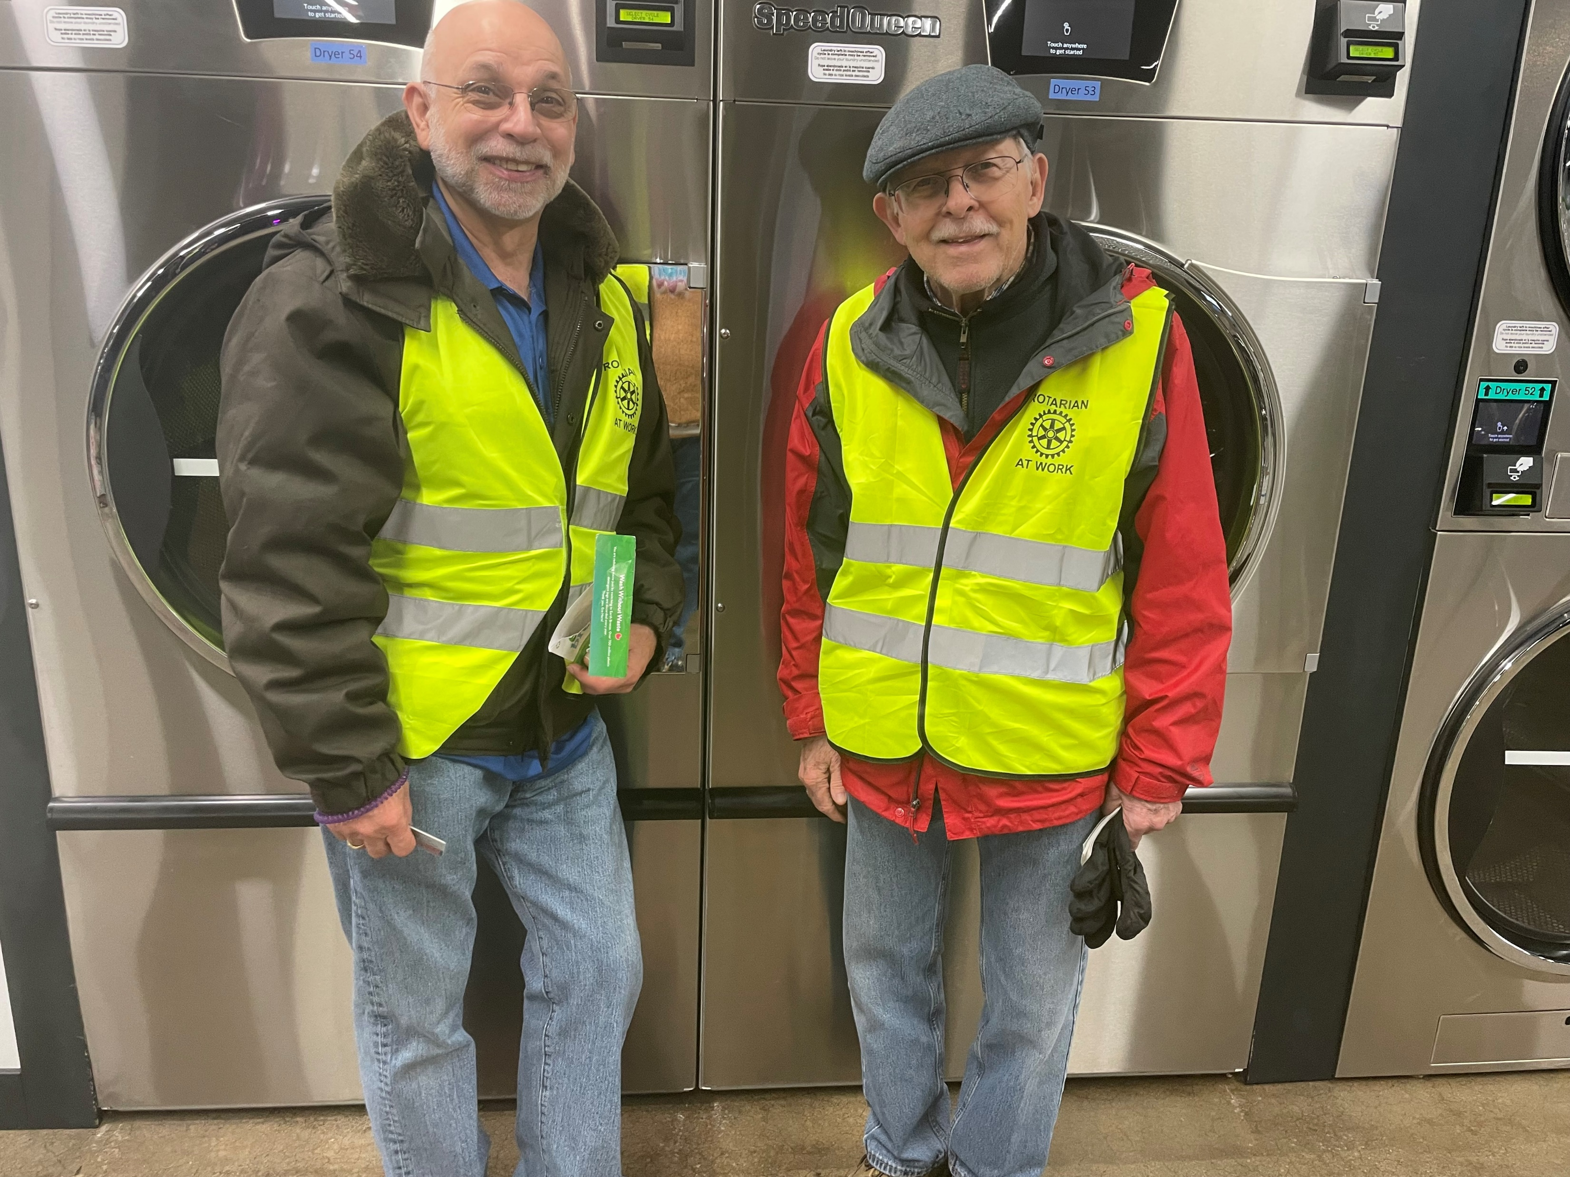
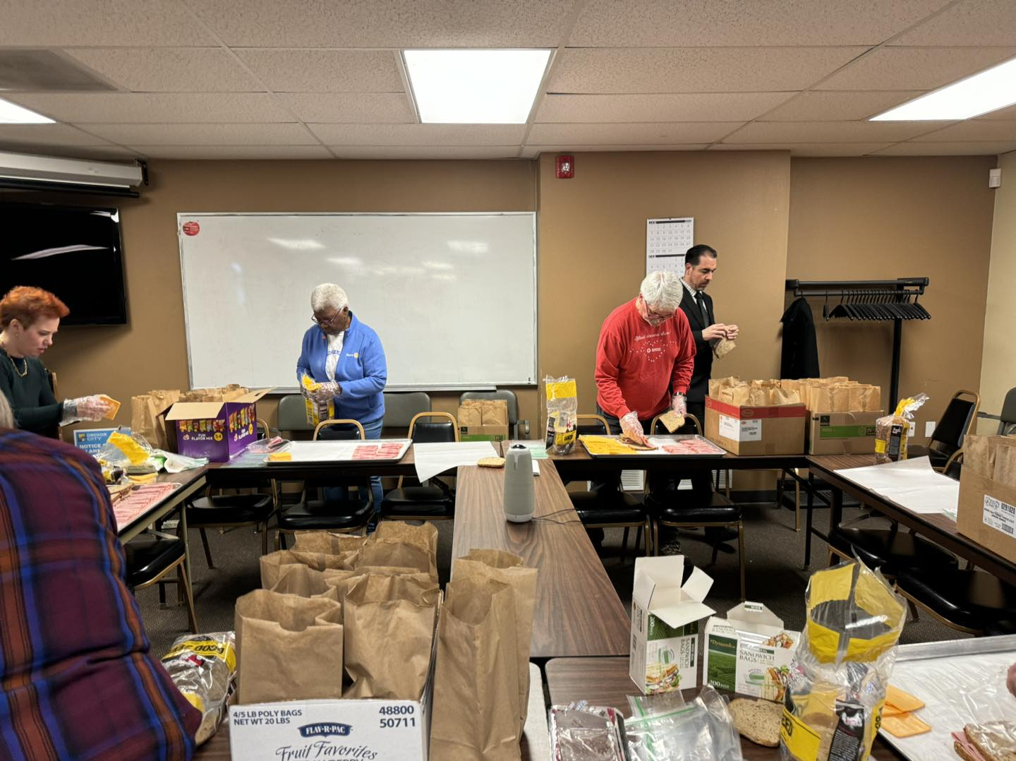
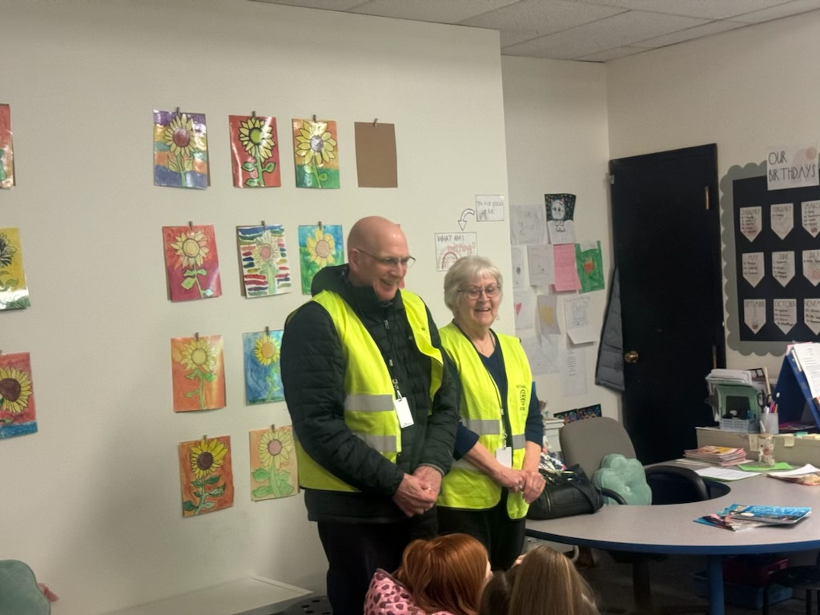
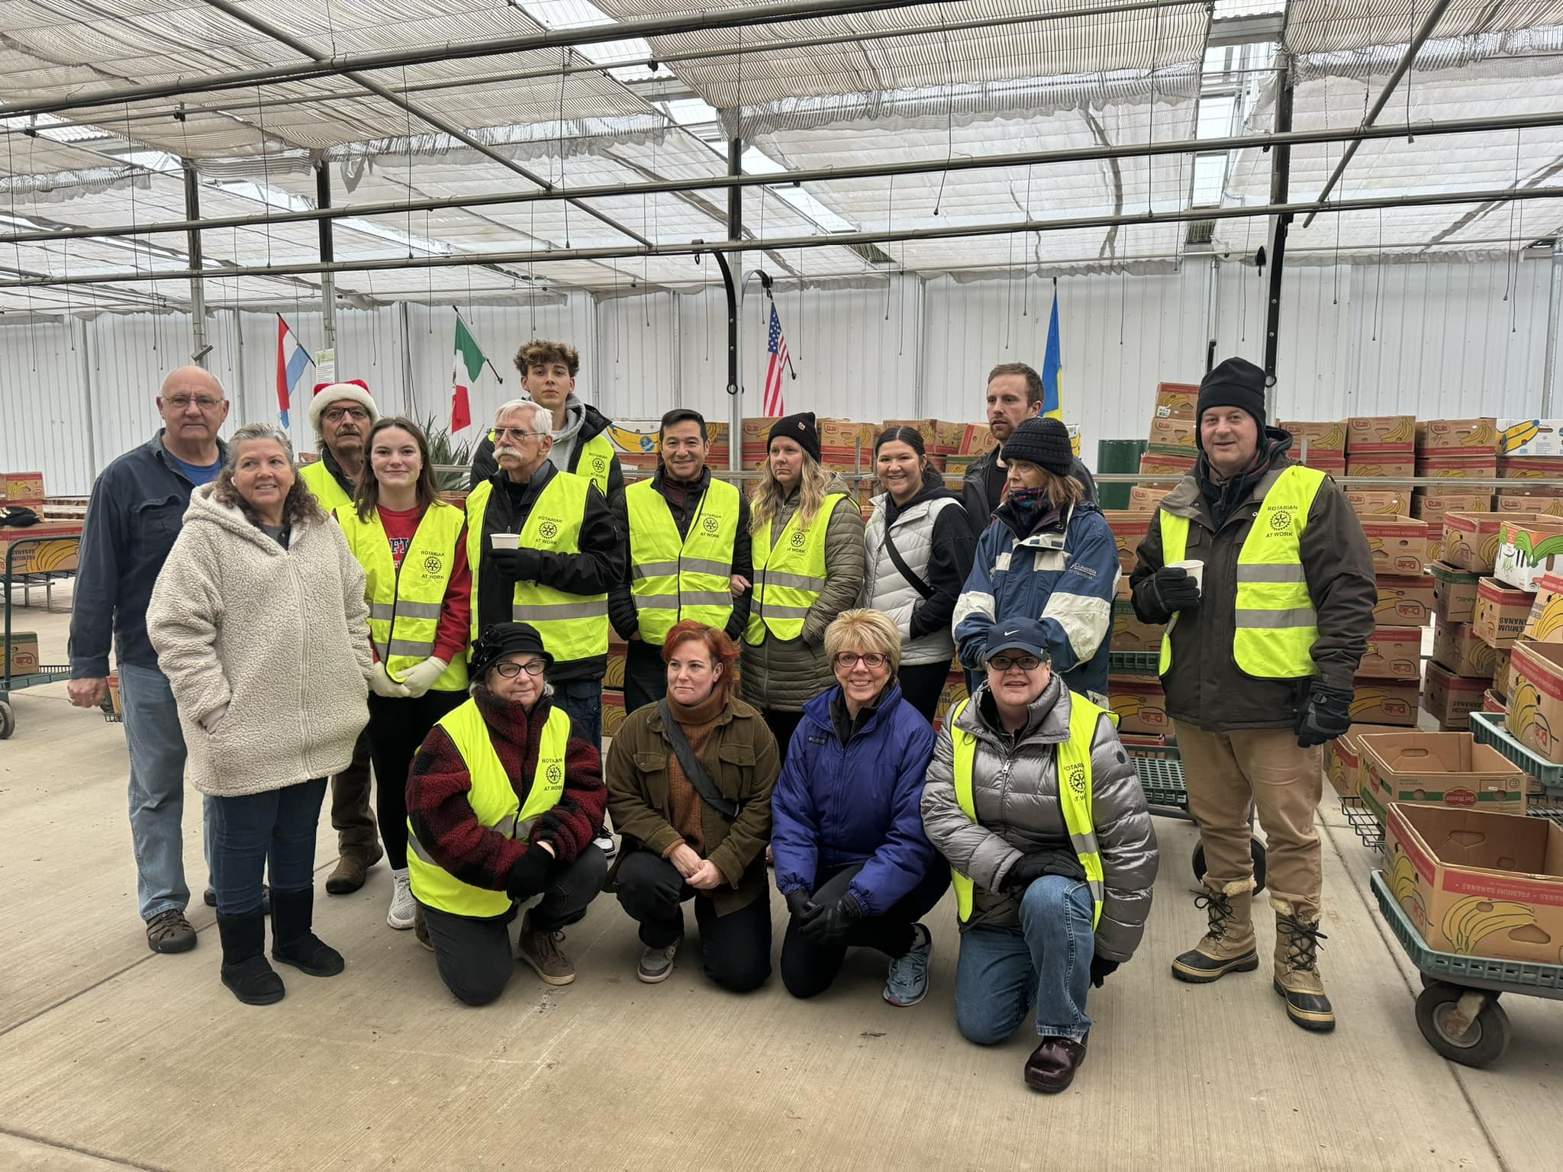
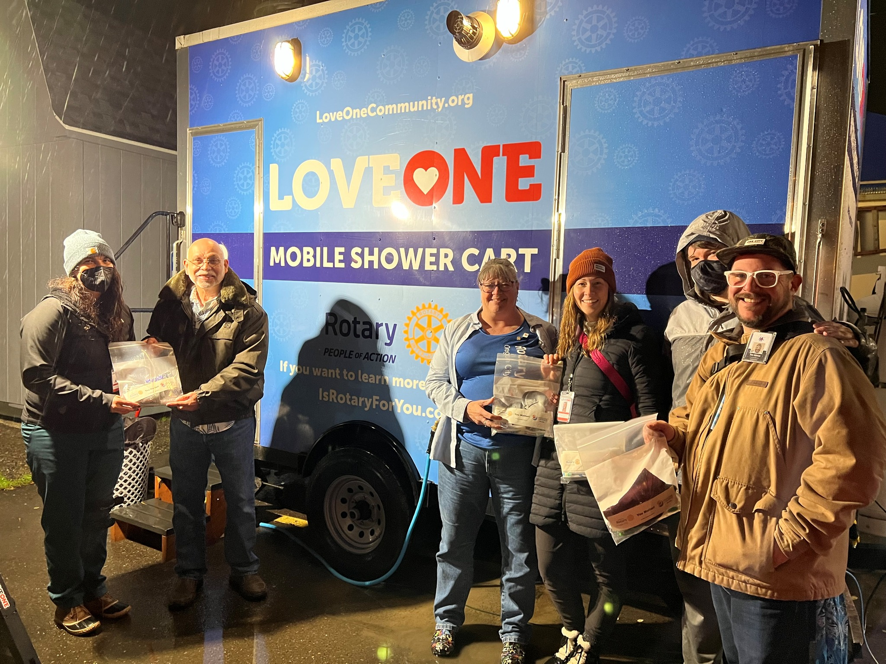
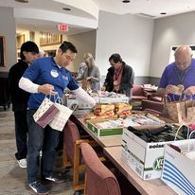
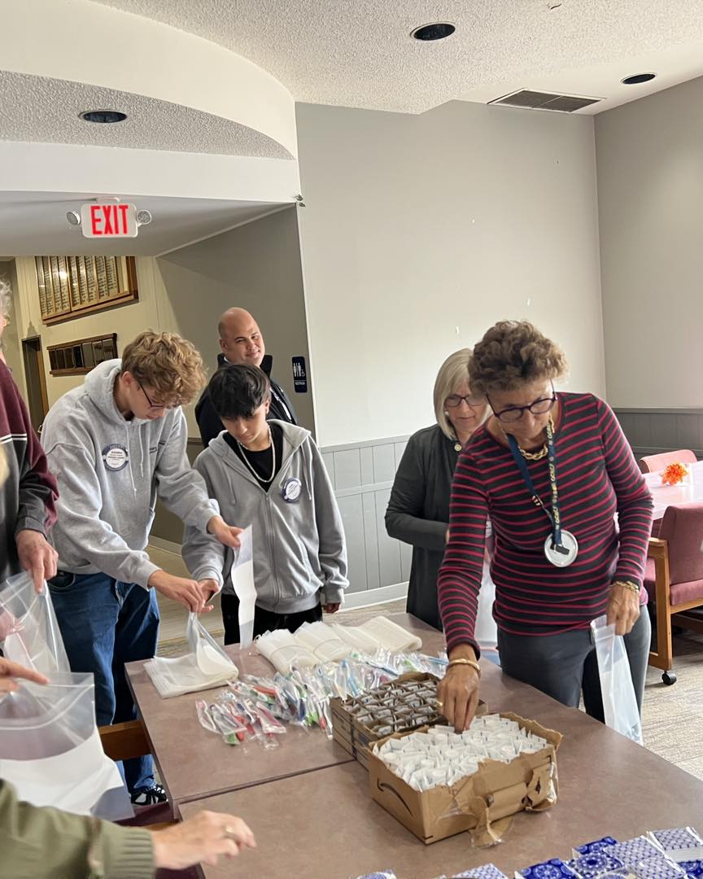
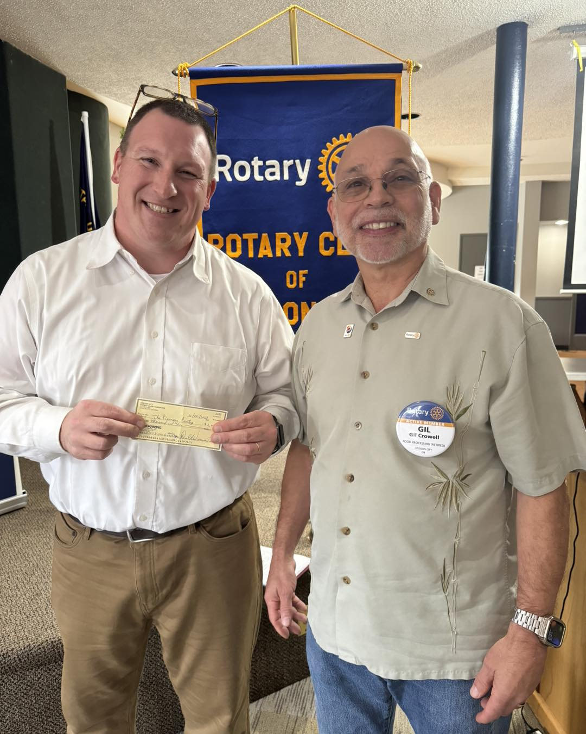
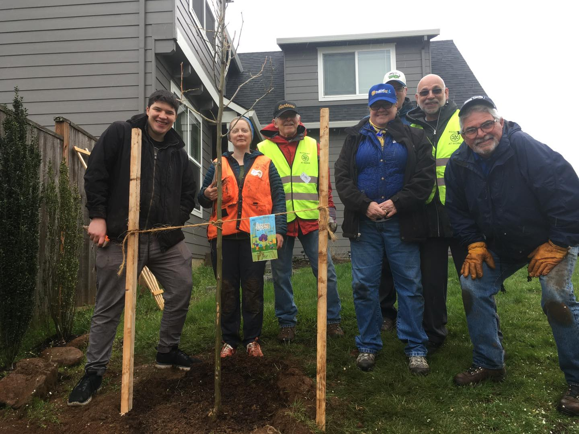
Rotarians At Work

Slide 21
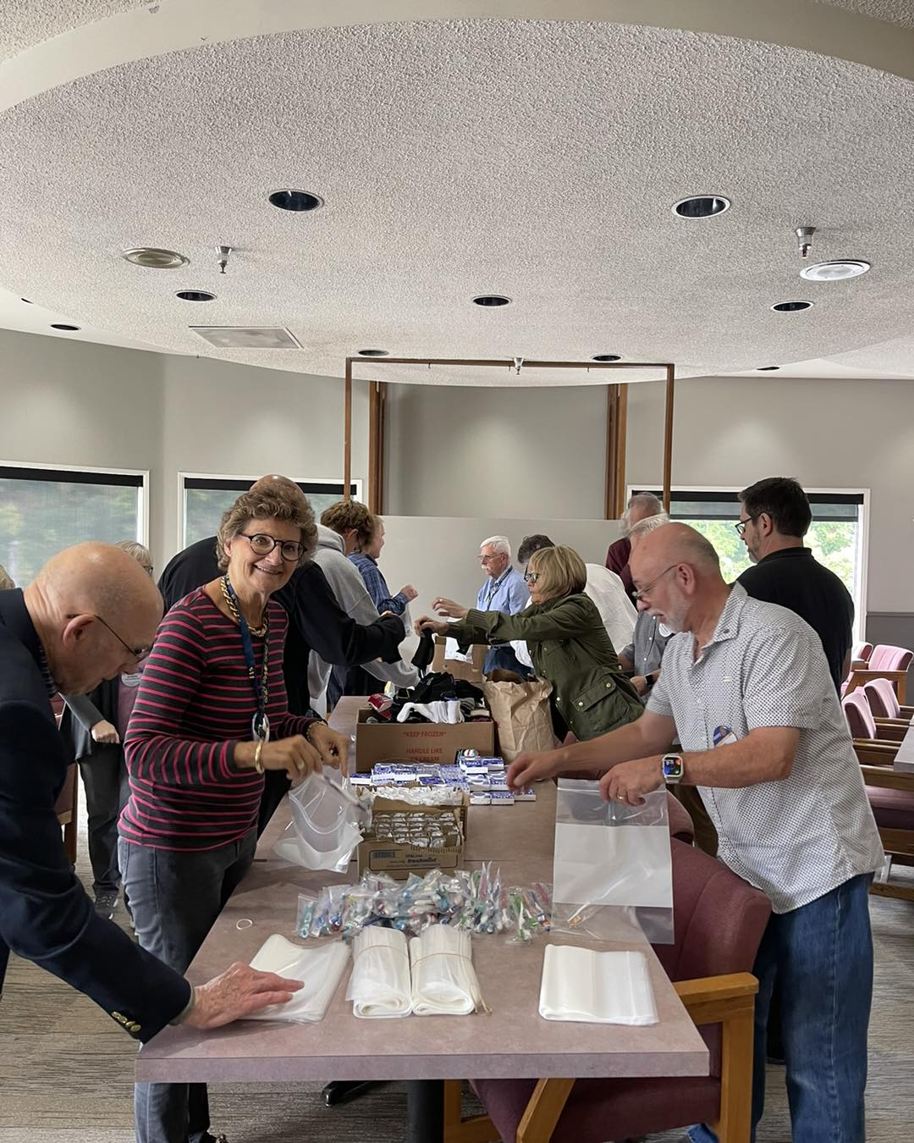
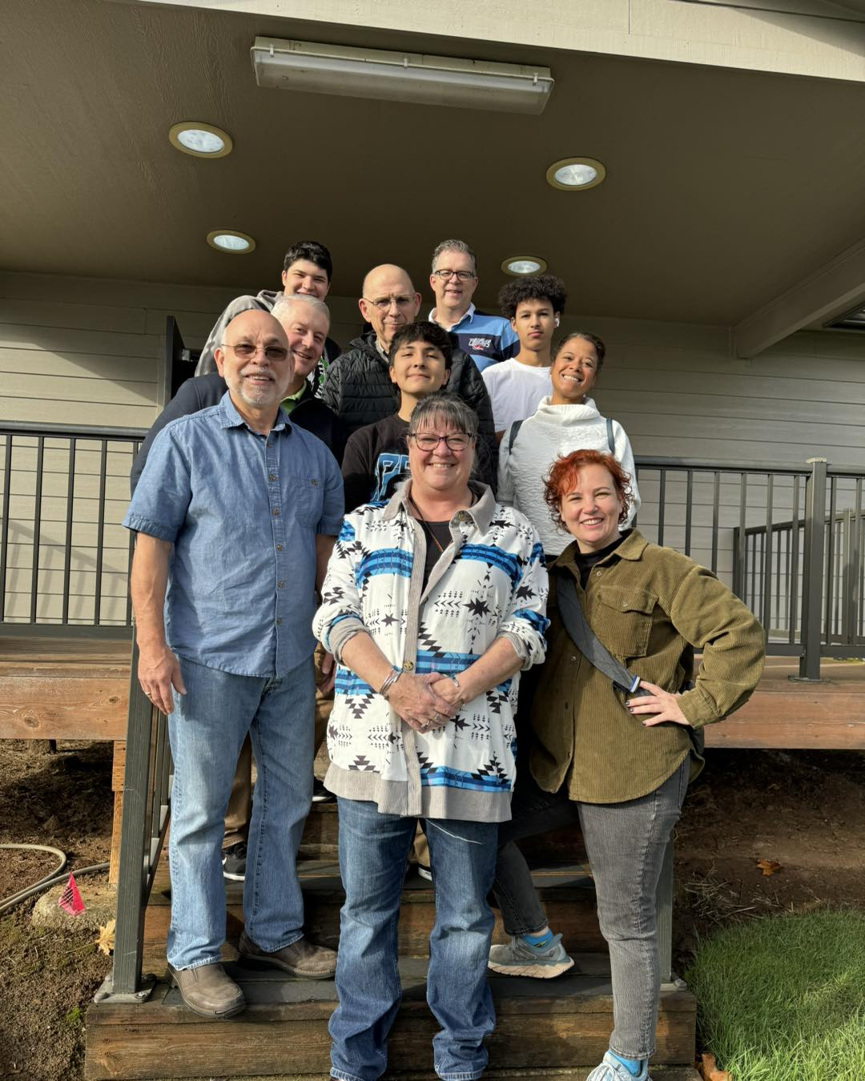
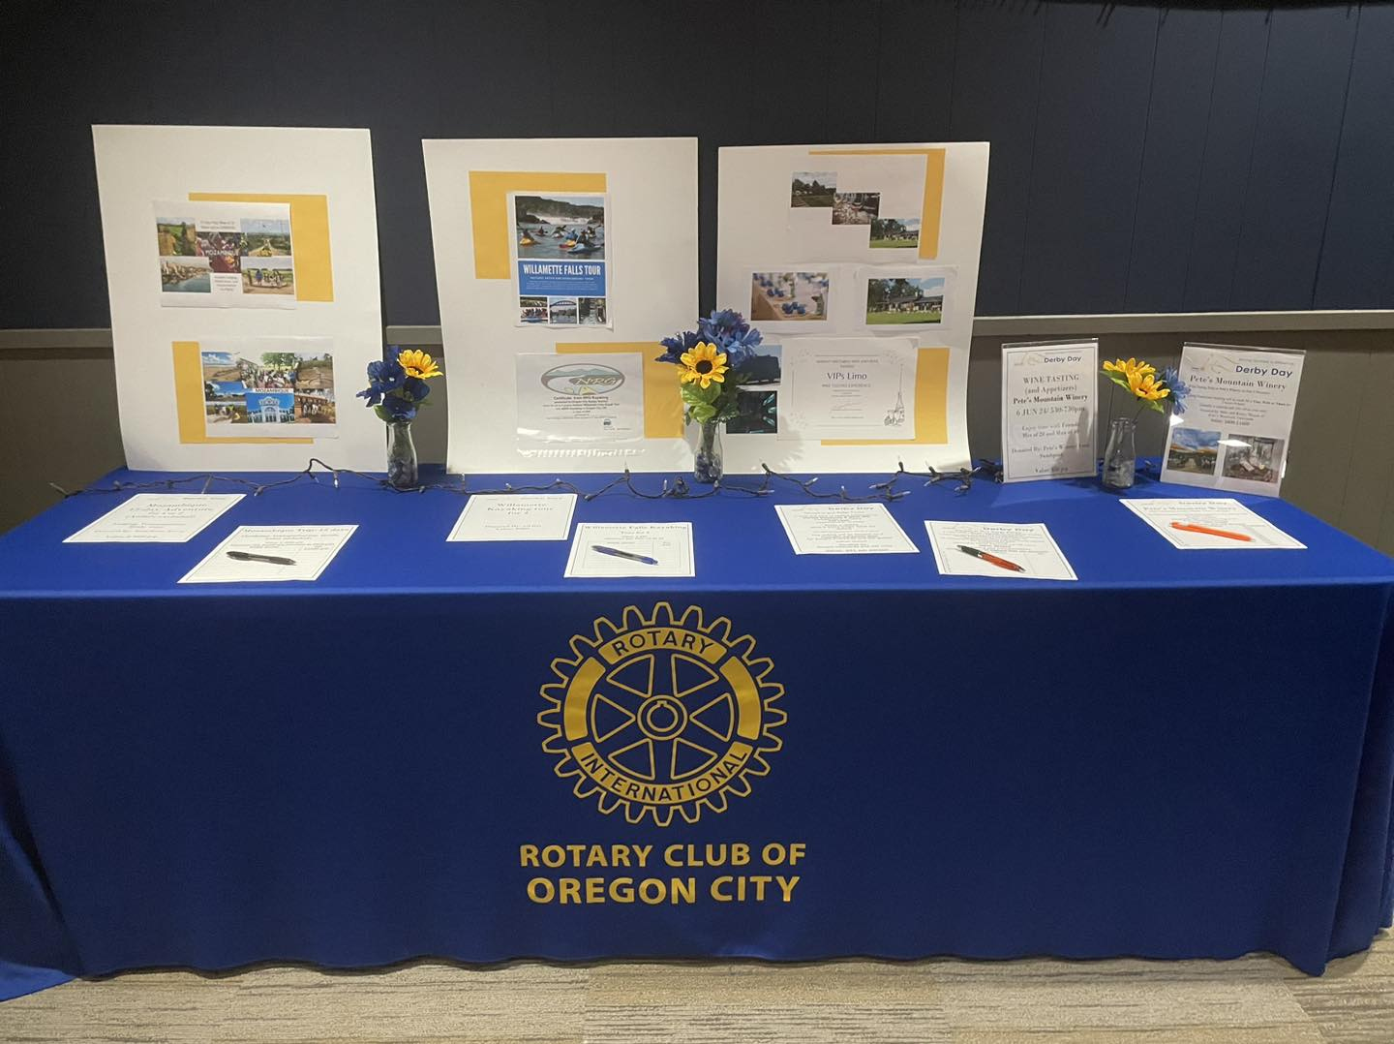
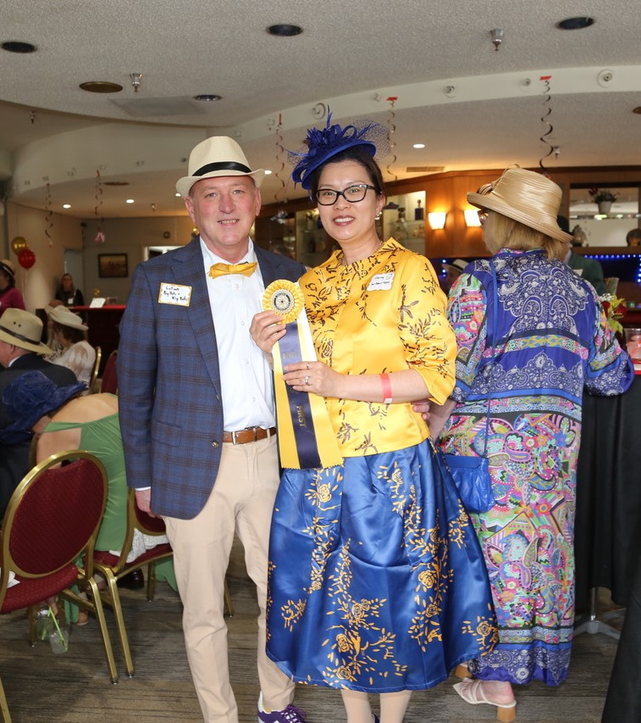
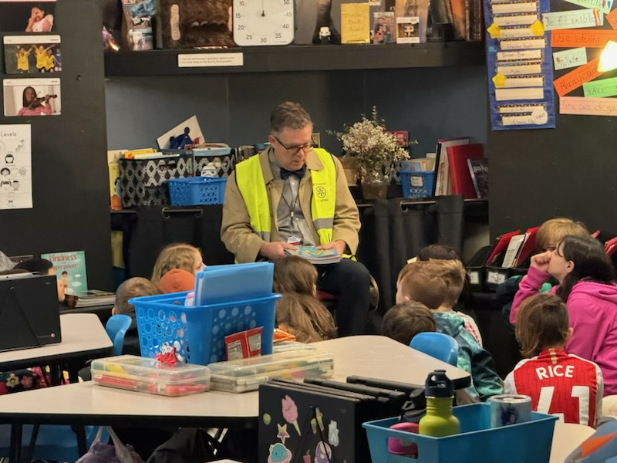
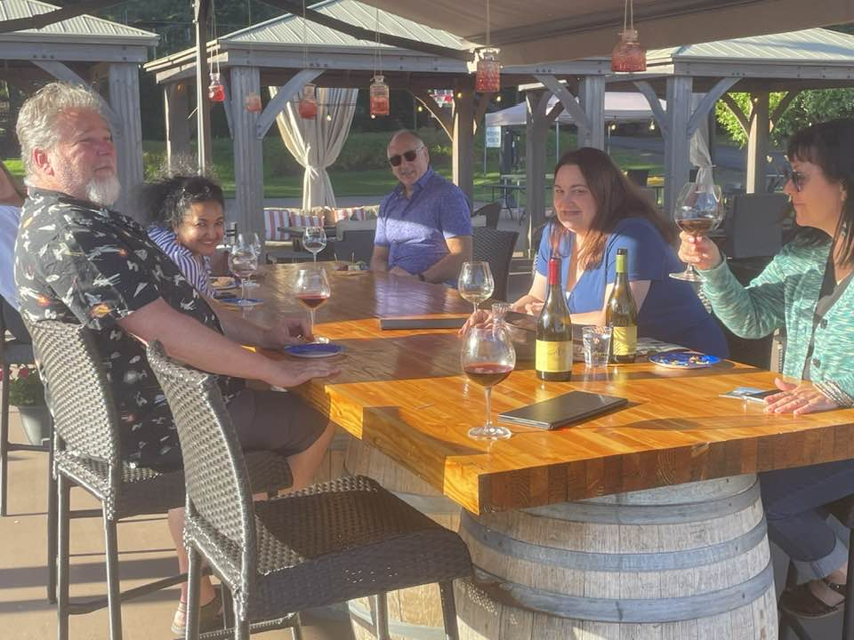
Thank you for letting me serve YOU

