Slide 1
District 6150
CLUB OF
THE YEAR
2016-2023
October 15, 2024

Slide 2
ROTARY GREETING
BRAZIL
Boa tarde
BOH-ah TAHR-jeh
Good afternoon!

Slide 3
PLEDGE OF ALLEGIANCE

Slide 4
INSPIRATIONAL MOMENT
Melissa Martin

Slide 5
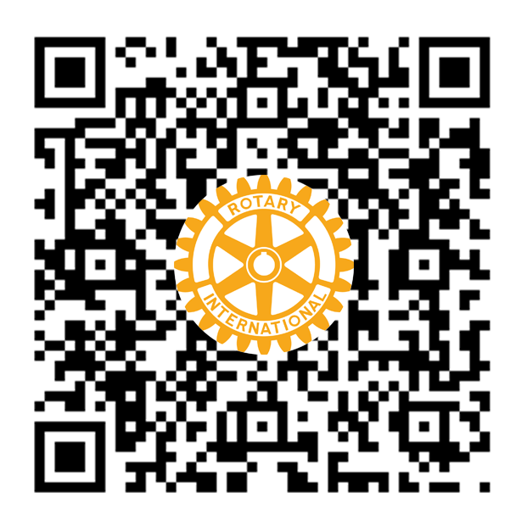
INTRODUCTION
OF GUESTS
JOIN US!
Brock Wooldridge
Interested in becoming a member?
Scan the QR code or visit www.JonesboroRotary.org to view our Membership Application

Slide 6
OCTOBER BIRTHDAYS
John Deacon
Alicia Benson Oct. 25
Brett Kohl Oct. 26
Brenda Fasulo Oct. 28
Christie Mink Oct. 28
Todd Welch Oct. 31
Monty May Oct. 31
Shaila Creekmore Oct. 1
Skip Smith Oct. 5
John Miles Oct. 10
Kenna Harrelson Oct. 18
Donald Cooper Oct. 22
John White Oct. 24
Dana Kennedy Oct. 25

Slide 7
GOOD NEWS
Gregory Hansen

Slide 8
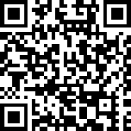
DONATE

Slide 9
POLIO PLUS SOCIETY
Pledge $100 or more each year to the PolioPlus program of the Rotary Foundation
Rotary has helped reduce polio cases by 99.9% since 1979
Polio remains endemic in only Afghanistan and Pakistan

Slide 10
CARITAS
Caritas is a Latin word that means to cherish, appreciate, and give special or loving attention with charity, compassion, and generosity of spirit.
We are looking for club members to write notes of encouragement and inspiration to RYLA students.
Caritas can include candy or small trinkets as well.

Slide 11
DUES

Slide 12
CLUB COMMITTEE SIGN-UP
Committee
Chair
Community Service
Foundation
Membership
Programs
Public Image
Vocational Service
Youth Service
Grant Allocation
Fundraising
Shaila Creekmore
Skip Smith
Jill Clogston
Jill Clogston
Melissa Martin
Bonnie May
Mark Morrow
Angy Abuanza
TBD

Slide 13
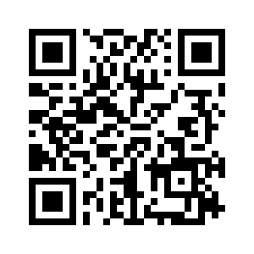
Rotary Youth Leadership Awards
What is RYLA?
Rotary Youth Leadership Awards (RYLA) is a fun, intensive training program for community youth leaders. Talented young people attend an all-expense paid weekend organized and run by Rotarians. RYLArians will make new friendships, learn about Rotary Service and learn about the leader inside themselves. RYLA will be October 17-20, 2024 at Ferncliff Camp in Little Rock.
Eligibility
This event is open to students who are currently in 10th or 11 grades. Children of Rotarians are eligible to attend.
Application
Complete the online application by Friday, September 20. Scan the QR code to access the application.

Slide 14
Join the
$10-A-MONTH CLUB
Also known as the Annual Fund, ShareFund, or Every Rotary Every Year
Funding goes to support Rotary’s seven areas of focus:
promoting peace
fighting disease
providing clean water and hygiene
saving mothers and children
supporting education
growing economies
protecting the environment
Along with supporting international and district projects, a portion of these funds come back to us for our own club projects

Slide 15
VOCATIONALS
Stephen & Jennifer Goad

Slide 16
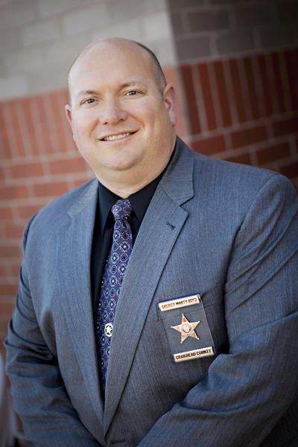
PROGRAM
Marty Boyd
Craighead County Sheriff

Slide 17
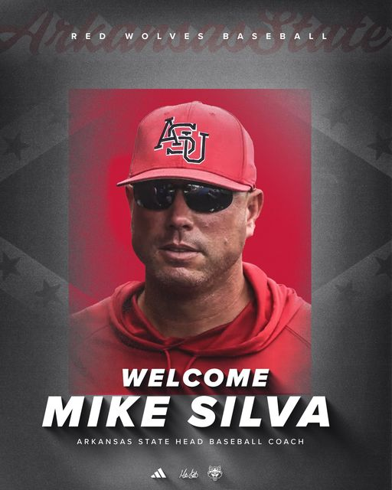
NEXT WEEK
Mike Silva
A-State Head Baseball Coach

Slide 18
THE FOUR-WAY TEST
of the things we think, say or do
Is it the TRUTH?
Is it FAIR to all concerned?
Will it build GOODWILL & BETTER FRIENDSHIPS?
Will it be BENEFICIAL to all concerned?

