Slide 1
ROTARY 101
Rotary Clubs 6220
New Member Orientation 2024-2025
Notes:
Thank you for joining us for today’s presentation-, Rotary 101

Slide 2
ROTARY 101-OBJECTIVES
Engage you in Rotary and our club, by providing answers and a better understanding of Rotary at the Member, Club, District, Zone and International levels.
Elevate your awareness of how you can learn more about Rotary on your own
Motivate and inspire you to have fun and get involved at the Club, District and Int levels
STRENGTHENING ROTARY |

Slide 3
WHO or WHAT is ROTARY?-SURVEY RESULTS
Never Heard of Rotary
Know Name Only
Some Familiarity
STRENGTHENING ROTARY |
Notes:
Which category were you in prior to joining Rotary?
The fact is, Rotary’s own Public Image Surveys* told us that people do not know us.
Four in 10 have never heard of Rotary.
Another four in 10 have heard of our “name only.”
Only two in 10 claim to have “some familiarity” with Rotary…and unfortunately what they know is often colored by misperceptions and half-truths.
*Research: Rotary Public Image Surveys completed 2006 and 2010. Responses received from six nations: Argentina, Australia, Germany, Japan, South Africa, United States. Surveyed approximately 1,000 individuals in each of six nations by phone and online. Survey has a +/- 4% margin of error.

Slide 4
ROTARY 101-BUILDING BLOCKS OF OUR BRAND
ESSENCE
VALUES
VOICE
Our reason for being
Our beliefs
Our expression
STRENGTHENING ROTARY |
Notes:
Our brand strategy is made up of three components:
Essence—our reason for being: What we stand for, how we’re different, why people should care.
Value—our actions/behaviors/beliefs.
Voice—our expression/personality/tone.
We would not have been able to develop our essence, activate our values or create our voice attributes without our research.

Slide 5
ROTARY 101-ESSENCE STATEMENT
Rotary joins leaders from
all continents, cultures and occupations
to exchange ideas and take action
for communities around the world.
STRENGTHENING ROTARY |
Notes:
Our Directors and Trustees adopted a new essence statement for Rotary.
Rotary unites leaders from
all continents, cultures and occupations
to exchange ideas and take action
for communities around the world.
Our essence statement distills our strengths and differentiates us from other nonprofits. Our essence:
Clarifies Rotary’s role as connector; reinforces “category of one” status by removing traditional nonprofit descriptors.
Defines leadership by outlook (i.e., diverse perspectives and expertise) versus title; emphasizes Rotary’s greatest point of difference in relevant terms.
Balances friendship and fun with service and impact; is active and inspiring.
Balances community and global impact.

Slide 6
ROTARY 101-ESSENCE STATEMENT-JET
As a new member you can
join leaders from
exchange ideas and take action
with your club, 6220 and Rotary
STRENGTHENING ROTARY |
Notes:
Our Directors and Trustees adopted a new essence statement for Rotary.
Rotary unites leaders from
all continents, cultures and occupations
to exchange ideas and take action
for communities around the world.
Our essence statement distills our strengths and differentiates us from other nonprofits. Our essence:
Clarifies Rotary’s role as connector; reinforces “category of one” status by removing traditional nonprofit descriptors.
Defines leadership by outlook (i.e., diverse perspectives and expertise) versus title; emphasizes Rotary’s greatest point of difference in relevant terms.
Balances friendship and fun with service and impact; is active and inspiring.
Balances community and global impact.

Slide 7
ROTARY 101-VISION STATEMENT (Approved 2018)
Together, we see a world
where people unite and take action
to create lasting
change across the globe,
in our communities, and in ourselves.
STRENGTHENING ROTARY |
Notes:
Our Directors and Trustees adopted a new essence statement for Rotary.
Rotary unites leaders from
all continents, cultures and occupations
to exchange ideas and take action
for communities around the world.
Our essence statement distills our strengths and differentiates us from other nonprofits. Our essence:
Clarifies Rotary’s role as connector; reinforces “category of one” status by removing traditional nonprofit descriptors.
Defines leadership by outlook (i.e., diverse perspectives and expertise) versus title; emphasizes Rotary’s greatest point of difference in relevant terms.
Balances friendship and fun with service and impact; is active and inspiring.
Balances community and global impact.

Slide 8
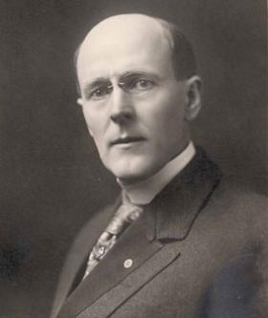
ROTARY 101- HISTORY of ROTARY
Rotary was an idea of Paul Harris
He was born in Racine, WI
First meeting 4 members on 23 February 1905
Club #1 is in Chicago
It was the first service club in the world
Clubs sponsor clubs
Members sponsor/invite new members
We now have 1.3 +million members in 200+ countries and territories in 35,000+ Rotary Clubs
Women were finally invited to join Rotary in 1989
STRENGTHENING ROTARY |
Notes:
Club #1 Chicago, Club #2 San Francisco first non English speaking club Havana Cuba 1916
1,209,491 members
35,114 clubs in 535 Districts; in 200 countries & Territories
Women welcomed into Rotary 1989

Slide 9
ROTARY 101-ORGANIZATIONAL STRUCTURE
ROTARY STARTS WITH MEMBERS AT CLUB LEVEL
CLUBS ARE SUPPORTED BY DISTRICT (6220) AND CLUBS ARE MEMBERS OF RI
DISTRICT 6220 IS SUPPORTED BY ZONE(29)
ROTARY INTERNATIONAL PROVIDES GUIDANCE AND SUPPORT TO ALL
STRENGTHENING ROTARY |

Slide 10
ROTARY 101-ORGANIZATIONAL STRUCTURE
Members belong to Rotary Clubs
Clubs are members of RI and are organized into Districts
Districts are organized into Zones
RI

Slide 11
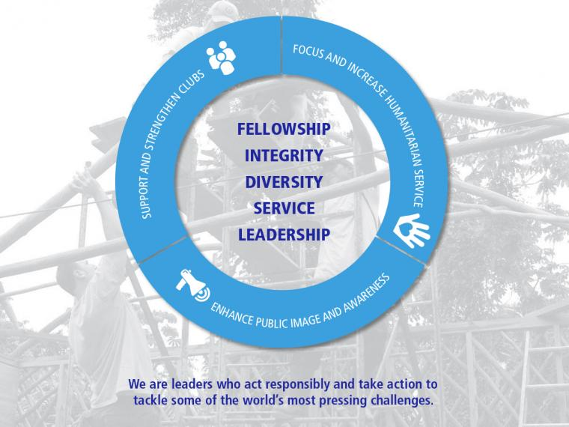
ROTARY INTERNATIONAL EXISTS & PROVIDES…..
Motto
Service Above Self
Guiding Principles
4-Way Test
Object of Rotary
Peace through understanding
5 Avenues of Service
6 Areas of Focus
STRENGTHENING ROTARY |
Notes:
The Goals for Support & Strengthen Clubs:- Foster Club innovation &flexibility- Encourage Clubs to participate in a variety of service activities
Promote membership diversity Improve member recruitment and retention Develop leaders- Start new & dynamic clubs-
Encourage strategic planning at club and district levels
Focus and Increase Humanitarian Service- Eradicate Polio

Slide 12
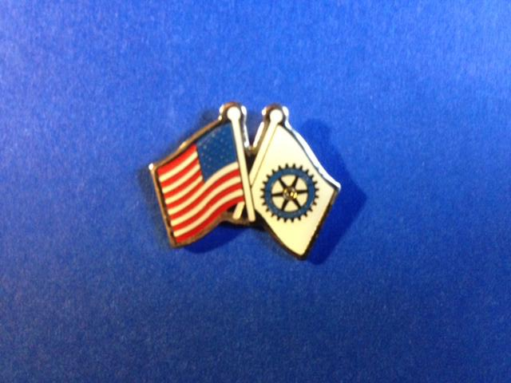
ROTARY 101- CLUB MEETINGS in 6220
Rotary is non-political. (we’re here to serve, so please keep political discussions outside of meetings)
Rotary clubs start and end their meetings with the ringing of the bell.
Meetings here start with a “pledge of allegiance” (in other countries it follows their customs)
Some clubs were singing clubs, but most are not. (some clubs that were chartered many years ago still sing)
Rotary is non-religious (we respect another’s beliefs)
Some clubs say a prayer after the pledge, or offer a “Thought of the Day” or share a “Rotary Moment/Minute”, or American Indian Land Acknowledgement
STRENGTHENING ROTARY |
Notes:
MT Club #27051

Slide 13
ROTARY 101-BUILDING BLOCKS OF OUR BRAND
ESSENCE
VALUES
VOICE
Our reason for being
Our beliefs
Our expression
STRENGTHENING ROTARY |

Slide 14
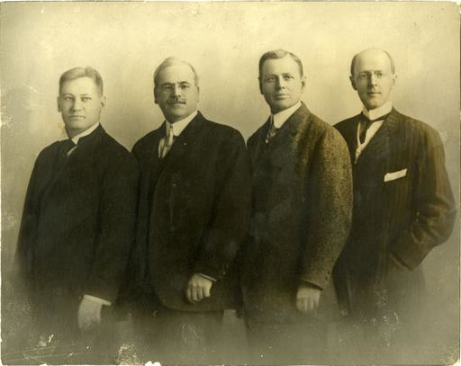
ROTARY 101-OUR VALUES & BELIEFS
Motto:
“Service Above Self”
Our Guiding Principles:
Four-Way Test
Object of Rotary
Peace through understanding
Our Actions:
5 Avenues of Service
7 Areas of Focus
STRENGTHENING ROTARY |
Notes:
1911-He Profits Most Who Serves Best- Service, Not Self then combined in 1950 with the addition of Service Above Self
1989 RI decided to focus on principle motto

Slide 15
ROTARY101-4-WAY TEST
ROTARY101-4-WAY TEST
ROTARY 101-THE FOUR-WAY TEST-OUR VALUES & BELIEFS
Of the things we think, say, or do:
Is it the TRUTH?
Is it FAIR to all concerned?
Will it build GOODWILL and BETTER FRIENDSHIPS?
Will it be BENEFICIAL to all concerned?
Notes:
Herbert J Taylor 1932-Chicago’s Club Aluminum 24 words- Adopted by RI in 1943 RI President 1954-55

Slide 16
ROTARY 101- THE OBJECT OF ROTARY-VALUES & BELIEFS
“to encourage and foster the ideal of service as a basis of worthy enterprise”
First: The development of acquaintance as an opportunity for service.
Second: High ethical standards in business and profession. The recognition of the worthiness of all useful occupations. The dignifying of each Rotarian’s occupation as an opportunity to serve society.
Third: The application of the ideal of service in one’s personal, business, and community life.
Fourth: The advancement of international understanding, goodwill, and peace through a world fellowship of business and professional persons united in the ideal of service.
STRENGTHENING ROTARY |
Notes:
This is also posted on our website and in the Rotarian magazine. You may want participants to take turn reading.

Slide 17
ROTARY’S 7 AREAS OF FOCUS
Peace and Conflict Prevention/Resolution
Disease Prevention and Treatment
Water and Sanitation
Maternal and Child Health
Basic Education and Literacy
Economic and Community Development
Protecting the Environment

Slide 18
BUILDING BLOCKS OF OUR BRAND STRATEGY
ESSENCE
VALUES
VOICE
Our reason for being
Our beliefs
Our expression
STRENGTHENING ROTARY |
Notes:
Next, let’s look at our voice…how we express ourselves…what we say…and how we say it.

Slide 19
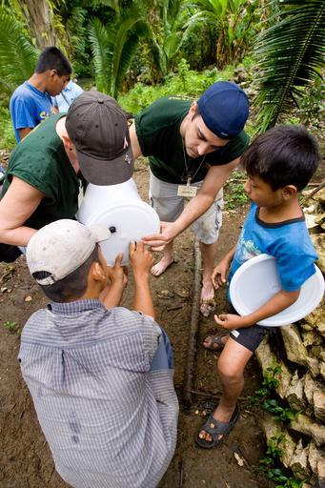
ROTARY 101- AVENUES of SERVICE-HOW WE EXPRESS
Club Service
Community Service
Vocational Service
International Service
Youth Service
Environmental Stewardship
STRENGTHENING ROTARY |
Notes:
Club Service-’17-’18 Chair Dave Kliber –membership engagement, social, holiday party, new member orientation
Community Service-’’17-’18 Danielle Deller Chair Jennifer Sutherland-local community projects (Oz Family Sharing)
Vocational Service ’17-’18 Chair John Haut-Scholarships MATC, job fairs, classification talks
International Service-’17-’18 (vacant) Chair Bob Leonhardt-Support GMRP, Hope Without Borders, Education & water filters
New Generations-’15-’16 Chair -David Schlageter-Rotary Youth Exchange, HHS Interact

Slide 20
ROTARY 101- THE ROTARY FOUNDATION-HAS 3 FUNDS
Annual Fund
E.R.E.Y.- Every Rotarian Every Year
Paul Harris Fellows (PHF) are recognized after a $1,000 in donations (includes gifts to Polio Plus)
After 3 years 50% of donations come back to District to fund programs & grants
Permanent Fund
The Endowment makes an annual distribution for programs and operating expenses. For Rotary year 2023-24, spendable earnings totaled $24.7M. Goal to have fund grow to $2,025,000,000 in 2025
Polio Plus
STRENGTHENING ROTARY |
Notes:
TRF was started by RI Pres Arch Klumph 1917- $26.50 Recent $ ______________ Charity Navigator 92% 4 Stars
In 1929, the Foundation made its first gift of $500 to the International Society for Crippled Children. The organization, created by Rotarian Edgar F. “Daddy” Allen, later grew into Easter Seals.
When Rotary founder Paul Harris died in 1947, contributions began pouring in to Rotary International, and the Paul Harris Memorial Fund was created to build the Foundation.
1978: Rotary introduced the Health, Hunger and Humanity (3-H) Grants. The first 3-H Grant funded a project to immunize 6 million Philippine children against polio.

Slide 21
ROTARY 101-OUR PROMISE TO END POLIO
Rotary leading the fight since 1985. Going from nearly 350,000 cases in 1988 to just 10 so far this year has required time, money, dedication, and innovation from thousands of people.
As a founding partner of the Global Polio Eradication Initiative, we've reduced polio cases by 99.9 percent since our first project to vaccinate children in the Philippines in 1979.
Rotary members have contributed more than $2.1 billion and countless volunteer hours to protect nearly 3 billion children in 122 countries from this paralyzing disease. Rotary’s advocacy efforts have played a role in decisions by governments to contribute more than $10 billion to the effort.

Slide 22
ROTARY 101-LEADERSHIP OPPORTUNITIES AND ANNUAL CHANGES
Rotary provides leadership opportunities, by changing leaders (in most positions) every year, at the Club, District and International level.
Our club has a leadership progression track to prepare our leaders for their progressive roles.
V.P (Pres. Elect Nominee)
PE (President Elect)
President
‘24-’25 RI President & country
Stephanie A. Urchick USA

Slide 24
ROTARY 101-LEADERSHIP OPPORTUNITIES AND ANNUAL CHANGES
In District 6220 and we have 40 Clubs in our District
Our RI Representative and District Governor (DG) for 2024-25 is Roger Utnehmer
Assistant Governor’s (AG’s) oversee and work with clubs in geographic areas (3-4 year term).

Slide 25
ROTARY 101- INFORM | INSPIRE | EMPOWER
Tools to assist you in elevating your awareness and knowledge of Rotary:
Read “Rotary Basics”
Explore our Club’s history (ask to meet with a long term member)
Visit D6220 Website www.ridistrict6220.org
Visit Rotary.org/My Rotary (sign up)/Rotary Club Central
Yes, you could always Google your Rotary question
STRENGTHENING ROTARY |
Notes:
Live Demo if possible

Slide 26
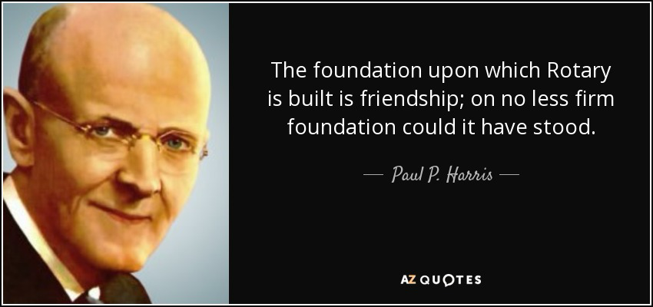
ROTARY 101- THE NUMBER ONE REASON WHY MEMBERS STAY IN ROTARY

Slide 27
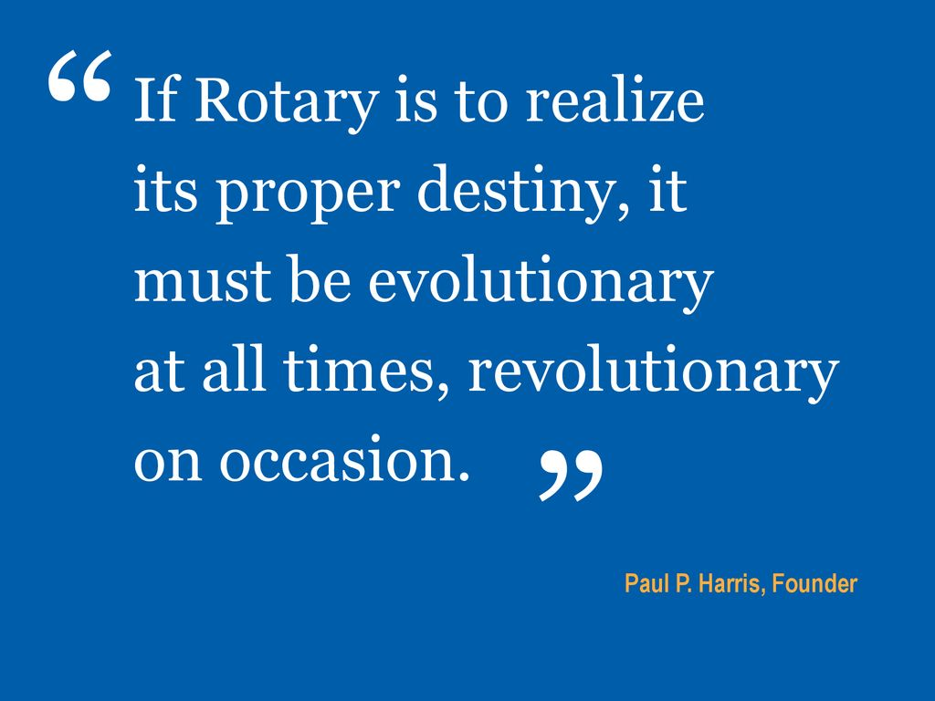

Slide 28
ROTARY 101- INFORM | INSPIRE | EMPOWER
Hoping that this was interesting, helpful, informative and will inspire you to have fun and get involved at our Club, District and International level by……..
STRENGTHENING ROTARY |

Slide 29
ROTARY 101- INFORM | INSPIRE | EMPOWER
Joining a Committee
Visiting other Rotary Clubs
Inviting a guest to a Club meeting
Attending a District Conference (Tri-Con Brookfield, WI 25-26 April)
Attending a District event
Volunteering for an International project
Attending a RI Convention (Calgary, Canada 21-25 June ‘25 )
Joining a Rotary Fellowships (check www.rotary.org)
Visit Rotary.org/My Rotary (sign up)/Rotary Club Central
STRENGTHENING ROTARY |
Notes:
Live Demo if possible

Slide 30
ROTARY 101- INFORM | INSPIRE | EMPOWER
QUESTIONS FOR US…………
STRENGTHENING ROTARY |

Slide 31
ROTARY 101- INFORM | INSPIRE | EMPOWER
QUESTION FOR YOU:
What is the first thing that you are going to do to strengthen, improve and grow your Rotary Club and Rotary?
STRENGTHENING ROTARY |

Slide 32
ROTARY 101- INFORM | INSPIRE | EMPOWER
THANK YOU
&
PLEASE BECOME A…
ROTARY
CHAMPION
Notes:
Thank You & Please Be a Rotary Champion.
By attending this session and listening to the presentation, you are already Rotary champions. Now that you’ve taken the time to learn more about this effort, you can use what you learned here today in your district conferences, regional seminars, and team trainings to share this message with the rest of the Rotary world.

