Slide 1
Rotary District 6540 Conference
April 20, 2024
Give Peace a Chance…
and How I Did

Slide 2
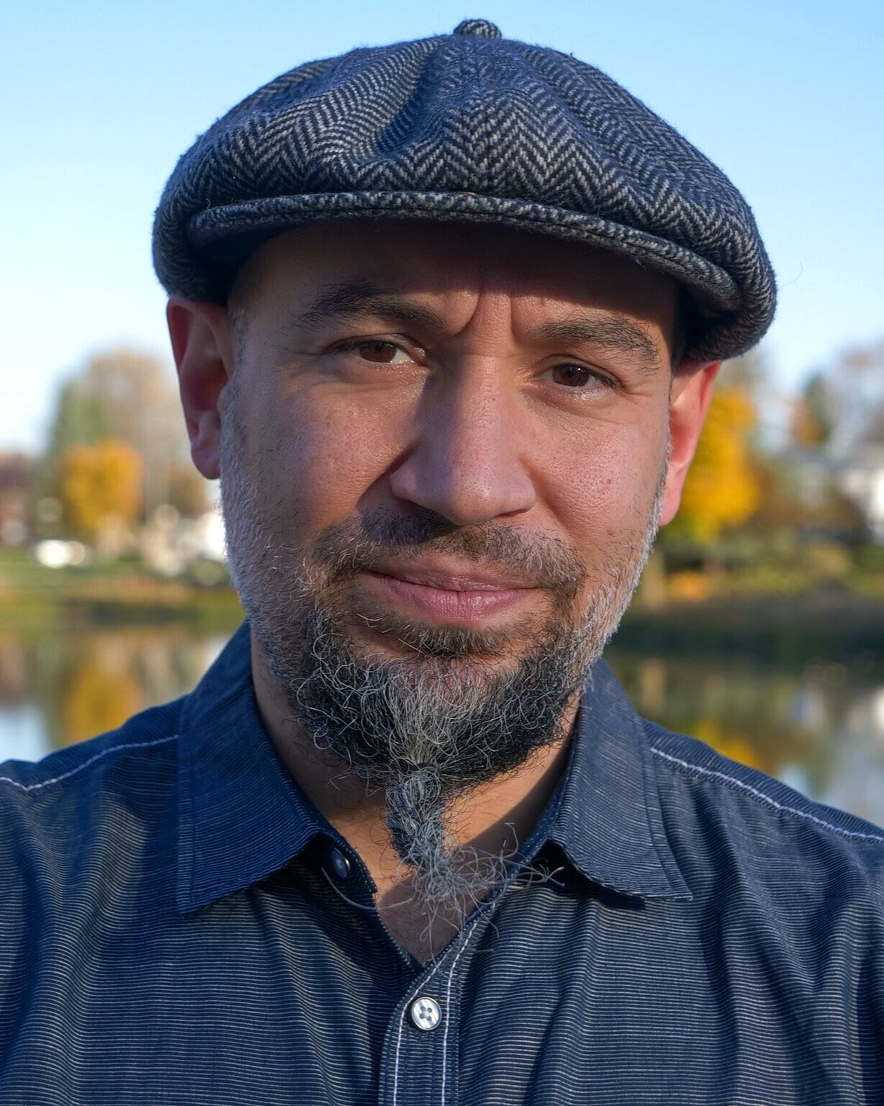
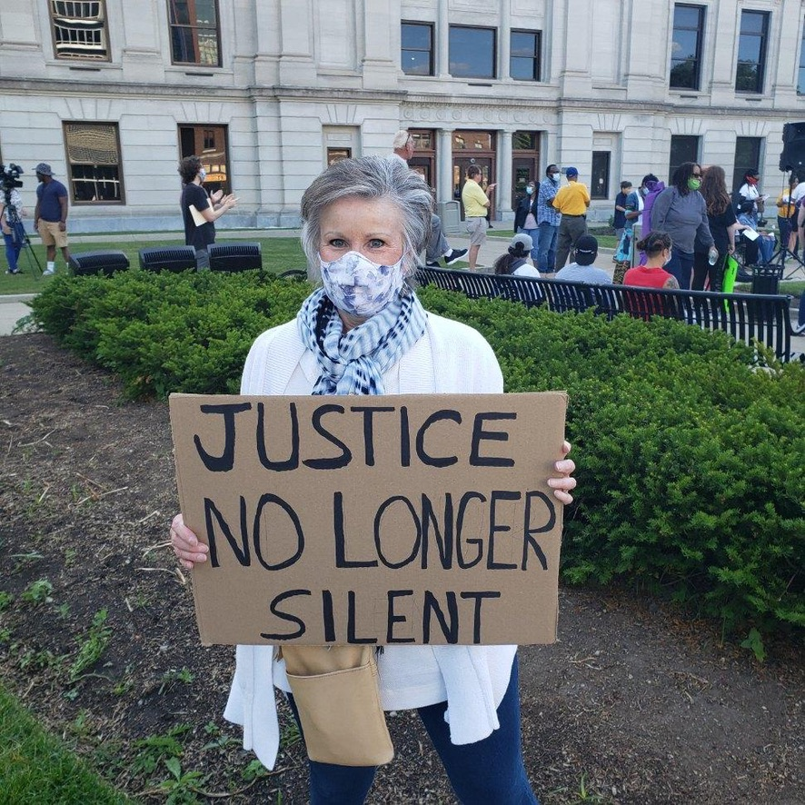
Two murders launched Fort Wayne’s
Peacemaker Movement
2016 2020
One personal. One national.
Give Peace
a Chance…
How I Did

Slide 3
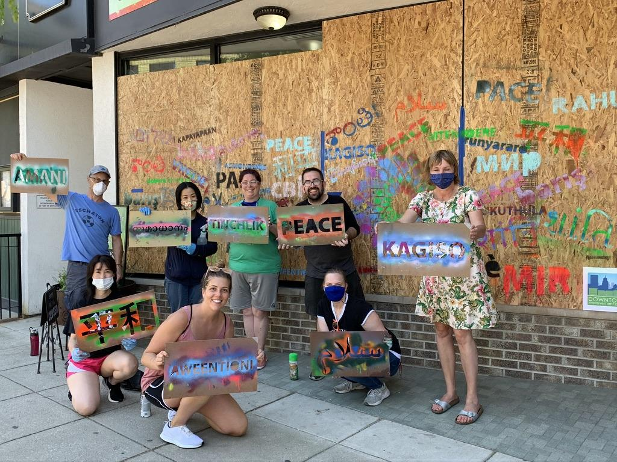
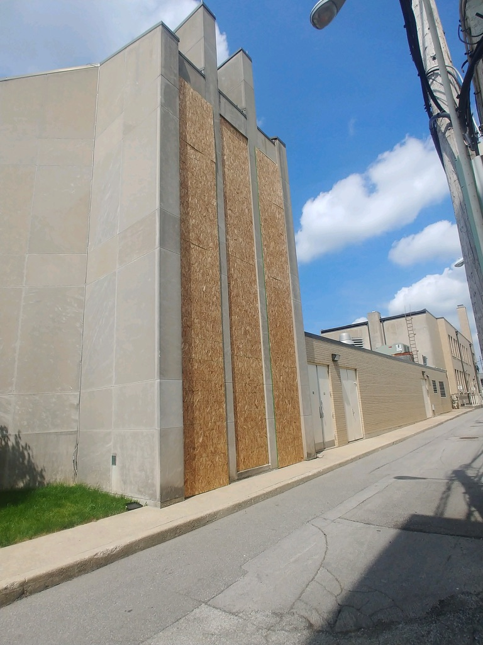
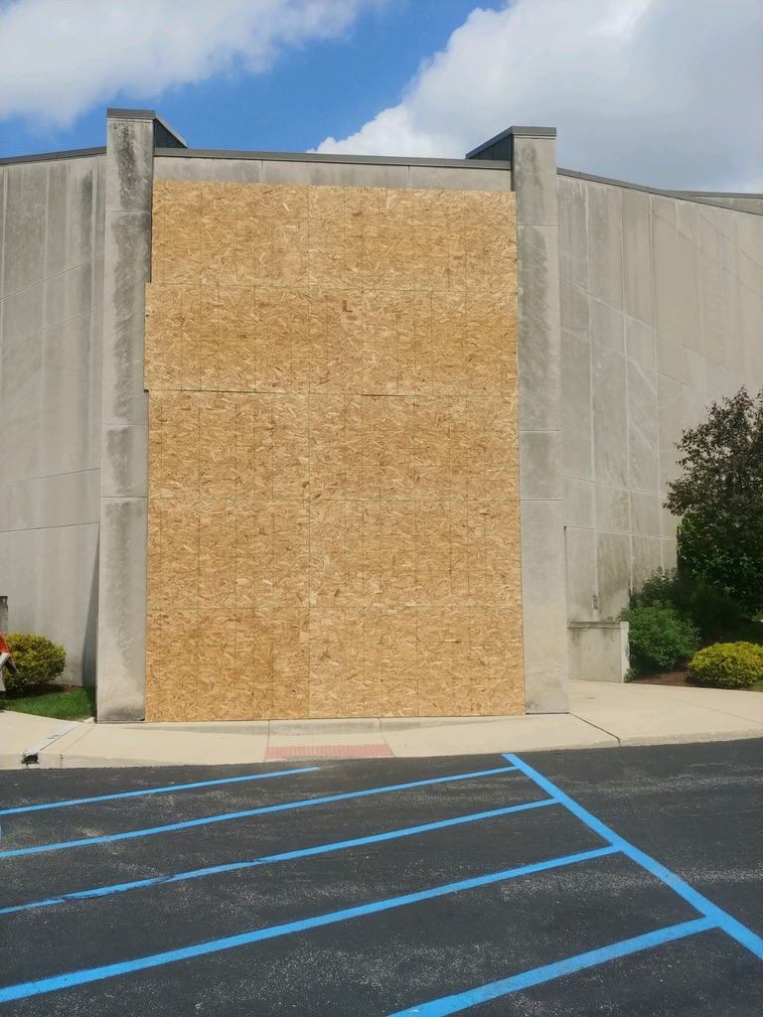
Fair trade store windows with international words of peace.
Give Peace
a Chance…
How I Did
Stained glass windows of First Wayne Street UMC boarded up.

Slide 4
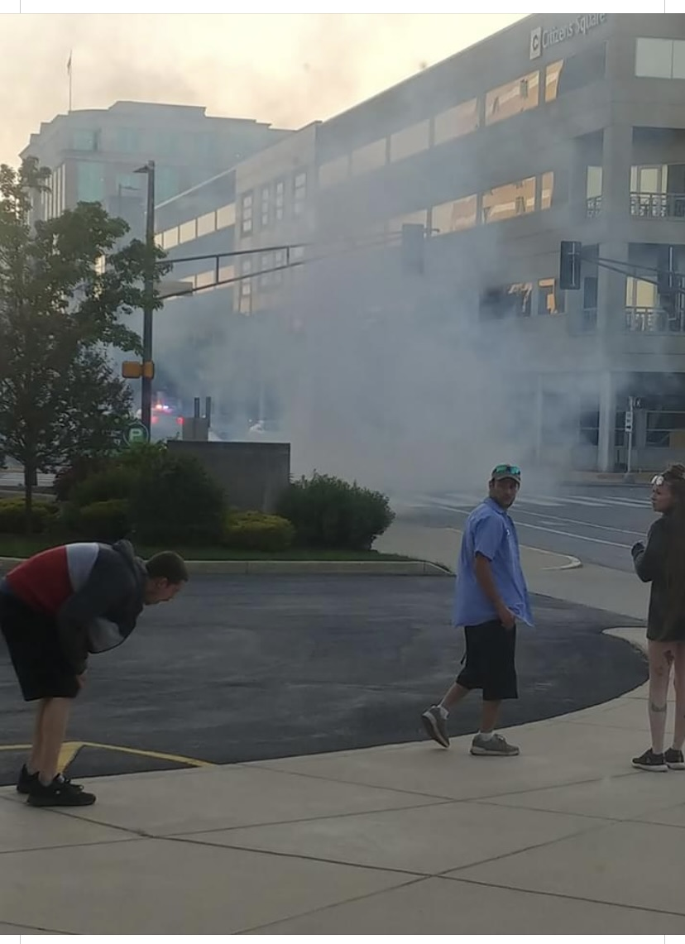
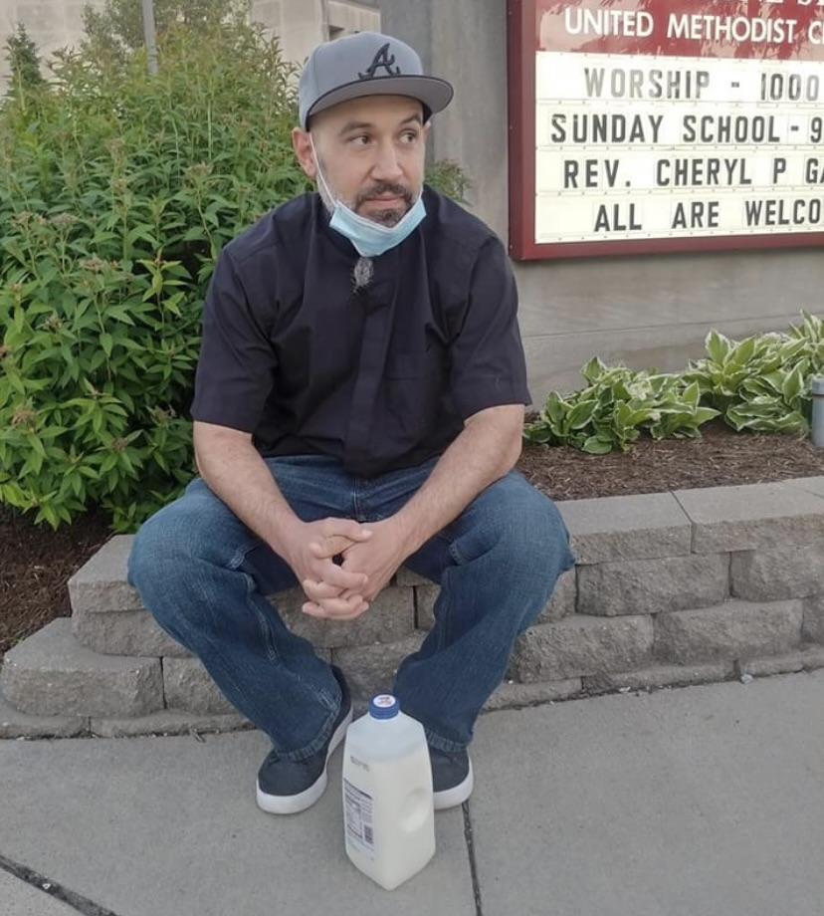
Give Peace
a Chance…
How I Did
Milk is antidote to tear gas.

Slide 5
Alive Community Outreach
Mission – create a community of nonviolence through relationships and education.
Programs based on 6 Principles of Kingian Nonviolence.
Institutionalize nonviolence through Peacemaker Academy.
Give Peace
a Chance…
How I Did

Slide 6
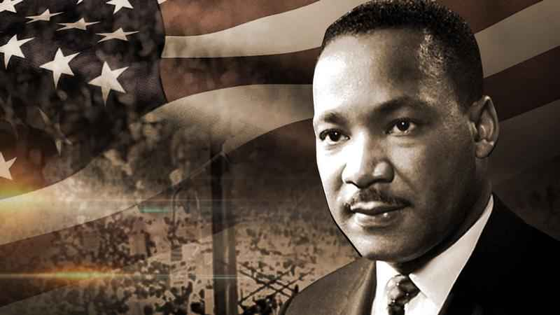
P
Principles of Nonviolence
Nonviolence is a way of life for courageous people.
The Beloved Community is the framework for the future.
Attack forces of evil not persons who are doing the evil.
Accept suffering without retaliation for the sake of the cause to achieve a goal.
Avoid internal violence of the spirit as well as external physical violence.
The universe is on the side of Justice.
Give Peace
a Chance…
How I Did

Slide 7
P
Impact of Peacemaking in School
Decrease in tardiness… …………….89%
Decrease in cutting class……………25%
Decrease in guns…………………….100%
Decrease in fights…………………….31%
Decrease in disruptive behavior…….19%
Decrease in average number of F’s per student…31%
Give Peace
a Chance…
How I Did

Slide 8
Rotary International Roles Promoting Peace
Practitioners – working to create optimal conditions for peaceful societies.
Educators – training 1,700 Peace Fellows worldwide.
Mediators – negotiating humanitarian ceasefires to serve communities.
Advocates – creating communities and convening groups that are connected, inclusive and resilient.
Give Peace
a Chance…
How I Did

Slide 9
How to Begin Peacemaking
Create a Peace Committee in your club.
Educate yourself about violence in your community.
Connect with organizations addressing violence/nonviolence.
Develop a strategic plan or outline goals and objectives.
Invite speakers, start a book club, watch a documentary, establish a beloved community.
Apply to be a Rotary Action Group for Peace.
Give Peace
a Chance…
How I Did

Slide 10
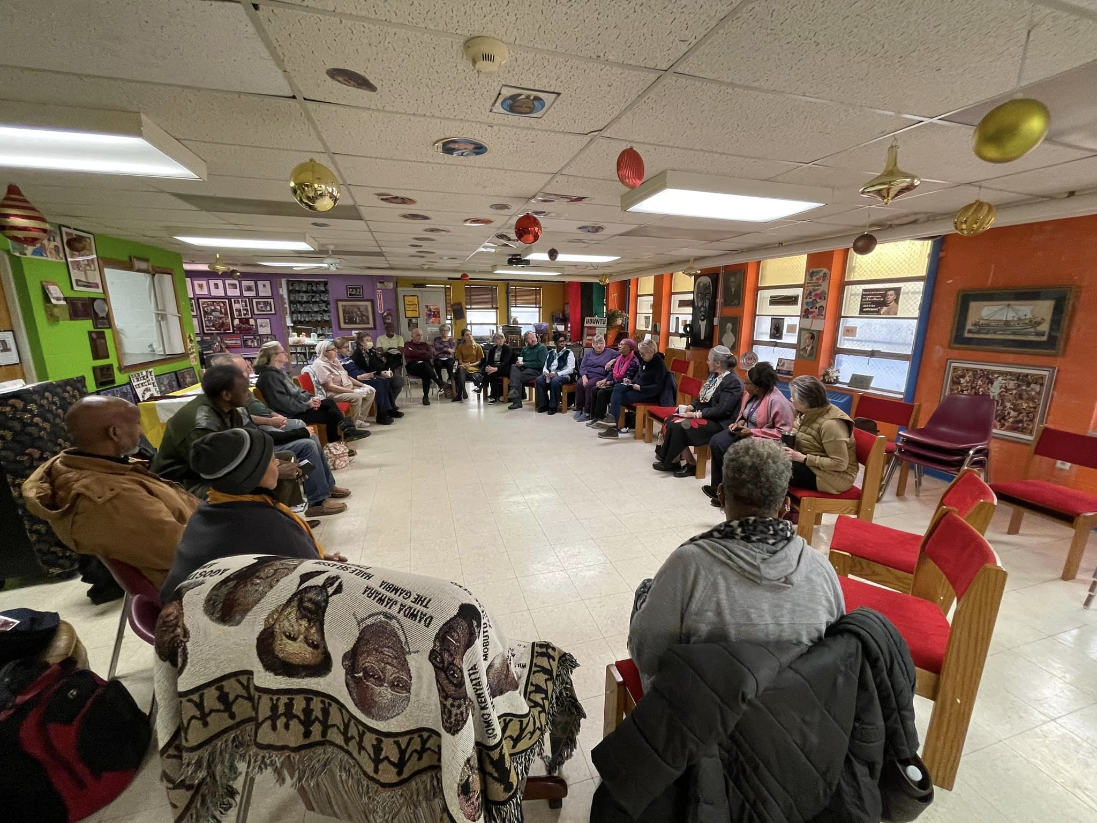
Peace Grannies and Grampies…
30-40 strong with diverse backgrounds/ethnicities.
Developed our version of
Beloved Community with a bi-weekly book/discussion.
Give Peace
a Chance…
How I Did

Slide 11
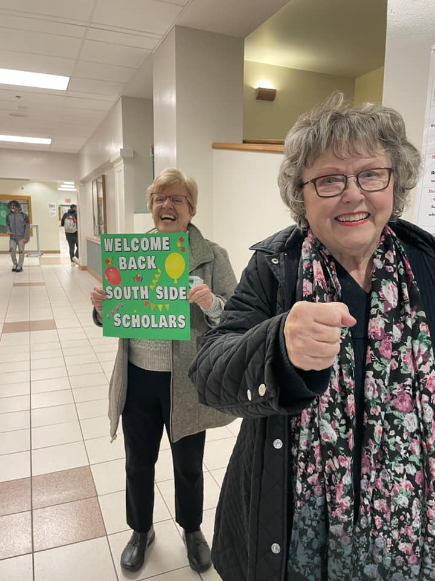
Peace Grannies and Grampies…
Participate in Peacemaker Academy activities and events.
Enthusiastically welcomed by schools because we are neutral…not selling or asking for anything.
Give Peace
a Chance…
How I Did

Slide 13
How will you give Peace a chance?
Give Peace a Chance…
How I Did

