Slide 1
Notes:
We are at a defining moment in Rotary’s history. We’re implementing the Rotary International Action Plan, a strategic road map that will help us better connect with each other, grow as an organization, and more effectively share our stories of how we are making a difference in communities.

Slide 2
Together, we see a world where people unite and take action to create lasting change — across the globe, in our communities,
and in ourselves.
Notes:
Rotary International Vision Statement – Have Lawrence read it

Slide 3
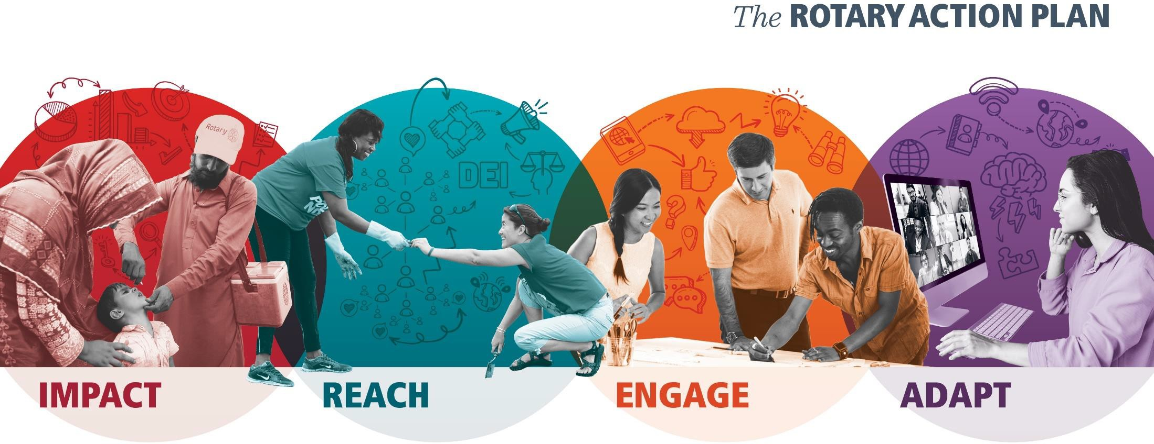
Notes:
These are the 4 Priorities of the Action Plan:
Impact: We want to put our resources behind programs that will have the greatest impact and that align with our areas of focus.
Reach: We’re committed to exemplifying and embracing diversity, equity, and inclusion (DEI) in everything we do.
Engage: We’re tearing down the walls between “us” and “them” and focusing on participants.
Adapt: We’re streamlining operations so we can be more agile and responsive.

Slide 4
INCREASE OUR IMPACT
Notes:
Sam – On behalf of the Zones 30 & 31 Foundation Teams, welcome to the ABC’s of The Rotary Foundation. I am Sam Adams, your Zone 30 RRFC. Joining us tonight are my counterpart, Pamela Stewart, your Zone 31 RRFC, Zone 30 EPNC Jerome Bannister, Zone 31 EPNC Mike Groom, Zone 30 EMGA Robert Huffman, Zone 31 EMGA Ted Huffhines, and our team members, Debbie Alexander-Davis, Deb Cheney, Jane Roush, M.J. Shackleford, Larry Titus, Suzanne Ellerbrock, Paul Reinert, Lance Singleton, Jennifer Van Houtte, and Bill Walker.

Slide 5
"Hope lies in dreams, in imagination, and in the courage of those who dare to make dreams into reality."
Notes:
We all have a reason why we do what we do, a passion, a dream ….

Slide 6
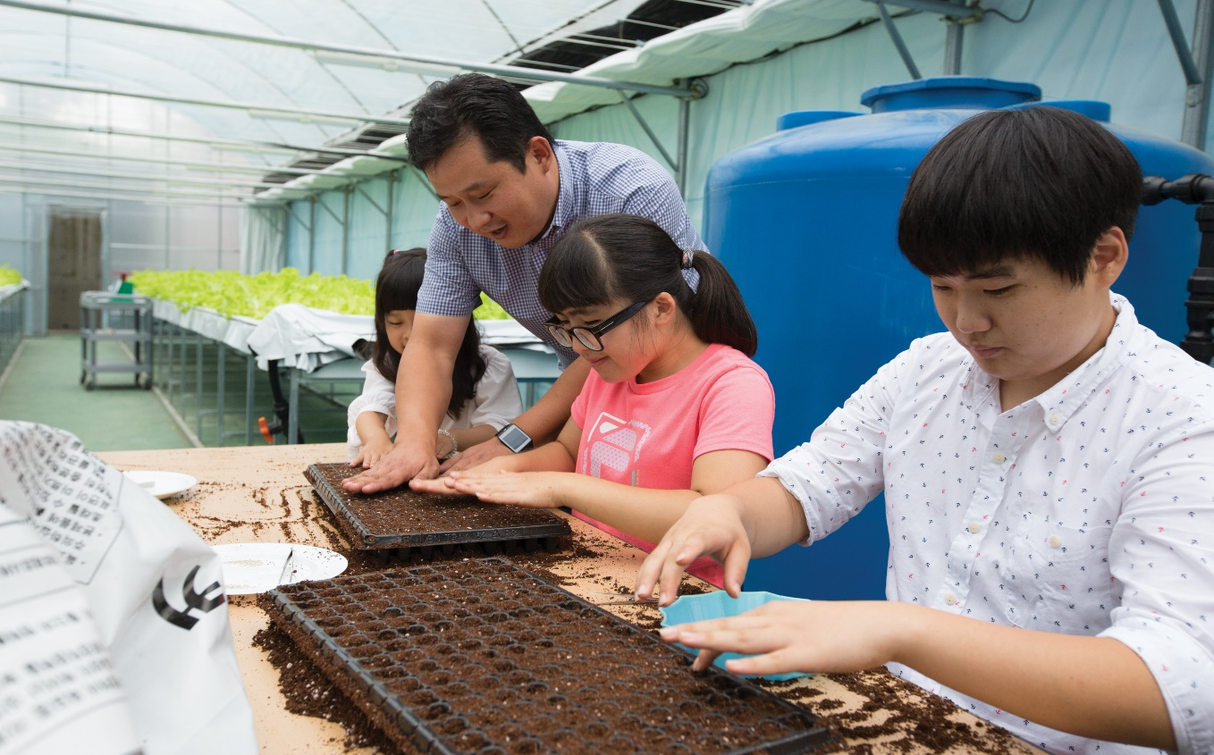
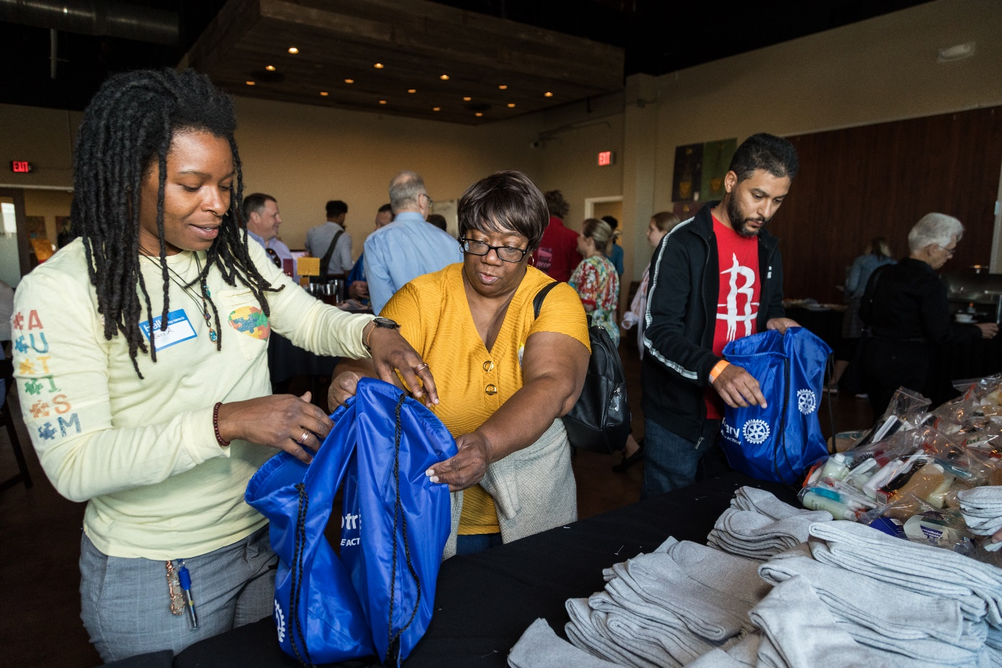
Notes:
Maybe its training students with intellectual disabilities, autism and emotional disabilities to plant seeds; maybe its providing food and sanitary items to those in need; maybe its…..

Slide 7
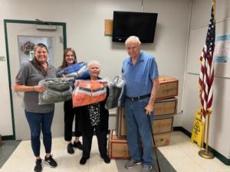
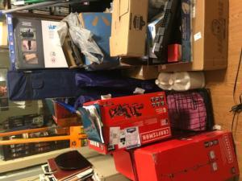
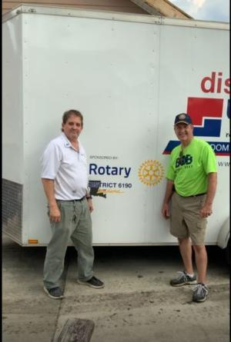
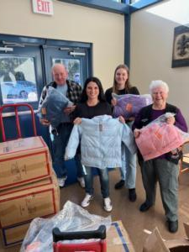
Notes:
For some the why is about making sure that students will be able to stay warm in the winter
For others the why is about serving victims of natural disasters.

Slide 8
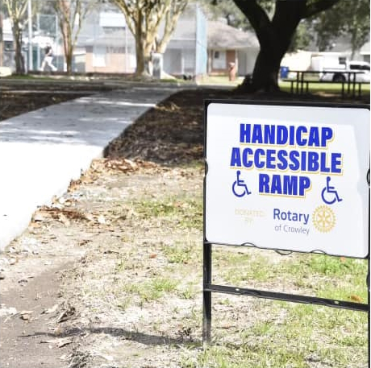
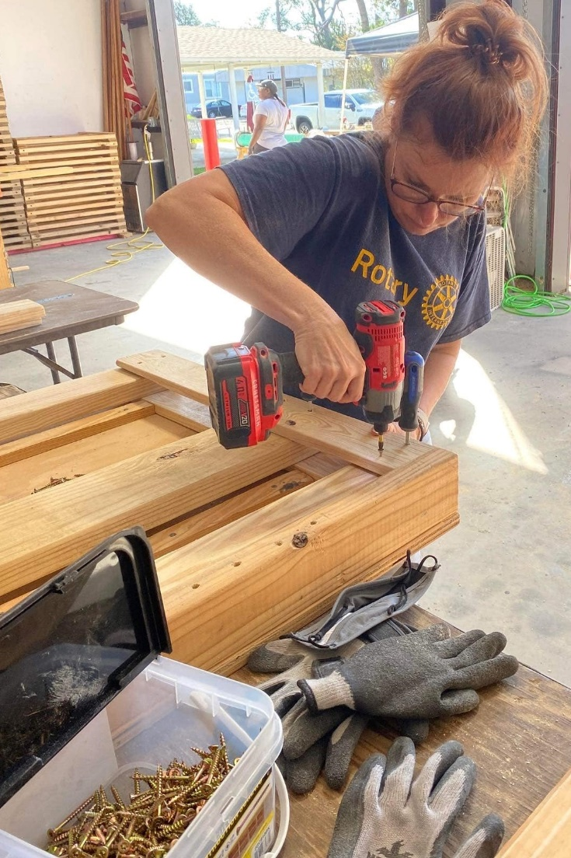
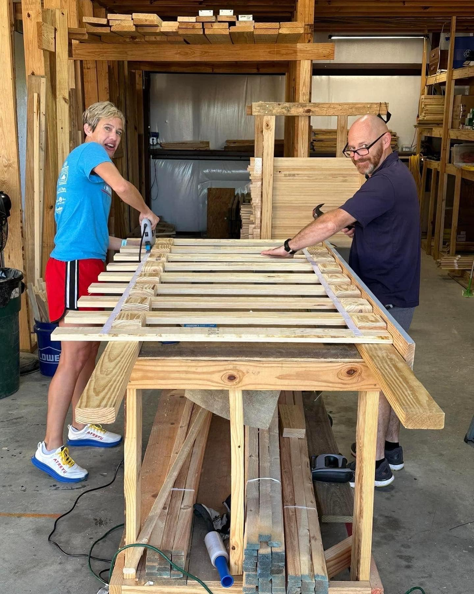
Notes:
As Rotarians, we may seek to provide handicapped accessibility to parks or to construct beds for At-Risk Children

Slide 9
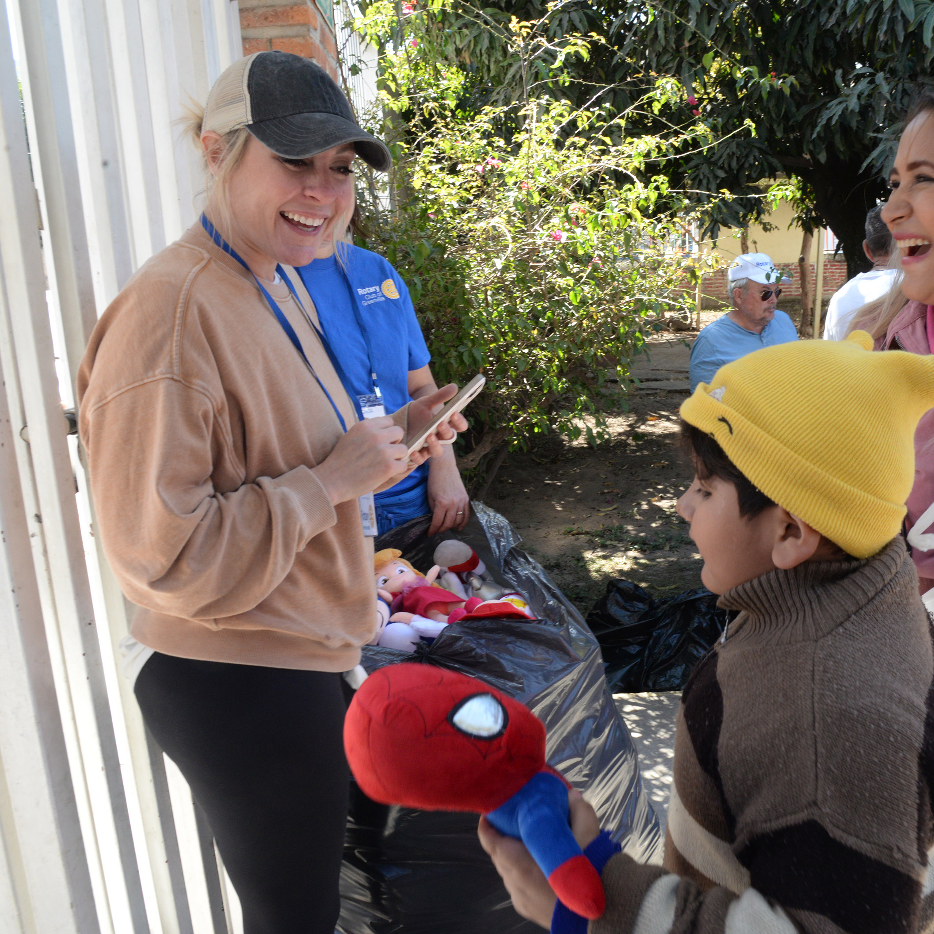
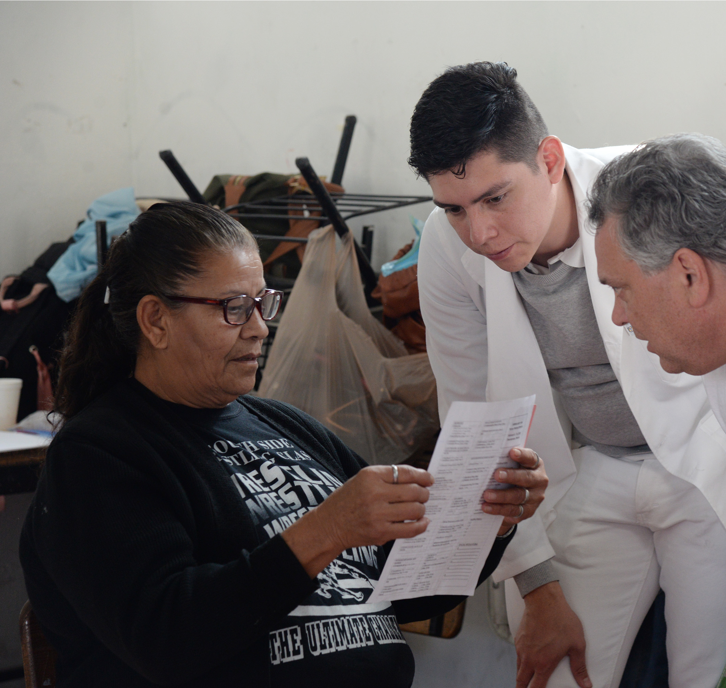
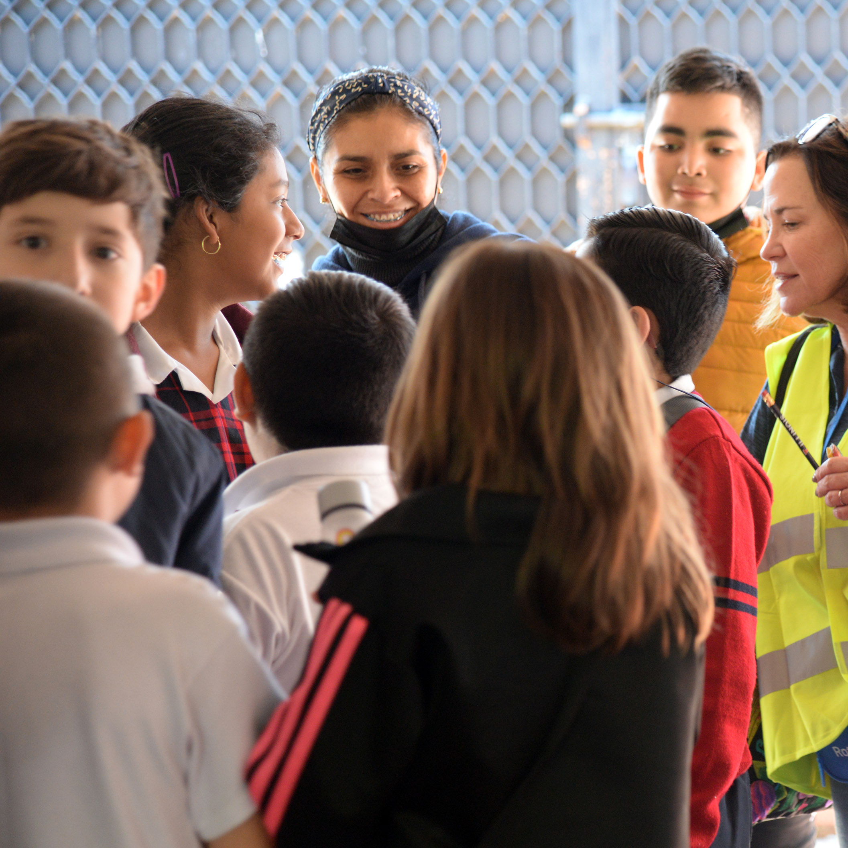
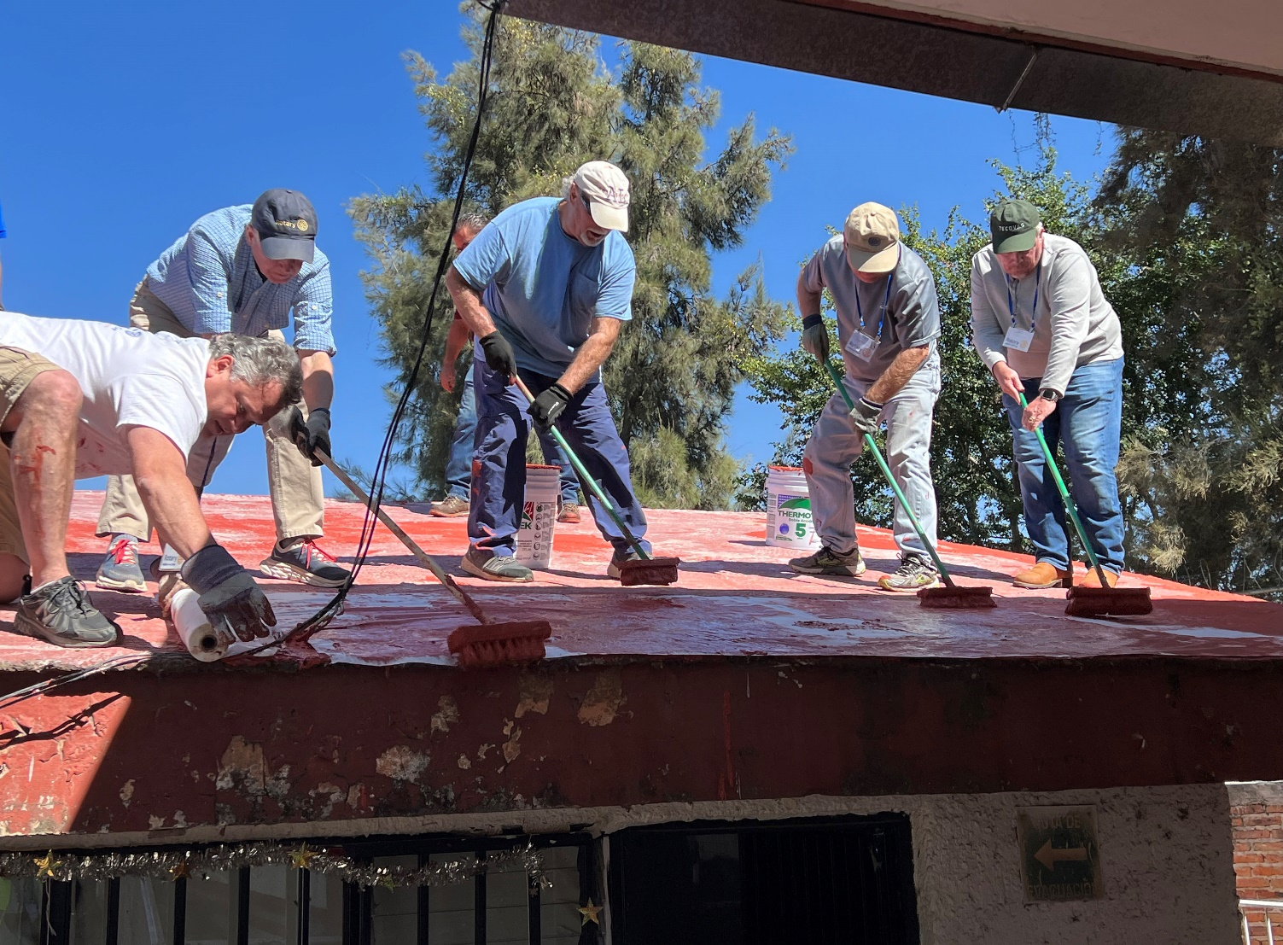
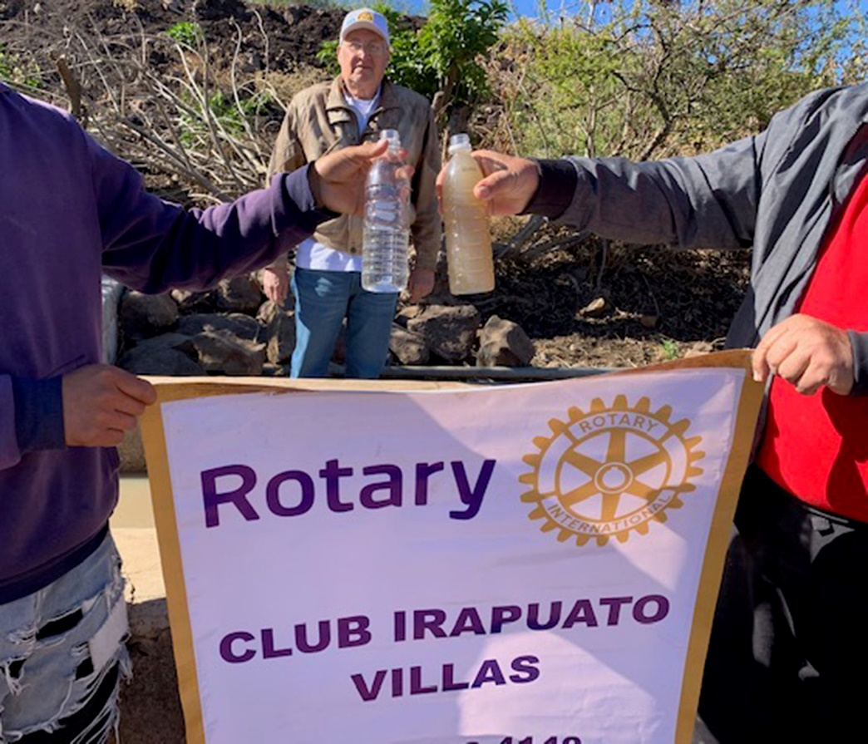
Notes:
Or to serve internationally like the
2023 Rotary Service Trip to Guadalajara, Mexico. Team members installed a waterproof membrane and roof coating at a rural elementary school, provided clean water to locals in a remote village, provided eye exams and glasses, handed out pencils, colors and coloring books, and stuffed toys to students.

Slide 10
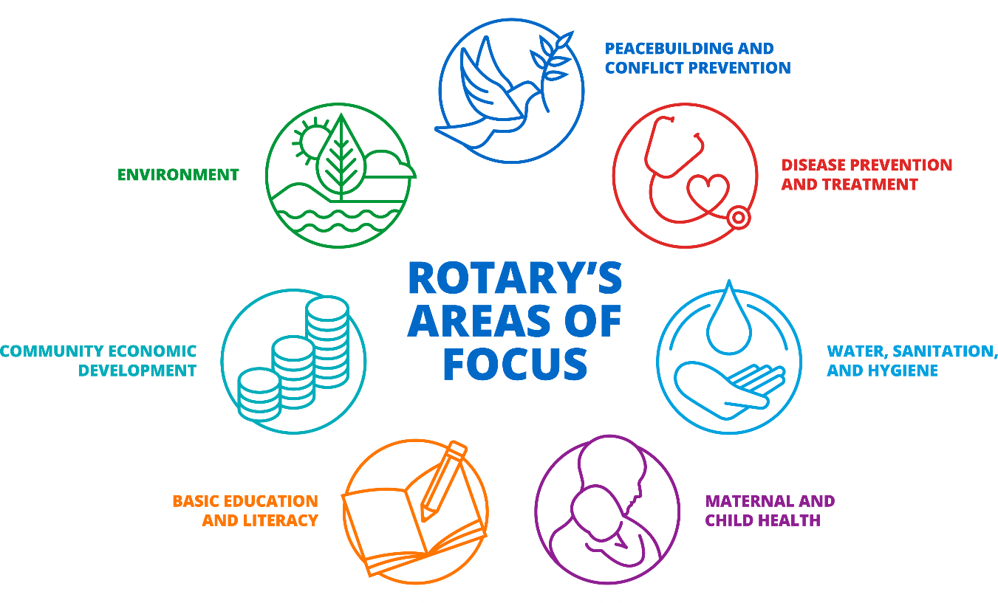
Seven Areas of Focus
Notes:
Mike: Remember we now have 7 areas of focus, as we added the Environment.

Slide 11
What is your passion?
Notes:
Take 5 minutes to share with your neighbor/pair and share/small group – what is your passion? What is your dream project?
How does encouraging donations to our Foundation help us increase our impact?
What messages inspire Rotarians and friends of Rotary to give?

Slide 12
Fundraising and the Rotary Foundation
The Rotary Foundation helps Rotary members to advance world understanding, goodwill, and peace by improving health, providing quality education, improving the environment, and alleviating poverty.
To support this mission, the Foundation has several grant programs, including District and Global Grants.
These programs are only possible thanks to the generosity of hundreds of thousands of donors from around the world.
Where does the money go? → Grant programs
Notes:
TRF invests its money in Grant programs to help Rotarians do good in the world.

Slide 13
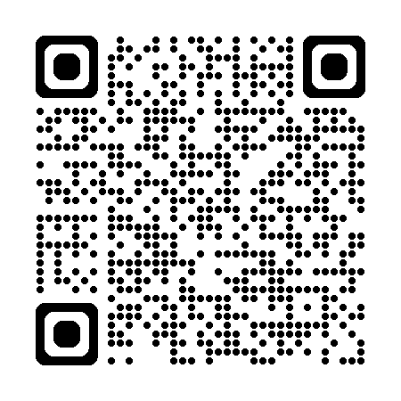
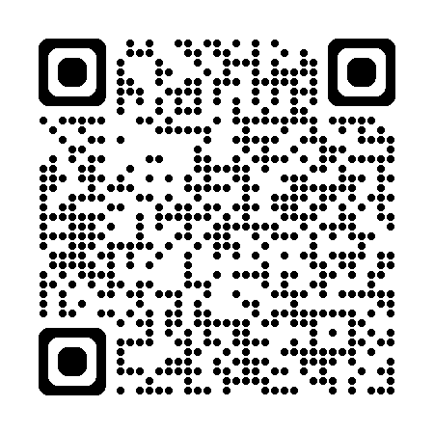
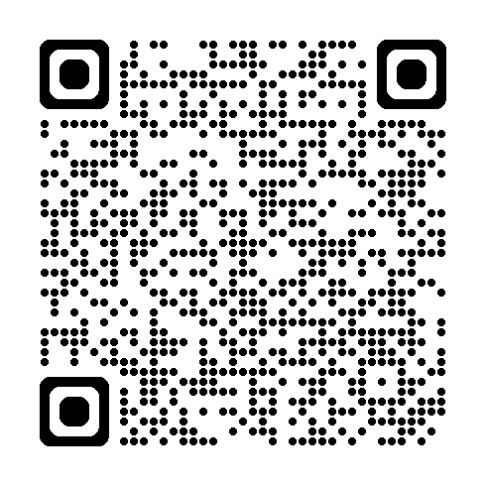
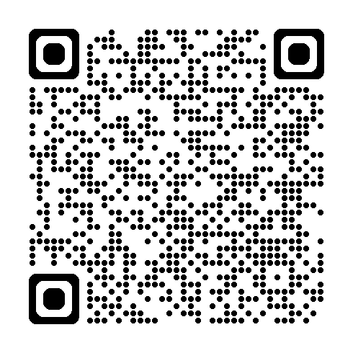
subhead
GRANT TYPES
GLOBAL GRANTS
DISTRICT GRANTS
Support large international activities with sustainable, measurable outcomes in Rotary’s areas of focus
Fund small-scale, short-term activities that address needs in a local community or communities abroad
PROGRAMS OF SCALE GRANTS
DISASTER RESPONSE GRANTS
Benefit a large number of people or a broad geographical area and are awarded to one program per year
Support relief and recovery efforts in areas that have been affected by disaster
Notes:
TRF is helping to expand our reach through more grant options, now 4 instead of 2.
The Rotary Foundation offers grants to support humanitarian projects, scholarships, and training, which involve Rotary members around the world. These grants may start small and grow as they become scalable. Think about your dream project and which type grant might help to make it a reality or grow it beyond your initial dream. [ give time….] [provide links for global grant application/reports/Rotary Showcase]

Slide 14
2022-23 GRANT STATISTICS
District grants
473 grants
$26 million
Global grants
1,092 grants
$55 million
Disaster response grants
324 grants
$15 million
Program of Scale grant
1 grant
$2 million
Notes:
PAS- In addition to the $2M Program of Scale grant, in 2022-23 our donations funded 473 district grants, 1,092 global grants, and 324 disaster response grants, and 1 Program of Scale Grant.

Slide 15
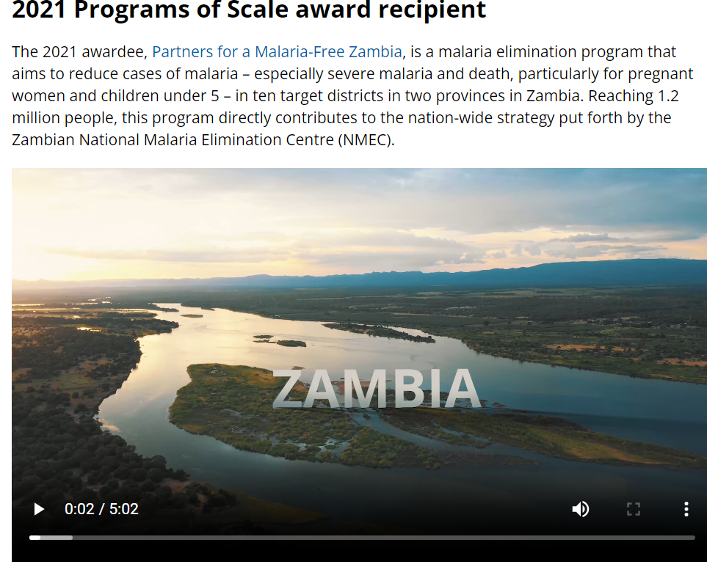
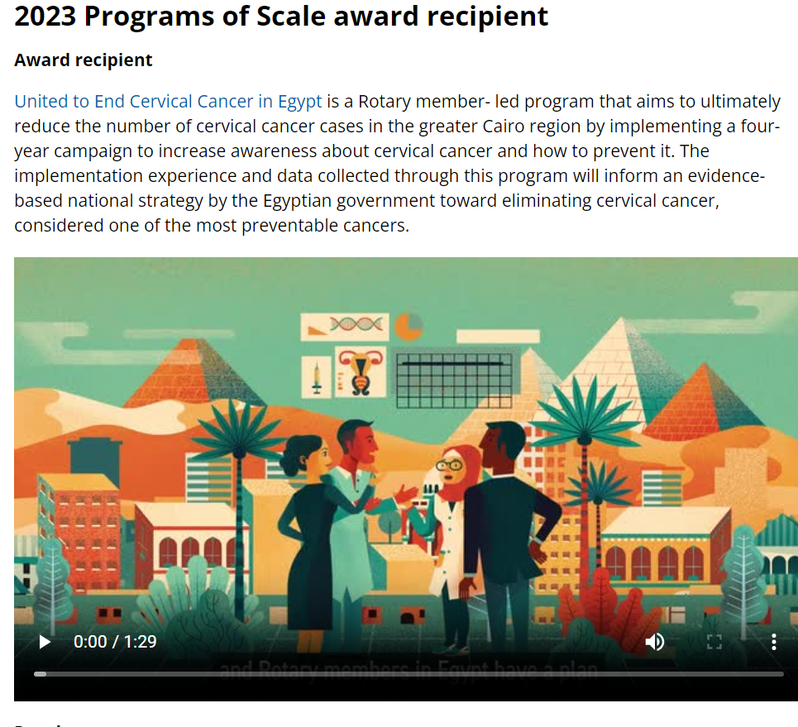
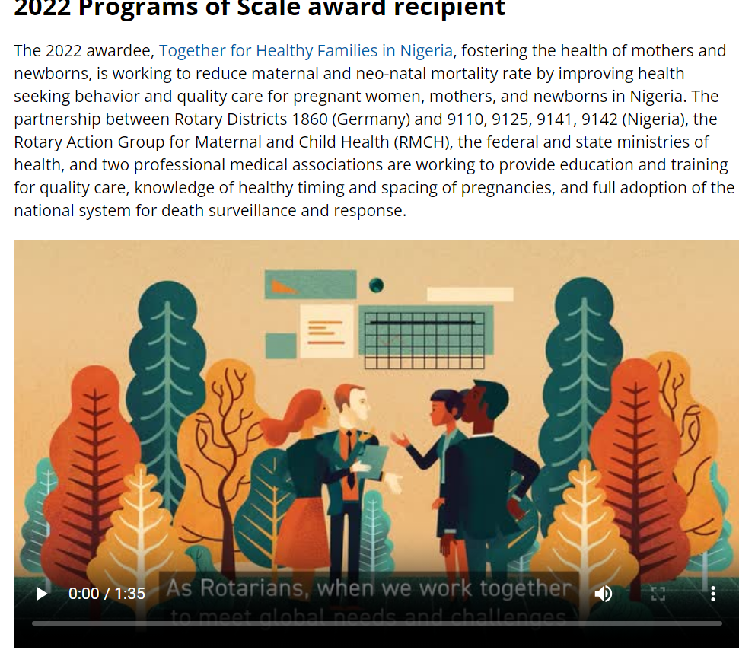
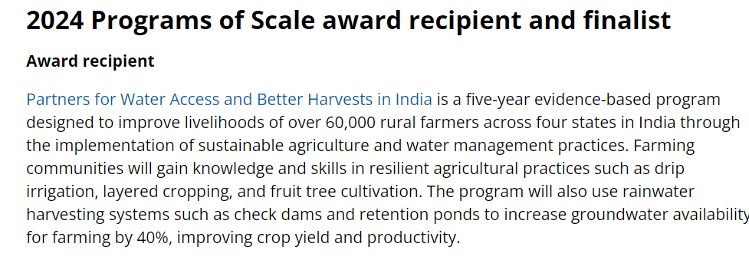
subhead
Notes:
We have awarded our 4th Programs of Scale grant. We began in 2021 with this $2M competitive grant based on a successful, long-term, scaleable project, Partners for a Malaria-Free Zambia reaching 1.2 million people. In 2022, we supported Together for Healthy Families in Nigeria, a project that districts in our Zones 30 & 31 have supported in the past. In 2023, we supported United to End Cervical Cancer in Egypt, and for 2024, this grant has been awarded to Partners for Water Access and Better Harvests in India reach will improve the livelihoods of over 60,000 rural farmers across 4 states in India.
2024 Programs of Scale award recipient and finalist
Award recipient
Partners for Water Access and Better Harvests in India is a five-year evidence-based program designed to improve livelihoods of over 60,000 rural farmers across four states in India through the implementation of sustainable agriculture and water management practices. Farming communities will gain knowledge and skills in resilient agricultural practices such as drip irrigation, layered cropping, and fruit tree cultivation. The program will also use rainwater harvesting systems such as check dams and retention ponds to increase groundwater availability for farming by 40%, improving crop yield and productivity.
2023 Programs of Scale award recipient
Award recipient
United to End Cervical Cancer in Egypt is a Rotary member- led program that aims to ultimately reduce the number of cervical cancer cases in the greater Cairo region by implementing a four-year campaign to increase awareness about cervical cancer and how to prevent it. The implementation experience and data collected through this program will inform an evidence-based national strategy by the Egyptian government toward eliminating cervical cancer, considered one of the most preventable cancers.
2022 Programs of Scale award recipient
The 2022 awardee, Together for Healthy Families in Nigeria, fostering the health of mothers and newborns, is working to reduce maternal and neo-natal mortality rate by improving health seeking behavior and quality care for pregnant women, mothers, and newborns in Nigeria. The partnership between Rotary Districts 1860 (Germany) and 9110, 9125, 9141, 9142 (Nigeria), the Rotary Action Group for Maternal and Child Health (RMCH), the federal and state ministries of health, and two professional medical associations are working to provide education and training for quality care, knowledge of healthy timing and spacing of pregnancies, and full adoption of the national system for death surveillance and response.
2021 Programs of Scale award recipient
The 2021 awardee, Partners for a Malaria-Free Zambia, is a malaria elimination program that aims to reduce cases of malaria – especially severe malaria and death, particularly for pregnant women and children under 5 – in ten target districts in two provinces in Zambia. Reaching 1.2 million people, this program directly contributes to the nation-wide strategy put forth by the Zambian National Malaria Elimination Centre (NMEC).

Slide 16
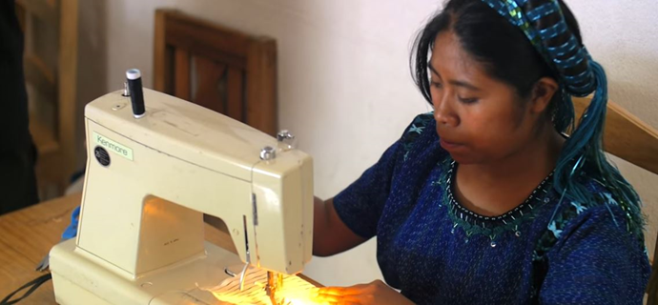
South Africa Rotary Trade School
District 6540 sponsored Global Grant:
Empowering women by teaching them how to sew and the business skills on how to sell their goods to be self-sustaining

Slide 17
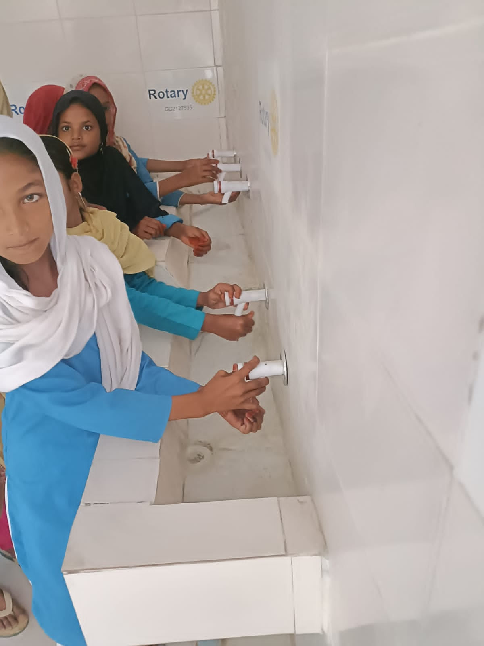
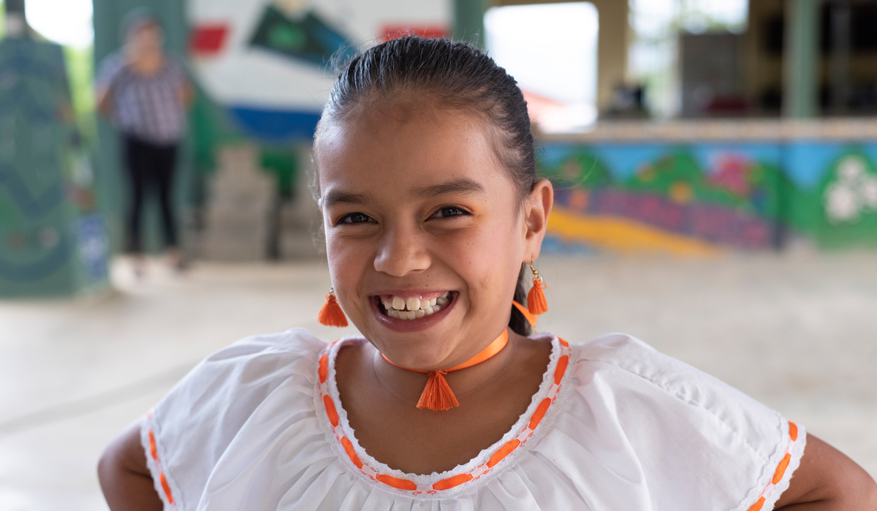
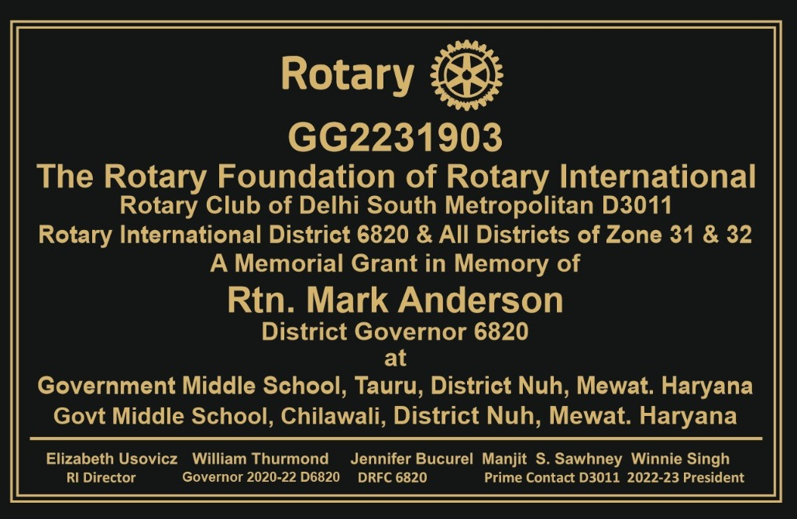
Notes:
…. Maybe its empowering girls through education or providing them sanitation & hygiene resources to stay in school.

Slide 18
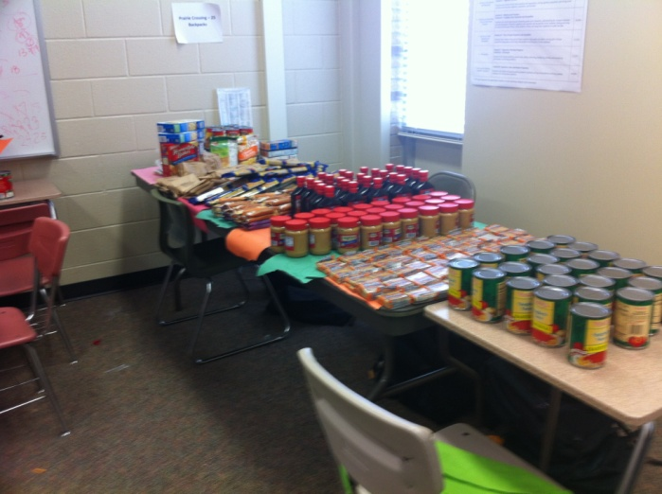
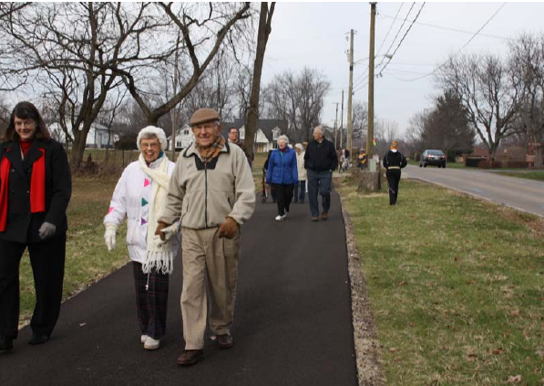
Parks
Playground Equipment
Carport Shelter for a Food Bank
Backpacks Stuffed with School Supplies
Backpacks Stuffed with Food
Chromebooks for Schools in Honduras
Smoke and CO Detectors
Bike Repair Stations on Bike Paths
Mobility Carts for Polio Survivors
Butterfly Pollinator Gardens
Little Libraries
Dignity Packs for Women Rescued from Trafficking
District Grant Projects 23-24 totaled $79,169 for Community Projects:
District 6690
Global and Local Grants

Slide 19
Fundraising and the Rotary Foundation
The Rotary Foundation helps Rotary members to advance world understanding, goodwill, and peace by improving health, providing quality education, improving the environment, and alleviating poverty.
To support this mission, the Foundation has several grant programs, including District and Global Grants.
Where does the money go? → Grant programs
Where does the money come from? → These programs are only possible thanks to the generosity of hundreds of thousands of donors from around the world.
Notes:
One major input could be provided through TRF. TRF invests its money in Grant programs to help Rotarians do good in the world. These programs require funding, and where does the funding come from? It comes from fundraising.

Slide 20
52%
Amount of total giving from gifts of US$1,000 or less to The Rotary Foundation
Notes:
​
Let’s talk about who Rotary’s donors are and address a common misconception when people think about charitable giving. ​
​ It fair to say that many people think incorrectly that only the world’s wealthiest people are driving important philanthropic and charitable organizations. ​
​ We think, unless we give very large amounts, like some wealthy donors do, our gifts don’t make as much of an impact. ​
​
Raise your hand – have you ever felt that way? (PAUSE)​
​
What’s great about The Rotary Foundation, is our donors at all levels are driving our impact. ​
​
As you can see by the statistic on the screen, last year, gifts to The Rotary Foundation of less than US$1,000 accounted for 52% of the Foundation giving – that was US$112 Million! More than half of all giving was gifts of less than $1,000. When many join together they can make a true difference!​
​
Many of you know someone in your club or district who have given up to US$1,000. Perhaps you've been a generous donor at this level. If so, you're in very good company and are helping to drive the vital work being accomplished by The Rotary Foundation every single day. Thank you!​
​
So if you or someone you know are looking for a way to make an incredible impact no matter how much you are able to give, you can partner with fellow Rotarians in supporting The Rotary Foundation to make a brighter future for all. ​
​

Slide 21
Fundraising and the Rotary Foundation
Fundraising
Grant Programs
Notes:
Here’s another way to look a this.
This may all seem logical, but it is important to understand that for the working of the Rotary Foundation, our fundraising efforts are as important as our grant programs, because our grants programs are not possible without fundraising. One cannot exist without the other. They go hand in hand. As with every charity, money needs to come in before it can go out. This must be understood at all levels of the organization.

Slide 22
We’ve earned 15 consecutive four-star ratings from Charity Navigator
Outstanding performance
We’re an organization you can support with confidence.
The Rotary Foundation continues to far exceed the standards set by independent charity-rating services like Charity Navigator.
Notes:
Our Foundation is carefully overseen by your fellow Rotary Members, the Trustees of The Rotary Foundation. They ensure that your donations are invested well and spent wisely so they’ll do good in the world.
Our members’ generosity and Rotary’s work haven’t gone unrecognized. For the 15th consecutive year, The Rotary Foundation has received the highest rating — four stars — from Charity Navigator, an independent evaluator of charities in the U.S., for demonstrating strong financial health and commitment to accountability and transparency.
The rating reflects Charity Navigator's assessment of how the Foundation uses donations, sustains its programs and services, and practices good governance and openness.
In recognition of its efficiency, transparency, good governance and impact, Charity Navigator, the largest independent evaluator of US based charities, awarded TRF another 4-star rating this year. A 4-star rating is best rating a charity can receive.
This is the 15th consecutive year TRF has received this designation, placing it among the top 1% of charities evaluated by Charity Navigator. This designation sets our Foundation apart from its peers – demonstrating to our members and the public its trustworthiness.

Slide 23
The Rotary Foundation
Ways to give
Disaster Response Fund
Directed Gifts
Annual Fund
PolioPlus
Endowment
Fund
The Rotary Foundation
Notes:
To summarize, donors can support the four funds of TRF. [provide link/access to Ways to Give Handout; Rotary Direct; PHS; PolioPlus Society]
The Endowment Fund offers a lot of options both for outright gifts and for bequests.
Optional question for the group: Which of these funds do you find most attractive and why?
Mark’s Magical Markers:
Lead by example.
Making a contribution to the Annual Fund
no later than 31 August 2024.
Making a contribution to the Endowment Fund
no later than 31 December 2024.
Increase by 10% the number of donors in your District enrolled in Rotary Direct.
Establish or continue a district PolioPlus Society with at least 50 members by the end of 2024-25.
Increase the number of Paul Harris Society members in your district by at least 10 and increase the rate of fulfillment.
Select a team to coordinate a legacy event in your District.

Slide 24
Au
Annual Fund- Share
District Members make contributions
Contributions are invested over 3 years
Contributions are divided into …
47.5% District Designated Fund
Use up to half for a district grant
Donate to PolioPlus, Rotary Peace Centers, and more
47.5% World Fund
Supports grants and programs available to all districts
Fund global grants and receive World Fund match
5% expenses
Notes:
Lance: When you give money to The Rotary Foundation Annual Fund, SHARE program, in 3 years 47.5% of this comes back to your district for grants. This is what we call District Designated Funds or DDF. Your district can allocate up to 50% of its DDF for district grants and the remaining 50% for global grants.
The 47.5% of our contributions goes to the World Fund which can be used to match your global grants, and 5% is used for operating expenses.

Slide 25
Individual recognition
Rotary Foundation Sustaining Member - When you give $100 or more per year to the Annual Fund.
Benefactor - When you include the Endowment Fund as a beneficiary of $1,000 or more in your estate plans or when you donate $1,000 or more to the fund outright.
Paul Harris Fellow - When you give $1,000 or more to the Annual Fund, PolioPlus, or an approved Foundation grant. To recognize someone else as a Paul Harris Fellow, you can give that amount in their name.
Multiple Paul Harris Fellow - When you give additional gifts of $1,000 or more to the Annual Fund, PolioPlus, or an approved Foundation grant.
Paul Harris Society member - When you elect to contribute $1,000 or more annually to the Annual Fund, PolioPlus, or an approved Foundation grant.
Notes:
Ted:
There are many opportunities for individual recognition such as a Rotary Foundation Sustaining Member, Benefactor, Paul Harris Fellow, and Paul Harris Society Member. [Let’s take a minute or two for you to enter your name in the chat if you have one or more of these recognitions.]
- [briefly skim over the below]
Naming opportunities
Special opportunities are available to create an endowment or make a directed gift in your name or the name of a loved one. Endowed gifts are invested in perpetuity, with part of their earnings spent on a designated program. Directed gifts are spent in their entirety, usually in the following Rotary year.
Endowed global grant fund
$500,000 or more: You can specify up to three of the following: the district sponsor, the area of focus, the general geographic region of the project, or the type of grant activity, such as a project or scholarship.
$250,000 or more: You may choose up to two of the options listed above
$150,000 or more: You may choose one grant activity type, such as a humanitarian project, scholarship, or vocational training team.
Named endowment
If you donate $25,000 or more, you can direct the money to one of the following:
Area of Focus: funds global grants in one area of focus
World Fund: funds global grants in all areas of focus
SHARE: supports the World Fund and provides district designated funds to your district
Rotary Peace Centers: supports Rotary’s partnership with leading universities around the world to train professionals in conflict resolution, peace studies, international relations, and related disciplines
Learn more
Directed gift global grants
$150,000: A one-time gift that provides funding for global grants in up to two areas of focus of your choice or to a special initiative of the Foundation, such as WASH in Schools
$30,000: A one-time gift that provides your district with funds for one or more global grants in an area of focus of your choice
$15,000: A one-time gift that provides funding for a global grant in an area of focus of your choice without specifying the district that will sponsor the grant
Rotary Peace Centers endowment opportunities
$1.5 million: Endows a Rotary Peace fellow every year
$1 million: Endows a Rotary Peace fellow every two years
$1 million: Endows a visiting lecturer every year
$750,000: Endows a Rotary Peace fellow every three years
$500,000: Endows a Rotary Peace fellow every four years
$250,000: Endows one Rotary Peace certificate fellow every year
$100,000: Endows an annual seminar at a Rotary Peace Center
$25,000 and up: Provides general support
Rotary Peace Centers directed gifts
$75,000: Provides funding for a Rotary Peace Fellow to complete a two-year master’s degree program
$75,000: Provides funding for up to 10 internships or research projects for peace fellows
$60,000: Provides funding for five fellows enrolled in the three-month professional development certificate program
$10,000: Provides general support
Rotary Peace Symposium directed gifts
$400,000-$500,000: Underwrites the cost of the Peace Symposium
$50,000-$100,000: Provides full funding for a donor-specified element of the peace symposium (speakers, Rotary Peace Fellow travel, etc.)
$10,000-$25,000: Provides funding for a hosted reception connected to the Peace Symposium
$10,000 and up: Provides general support for the Peace Symposium
Entrepreneurial named gift for peace
$75,000-$1 million: Funds new opportunities within Rotary’s peace programs for global grants and the Rotary Peace Centers, such as workshops and retreats, and other initiatives.

Slide 26
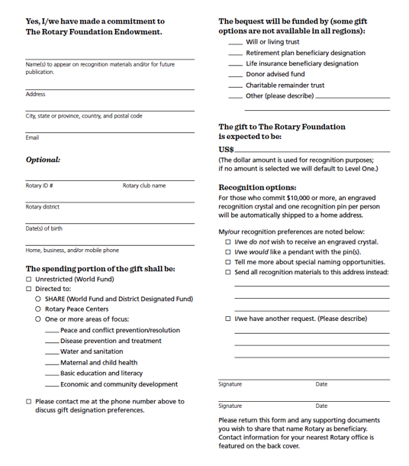
Cumulative gifts to date or legally binding agreement
Major
Donor
$10,000⁺
Arch Klumph
Society
$250,000⁺
Documented promise of a future gift
Bequest
Society
$10,000⁺
Legacy
Society
$1,000,000⁺
Notes:
Robert: You can receive special recognition for your legacy by notifying the Foundation of your commitment. You can do this by completing a Your Rotary Legacy notification form or submitting notification online at rotary.org/legacy.
When you make a promise of a future commitment to the Endowment or an outright gift of $1,000 to the Endowment, you will be recognized as a Benefactor. Starting this year, clubs that have 100% member support of the Endowment may be recognized as Rotary’s Promise Clubs.
As you can see on the slide, gifts made during your lifetime count toward Major Donor and Arch Klumph Society recognition.
Additionally, the Trustees are pleased to confer membership to the Bequest Society for anyone who tells The Rotary Foundation they have left a legacy of $10,000 or more. Members of this group of dedicated humanitarians receive special Foundation updates, invitations to events, and an exclusive pin or pendant. Rotarians who invest in the Foundation’s future retain their membership regardless of fluctuations in their financial portfolio or other assets.
We also have a special recognition for individuals and couples who substantiate a future gift to The Foundation of $1 million or more.

Slide 27
Notes:
Jerome/Mike: We are also expanding our reach through Polio Eradication, Rotary’s #1 humanitarian project.
Mike and Jerome – WHO WE ARE (as EPNCs)
Our role is to foster awareness of polio and advocate for its eradication, as well as to raise funds for our number one humanitarian project at the club and district levels. We help Rotary raise at least $50 million each year in contributions, District Designated Funds (DDF), and World Fund matches to achieve our annual End Polio Now: Countdown to History fundraising goal.
We understand and communicate:
Inclusion in Rotary’s Action Plan
The progress of the global polio eradication effort
PolioPlus fundraising goals and priorities
Opportunities to raise money for the PolioPlus Fund
We promote locally and regionally:
Continuous support for achieving a polio-free world
Use of Rotary Foundation giving tools
Increasing the number of clubs that support the PolioPlus program
Allocation of 20% or more of districts’ DDF to the PolioPlus Fund
We are resources for all of you to use in our efforts to eradicate polio.

Slide 29
– endowment fund
Ways to give
Gifts to this fund are invested forever, and the spendable earnings are used to support the program that donors have designated:
World Fund
SHARE
Peace Centers
Area of Focus
Gifts to the endowment can be made today, or in the future through a bequest.
Option to create a Named Endowed Fund
Notes:
Donors can also make major gifts to the Endowment Fund.
What’s different about the Endowment fund is that gifts to this fund are not spent, but are invested forever, and only the spendable earnings of these investments are used to support TRF grant programs. And what’s more is that donor can specify what they would like to support via the Endowment Fund. The options are:
World Fund (where the need is greatest)
SHARE (tied to a specific district)
The Rotary Peace Centers
One of the seven Areas of Focus of the Rotary Foundation. This support will go to Global Grants, which are always in an Area of Focus.
Gifts to the endowment can be made today, or in the future through a bequest.
And there is the option to create a Named Endowed Fund. This is one of the most attractive opportunities donors have within the menu of the giving options of the Rotary Foundation. It is a form of personalized philanthropy that allows donors to have a lasting impact and leave a personal Rotary legacy. Let’s look at this this in more detail.

Slide 30
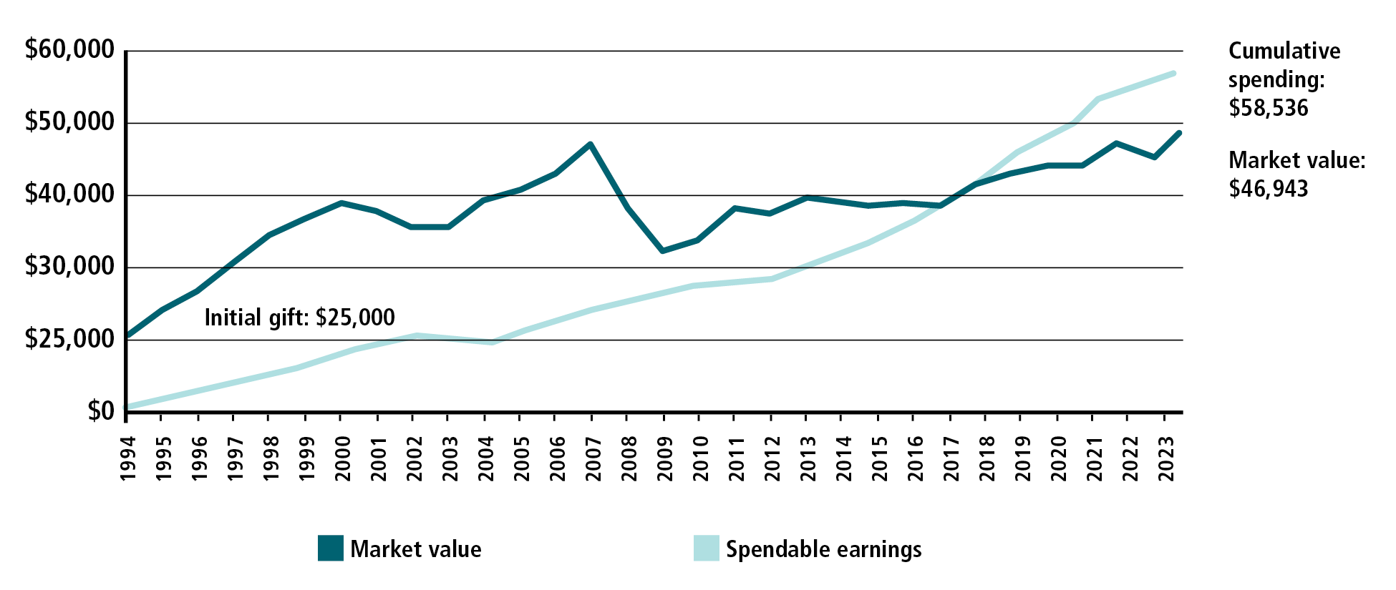
– named endowed funds
Ways to give
Notes:
This is an example of the performance of a named endowed fund. It shows a gift of 25,000 US$ made in 1997.
25 years later, the NEF is worth more than 32,000 US$, but at the same time, over 30,000 US$ in spendable earnings became available and was spent on TRF grant programs, according to the wishes of the donor.
This graph illustrates very clearly how giving to the Endowment has a lasting impact.

Slide 31
Club recognition
100% Foundation Giving Club - For clubs that achieve an average of $100 in per capita giving and 100 percent participation, with every dues-paying member contributing at least $25 to any or all of the following during the Rotary year: Annual Fund, PolioPlus Fund, approved global grants, or Endowment Fund.
Every Rotarian, Every Year Club - For clubs that achieve a minimum Annual Fund contribution of $100 per capita during the Rotary year, and every dues-paying member must personally contribute at least $25 to the Annual Fund during the year.
Top Three Per Capita in Annual Fund Giving - For the three clubs in each district that give the most, per capita, to the Annual Fund. Clubs that give at least $50 per capita are eligible.
100% Paul Harris Fellow Club - For clubs in which all dues-paying members are Paul Harris Fellows. This is a one-time recognition.
Notes:
PAS : Just as there are individual recognitions, there are club recognitions for those clubs which create a culture of giving and support for The Rotary Foundation, including 100% Paul Harris Fellow Clubs, 100% Paul Harris Society Clubs, 100% Foundation Giving Clubs, 100% Rotary’s Promise Clubs, Every Rotary, Every Year Clubs, and top per capita giving clubs, and Rotaract Giving clubs.

Slide 32
How do you give?
Write a check
Mail to The Rotary Foundation
Give to Club Foundation Chair
Online
my.rotary.org
Rotary Direct
IGNITE app
Required Minimum Distribution from IRA
One-Time Charitable Gift Annuity from IRA
Appreciated Stock
Bequest from Your Will

Slide 33
Ways to Encourage Giving
Contests/Challenges
Change Jar
Club or District Matching Points
IGNITE Giving Day
Paul Harris Breakfast Club
Club Donates $25 for a new member
Connect with their passion

Slide 34
QUESTIONS
Notes:
PAS Any Questions?
Thank you …..

