Slide 1
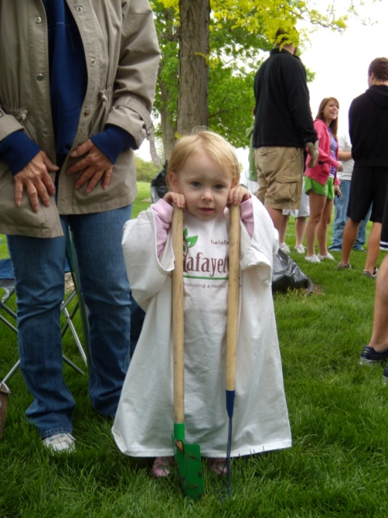
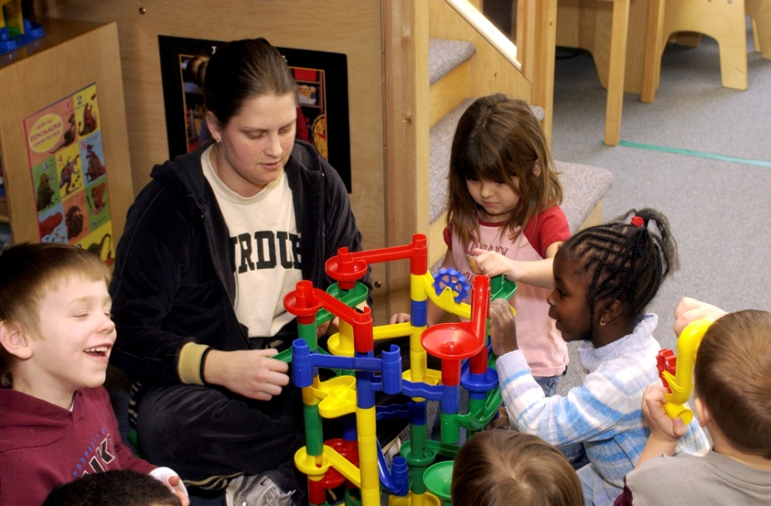
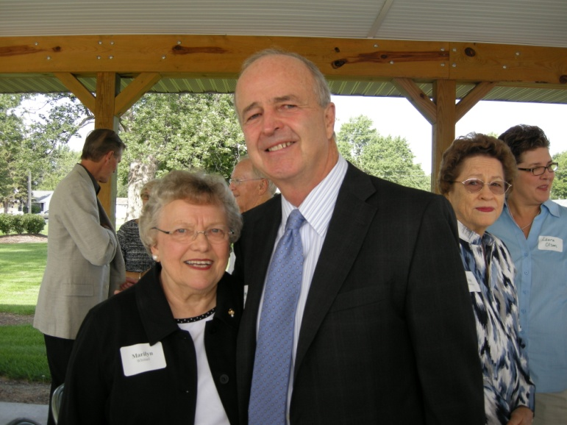
Notes:
Today I will try to provide you with an overview of the Community Foundation:
Last time I was up here was March of 2010 – we covered the basics
I get it a little better now, so I’ll try to give you an update and take any questions
Since the last time we chatted
Met hundreds of people
Hired new auditing and investment management firms
Offered our first request for proposals for targeted grants
Offered a matching campaign for agency endowments
Time to be involved in our Rotary board, along with the RYLA and Rotary Scholarship programs this year

Slide 2
Rotary Youth Building Update
Rotary Youth Leadership Awards
http://ryla6560.weebly.com/
Scholarship Applications (40!)
Notes:
RYLA camp was St. Patrick’s Day weekend
Harrison HS
Bailey Sliger
Drezden Johnson
WL did not participate – spring break and band/orchestra camp
Faith did not participate
Daybreak – Jeff, McCutcheon, CC
35 Scholarship applications – will update you on May 1

Slide 3
Giving USA 2010 Survey
Notes:
Total charitable giving in the US in 2010 was $291 billion, an increase of 3.8% over 2009
Individuals give 81% through outright gifts and bequests, and probably half of the foundation giving is through family foundations. So, people account for about 90% of the total, with the rest coming from institutions.

Slide 4
Giving USA 2010 Survey
Notes:
This is pretty consistent year to year, with Religion and Education being the top categories to which donors give.

Slide 5
Charity Quiz
% of pre-tax profits given by corporations
.09% 3.4% 5.1% 7.2%
% of household income given by individuals
.05% 1.9% 3.6% 8.5%
# of nonprofit organizations
U.S. (2009): 1.4 million (source: Wall St. Journal)
Indiana (2010): 12,693 (source: Foundation Center)
Tippecanoe County: (2010): ~ 300 (source: Foundation Center)
Notes:
Conclusions to draw – people are being asked a lot for gifts!
We have 16 discretionary funds set up by individuals and families. They make their donations to their funds and our grants committee evaluates proposals and makes grants in the fund’s name to area organizations.
Over the last five years, we have made 274 grants to 128 different non-profit agencies for a total of $1.8 million from these discretionary funds!

Slide 6
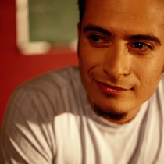
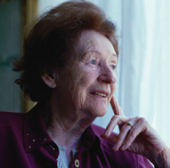
We are a tax-exempt public charity created by and for the people of Greater Lafayette
The mission of The Community Foundation of Greater Lafayette is to
inspire, nurture, and practice
philanthropy, stewardship, and leadership
in the communities we serve.
Notes:
Many of you have heard of foundations like the Ford Foundation and the Lilly Endowment. Those are private foundations. We are a public foundation for the entire community, governed by a board of private citizens chosen on a rotating basis, who are representative of the public interest.
Sort of a community savings account intended to provide leadership and financial support for community needs – in a sustainable and enduring way.
[click]

Slide 7
foundation
facts
Our vital statistics
Community Foundation of Greater Lafayette
› Celebrating 42 years of operation in 2012
› More than 150 funds and trusts
› $33 Million in managed assets
› $869,564 in 2011 grants
› $13.8 Million cumulative grants
› 7.1% - 20 year investment return
› White County affiliate
Notes:
Since we last talked two years ago:
Added about 25 new endowment funds
Added about $5 million in managed assets
Gave away about $2 million
Improved our investment strategy
Supported our friends to the north
About a $1.5 million economic impact on community from grants, trust payments and dollars spent through annual operating budget

Slide 8
What’s New – Agency Endowment Matching Campaign!
Matching Grant: $500,000
Maximum; $50,000/agency
Match Ratio:
1 TO 4; Not-for-profit (NPO) raises $4 in new gifts; CFGL will match $1
Participation – 16 agencies
9 new endowments
Next critical dates
April 2: 10% of campaign goal due
April 30: Campaign Kick-Off Event at Lafayette Country Club
Notes:
We get numerous requests for operating grants. Agencies that have endowments designated for themselves can use our annual distributions any way they like – capital or operations.
So we thought, let’s help agencies with a permanent, reliable source of unrestricted giving that they can put into their budget every year.
The goals of the campaign are two-fold:
Build your endowment!
Build your base of supporters so that not only does your endowment grow, but your annual donor base will increase also.
You don’t hear “buzz” and “endowment” in many sentences together, but we have visited with about 25 agency boards and discussed how an endowment might be of some benefit. Timing is not always right, but our board really wanted to walk the talk about the value of endowments, so they allocated $500,000 from our unrestricted endowment principle to provide the matching funds.

Slide 9
Endowment Accounting 101
Notes:
Here is an illustration of the Rotary Foundation’s endowment, minus the beanstalks and song; unless Bob, Dave and Richard would like to reprise that top 40 hit from last month!
Currently the Foundation’s endowment sits at $400,000. If we hit our campaign goal, and the markets cooperate, we’ll pass the $500,000 mark next year. It takes 3 years for the full grant amount to be available, after which we can count on $25,000 per year to be available for club priorities.
If we don’t add anything to the endowment after this campaign is over, within ten years we will have given away a quarter of a million dollars. So, over the next fifty years, we will build the endowment to $1 million while we give away $2 million. This is clearly a long term, strategic decision by us now to make sure that The Lafayette Rotary Club makes a lasting impact on Greater Lafayette.

Slide 10
How can we make a difference
Where do our grants go?
Who else makes grants in our community?
What are the greatest un-met community needs?
Process
Board input
Other funders’ input
Web-based community needs assessment
Convening sessions
Educators
Law enforcement
Service-providing organizations
Notes:
In early 2010 our board started having discussions about how we might continue to be the go-to place for small capital grants through our grant application process, but is there something we can target that would really make a big difference in our community?
So we asked and answered the questions about where our grant dollars go, who else is making grants in the community and what are our greatest unmet needs.
We solicited input from as many stakeholders as we could, including a web-based community needs survey.

Slide 11
What’s New - Community
Notes:
Here are the results of that survey – Children and education are our top community proirities.

Slide 12
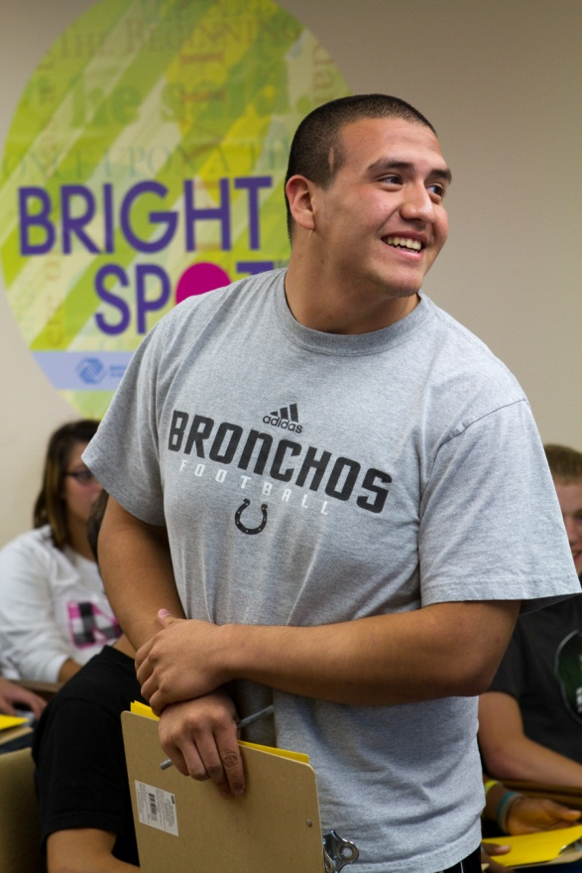
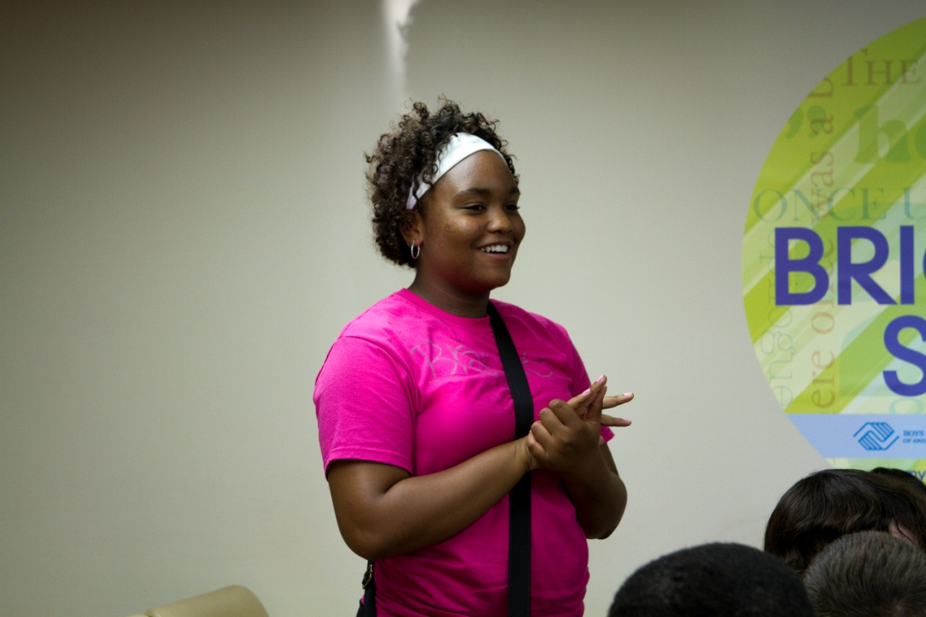
Request for Proposal
Innovative programs to address causes of
Teen pregnancy
Substance abuse
Gang involvement
Desired Outcomes
Provide opportunities to:
Graduate from high school
Earn income, life skills and self-esteem
Notes:
From our survey and solicited input, it became clear that our kids are our priority. Teen pregnancy, substance abuse and gang involvement were identified as the symptoms that were causing our young people to fail or drop out of school.
So we asked for proposals that would attack the root causes of these big 3 problems with the desired outcome to provide opportunites for students. Hopefully they would seize these opportunities that would lead to higher graduation rates and self-confidence.

Slide 13
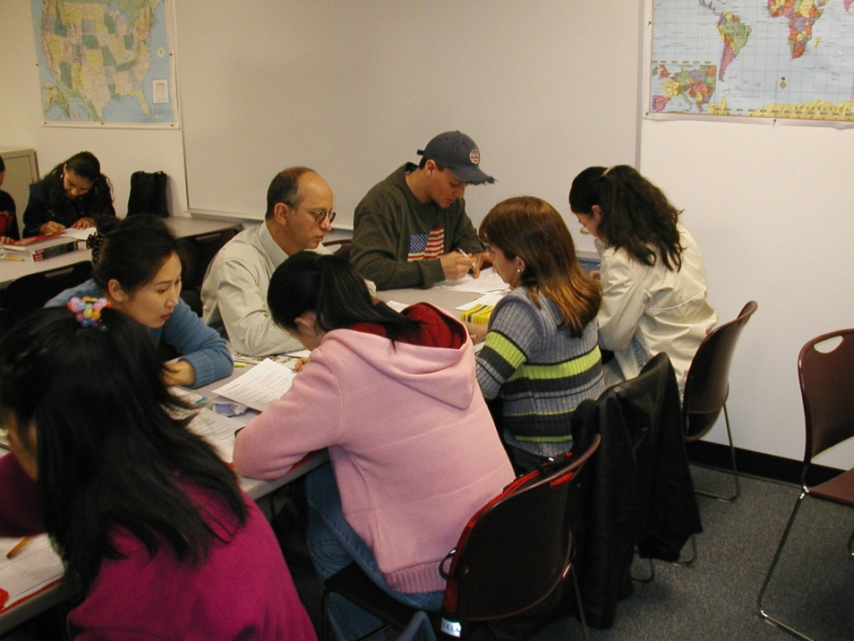
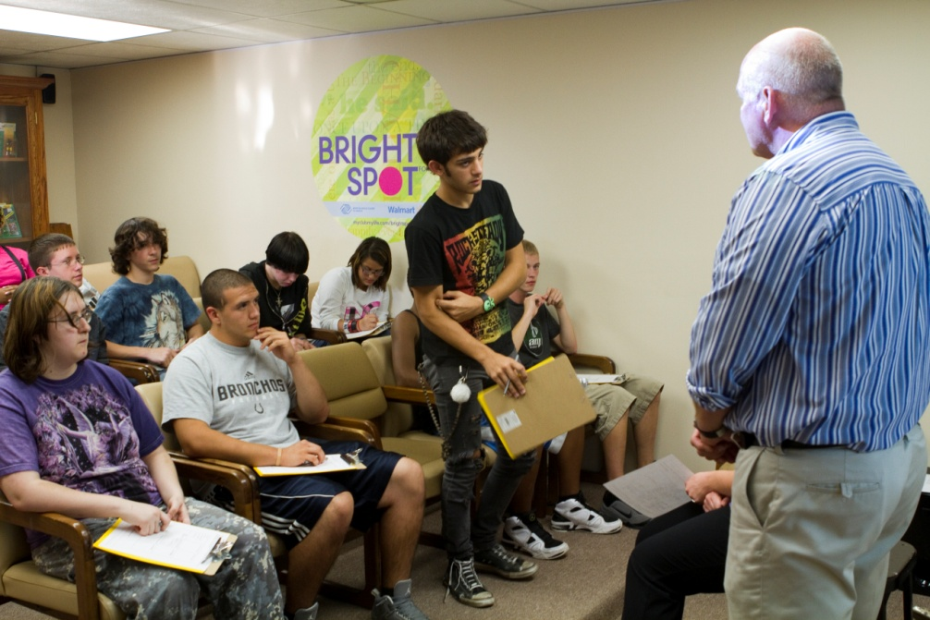
Youth Building Request for Proposal
$75,000 to Oakland High School
Science discovery lab -“A community approach to science literacy”
$25,000 to Lyn Treece Boys and Girls Club
Youth employment program partnering with local non-profits and employers
Notes:
We received four excellent proposals and made these awards in July of last year.
Oakland HS opened last August and provides comprehensive, rigorous secondary educational opportunties and relevant community experiences that will prepare students for work, active citizenship, and post secondary endeavors.

Slide 14
Notes:
Here is a quick recap of our grants over the last five years, with blue being from our discretionary funds and red from designated and donor-advised funds. As you can see, we have fully recovered from the 2008-09 market volatility AND we did not stop making grants during the downturn.
The compound annual growth rate of our grantmaking is 3.2% over the five-year period. Inflation has averaged 2.41% over that timeframe, so we are keeping up with inflation in getting grant dollars out to area organizations.

Slide 15
Notes:
We saw earlier that our community puts a high value on support for children and youth. Adding up the 3 categories of Children/Youth, Education and Health, which effects most families, 69% of our grantmaking has gone to those categories.
But, we also value Arts & Cultural activities, a safe and enjoyable environment and a growing awareness and importance for diversity in our relationships and experiences.

Slide 16
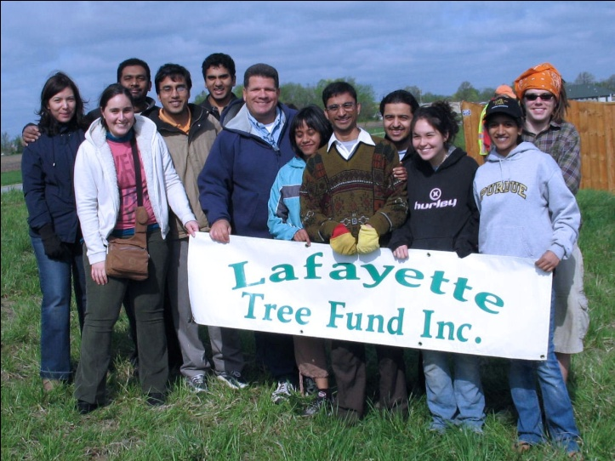
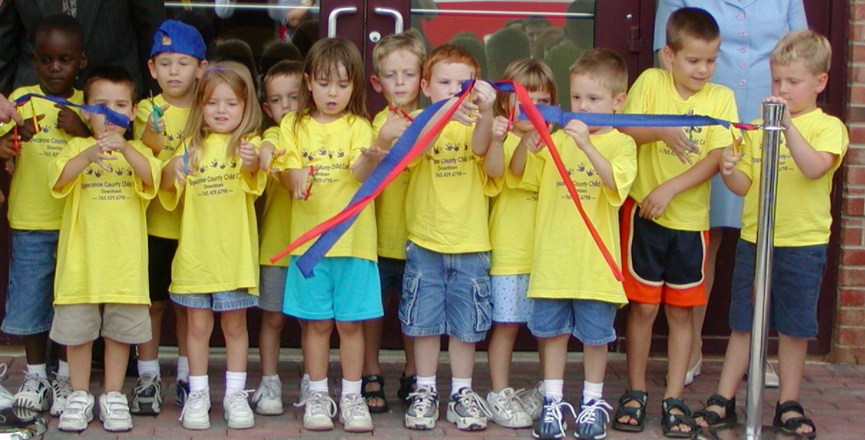
foundation
facts
Other grant examples
› Children and Youth Lyn Treece, Bauer, TCCC
› Arts & Culture Civic Theatre, Long Center, TAF
› Community Partnerships Gold Star Mothers, LPD
› Scholarships
Notes:
Let me show you some specific examples of how DISCRETIONARY donor grants touch our community.
Over 5 years – 128 organizations, 274 grants, $1.8 million
Lyn Treece boys and girls club – renovations at both the 10th st. and Beck Ln. facilities have resulted in new programs and increased membership
Civic Theatre has a new roof and a renovated auditorium with our help and the help of many others in our community.
Partnerships with the City of Lafayette helped us get involved with the Gold Star Mothers Honor Flight program; we helped secure funds and made a grant to their Honor Flight program – they will be sending a group of WWII veterans to Washington DC in April to visit the WWII memorial.
We also worked with LPD to secure a grant from the Ben Roethlisberger Foundation to help them acquire a police dog for their K9 unit.
Last year we gave away 52 scholarships ranging from $500 to $5,000 from our funds and we also awarded 3 Lilly Community scholarships.

Slide 17
Leading Others
Eberle Board Governance Series
Build knowledge about responsible oversight and governance
Designed for Board Volunteers and Executive Directors
Coaching Series
A series of one-hour brown bag seminars for staff and volunteers
Drill down on governance concepts and receive implementation steps to improve board effectiveness
Financial Series
A series of one-hour brown bag seminars for staff and volunteers
Practical financial and accounting information you can use in organizational oversight activities

Slide 18
o
n
e
Relationship and Fund Development
t
w
o
Community Leadership
t
h
r
e
e
Grantmaking
Notes:
To sum up, your community foundation can help you by:
Asset development assistance
Planned giving back office
Marketing materials that describe the various gift instruments
Software to calculate gift impact and tax considerations to help structure planned gifts
Provide counsel – meet with you, your donors, your boards; whatever
Working with your donors to establish agency endowments; provides support forever, establishes a legacy for your donor, and establishes sustainable funding for your organization – accountability and credibility follow.
2. Grantmaking
The exciting part about grantmaking is that it’s the local community – us in this room and our donors and volunteers – decide how our funds are used to solve or prevent local problems. Donors can direct funds to specific causes or our board of directors can direct unrestricted funds for community benefit.
3. Community leadership
Objective partner to help convene stakeholders in addressing a community need or opportunity
[click]

Slide 19
Thought for the Day
Gifts to the Community Foundation are gifts to the Community
We don’t build funds for us
We build funds for things that matter
By working with people who care about Greater Lafayette
Trust – stability – community

Slide 20
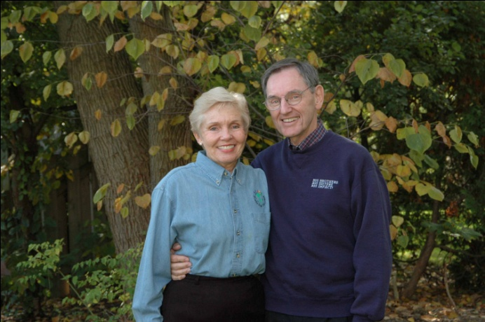
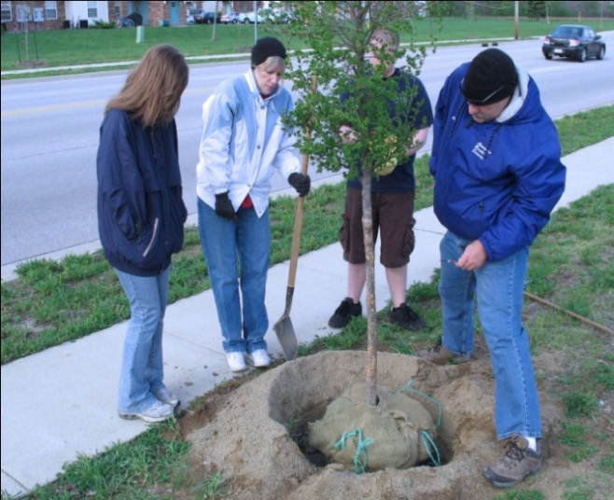
Helping you help
your community
To learn more about us, call 765/742-9078 or contact us at www.cfglaf.org
© 2010 Community Foundation of Greater Lafayette, Council on Foundations and Community Foundations of America
Notes:
We’re the Community Foundation of Greater Lafayette and we really appreciate your time and willingness to learn more about us today.
There’s so much more we’d like you to know… so we encourage you to contact us anytime you have a suggestion or a need for philanthropic advice.
Thank you and have a good day.

