Slide 1

Recognition of
Long-Term ERC Members
July 9, 2024

Slide 2
Membership Recruiting and Retention
Recruiting and retaining club members is an important aspect of all Rotary Clubs.
Membership has been falling faster than the traditional 14 to 15% average.
While some resignations may be caused by disputes or lack of vibrancy in a club, business and life changes are by far the major reason members leave.
Members of long-term bring a sense of tradition to any club and they benefit from being part of the club.

Slide 3

Why might members continue membership on long term?
Dan Buettner is an American author, explorer, longevity researcher and public speaker. He co-produced the documentary TV mini-series Live to 100: Secrets of the Blue Zones. His views on the topic of remaining healthy as we age are pertinent to continuing your Rotary membership.
Strong Social Network: The foundation of living long
Beyond Friends: Finding meaning by serving others
Keep Moving: A key to living longer
Less Stress: Another ingredient of long life
Living in the Present: The power of mindfulness
Being a part of something greater
Concepts are taken from an article by Haresh L. Ramchandani, past district governor, member of the Rotary Club of L.I.F.E., Jamaica, and a member of the RI Membership Growth Committee

Slide 4

Rotary International v. ERC
Rotary International started in 1905
ERC was chartered in April 1918.
  We are starting our 107th full year. That means that anyone with over 35 years of service has been part of our club for 1/3rd of the club’s existence.
We have 21 members with retention of 35 or more years. That is 22% of the membership.
Some of those members have elected to be permanently excused from attendance. We may not see them at meetings, but they are still supporting the club.

Slide 6
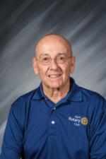
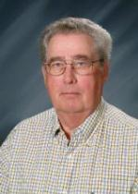
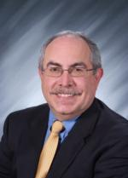
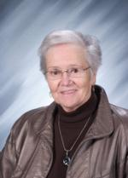
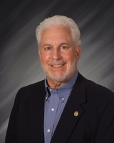
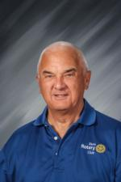
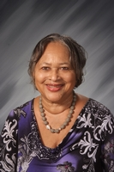
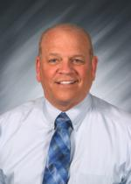
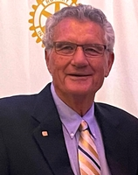
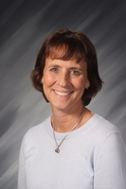
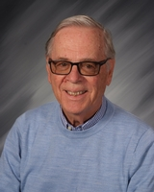
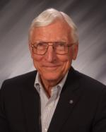
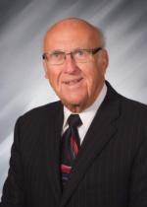
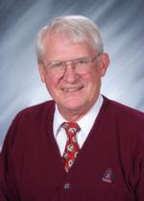
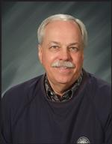
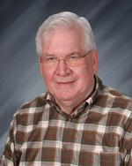
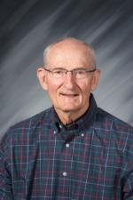
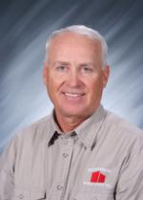
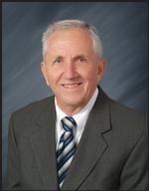
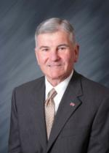
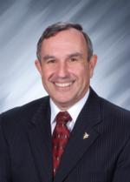

Slide 7
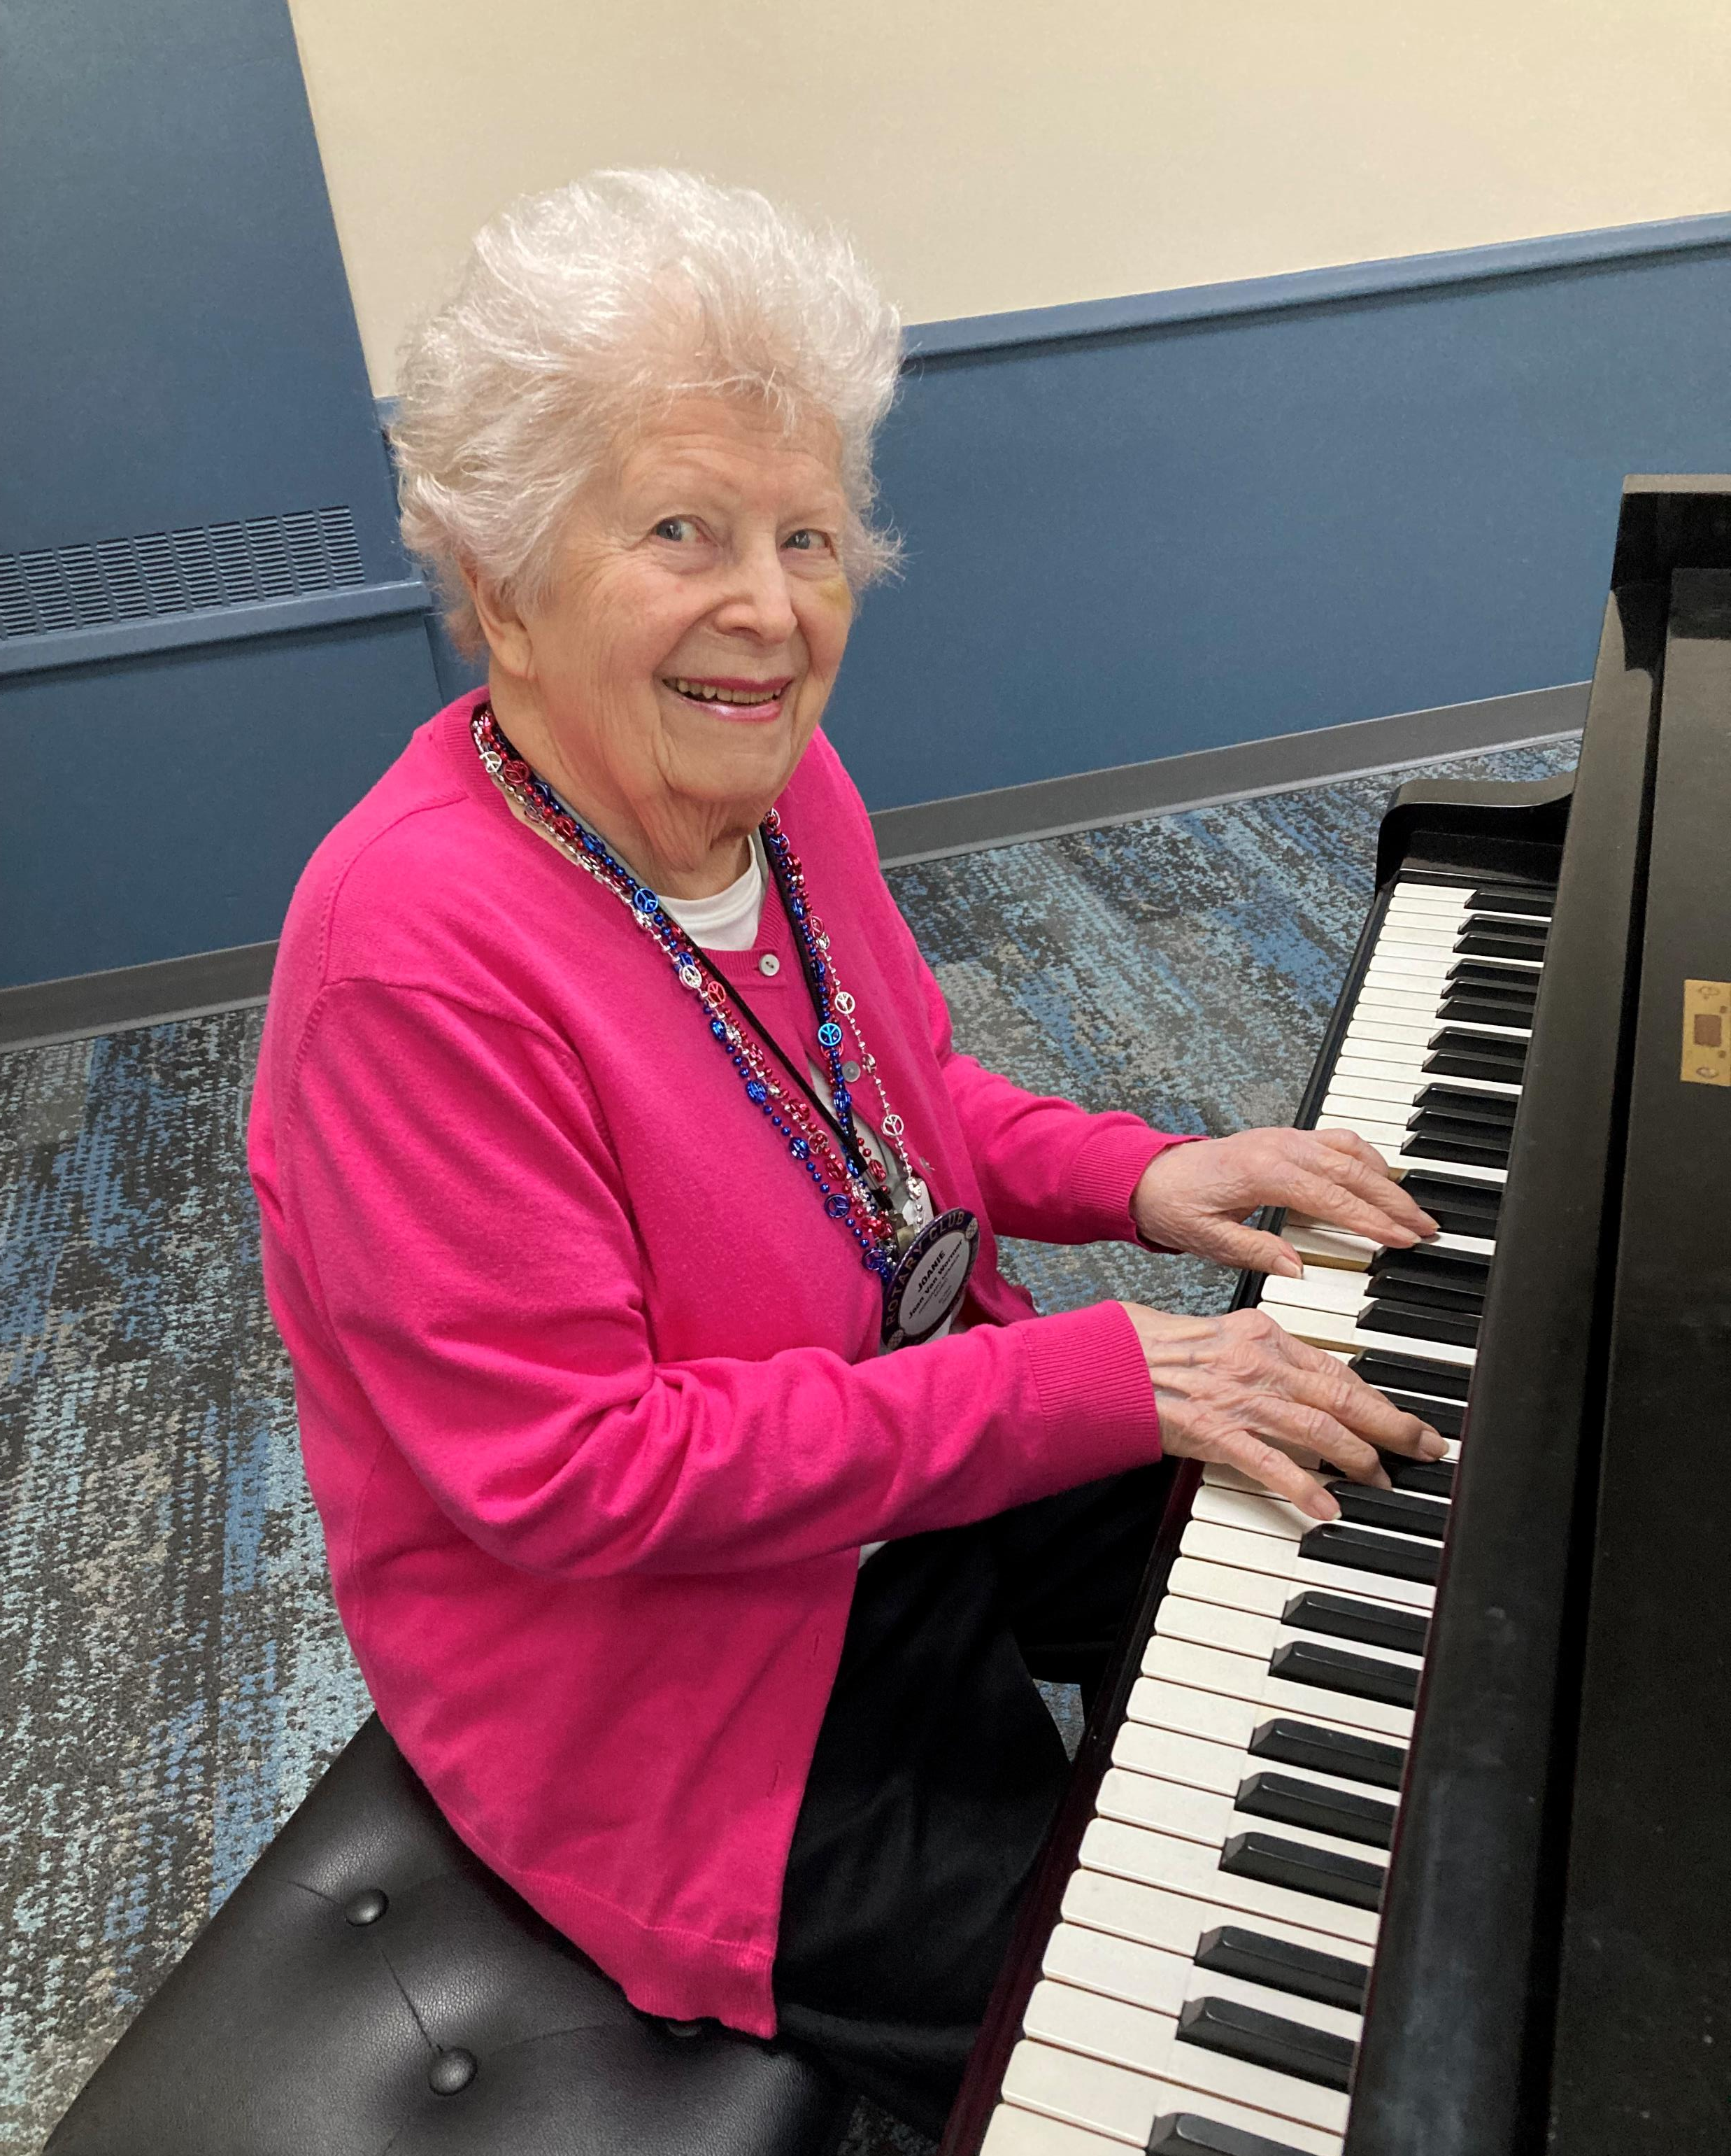

Special Recognition
In July 2000 Helen Kolopus, our long-time piano player, passed away.
In the beginning of club year 2000/2001 Joan Van Wormer, our new piano player, started to accompany our musical efforts.
Joan is starting her 25th year in the role.

