Slide 1
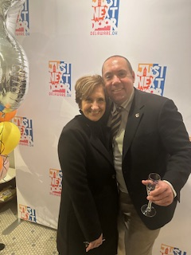
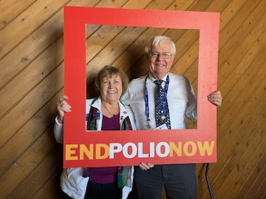

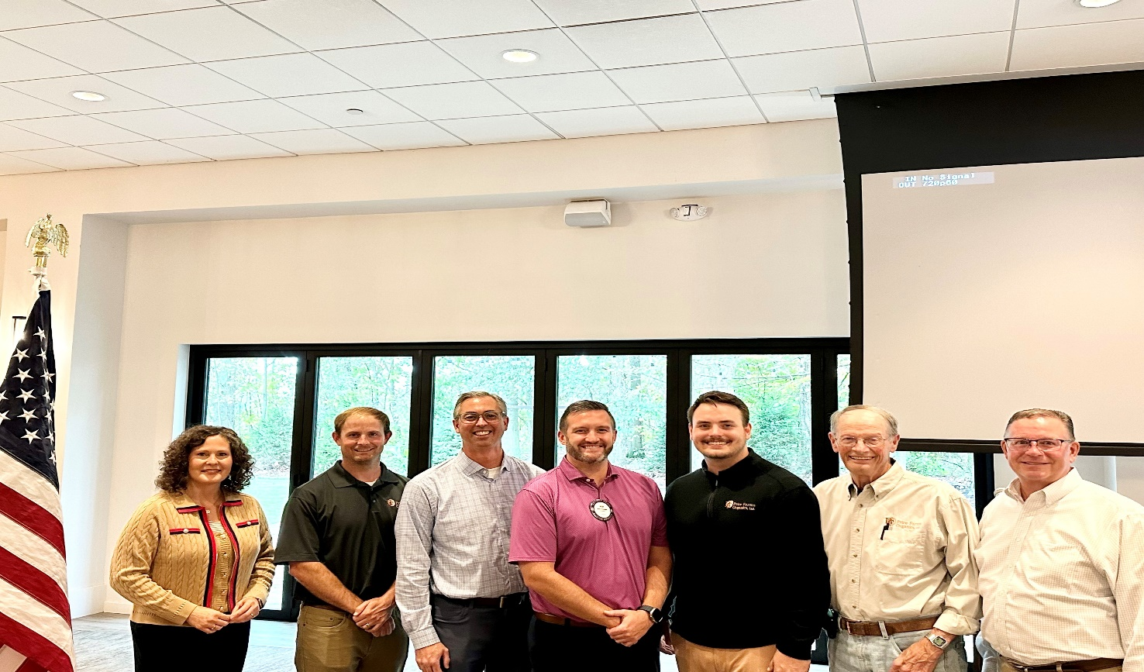
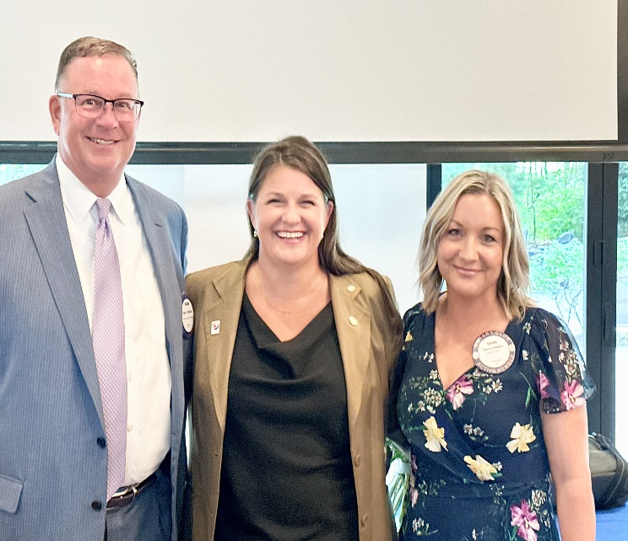

Rotary Weekly Meeting
November 25th

Slide 2


Invocation/Inspiration
Ryan Wilkins
Pledge of Allegiance
Fran Veverka
Greeters-Trevor Thomas and Ryan Wilkins
Desserts –frank reinhard

Slide 3


VISITING ROTARIANS
AND GUESTS
Jim Bandeen
Tommy Seguin – IGS
Ben Coy - COSO

Slide 4

CLUB ANNOUNCEMENTS
Ryan Wilkin chairing new marketing committee – developed a marketing plan currently being reviewed by the BOD
Larry Walters leading our club efforts with the bell ringing for Salvation Army – Krogers on Houk Rd Dec. 21st 11am -7pm.
Taste of Downtown Delaware Tuesday June 17th, 2025 – Please Save the Date
Other club announcements

Slide 5
CLUB ANNOUNCEMENTS
SA
Steve Hedge – PIN date Dec 15th
Honor Flight for district #6690 Sept. 2025 Jeff Hill and Ken Spicer leading our club efforts. Local Rotarian veteran?
Club election is on December 16th
Super Bowl Pool $5 per square 50% to winner and 50% to Polio Plus see Dana Vogelmeier
Other club announcements

Slide 6
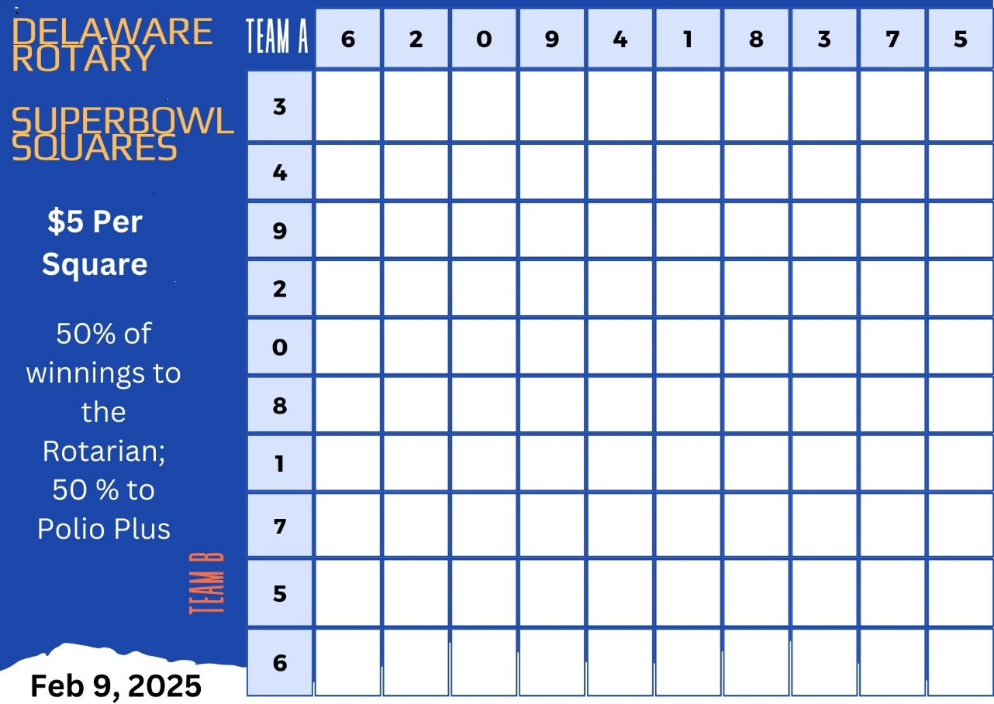

Slide 7
CLUB ANNOUNCEMENTS
Need a chair for service projects, let Frank know if interested
Jim Frisch Jr. – has a new job and requested a 6 month leave of absence
Lynsey is hosting the Club Dessert Exchange on Dec 16th
Happy Birthday wishes to Bethany Moore 11/25 and Ryan Wilkins 11/26
Other club announcements

Slide 8
Paul Harris Plus 3
Fara Waugh presented by Mike Dickey
PP

Slide 9

SERGEANT
AT ARMS
Dave Hejmanowski

Slide 10
Matt finkes – osu gold pants club introducted by kirt trimble

Slide 11

Pieces of Eight
¼ Delaware Rotary Foundation
¼ Scholarship Fund
¼ to the Pot
¼ to the Winner

Slide 12
Next meeting state of farming hardscrabble farms – by brian skinner

Slide 13

Is it the Truth?
The FOUR WAY TEST
Of the things we think, say, or do
Will it build goodwill and better friendships?
Will it be beneficial to all concerned?
Is it Fair to all concerned?

Slide 14
THANK YOU and Happy Thanksgiving!

