Slide 1
Rotary District 7620
Welcome Outbound Global Grant Scholars!
Global Grants Scholarship
Jimmie Gorski, Chair
jimmiegorski@comcast.net

Slide 2
SCHOLARSHIP COMMITTEE
Jimmie Gorski, Committee Chair – Rotary Club of Upper Marlboro jimmiegorski@comcast.net
Judy Cappuccilli, Rotary Club of Historic Prince George’s County
David Gough, Rotary Club of Upper Marlboro
Navin Valliappan, Rotary Club of Federal City

Slide 3
DISTRICT 7620 SCHOLARSHIPS

Slide 4
GLOBAL GRANTS SCHOLARSHIP
Global Grants Scholarship
$30,000.00
One Recipient
January 1, deadline for Clubs to submit complete nominee packets to District Global Grants Scholarship Committee Chair

Slide 5
LOCAL CLUB ELIGIBILITY REQUIREMENTS

Slide 6
LOCAL CLUB ELIGILILITY REQUIREMENTS
The Club must make a donation to the Annual Program Fund (APF).
The Club must be MOU (Memorandum of Understanding) trained.
Note that the Club MOU is a binding agreement between the Club and the District.

Slide 7
GLOBAL GRANT SCHOLARSHIP APPLICATION

Slide 8
GLOBAL GRANTS SCHOLARSHIP
One scholarship for a minimum of $30,000.00 will be awarded for one year to pursue a graduate school program abroad and support Rotary goals in one of the six areas:
Basic Education and Literacy
Disease Prevention and Treatment
Economic and Community Development
Maternal and Child Health
Peace and Conflict Resolution
Water and Sanitation

Slide 9
GLOBAL GRANT SCHOLARSHIP
October 31: Students submit completed applications and supporting documents to a qualified Rotary Club in our District.
November: Clubs review applications, interview applicants, and select their nominee.
January 1: Deadline for all individual Clubs to submit a letter of sponsorship and completed application packet to Jimmie Gorski, jimmiegorski@comcast.net, District Global Grants Scholarship Committee Chair.
Incomplete application packets will not be considered for further review.

Slide 10
GLOBAL GRANTS SCHOLARSHIP
January-February: If selected as a finalist, applicants will be contacted for an interview by the District Global Grants Scholarship Committee Chair.
March: Interviews will be conducted and scholarship recipients notified of their scholarship award by the District Global Grants Scholarship Committee Chair.
May 1: Scholarship recipient notifies the District Global Grants Scholarship Committee Chair of scholarship acceptance to begin RI approval and funding. Alternate scholarship recipient notified of award if necessary.

Slide 11
GLOBAL GRANTS SCHOLARSHIP
May 1: The confirmed scholar will be proposed to the International Host Club and to Rotary International for evaluation and funding ninety days before travel is to begin.
June-August: Scholarship paper work will be completed and approved by Rotary International Foundation.
August-September: Scholarship funding will begin once received from the Rotary International Foundation.

Slide 12
GLOBAL GRANTS APPLICATION PACKET

Slide 13
GLOBAL GRANTS APPLICATION PACKET
Completed application form (www.Rotary7620.org > Scholarships-Global Grants Scholarship)
Letter of sponsorship from your club in District 7620
Resume/CV
Copy of college transcript(s)
College or University Offer Letter

Slide 14
GLOBAL GRANTS SCHOLARSHIP

Slide 15
DISTRICT 7620 GLOBAL GRANTS SCHOLARS

Slide 16
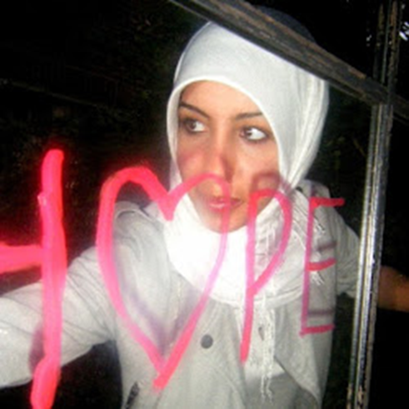
DISTRICT 7620 GLOBAL GRANTS SCHOLAR 2012-2013
Salmaa Elshanshory
Studied at the Graduate Institute of International and Development Studies in Geneva, Switzerland
Earned a Master’s degree in International Affairs with a focus on Conflict Resolution
Aspires to begin field work in the area of conflict resolution in the Middle East.

Slide 17
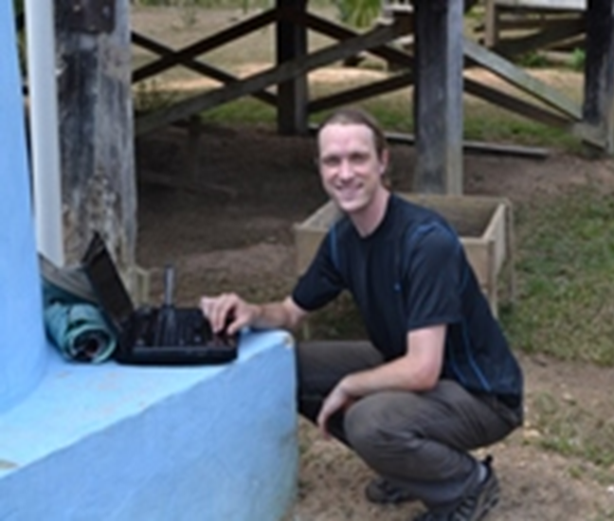
DISTRICT 7620 GLOBAL GRANTS SCHOLAR 2013-2014
Daniel Smith
Studied at the University of Leeds in the United Kingdom
Earned a Master's degree in Water, Sanitation, and Health Engineering, in the School of Civil Engineering
Planning to work on water, sanitation, and hygiene development programs in Latin America and Africa

Slide 18
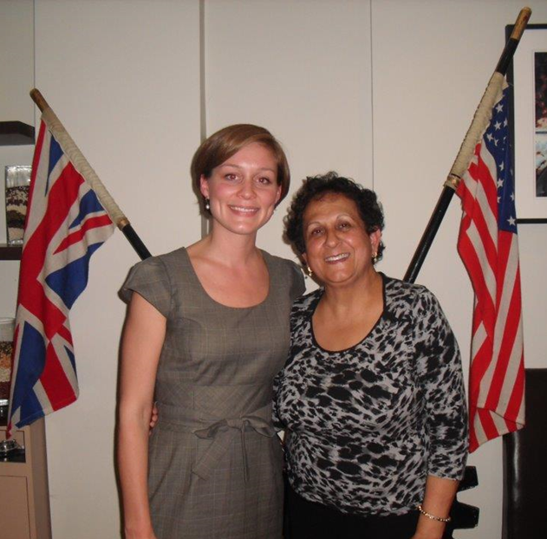
DISTRICT 7620 GLOBAL GRANTS SCHOLAR 2013-2014
Leanne Polachek
Recently completed her study at the London School of Hygiene and Tropical Medicine
Will receive a Masters in Public Health in Developing Countries
Will continue working in international development specifically focusing on initiatives related to women’s health concerns, health systems, and community health in low and middle income countries
Leanne with her Rotary counselor

Slide 19
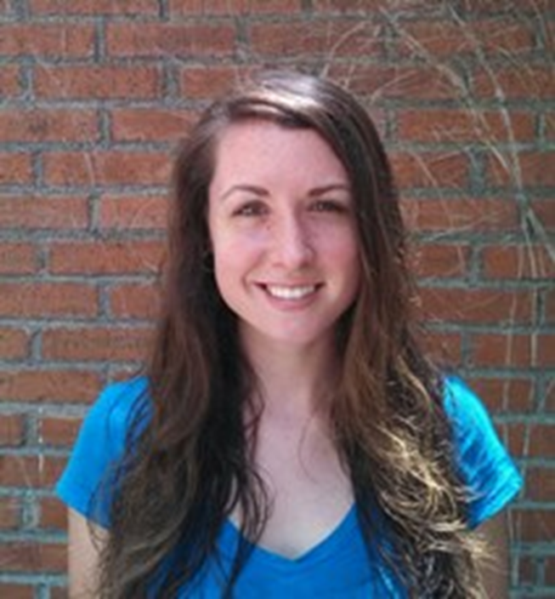
DISTRICT 7620 GLOBAL GRANTS SCHOLAR 2014-2015
Sarah Dobson
Studying at the University of Peace in Ciudad Colon, Costa Rica
Will earn a Master's degree in Gender and Peacebuilding
Planning to work in gender violence prevention and peacebuilding work

Slide 20
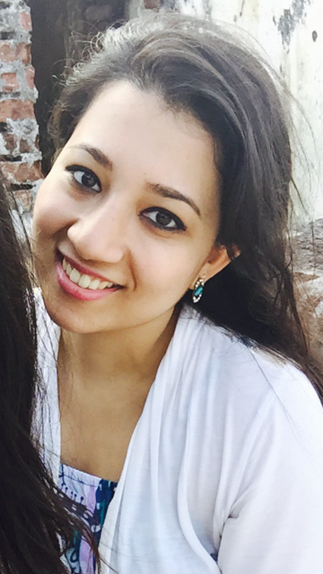
DISTRICT 7620 GLOBAL GRANTS SCHOLAR 2015-2016
Sundus Ahmed
Studying at the University of Cambridge in Cambridge, United Kingdom
Will earn a Master's degree in Epidemiology
Aspires to attend medical school after completing this degree and work on the prevention and treatment of infectious diseases in developing countries

Slide 21
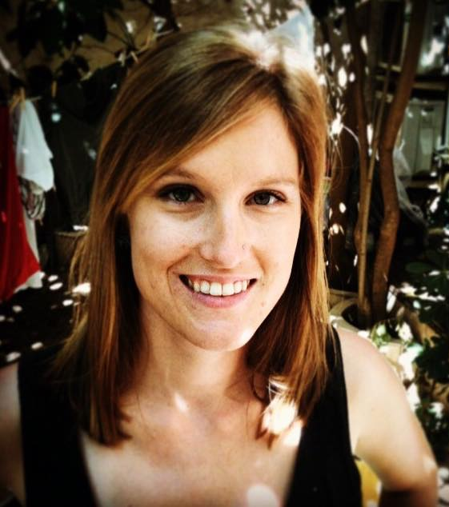
DISTRICT 7620 GLOBAL GRANTS SCHOLAR 2015-2016
Katie Northcott
Studying at London School of Economics and Political Science
Pursuing a Master's of Science in Population and Development
Planning to work in international family planning and reproductive health programming, specifically in West Africa

