Slide 1
Rotary Club of global impact
President Dr. Pauline Crawford, PHD
“Enriching our world through the power of authentic harmony”

Slide 2
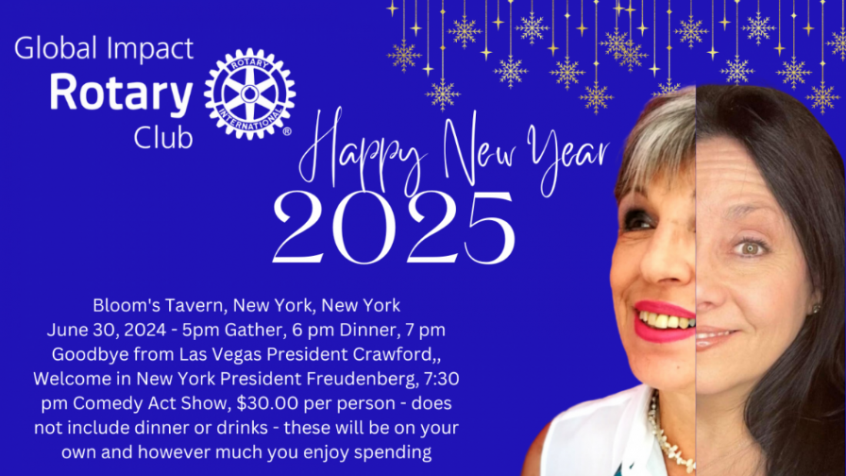

Slide 3
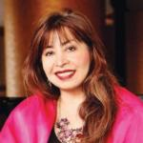
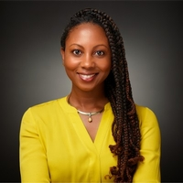
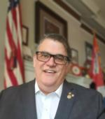
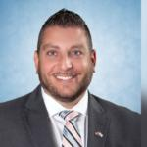
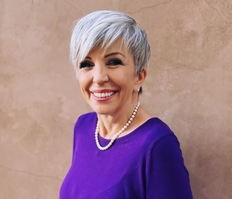
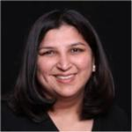
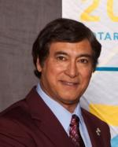
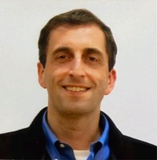
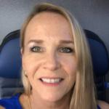
Kay Doxilly Past President Green Valley Las Vegas joining us from July 1st
Maria Rosa “Bing” Carrion Past President Supreme Club of Philippines- my original sponsor to Rotary….
Marti Mongiello Past President and Founder of Rotary Club of Global Impact and my transferring sponsor …
“Thank you to Past Presidents, Governors and Rotarians who support the Rotary Club of Global Impact…”
Nico Iannelli
Past District Governor
Firoz Peera
Past District Governor
Supporter for my Paul Harris Fellowship…
Dolly Parikh
Twin Club
Past President of Silicon Valley
Dave Lynn
Past President
Terri Miller
Past President

Slide 4
Four-way test
Is it the TRUTH?
Is it FAIR to all concerned?
Will it build GOODWILL and BETTER FRIENDSHIPS?
Will it be BENEFICIAL to all concerned?

Slide 5
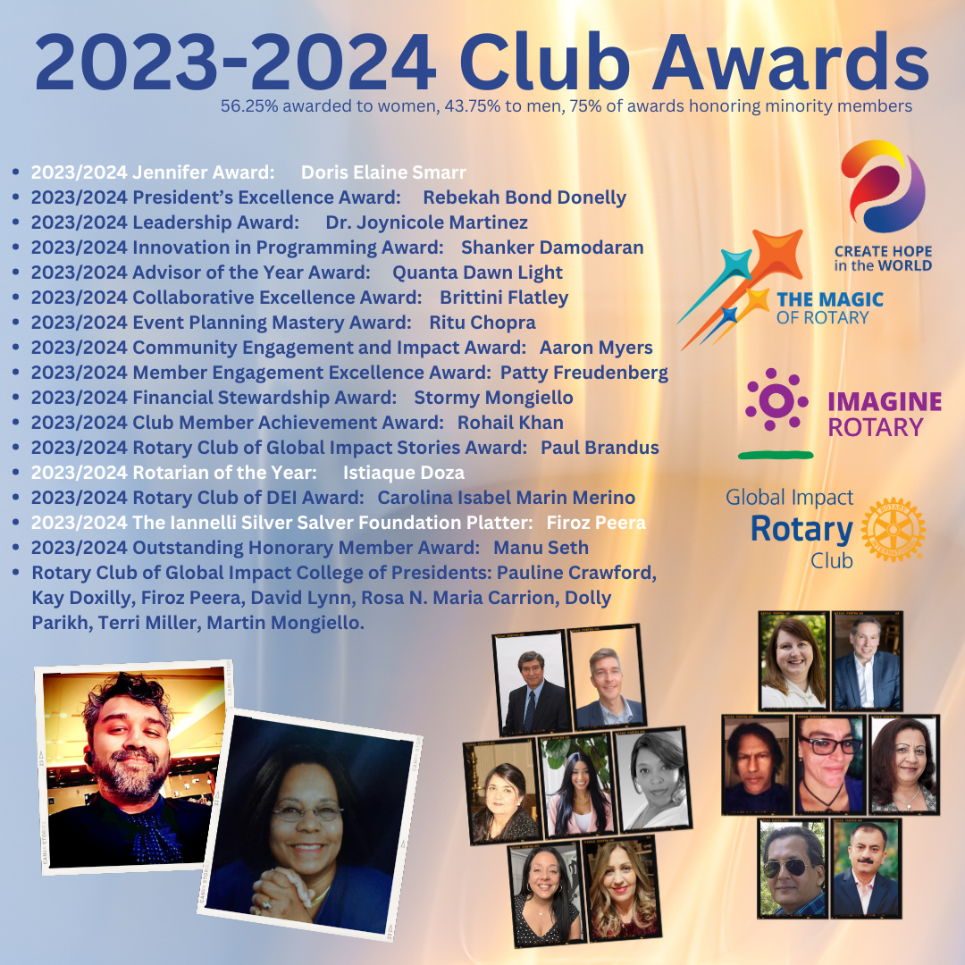

Slide 6
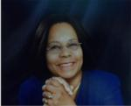
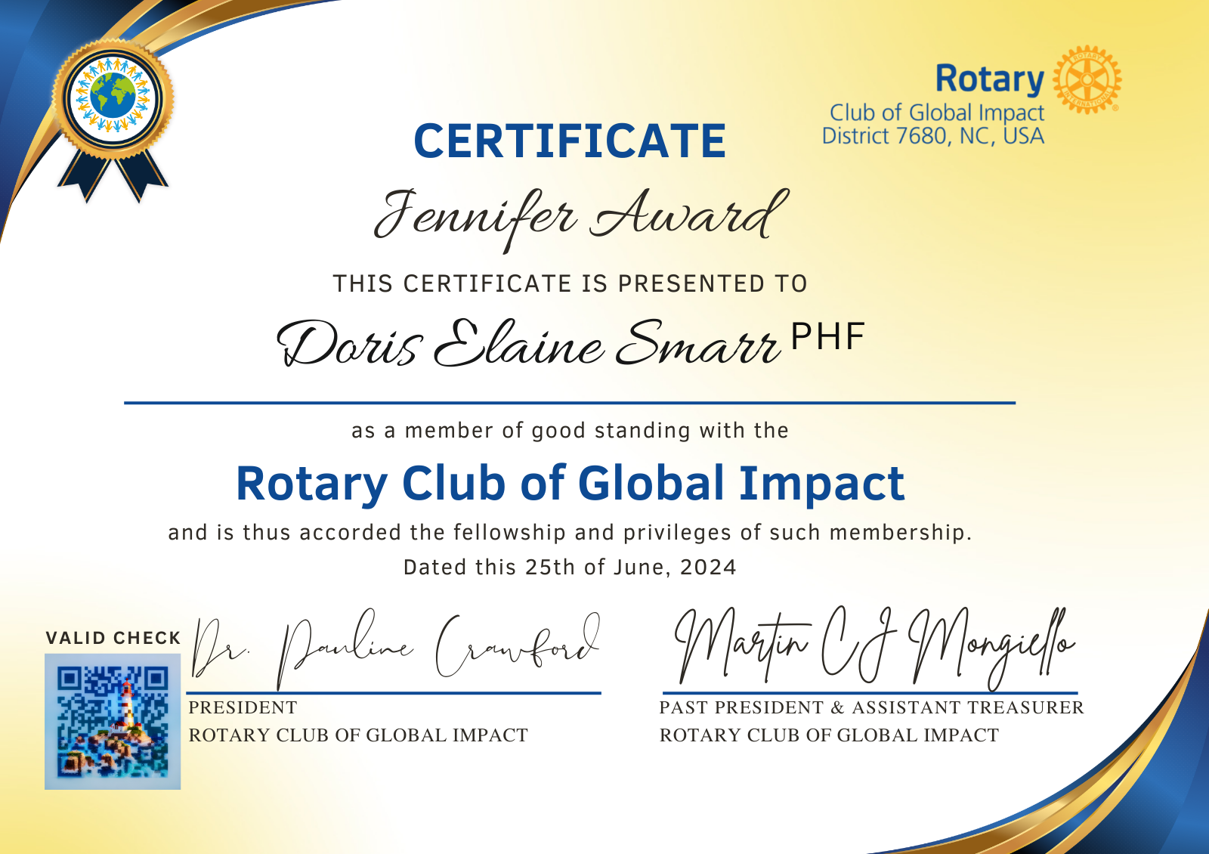

Slide 7
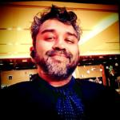
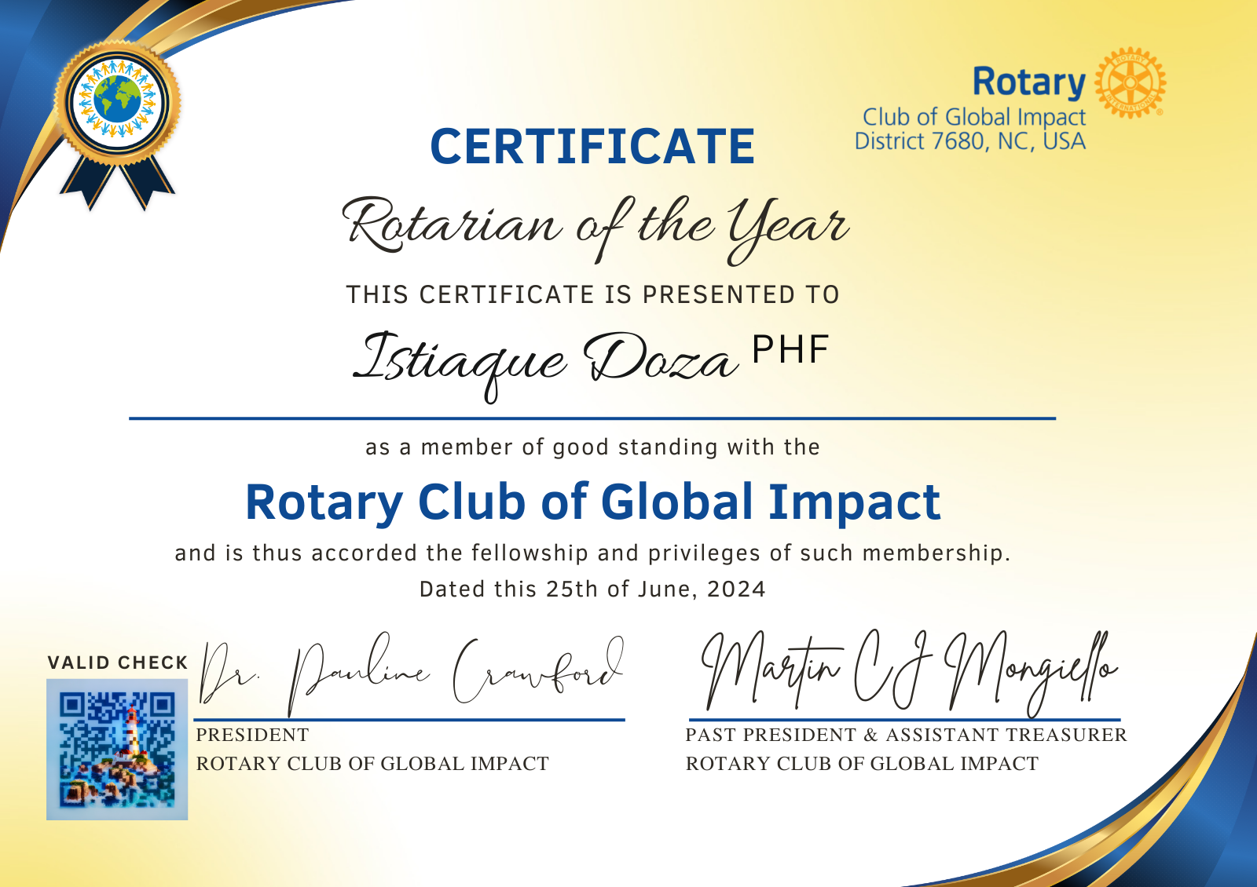

Slide 8
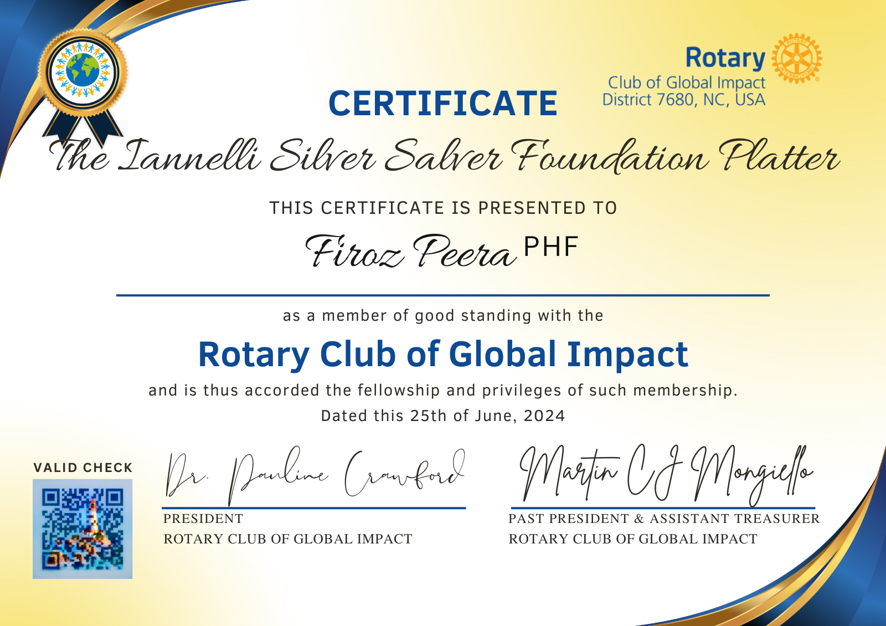

Slide 9
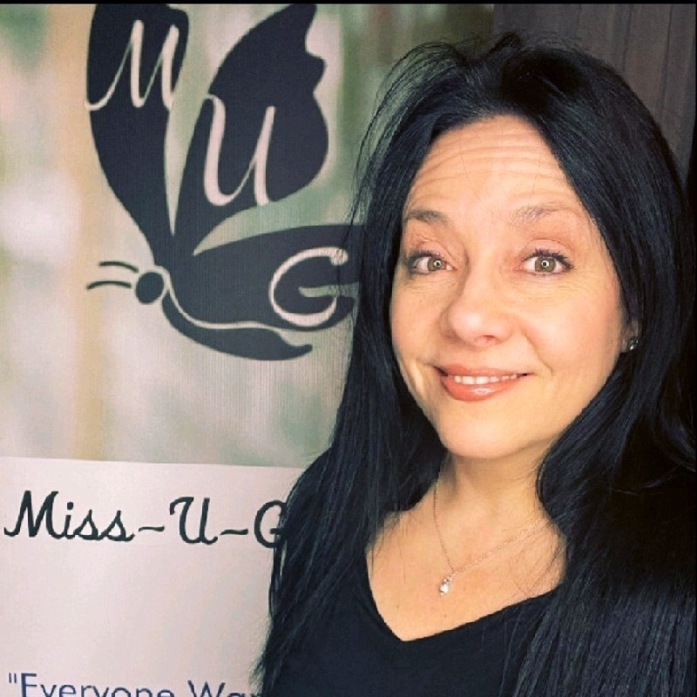
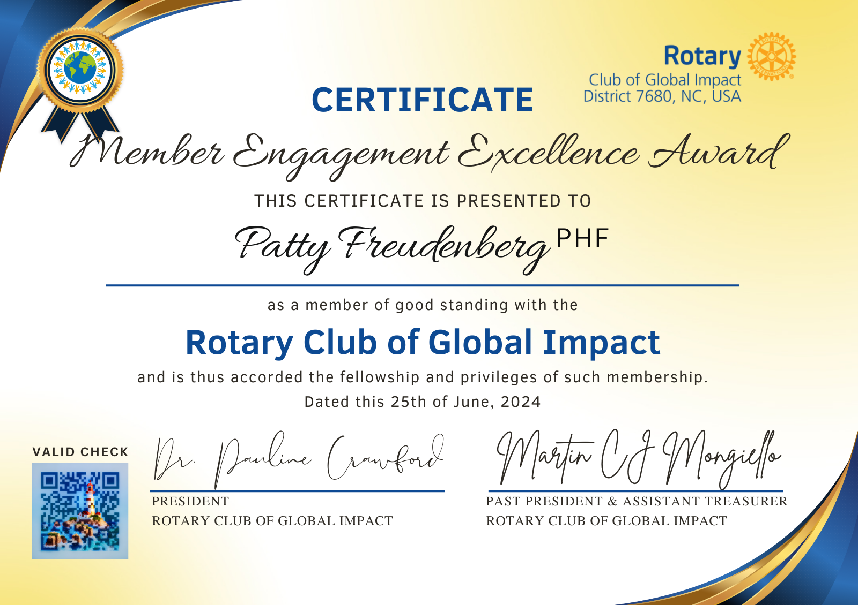

Slide 10
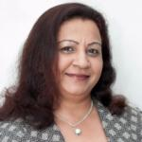
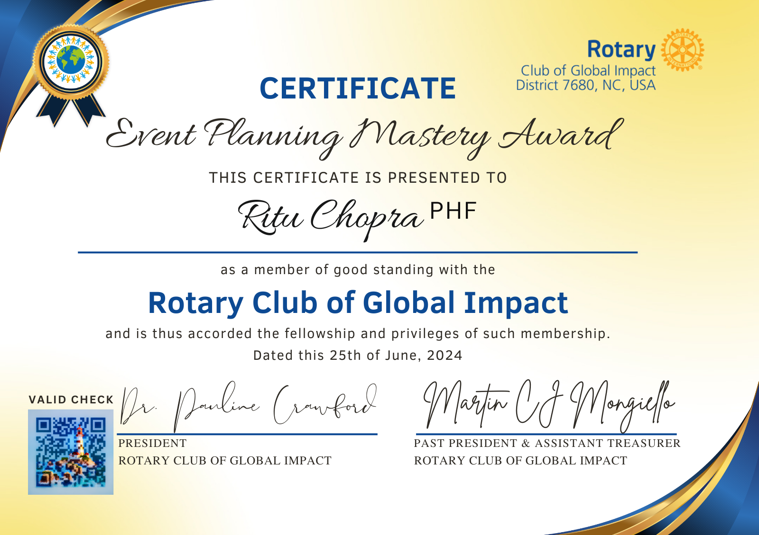

Slide 11
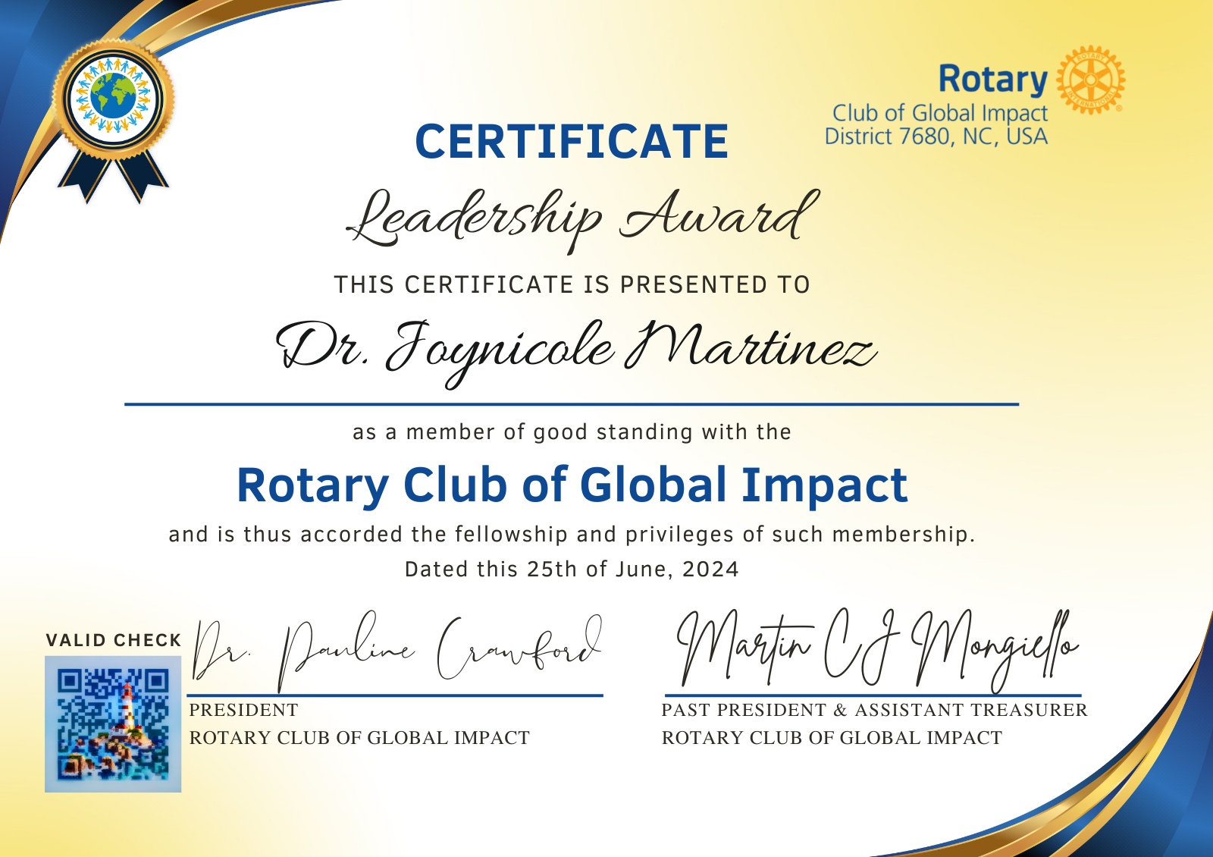

Slide 12
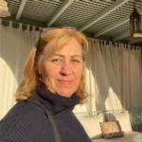
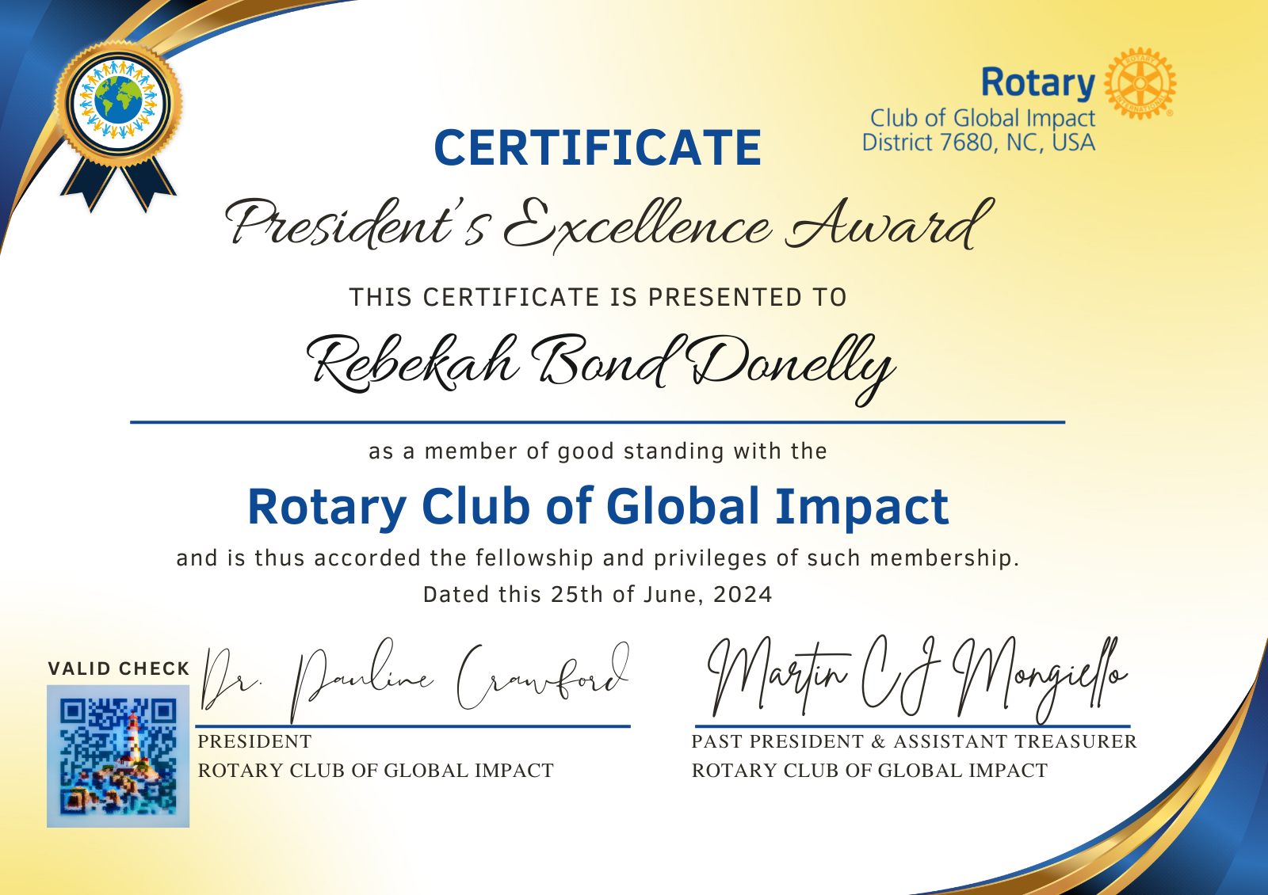

Slide 13
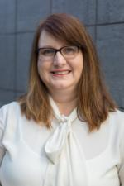

Slide 15
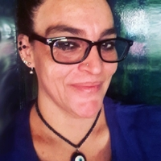

Slide 16
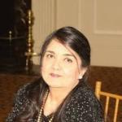
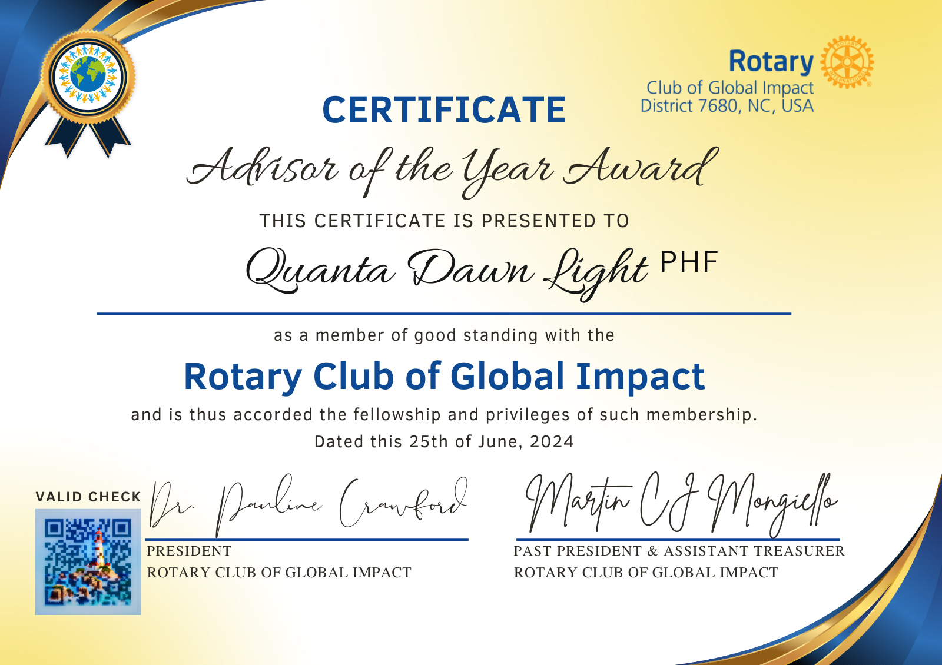

Slide 17
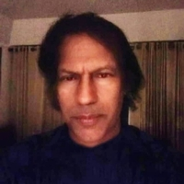
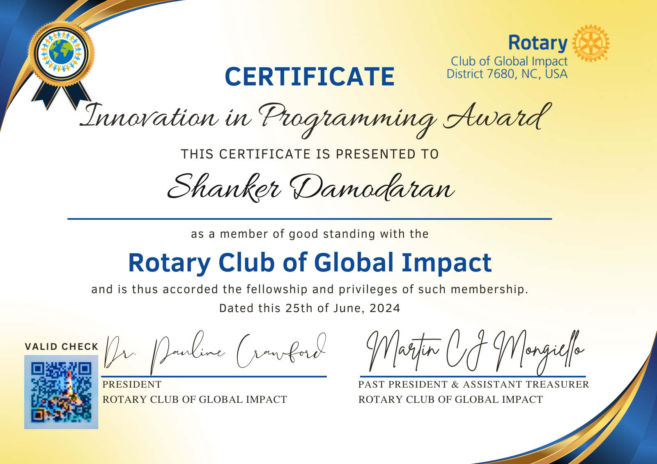

Slide 18
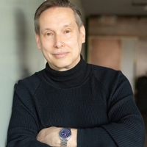

Slide 19
