Slide 1
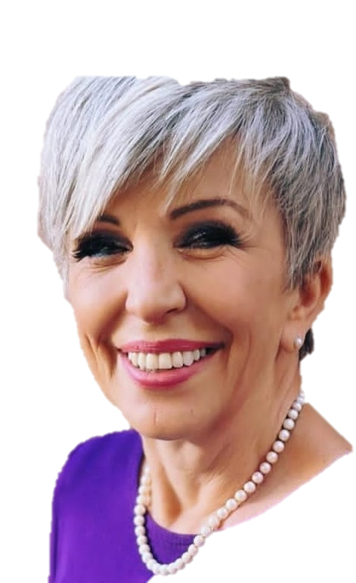




Rotary Club of global impact
President Dr. Pauline Crawford, PHD
“Enriching our world through the power of authentic harmony”

Slide 2
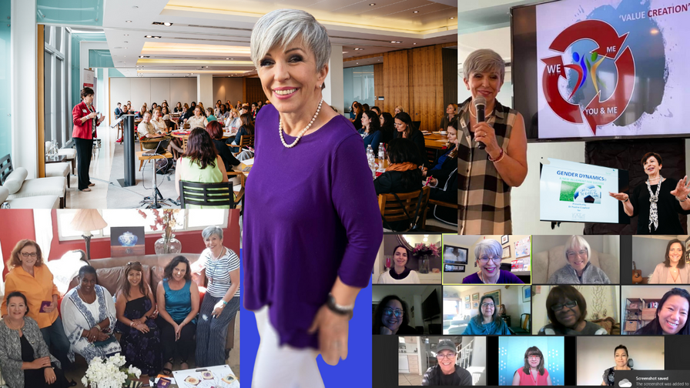
"life is what you make IT...
service is about tuning into others"
THREE STEPS
Know who you are
Value creation grows when we tune into others
We transform our power source with love

Slide 3
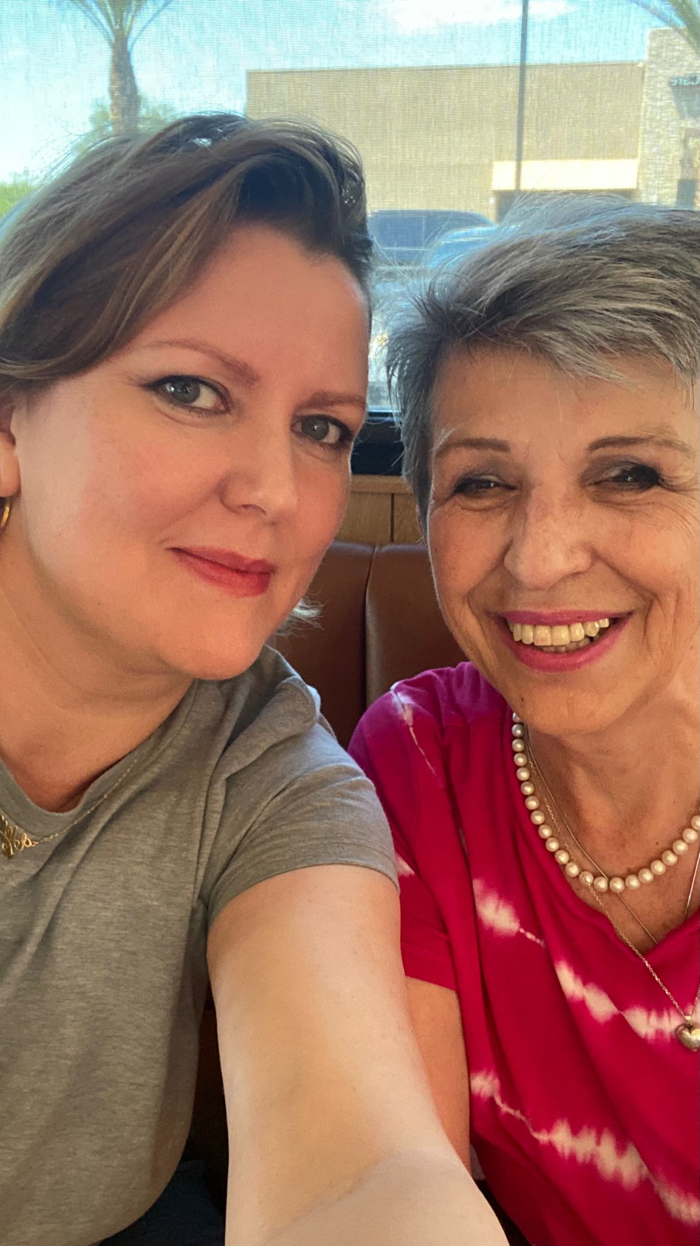
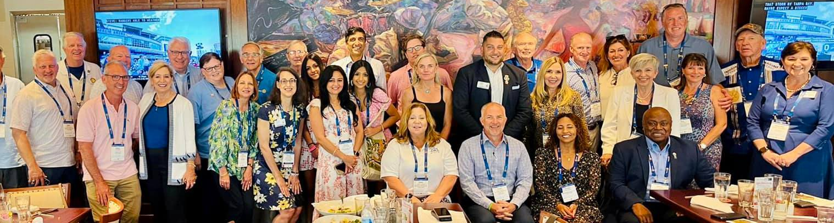

Slide 4

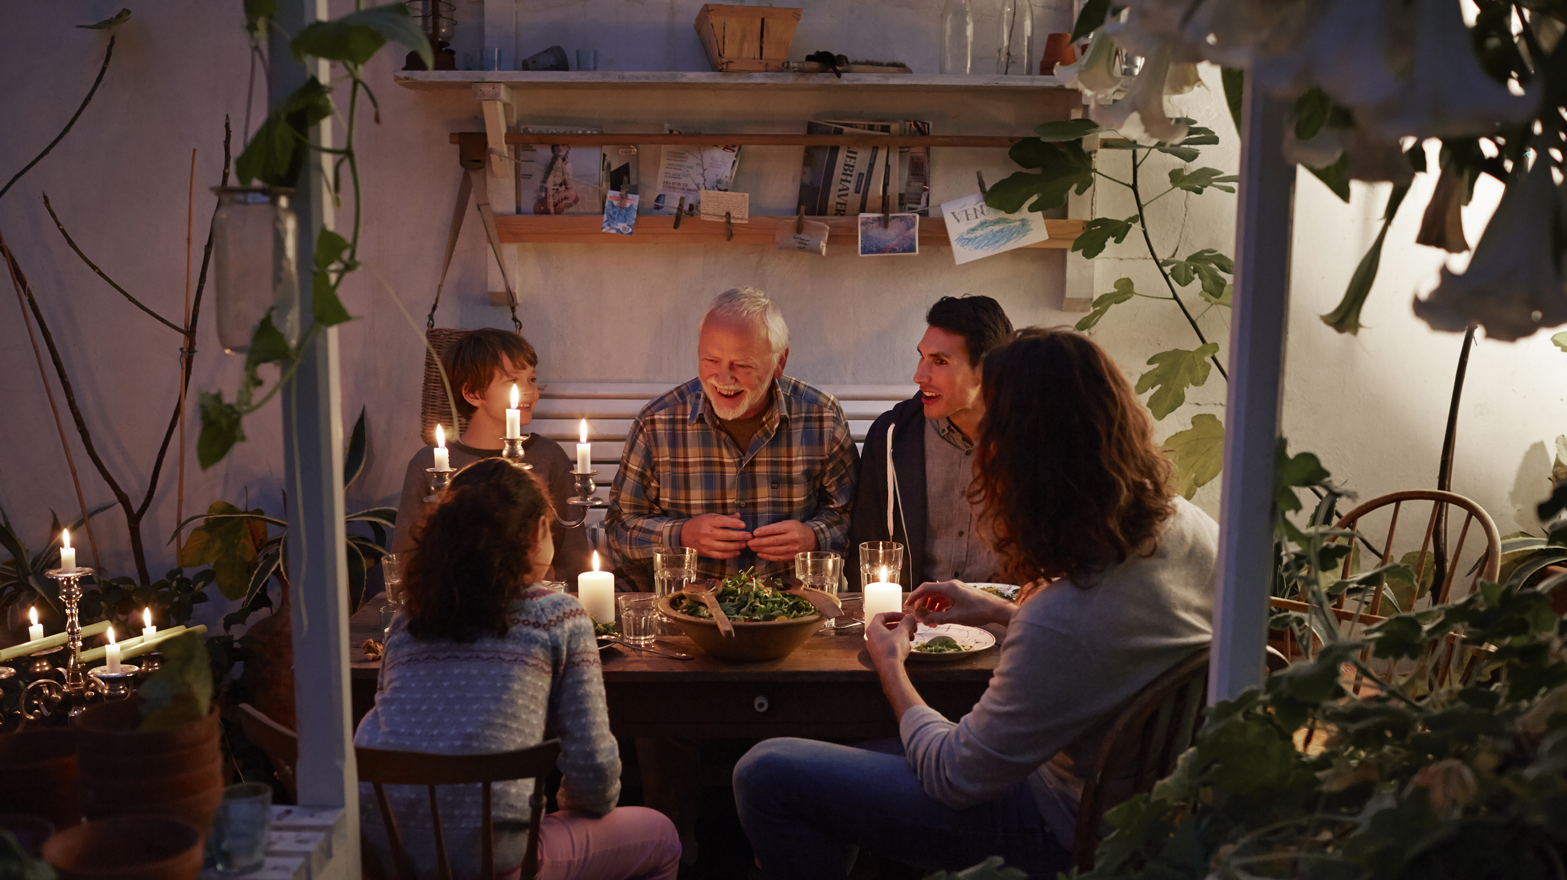



Meetings
Monthly live-streamed meeting on the second Tuesday of each month:
Utilizing technology where available to live stream our meetings with special guest speakers will create hope by allowing us to reach a global audience and inspire them with our impactful projects and initiatives.
Private Club Meeting on the fourth Tuesday of each month:
Providing a private meeting for members with Passion Project presentations and support resources as needed by members will create hope by fostering deeper connections and knowledge-sharing among our community.

Slide 5


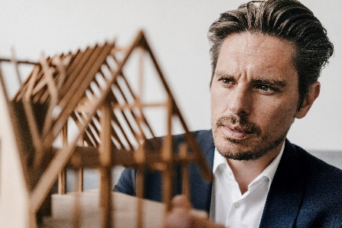
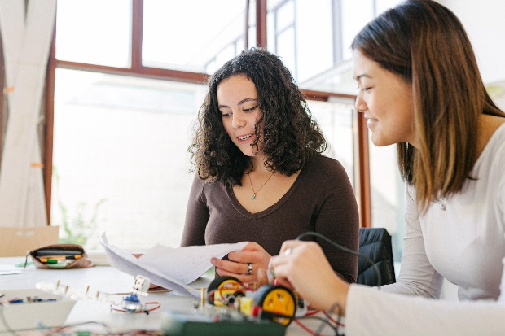
YOUR PASSION PROJECTS
We want to get to know you as club members - your talents and passion projects:
By fostering a strong sense of community and camaraderie, we will create hope by supporting one another's talents and passions.
Encouraging members to share their projects to inspire hope as we collectively work towards making a difference.

Slide 6
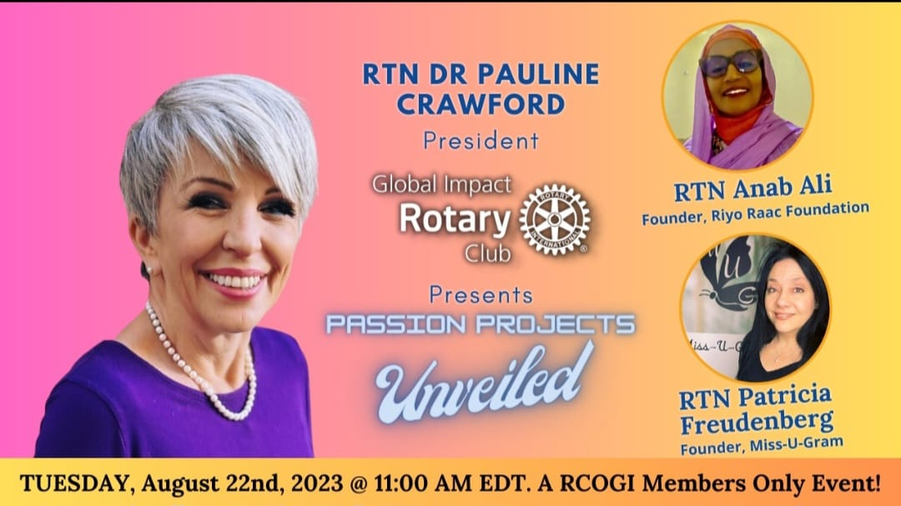

Slide 7


"what do you desire?"
Is it the TRUTH?
Is it FAIR to all concerned?
Will it build GOODWILL and BETTER FRIENDSHIPS?
Will it be BENEFICIAL to all concerned?

Slide 8
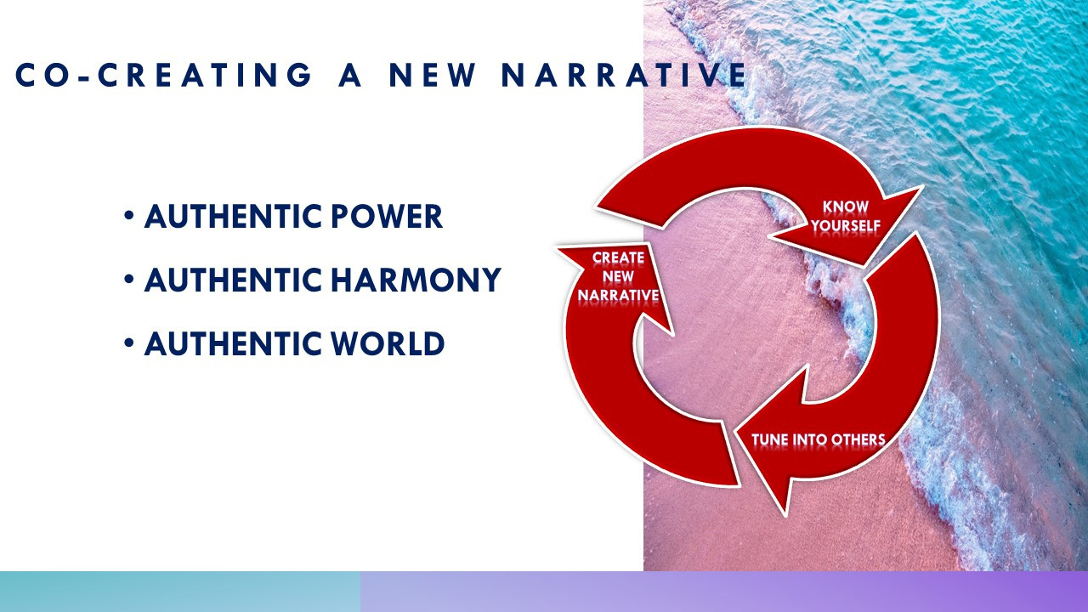


Slide 9
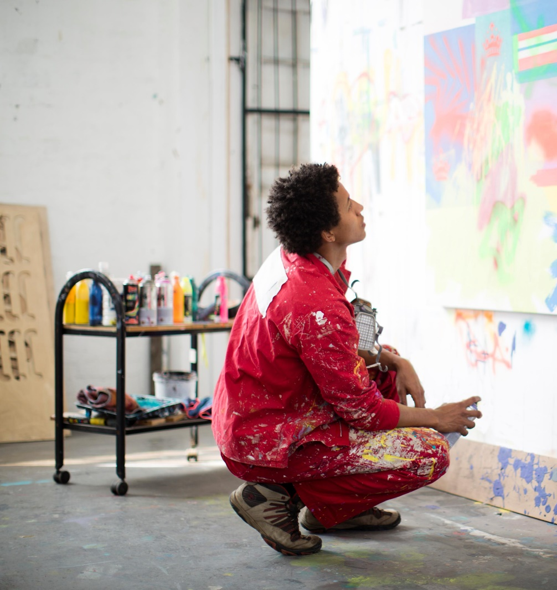

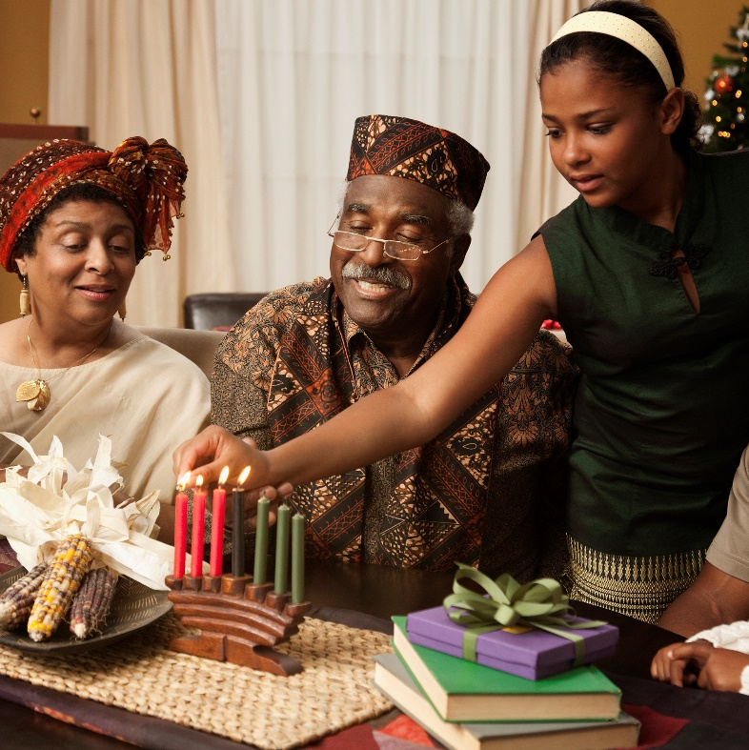

YOUNG ADULT EDUCATION & ADULT ENTERPRISE BUILDING
Focusing on youth enlightenment, authentic harmony, and inter-generational conversations – our goal is to end toxic behavior and violence against women….
Grow vibrant social impact.
Prioritizing these areas aligns with the Rotary International slogan of "Creating Hope in the World" by addressing critical challenges and working towards positive change.

Slide 10
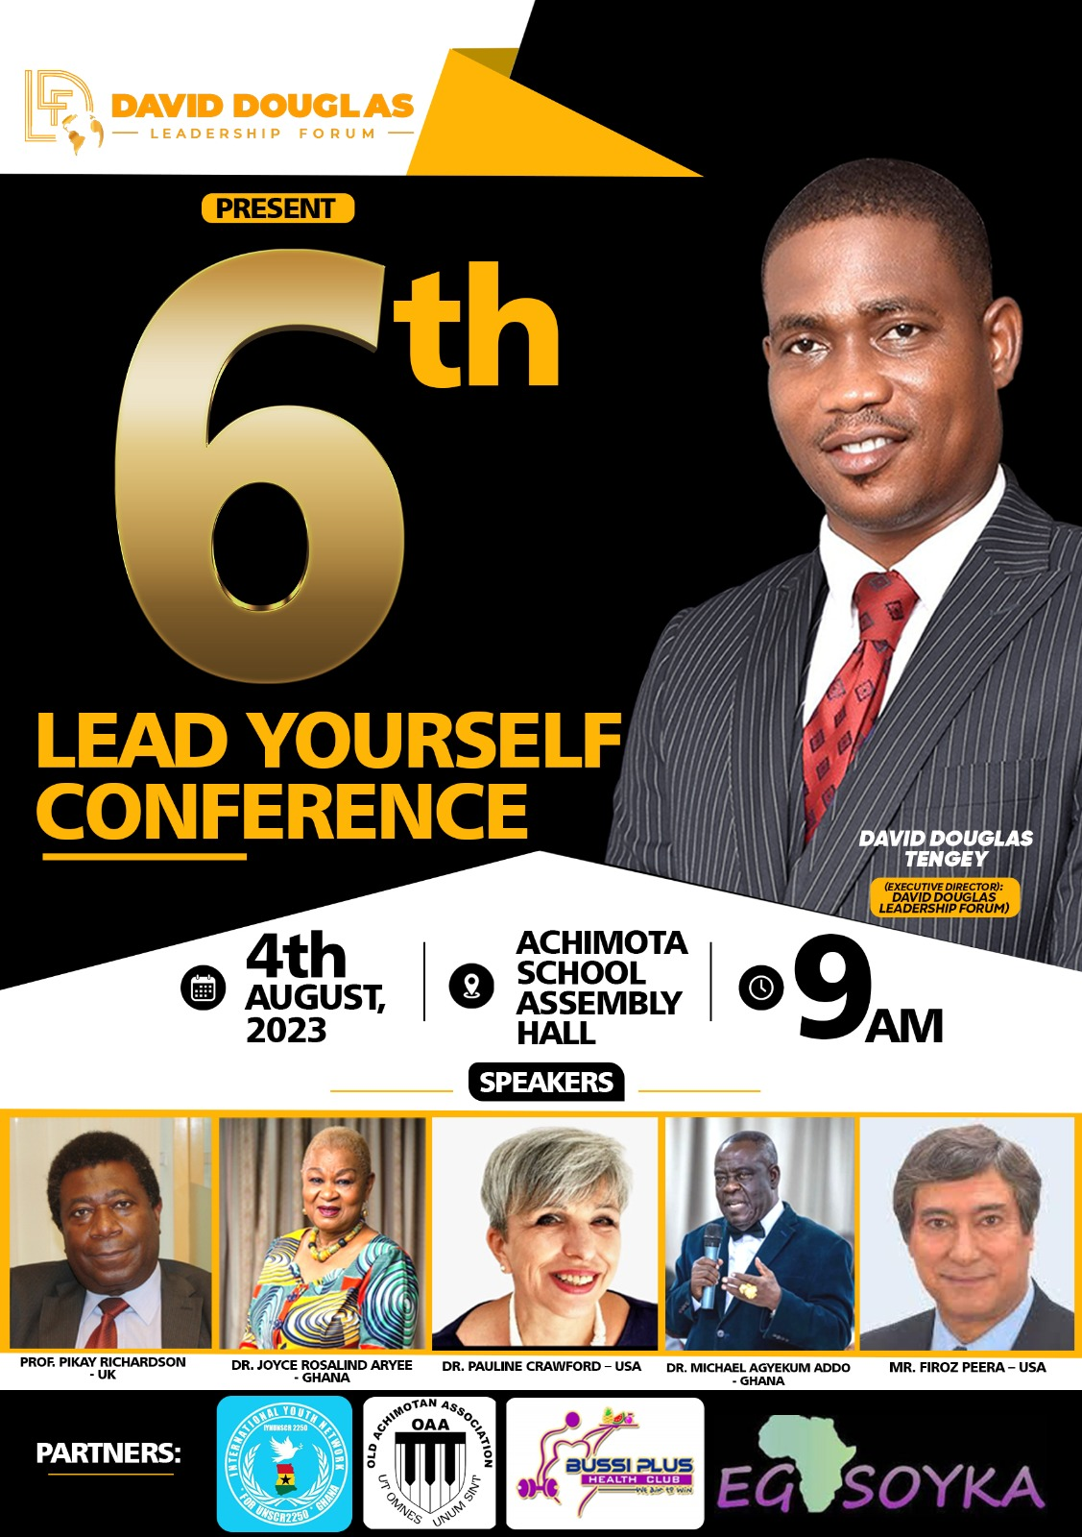
EDUCATION for hope in our world
Prioritizing education will create hope by empowering young and old alike to build a better future for themselves and their communities.
Proposal to invite a Twin club with David Douglas's club in Accra:
Building international friendships through twin clubs will create hope by fostering education and entrepreneurship development.
SUGGESTION a global grant application for Youth Education Across Africa for boys and girls 18 plus
Securing global grants will create hope by providing resources to implement impactful projects e.g., Youth Education that addresses the social impact of the younger generation on economic development and family life to transform all lives.

Slide 11
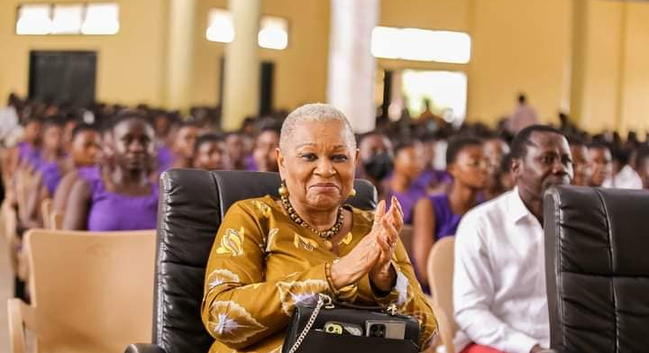
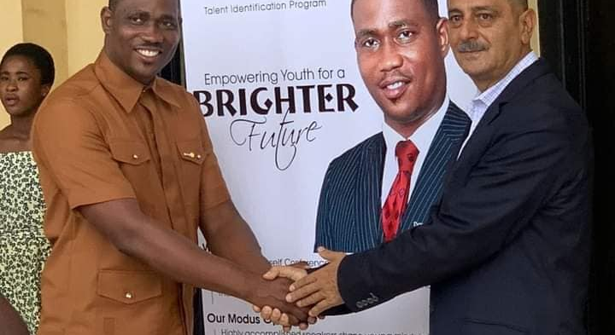
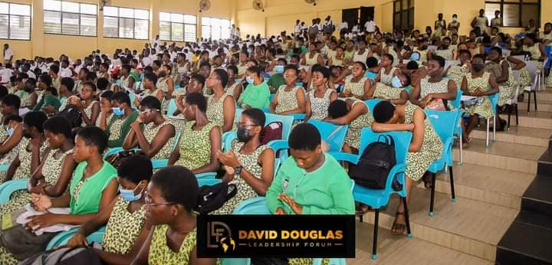
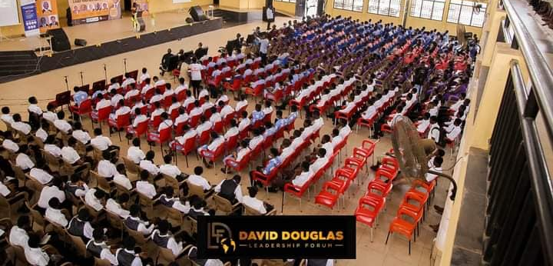

Slide 12


FOCUS ON PEACE PROJECTS & AUTHENTIC HARMONY IN LEADERSHIP
Promoting peace projects will create hope by working towards ending violence and conflict, providing hope for a more harmonious and stable world.
E.G, continuing support for Ukraine and projects that bring peace to our global communities.
Stopping Violence against Women …
Collaborating with The Red Card Campaign to stop violence against women and girls will create hope by advocating for a safer and more equitable society.

Slide 13
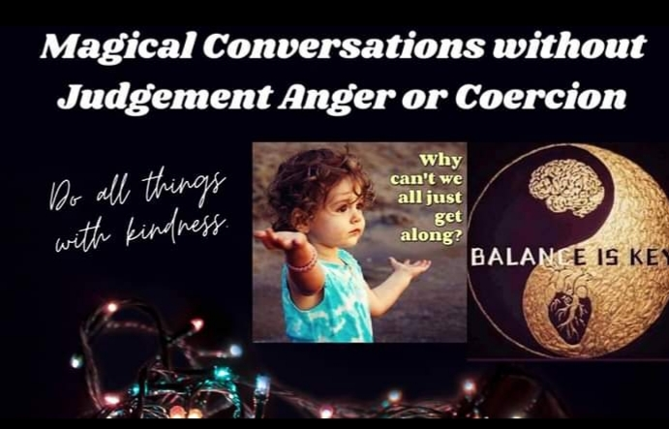

Slide 14


Slide 15
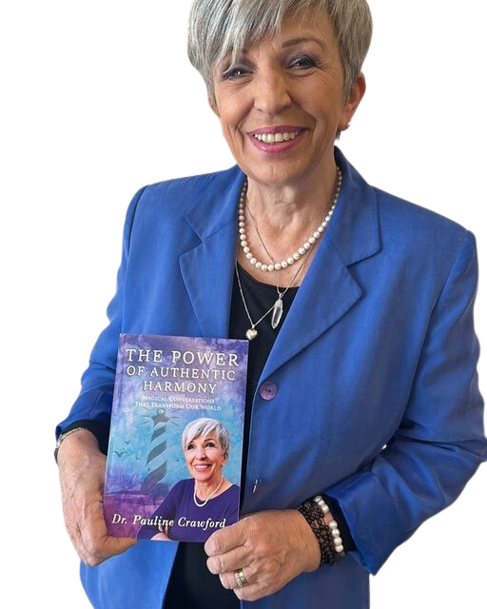
Rotary Club of global impact
“Enriching our world through the power of authentic harmony”
Thank you

