Slide 1
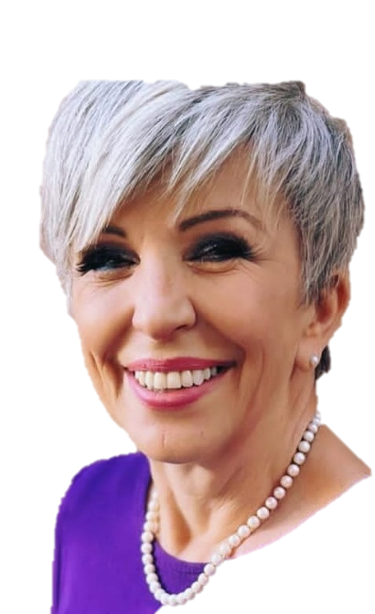




Rotary Club of global impact
President Dr. Pauline Crawford, PHD
“Enriching our world through the power of authentic harmony”

Slide 2
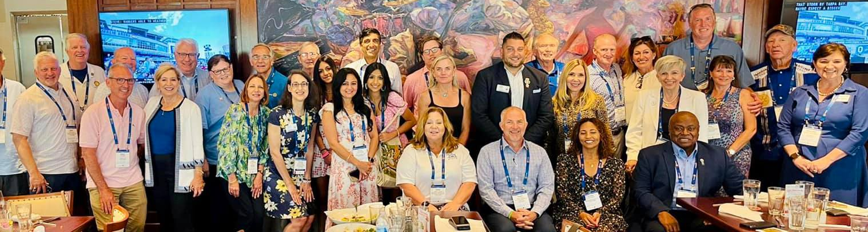

Slide 3
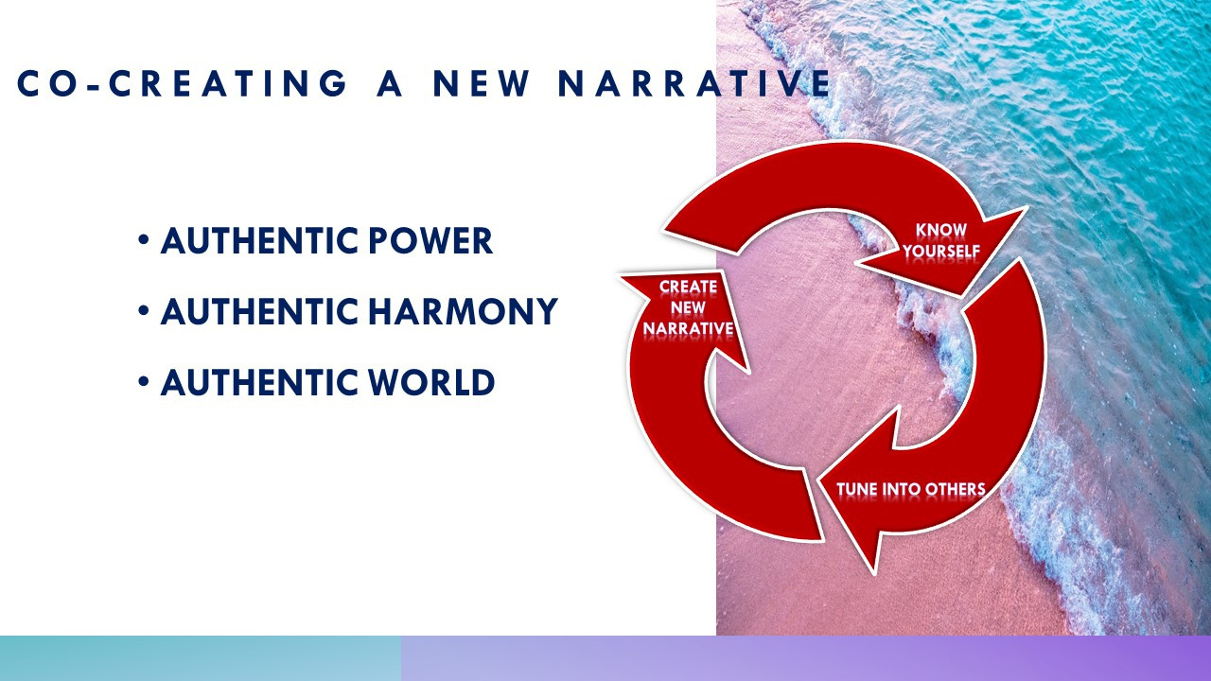
"life is what you make IT...
service is about tuning into others"
THREE STEPS
Know who you are
Value creation grows when we tune into others
We transform our power source with love

Slide 4


Is it the TRUTH?
Is it FAIR to all concerned?
Will it build GOODWILL and BETTER FRIENDSHIPS?
Will it be BENEFICIAL to all concerned?

Slide 5
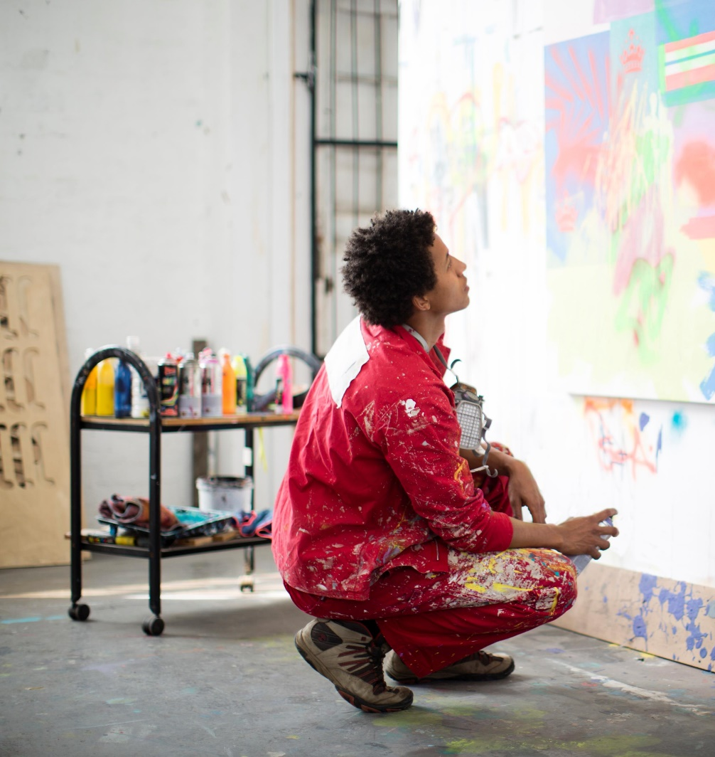



YOUNG ADULT EDUCATION & ADULT ENTERPRISE BUILDING
Focusing on youth enlightenment, authentic harmony, and inter-generational conversations – our goal is to end toxic behavior and violence against women….
Grow vibrant social impact.
Prioritizing these areas aligns with the Rotary International slogan of "Creating Hope in the World" by addressing critical challenges and working towards positive change.

Slide 6
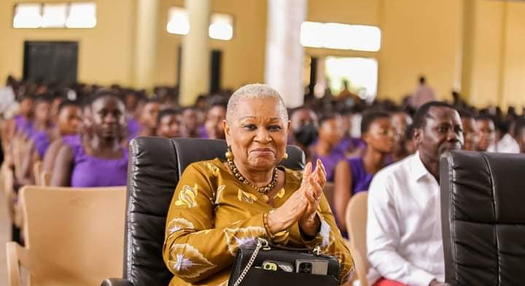
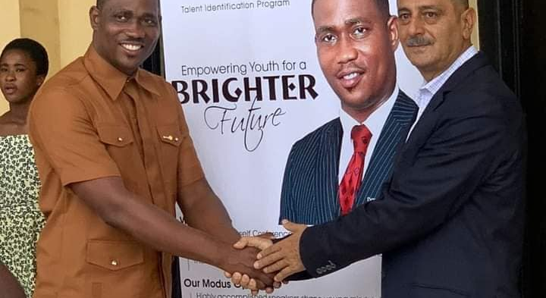
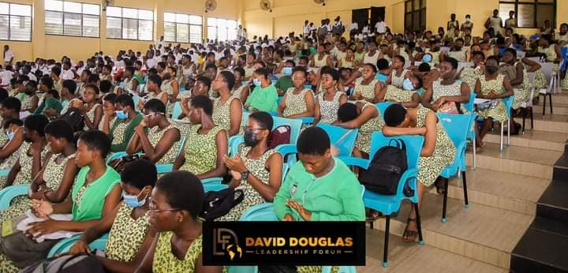
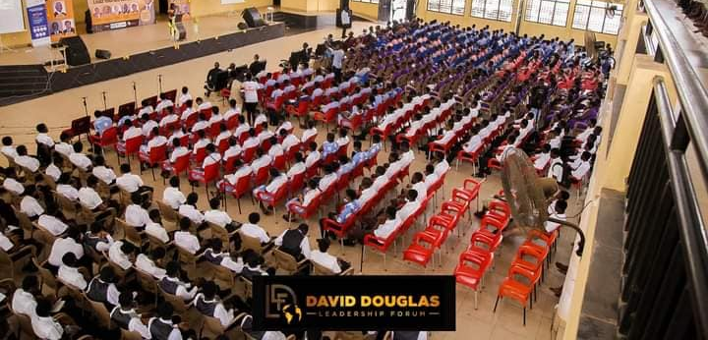

Slide 7


FOCUS ON PEACE PROJECTS & AUTHENTIC HARMONY IN LEADERSHIP
Promoting peace projects will create hope by working towards ending violence and conflict, providing hope for a more harmonious and stable world.
E.G, continuing support for Ukraine and projects that bring peace to our global communities.
Stopping Violence against Women …
Collaborating with The Red Card Campaign to stop violence against women and girls will create hope by advocating for a safer and more equitable society.

Slide 8
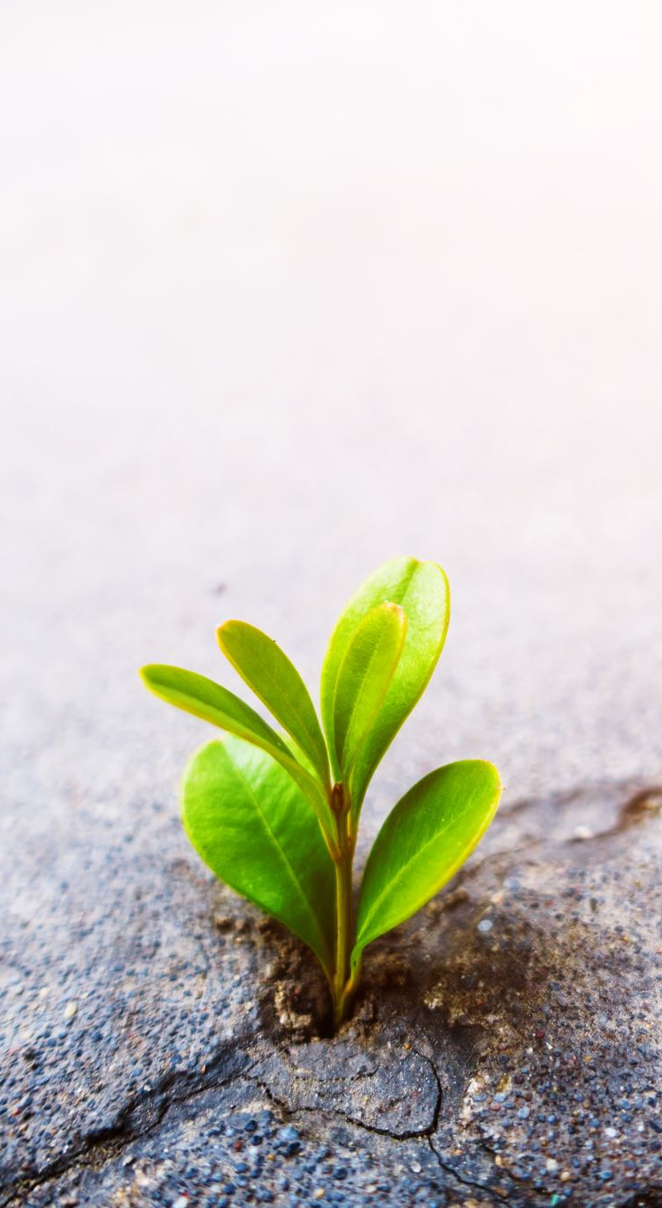

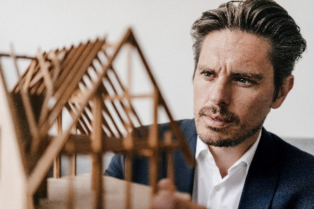
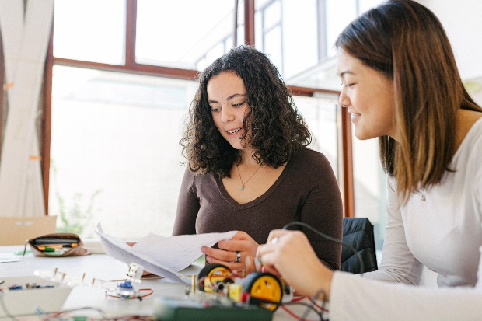
YOUR PASSION PROJECTS
We want to get to know you as club members - your talents and passion projects:
By fostering a strong sense of community and camaraderie, we will create hope by supporting one another's talents and passions.
Encouraging members to share their projects to inspire hope as we collectively work towards making a difference.

Slide 9
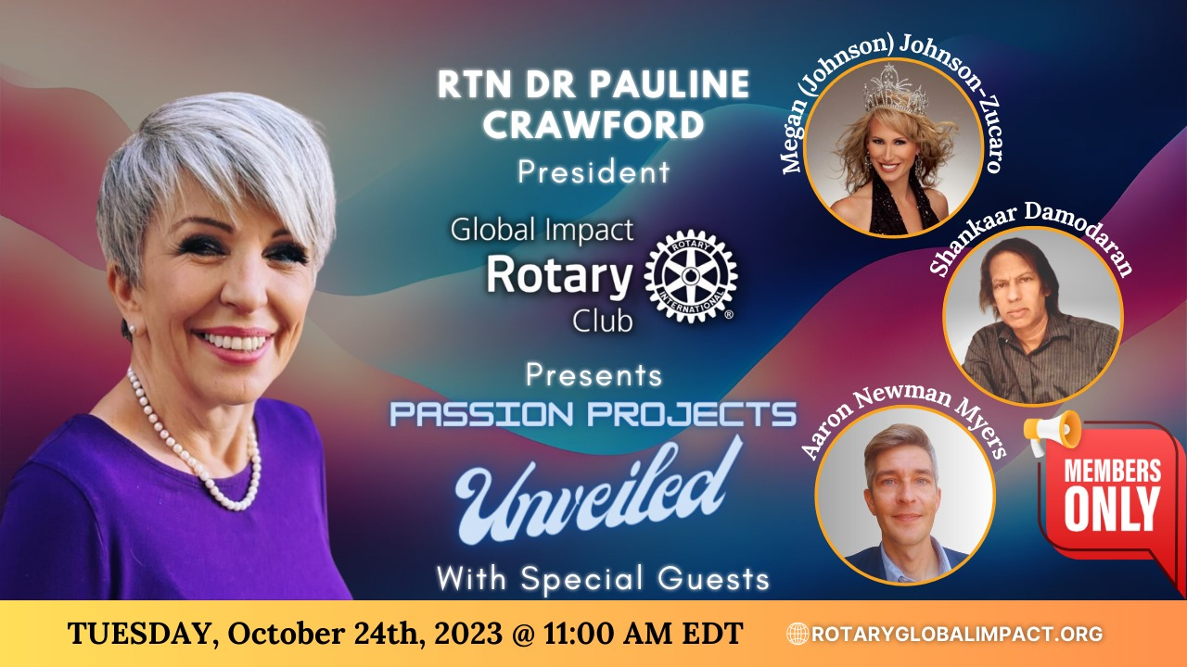

Slide 10
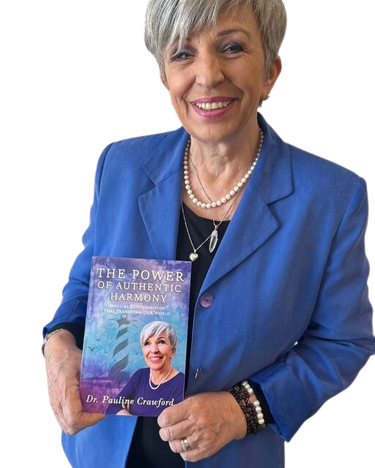
Rotary Club of global impact
“Enriching our world through the power of authentic harmony”
Thank you

