Slide 1
S T R O N G A R E A S
Bob Gross
District Governor Elect
(DG 2022-23)

Slide 2
ROTARY ORGANIZATION
Rotary International
Board of Directors
President - Shekhar Mehta/Jennifer Jones
Zones - Rotary has 34 Zones throughout the World
We are in Zone 33 – often linked with Zone 34 (Zones 33/34)
Each has a director – Peter Kyle followed by Jeremy Hurst
46,000 Clubs
District 7770
74 clubs
3,500 members
Columbia – Charleston
Myrtle Beach – Hilton Head

Slide 3
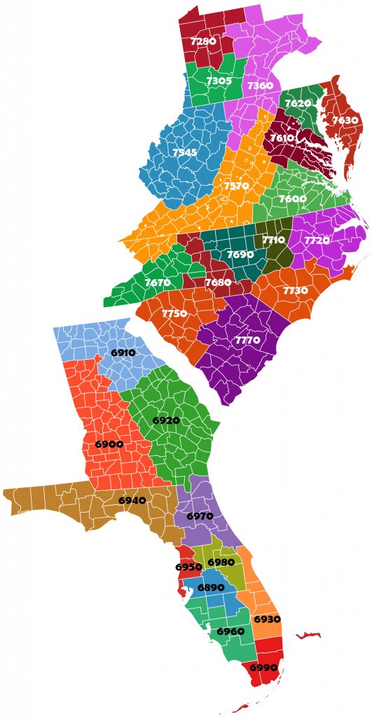

Slide 4
DISTRICT 7770
Council of Governors
Past District Governors (PDGs)
District Governor Line
PDG Pauline Levesque – Myrtle Beach
DG Paul Walter – Hilton Head
DGE Bob Gross – Sea Island (Beaufort) 2022-23
DGN Mike Jukofsky – Hilton Head 2023-24
DGND Mary Gasque – Five Points (Columbia) 2024-25
Committees
Membership – Digit Metheny/Sandy Olson
Foundation – PDG Paula Matthews
Public Image – Donald Hovis/Ken Gasque
Finance – PDG Rod Funderburk
Long Range Planning – DGN Mike Jukofsky

Slide 5
ASSISTANT GOVERNORS
Area 1 Ram'on Wideman
Area 2 Ben Carlton
Area 3 Babbie Jaco
Area 4 Mary Briggs
Area 5 Whitney McDaniel
Area 6 Kimberly Nolte
Area 7 Sandy Morckel
Area 8 Amy Heath
Area 9 Angie Kohl
Area 10 Debbie Huntsberry
Area 11 Susan Cunnup
Area 12 Melissa Evans
Area 13 Henry Miller
Area 14 Butch Byron
Area 15 A. L. Hough-Everage
Area 16 Charles Saverance

Slide 6
THE WORLD OF ROTARY
Rotary International Conventions
Copenhagen
Salt Lake City
Los Angeles
New Orleans
Atlanta
Bangkok
Rotary Club Meetings
Bahamas
Tokyo, Japan
Chang Mai, Thailand
China
Mongolia (4)
Tanzania
Istanbul (2)
Egypt (4)

Slide 7
THE WORLD OF ROTARY
Anyone can attend an International Convention
Often PDGs, DG, DGE, DGN, Committee Chairs
Benefits
Greater understanding of Rotary
Contacts/friendships
Rotary contacts
Istanbul
Alexandria, Egypt
Cairo, Egypt
Greater understanding of countries, cultures, people

Slide 9
I M A G I N E
Imagine a world that deserves our best where we get up each day knowing that we can make a difference.
Imagine a world without Polio.
Imagine a world with clean water for everyone.
Imagine a world free of disease.
Imagine a world where every child learns to read.
Imagine kindness, hope, love, and peace.
- RI President-elect Jennifer Jones

Slide 10
2022-23 LOGO & THEME
Circle - we are one people
7 dots – Rotary’s 7 Areas of Focus
Green bar – Australian Digging Stick – We are People of Action
Colors:
Purple - polio eradication
Green – the environment, the newest addition to our areas of focus
White - peace, our core mission.
Together, they are the colors of the women’s movement, the Suffragette.

Slide 11
ROTARY’S VISION STATEMENT
TOGETHER WE SEE A WORLD
WHERE PEOPLE UNITE AND TAKE ACTION
TO CREATE LASTING
CHANGE ACROSS THE GLOBE
IN OUR COMMUNITIES, AND IN OURSELVES.

Slide 12
ROTARY’S ACTION PLAN Four Priorities - next five years
Increase our impact
Expand our reach
Enhance participant engagement
Increase our ability to adapt

Slide 13
INCREASE OUR IMPACT
Eradicate Polio and leverage the legacy
Focus our programs and offerings
Improve our ability to achieve and measure impact

Slide 14
EXPAND OUR REACH
Grow and diversify our membership and participation
Create new channels into Rotary
Increase Rotary’s openness and appeal
Build awareness of our impact and brand

Slide 15
ENHANCE PARTICIPANT ENGAGEMENT
Support clubs to better engage their members
Develop a participant-centered approach to deliver value
Offer new opportunities for personal and professional connection
Provide leadership development and skills training

Slide 16
INCREASE OUR ABILITY TO ADAPT
Build a culture of research, innovation, and willingness to take risks
Streamline governance, and processes
Renew governance to foster more diverse perspectives in decision-making

Slide 17
ROTARY’S CORE VALUES
FELLOWSHIP
INTEGRITY
DIVERSITY
SERVICE
LEADERSHIP
By honoring the past and embracing our future, we can evolve and keep Rotary not only relevant, but thriving.

Slide 18
DISTRICT 7770’s ACTION PLAN
INCREASE OUR IMPACT
EXPAND OUR REACH
ENHANCE PARTICIPANT ENGAGEMENT
INCREASE OUR ABILITY TO ADAPT

Slide 20
DETAILS
DG cannot be very close to each club, but AG can
DG must rely on AGs to know what is happening in each club
Projects
Membership
Foundation
Issues
Needs
AGs should attend club monthly board meetings
AGs should attend club meetings once a month
Monthly zoom calls with DG & AGs
Monthly zoom calls with Club Presidents
Communication

Slide 21
ENVIRONMENT COMMITTEE
Supporting The Environment - Rotary’s Seventh Area of Focus
Rotary is committed to supporting activities that strengthen the conservation and protection of natural resources, advance ecological sustainability, and foster harmony between communities and the environment.
Rotary empowers communities to access grants and other resources, embrace local solutions, and spur innovation to address the causes and reduce the effects of climate change and environmental degradation.

Slide 22
ENVIRONMENT COMMITTEE
The Committee will partner with organizations that sponsor and perform environmental projects.
Such organizations might include:
The Nature Conservancy
The South Carolina Coastal Conservation League
Open Land Trust
Clemson University (stormwater management)
Sierra Club
Palmetto Pride
Water Environment Association of South Carolina

Slide 23
ENVIRONMENT COMMITTEE
Typical projects might include:
Beach sweeps, river sweeps
Creating butterfly gardens
Stabilizing stream banks
Uncovering streams that have been piped
Re-seeding oyster beds
Planting sea oats on beach dunes and marshes
Clearing open land views

