Slide 1


“Together Let’s Grow Rotary”
The Nuts & Bolts of Growing Membership
Title Page Option

Slide 2
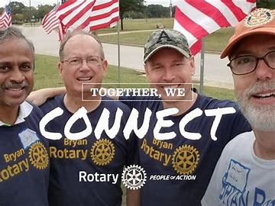
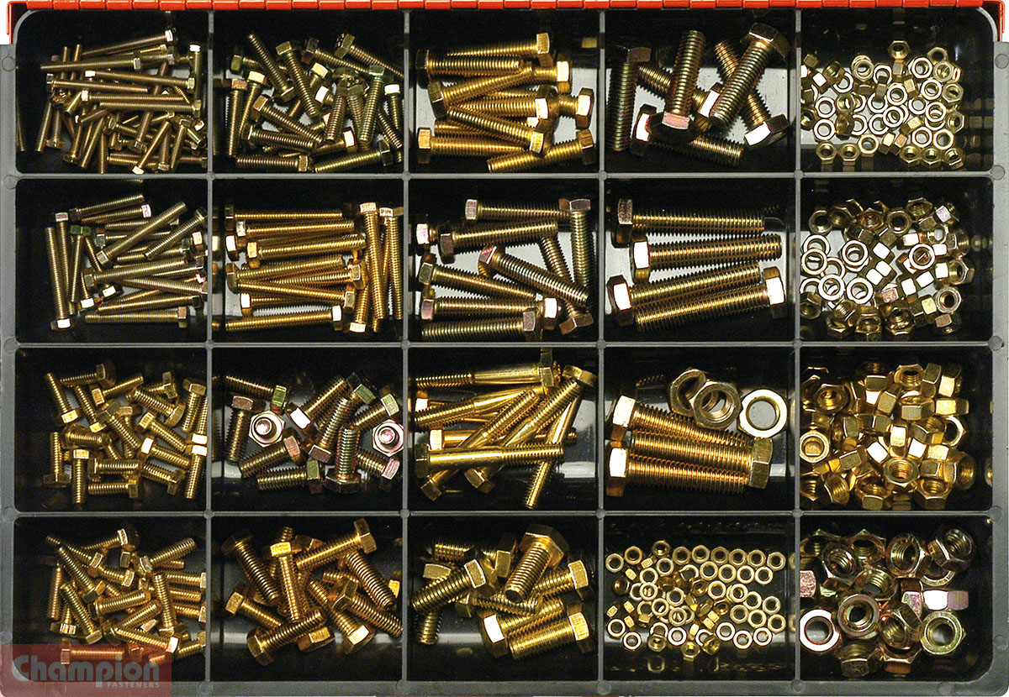
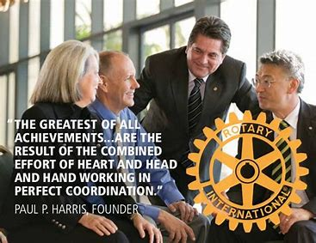
Nuts + Bolts = Strength
Clubs + Members = Doing Good in the World
Title Page Option

Slide 3

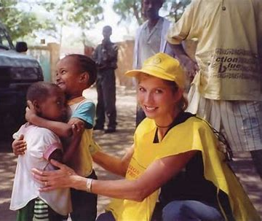

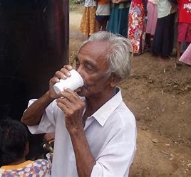



Why Does Membership Growth Matter?
Title Page Option

Slide 4

What Makes A Successful Club?
Five Common Characteristics
Leadership
Engaged Members
Public Image
Service
Membership Growth Culture
Title Page Option

Slide 5




What Makes A Successful Club?
Strong Leadership
Leadership Continuity
Identifying Potential Leaders
Mentoring & Training
Title Page Option

Slide 6
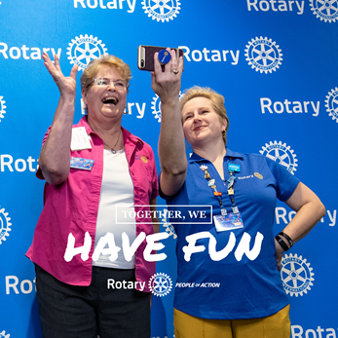
What Makes A Successful Club?
Engaged Members
Consistent flexible meetings/virtual
New member orientation & training
Strong friendships, fellowship & fun
Title Page Option

Slide 7
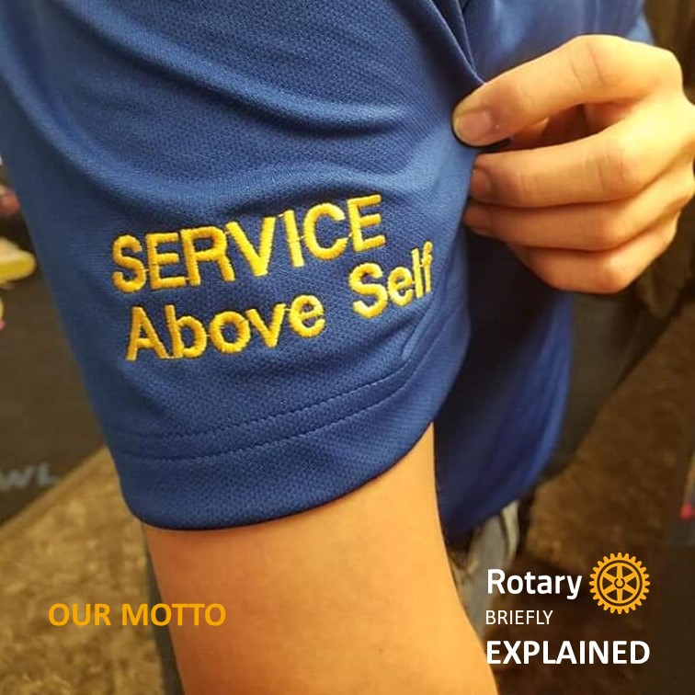
What Makes A Successful Club?
Meaningful Service
Meaningful projects
Signature project/fundraiser
Recognize member time/talent
Title Page Option

Slide 8
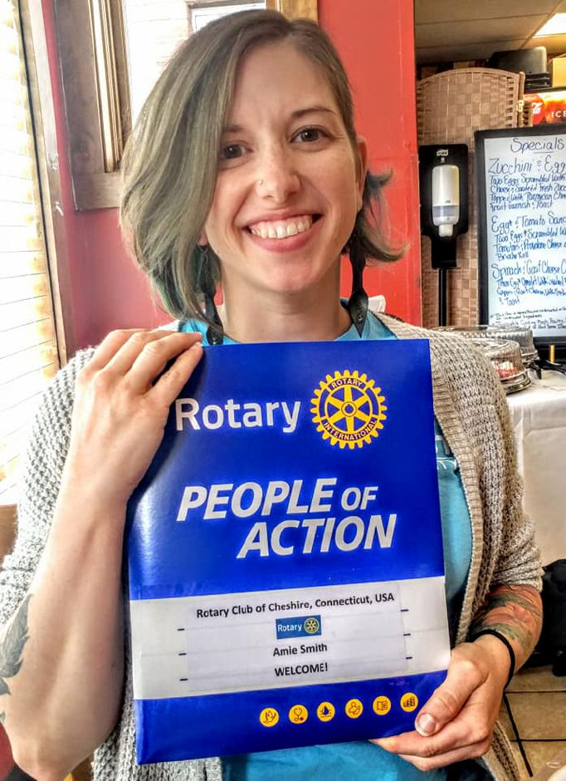
What Makes A Successful Club?
Strong Growth Culture
Set membership goals
Majority of members sponsor new members
Hold events specifically for
attracting new members
Title Page Option

Slide 9

What Makes A Successful Club?
Public Image
Visible in community
Include community members
Effective use of media tools
Do and be seen
Title Page Option

Slide 10
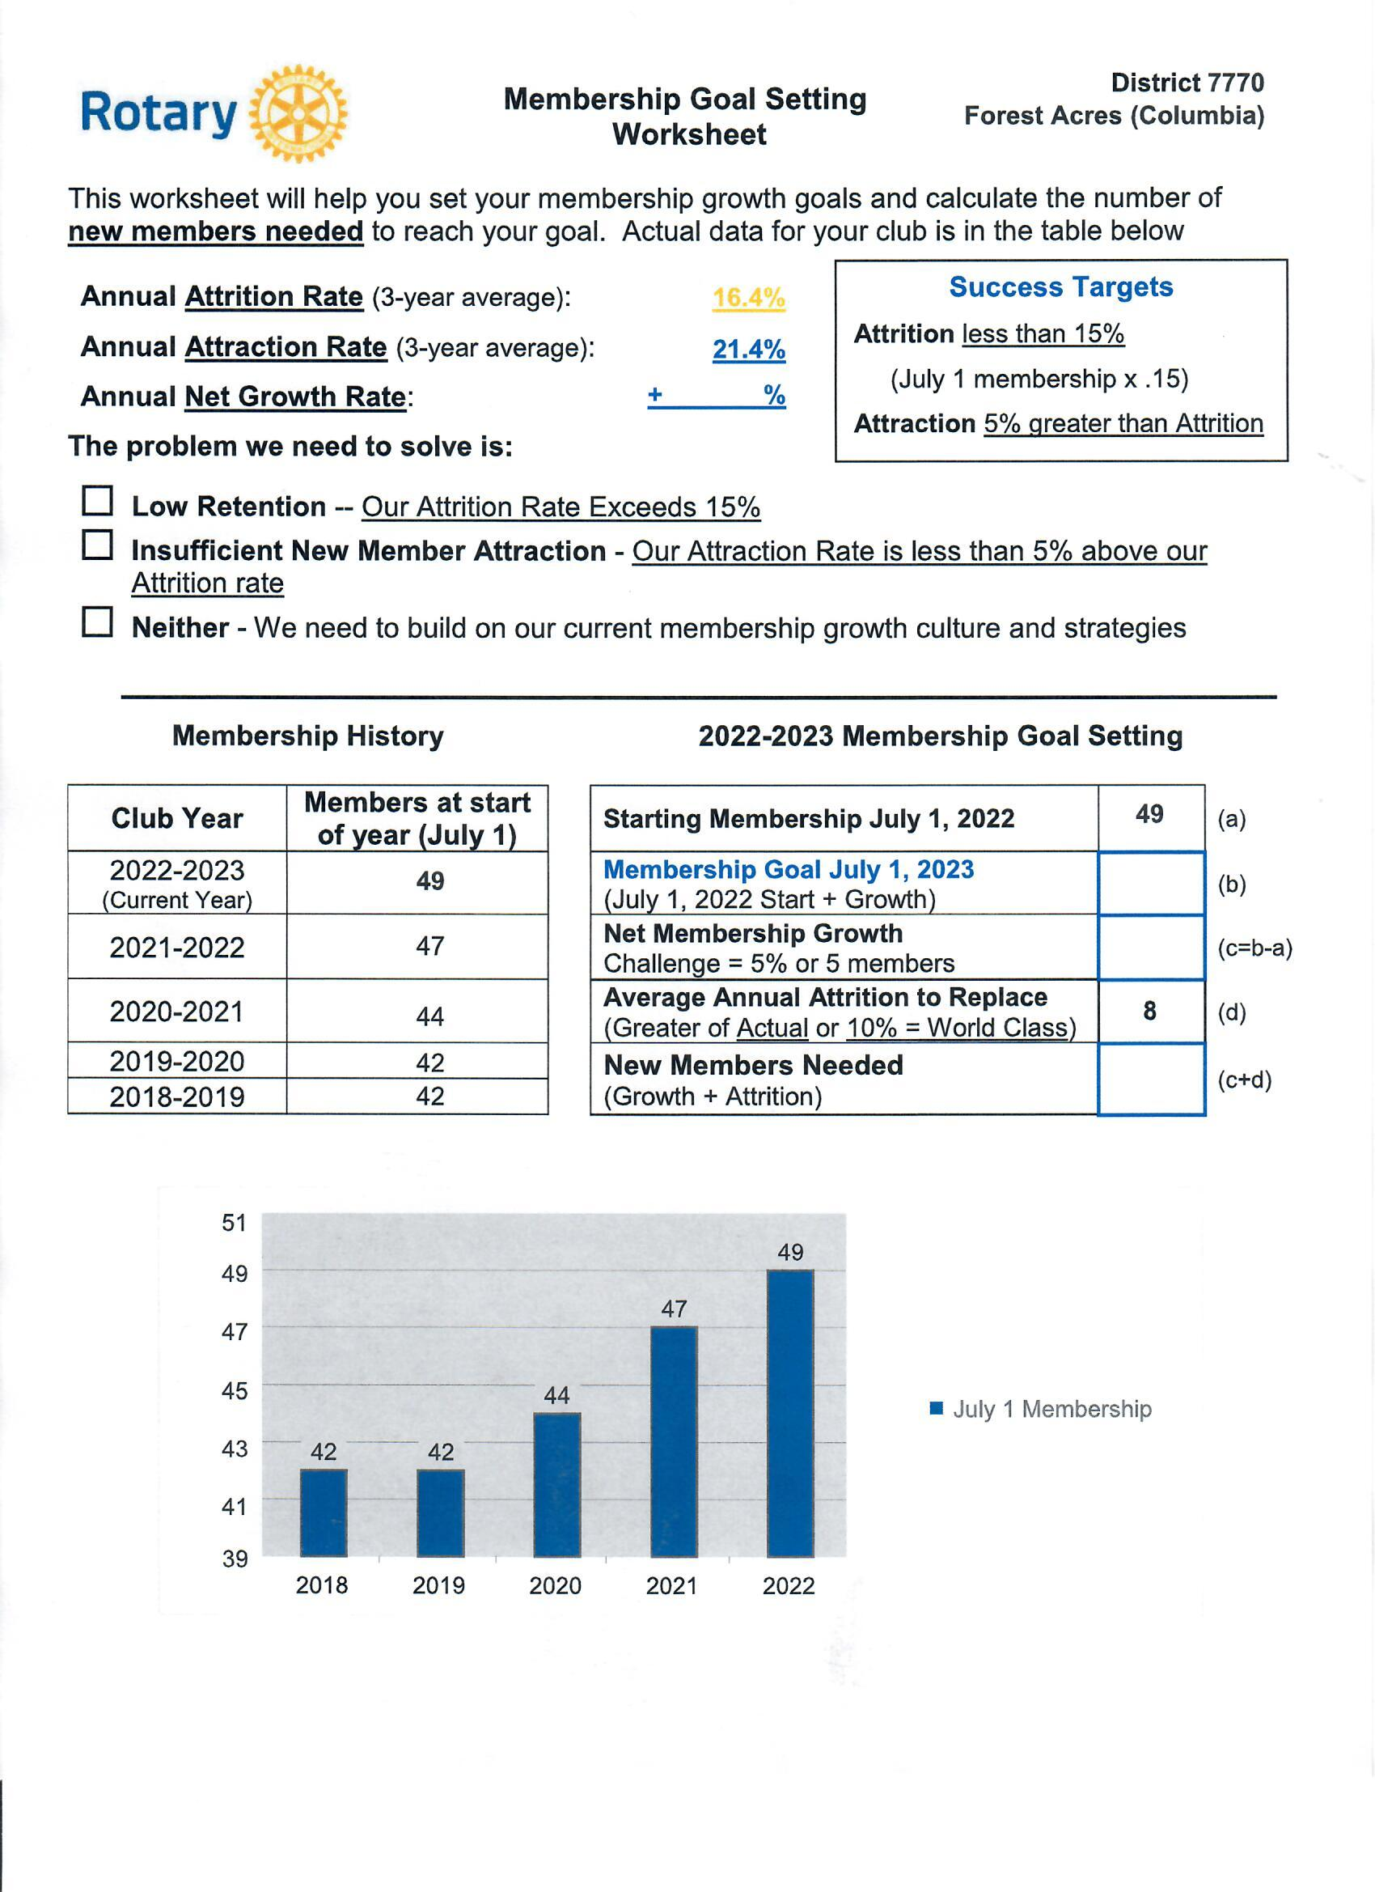

Back To Basics
Membership Goal Worksheet
Attrition & Attraction
Set membership goal
Title Page Option

Slide 11
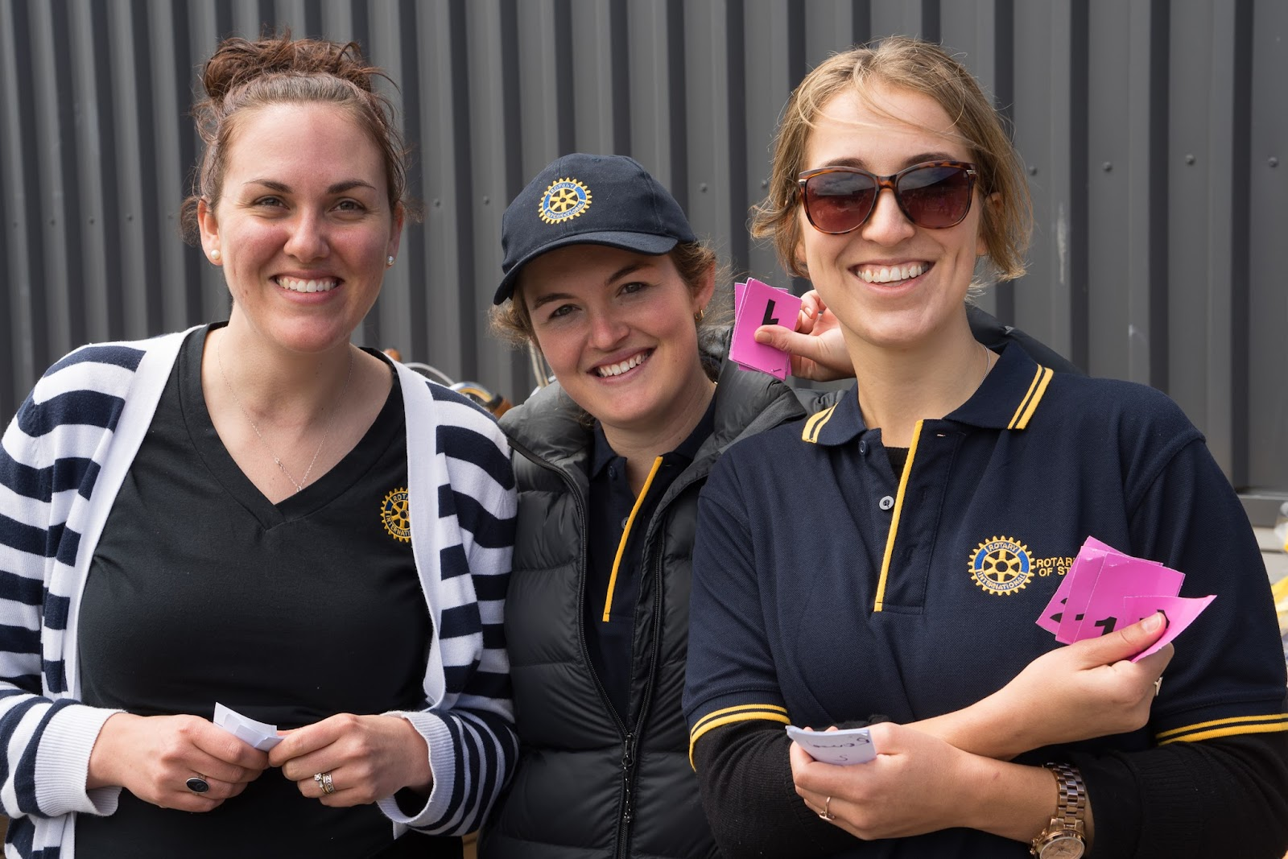


Intentional Growth Strategies
Written Strategy Statement
“Our club is committed to grow membership consistently & moderately every year by 5%.”
Membership Team
Membership Plan
Strong Growth Culture
Discover Rotary
Title Page Option

Slide 12
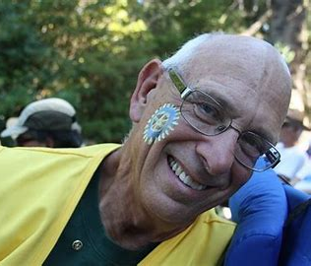



Membership Team
Title Page Option

Slide 13
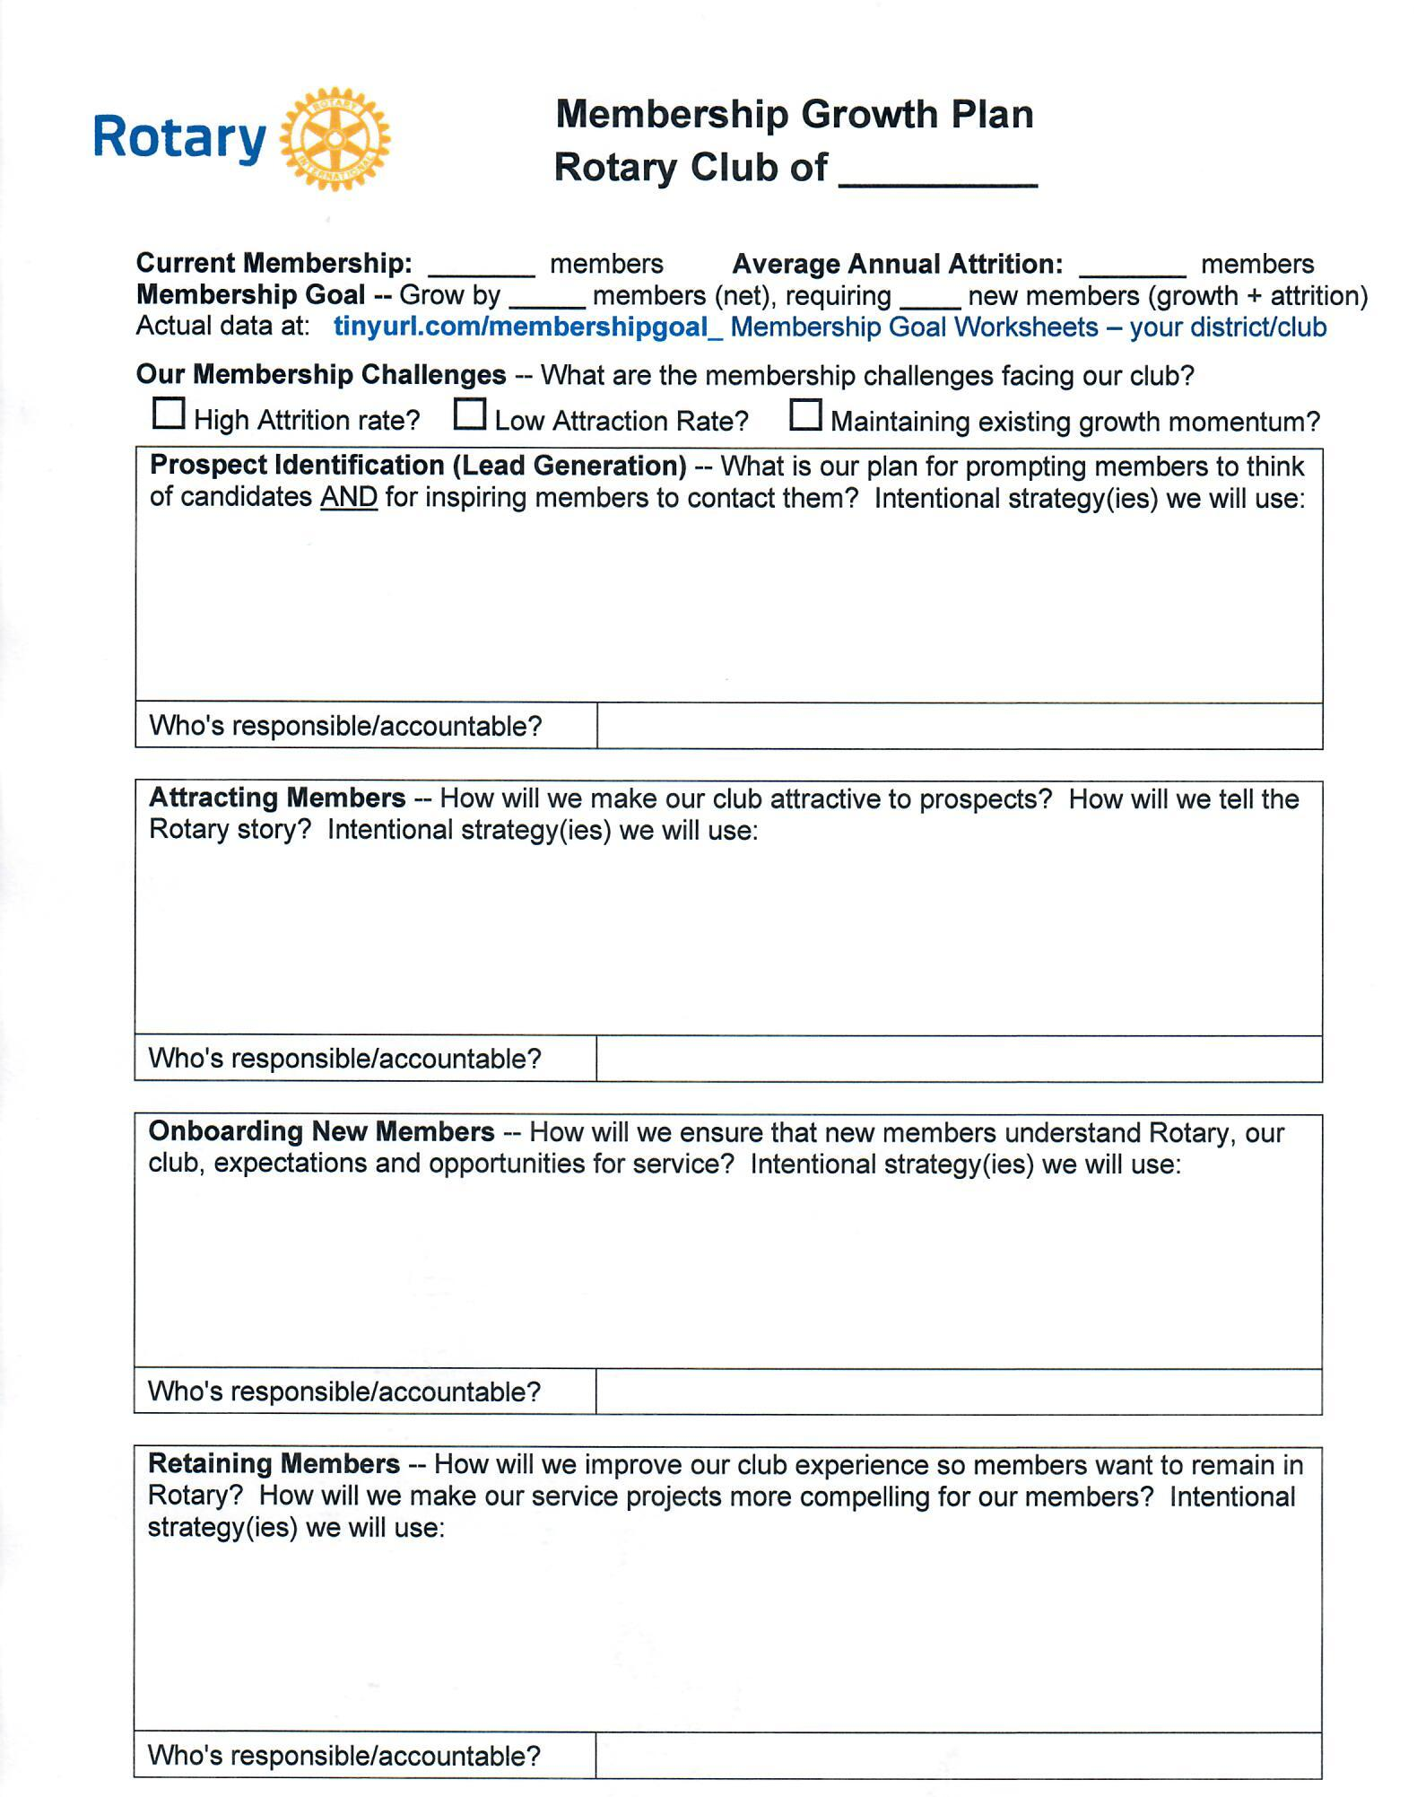
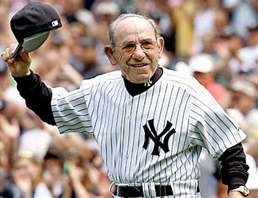
Membership Plan
“If you don’t know where you’re going, you’ll end up somewhere else.”
Title Page Option

Slide 14



Developing Strong Growth Culture
Club Members Commit To Growing
Membership Every Year

Slide 15





Discover Rotary

Slide 16
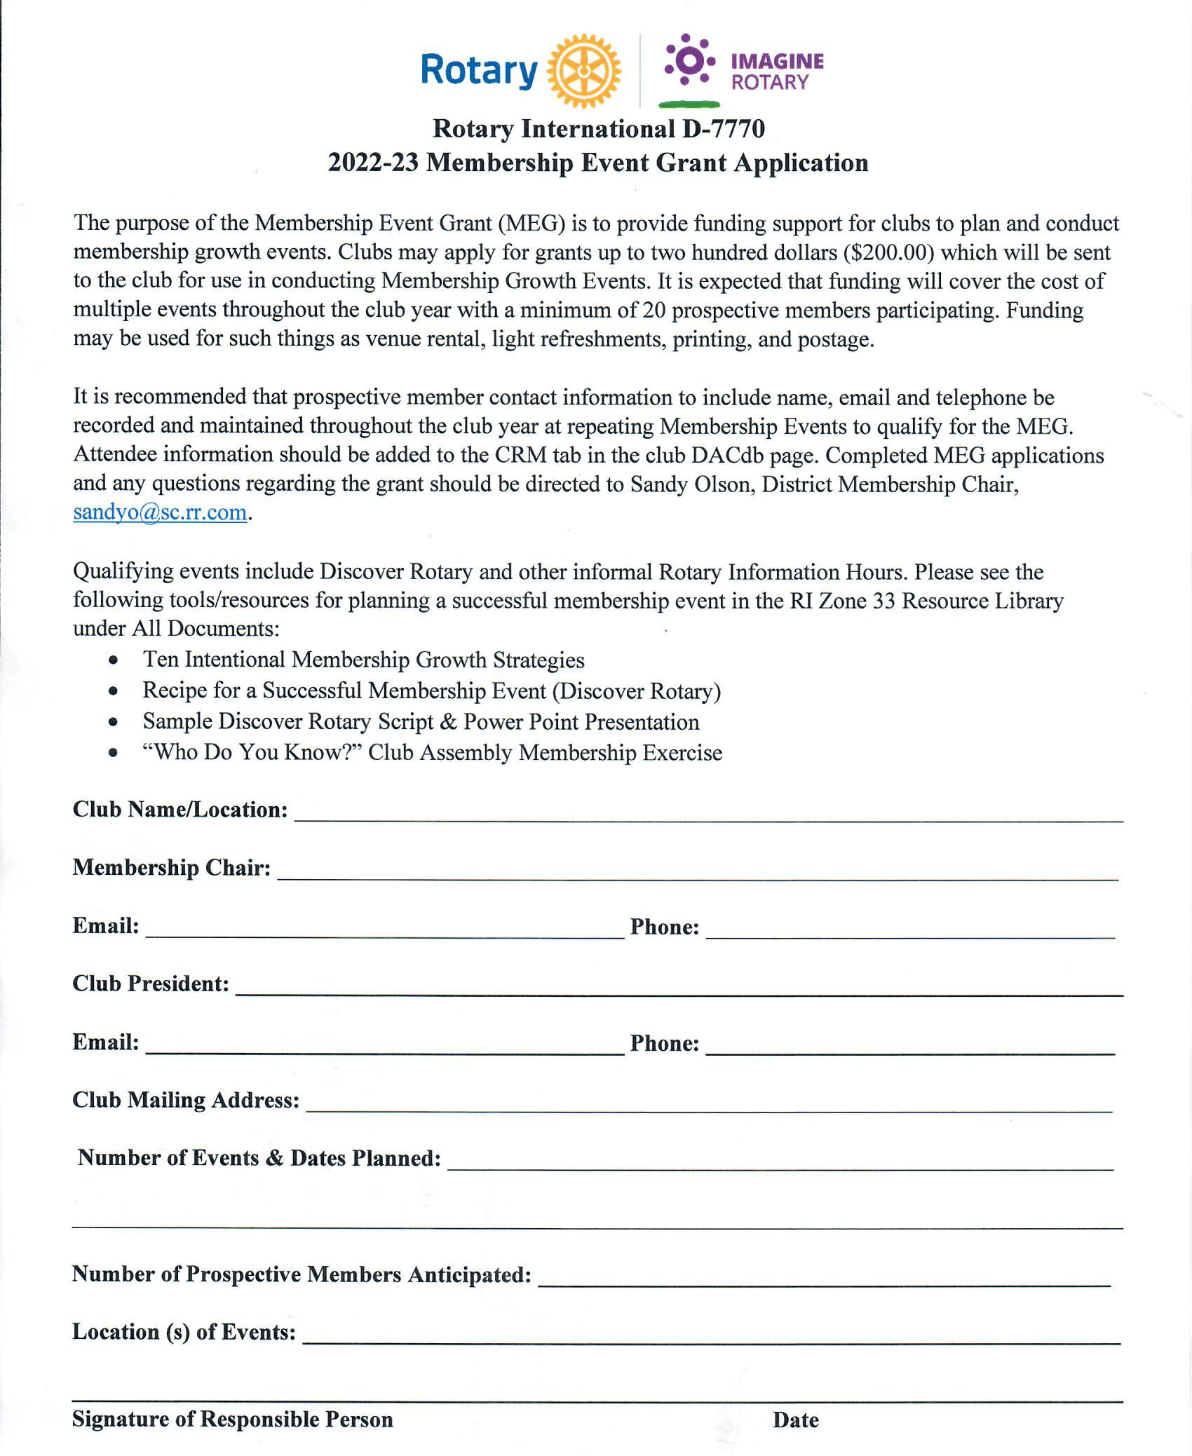
Discover Rotary Membership Event Grant

Slide 17
Innovative Club Approaches
Club Formats:
Satellite Club
IMPACT Club
Corporate Club
Cause Based Club
Interest Based Club
Passport Club
E-Club
Membership Options:
R-85 Membership
R-35/Young Professional Membership
Business/Corporate Membership
E-Membership
Family Membership
Associate Membership
Friends of Rotary

Slide 18
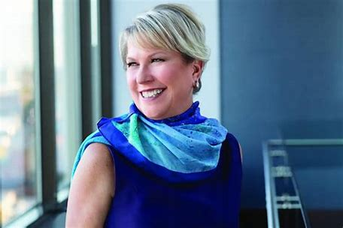
Easy 5-Step Process To Welcome A New Club Member
Discover Rotary
Induction
Mentor
Orientation & Training
Engagement
Review Your Club’s Application Process: Streamline

Slide 19
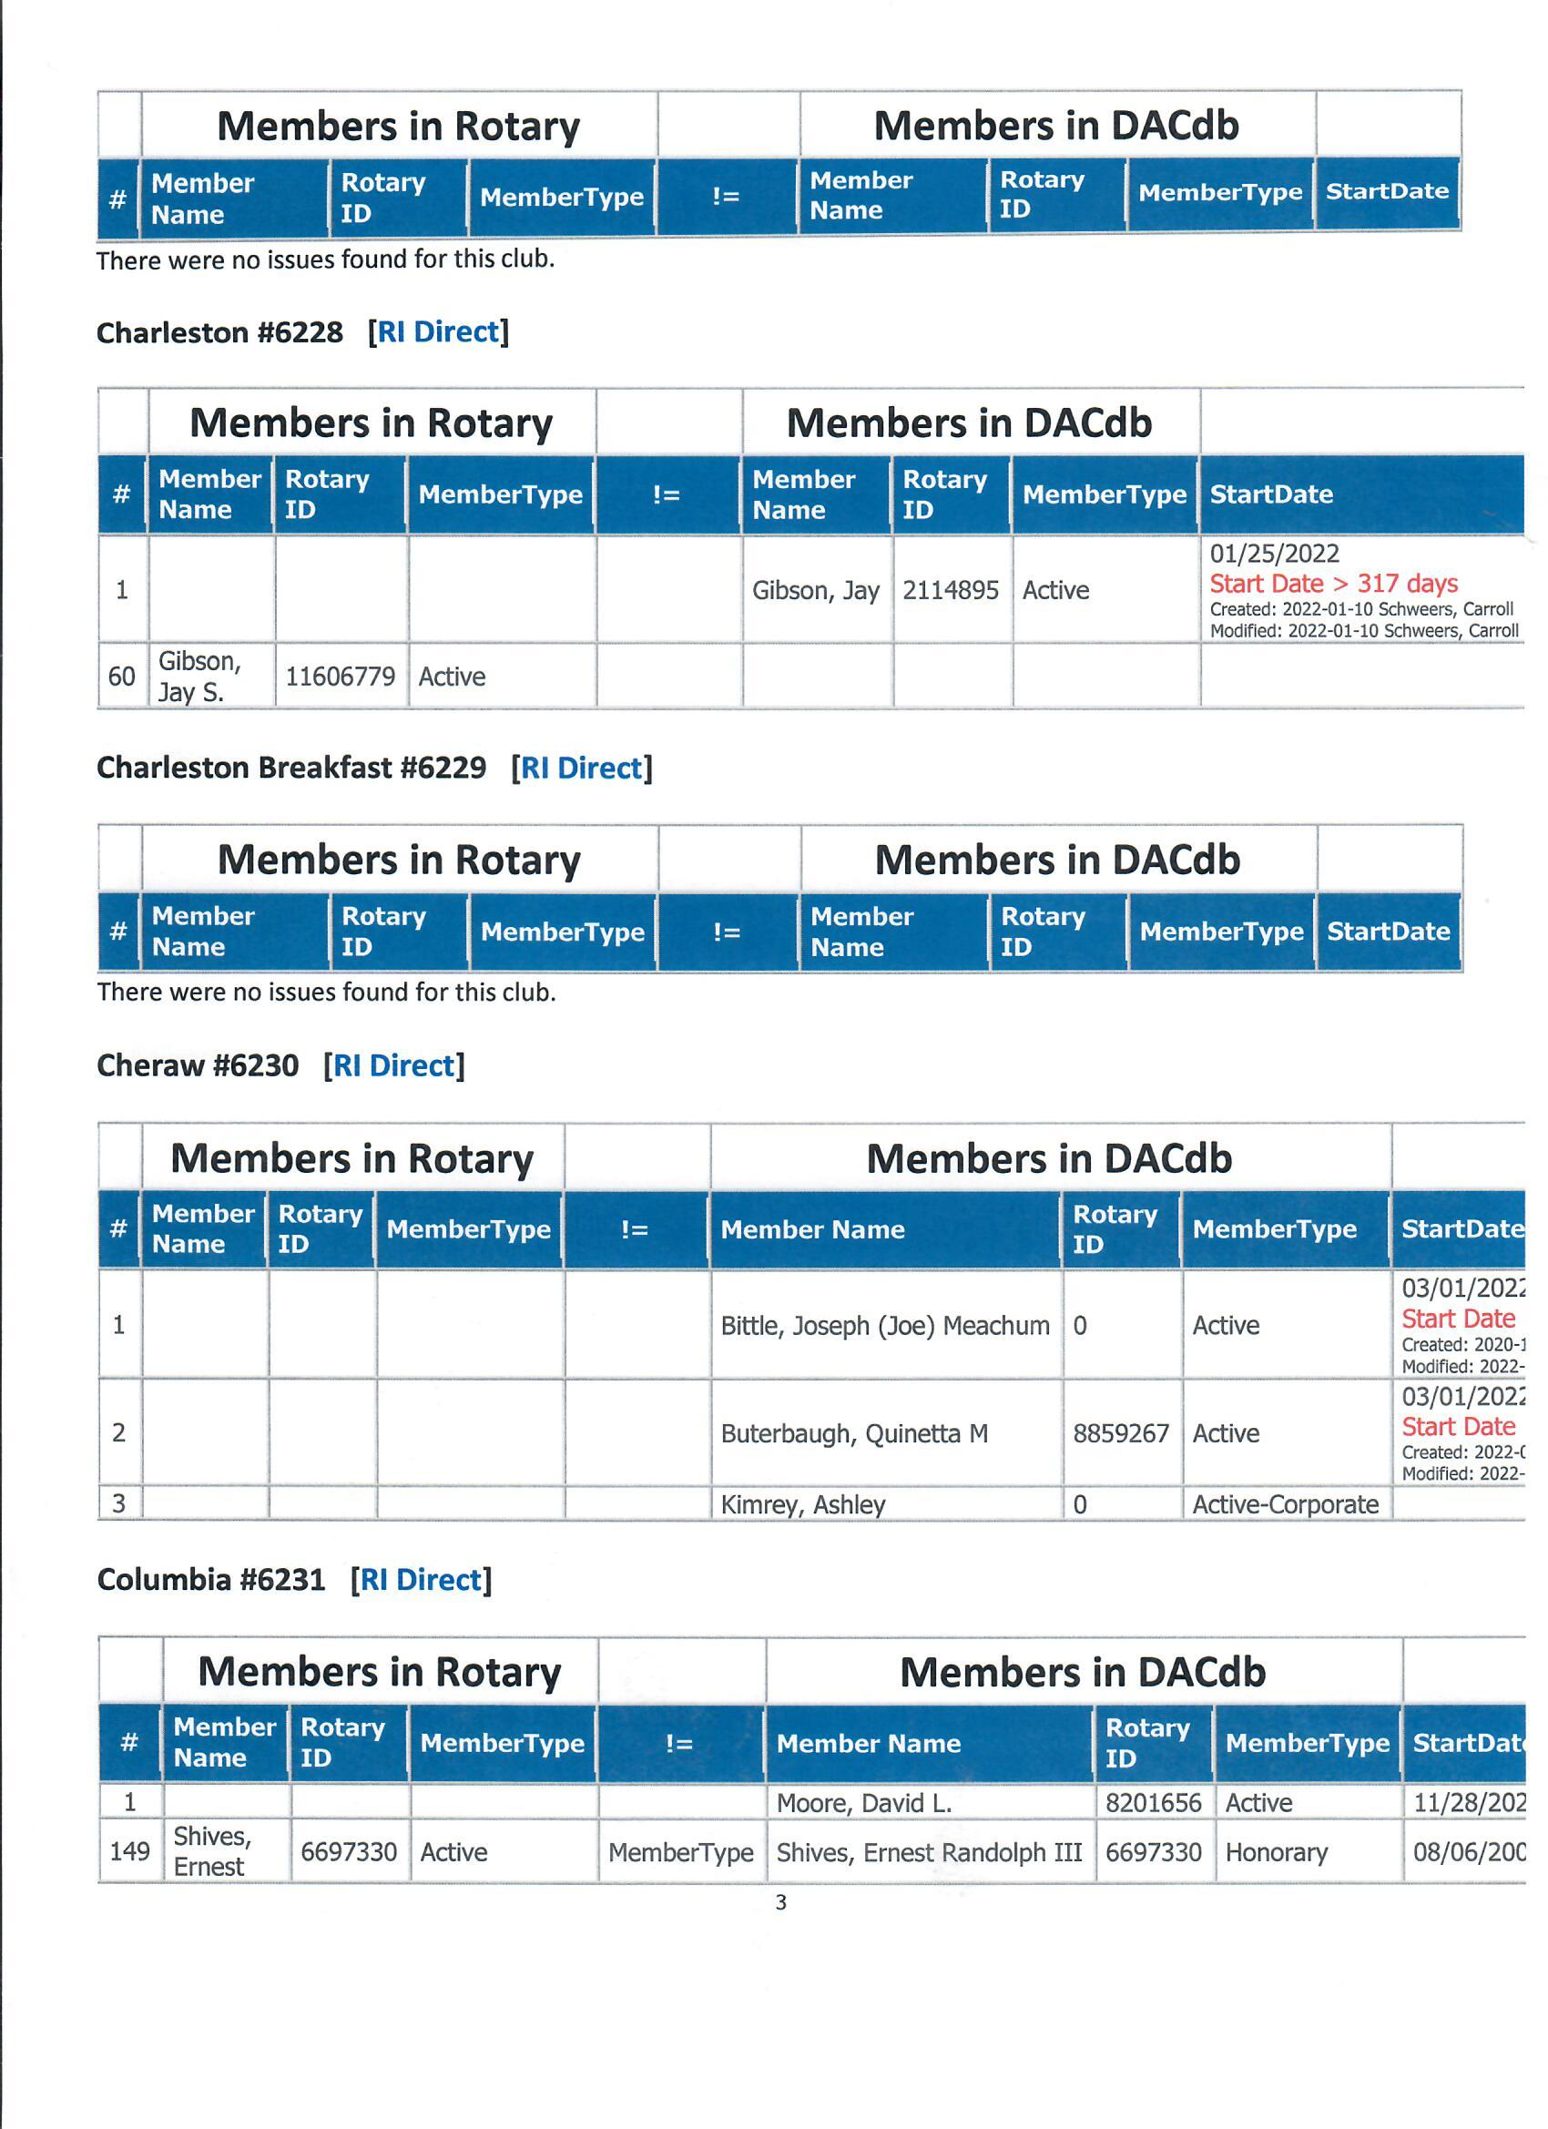
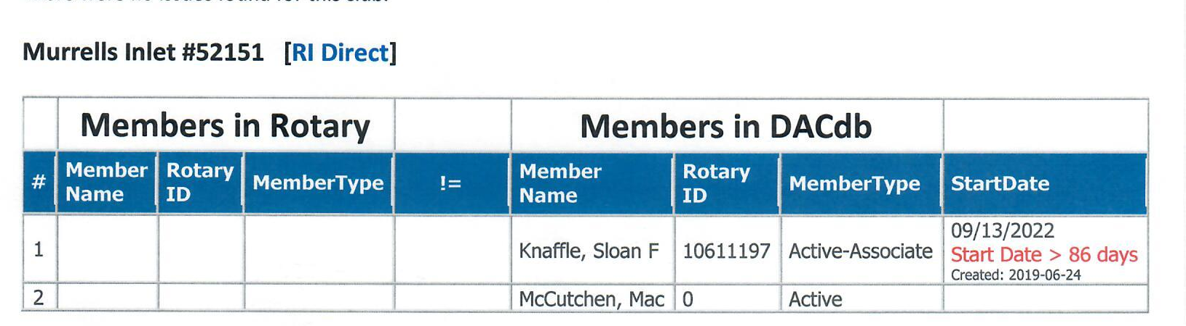
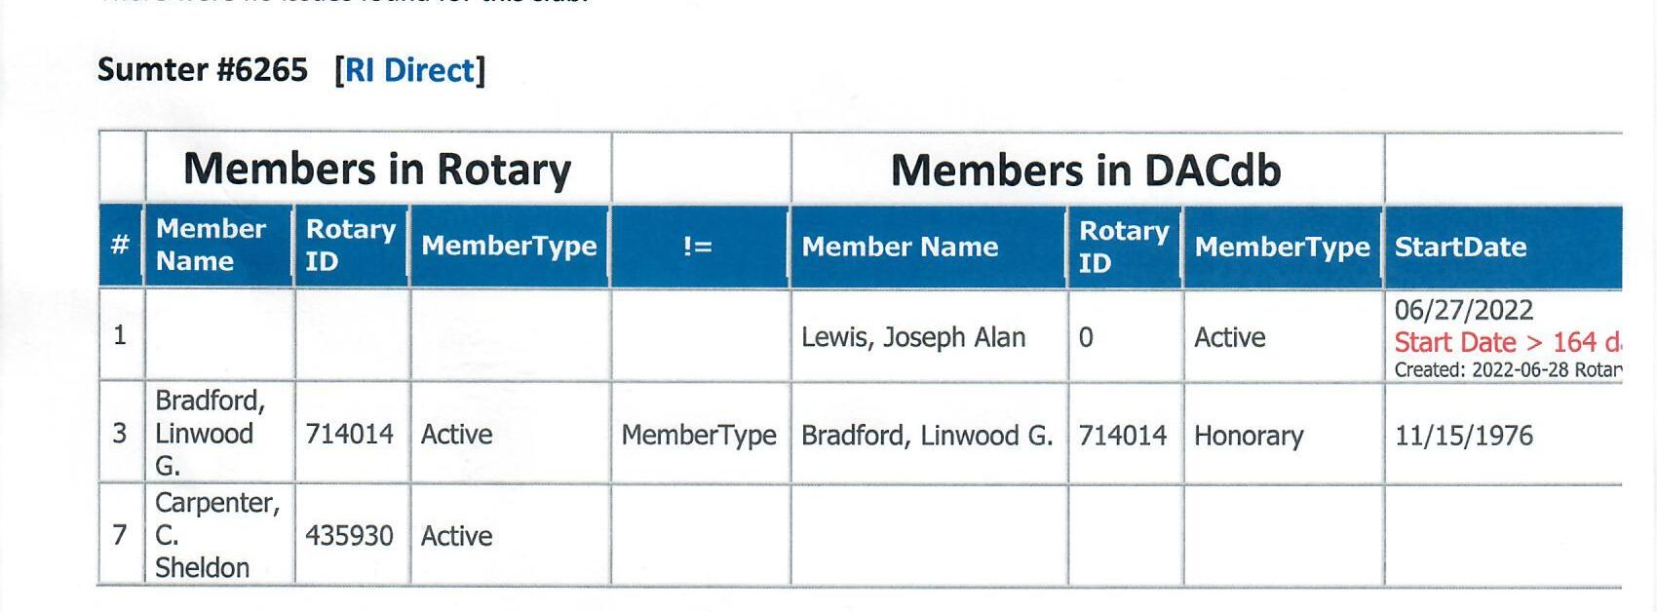
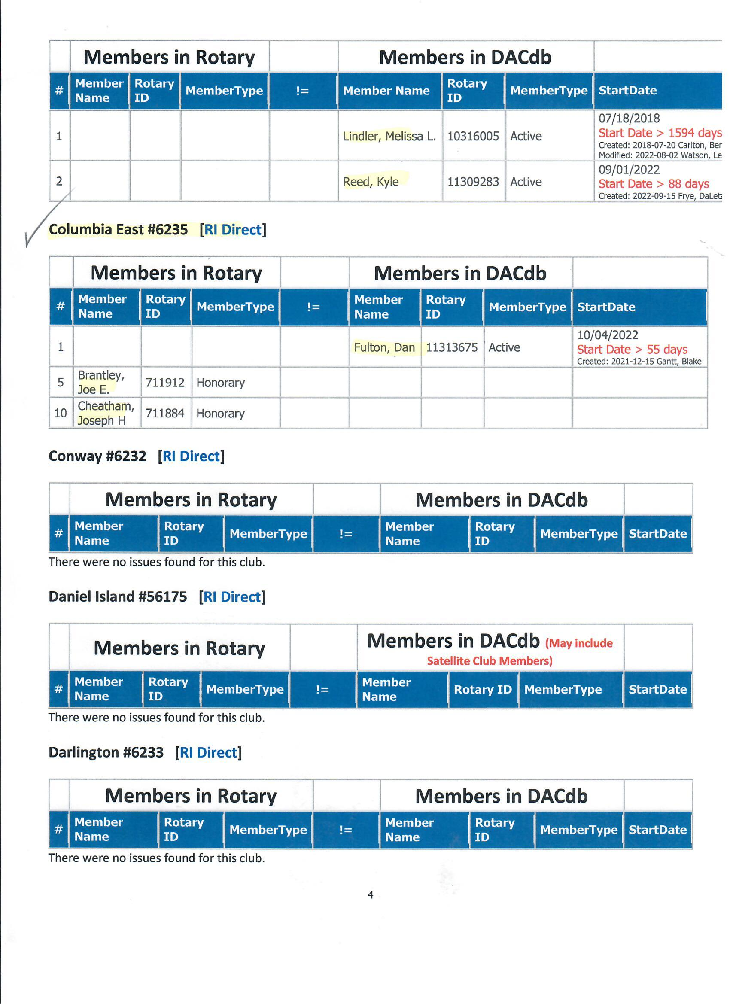
Rotary Compare

Slide 20
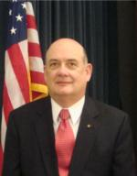

Manage Your Leads
This is Mark McCain, District Leads Manager
When he emails you a lead, please FOLLOW UP!

Slide 21
Membership Table Discussion
Why are club members reluctant to attract new members?
What are some ways to inspire members
to attract new members?
Membership growth success stories.
15 minutes

Slide 22

Leading Change
Club to change strategy: hope to laser-beam intentional
Members to change behavior: do things differently

Slide 23

Leading Change
Club to change strategy: hope to laser-beam intentional
Members to change behavior: do things differently

Slide 24
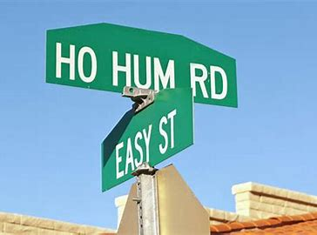
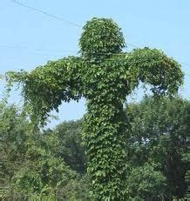

Leading Change
Kudzu of Complacency

Slide 25
Leading Change
“Leaders are visionaries with a poorly developed sense of fear, and no concept of the odds against them. They make the impossible happen.”
Robert Jarvik

