Slide 1
KEEPING ROTARY RELEVANT FOR THE NEXT CENTURY
r
Diversity
Equity
INCLUSION
DEI
WORKSPACE.GOOGLE.COM
MENTIMETER.COM
SLIDESWITH.COM

Slide 2
Keeping Rotary Relevant for the Next Century
Starting The Conversation: Diversity, Equity & Inclusion
Diversity: Variety in a group of people’s backgrounds, experiences & identities
Equity: Differing levels of support, opportunities, and resources so all participants have a welcoming and productive experience according to their needs or circumstances.
Inclusion: Creating experiences in which all people are welcomed, respected and valued.
STARTING THE CONVERSATION

Slide 3
Rotary International’s Diversity, Equity, and Inclusion
THE JOURNEY
2019 RI’s First Statement on DEI
2020 RI Board of Dir. Convenes DEI Taskforce
2021 RI Strengthens Commitment to DEI & Develops New Statement
2023 RI Board Extends Work of Taskforce through June.

Slide 4
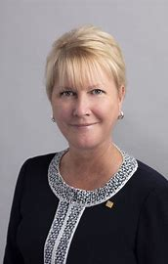
Jennifer Jones
Rotary International President
“Imagine Diversity, Equity, & Inclusion”
Presidential Initiative
Expanding our Reach

Slide 5
RI’s Diversity, Equity, & Inclusion Statement
At Rotary, we understand that cultivating a diverse, equitable, and inclusive culture is essential to realizing our vision of a world where people unite and take action to create lasting change. We value diversity and celebrate the of people of all backgrounds, across age, ethnicity, race, color, disability, learning style, religion, faith, socioeconomic status, culture, marital status, languages spoken, sex, sexual orientation, and gender identity as well as differences in ideas, thoughts, values, and beliefs.
Recognizing that individuals from certain groups have historically experienced barriers to membership, participation, and leadership, we commit to advancing equity in all aspects of Rotary, including in our community partnerships, so that each person has the necessary access to resources, opportunities, networks, and support to thrive.
We believe that all people hold visible and invisible qualities that inherently make them unique, and we strive to create an inclusive culture where each person knows they are valued and belong.
In line with our value of integrity, we are committed to being honest and transparent about where we are in our DEI journey as an organization, and to continuing to learn and do better.

Slide 6
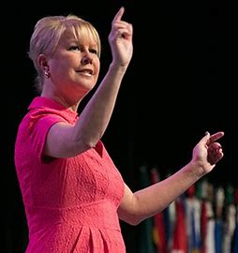
President Jennifer Jones
“Imagine Diversity, Equity, & Inclusion”
Our First Steps
Learn more about Rotary’s DEI
Why DEI matters in your club
Raise DEI Awareness & understanding
Ideas for introducing DEI in your club

Slide 7
How Does DEI Relate To Membership Growth?
MEMBERSHIP which is
Vital to the HEALTH and LONGEVITY of the organization by offering us new and bold ideas to
Keeps ROTARY RELEVANT for the next century.

Slide 8
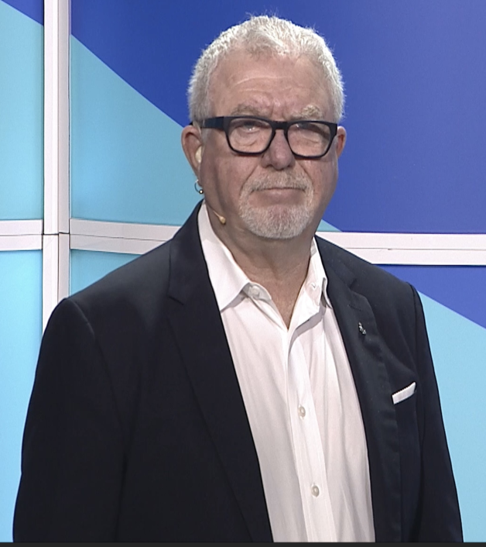
Dr. Todd “Bowtie” Jenkins
Mr. Mark V. Wafer
Partner, RI Vice President
Senior DEI Innovation Leader /DEI Task force
Global Inclusion Trainer/Strategist/Speaker
Graduated Honors U. of South Carolina
Masters Illinois State/Doc. U. of Arkansas
Post-Doctorate Studies at Harvard
Member & PHF Rotary Club Fayetteville, Ark.
One of Youngest Youth Exchange District Chairs in RI
Serves on the RI DEI Task Force
Rotary Club of Whitby Sunrise,, Ontario , Canada
Disability and Special Needs
Public responses/judgements
Focus on Abilities rather than
Disabilities can be invisible until mentioned .
Recognize their contributions and celebrate their gifts.

Slide 9
Diversity, Equity, & Inclusion Resources at RI
RI Learning Center Modules
DEI Basics
DEI Intermediate
Diversify Your Club
Committing to DEI
Creating Inclusive Club Culture
Plan For An Inclusive Future
DEI Webinar Series
LGBT DEI Rotary Affinity Group
Gender Equity in Rotary

Slide 10
Rotary International’s Diversity, Equity, and Inclusion
Club and Group Discussion
Rotary International’s Diversity, Equity, and Inclusion
Why is it important for us to understand RI’s of DEI?
RI President Jennifer Jones calls her Initiative “Imagine DEI.” Why do you think she did this?
What are some ways you might start a conversation about DEI in your club?
Develop an ongoing open Club Toolkit.

Slide 11
Many thanks for joining the Discussion !

Slide 12
Keeping Rotary Relevant for the Next Century
Benetta Gadegbeku-Bell, D.M.D. (Presenter)
Diversity, Equity and Inclusion, District 7770
Rotary Club of Eau Claire/North Columbia
Columbia, South Carolina
803-779-9666 / 803-269-3344
bgbell58@gmail.com or
dei.inquiries@rotary.org

