Slide 1
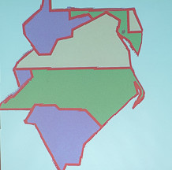
Welcome to the Rotary Leadership Institute www.MidAtlanticRLI.org

Slide 2
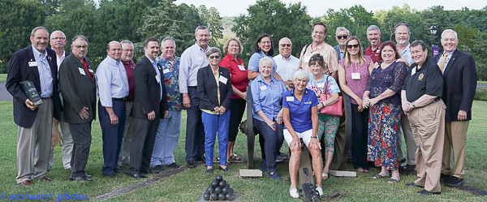
Throughout the Pandemic, The Zone 33 Rotary Leadership Institute has continued to conduct events in the states of Delaware, Maryland, North Carolina, South Carolina, Tennessee, Virginia, West Virginia, and The District of Columbia

Slide 3
Starting in early 2020, the Zone 33 RLI team converted the In-Person courseware to a total virtual offering that was first presented in the Fall of 2020.
These programs were offered through May 2021, and have continued into Fall 2021 and beyond.

Slide 4
The program (F2F or Virtual) consists of the separate sessions:
Part I, Part II, and Part III
Attendees progress through the three part on separate days and complete the program at their own pace.

Slide 5
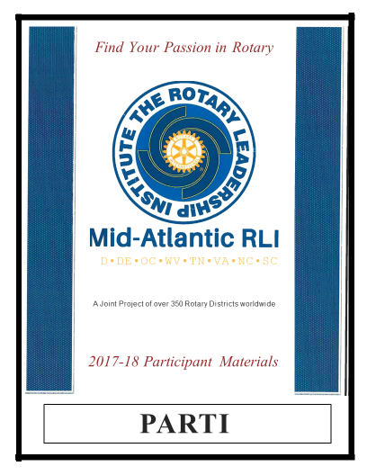
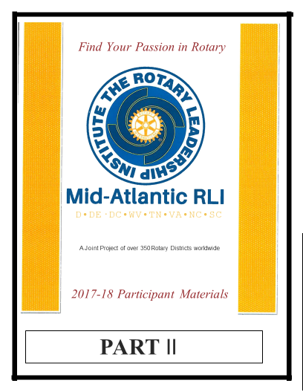

Slide 6
Part I
The Roots of Rotary
My Club & Beyond
Engaging Members
Our Foundation
Creating Service Projects

Slide 7
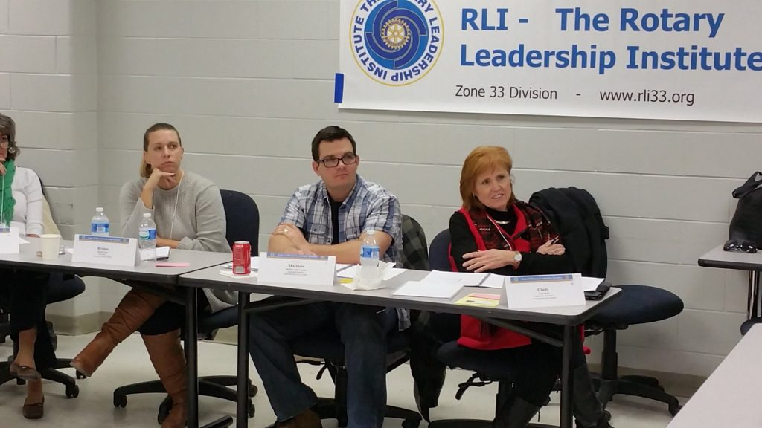
Part II
Strategic Planning
Team Building
Rotary and Ethics
Targeted Service
Attracting Members

Slide 8
Part III
Public Image and Public Relations
Effective Leadership Strategies
International Service
Club Communications
Vocational Service and Expectations

Slide 9
All clubs are concerned about:
Engaging/Attracting New Members
“On-Boarding” New Members
Retaining New Members
Developing the Club Leadership
Sustaining the Club

Slide 10
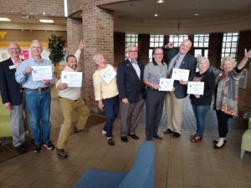
Rotary Leadership Institute (RLI):
Engages
Networks
Attracts
Retains
Develops

Slide 11
For Your Consideration (THE ASK):
Make RLI/Part I
a part of every new member’s first year engagement
Make RLI/Parts II and III
a part of your club’s Leadership Development

Slide 12
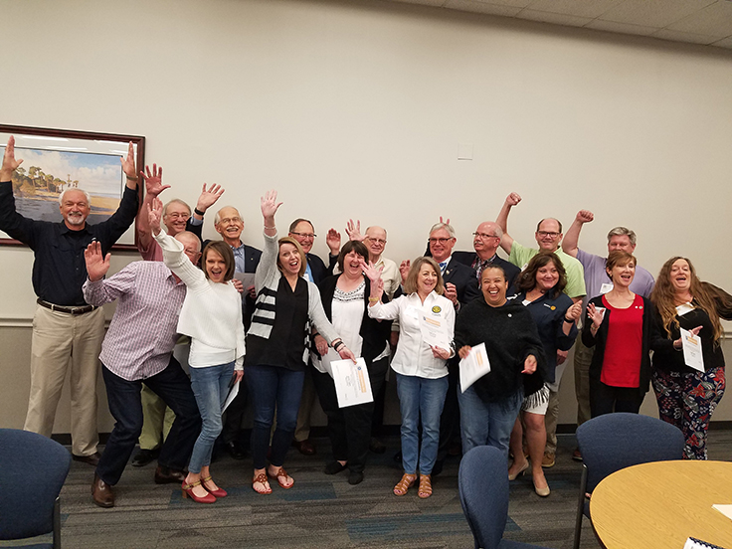
QUESTIONS and COMMENTS?

Slide 13
Tom Ledbetter
District 7770 RLI Training Committee Chair
www.midatlanticrli.org
tom.ledbetter.rotary@gmail.com
Thank you!!!

