Slide 1
Running Your Meetings & Keeping them Interesting..101

Slide 2
How to Prepare...
01
Create an Agenda
Throughout the week keep notes: special events/member spotlights/etc
02
Be Sure Your Club Administrator and Public Relations Director Are Aware Of Any Changes

Slide 3
How to Prepare...
03
Communicate With Your Sergeant at Arms Prior To The Meeting To Discuss The Club Meeting
04
Create Your Meeting Presentation or Discussion
05
Show Up & Be Happy!

Slide 4
....THe Day of
Be the First One There and the Last One Out
Be Welcoming
Start and End On Time Every Time
Allow Your Speaker Enough Time & Ensure They Felt Welcomed With a Thank You Gift
Allow Time for Q&A and Interaction Between the Speaker and Club
Be Ready....

Slide 5
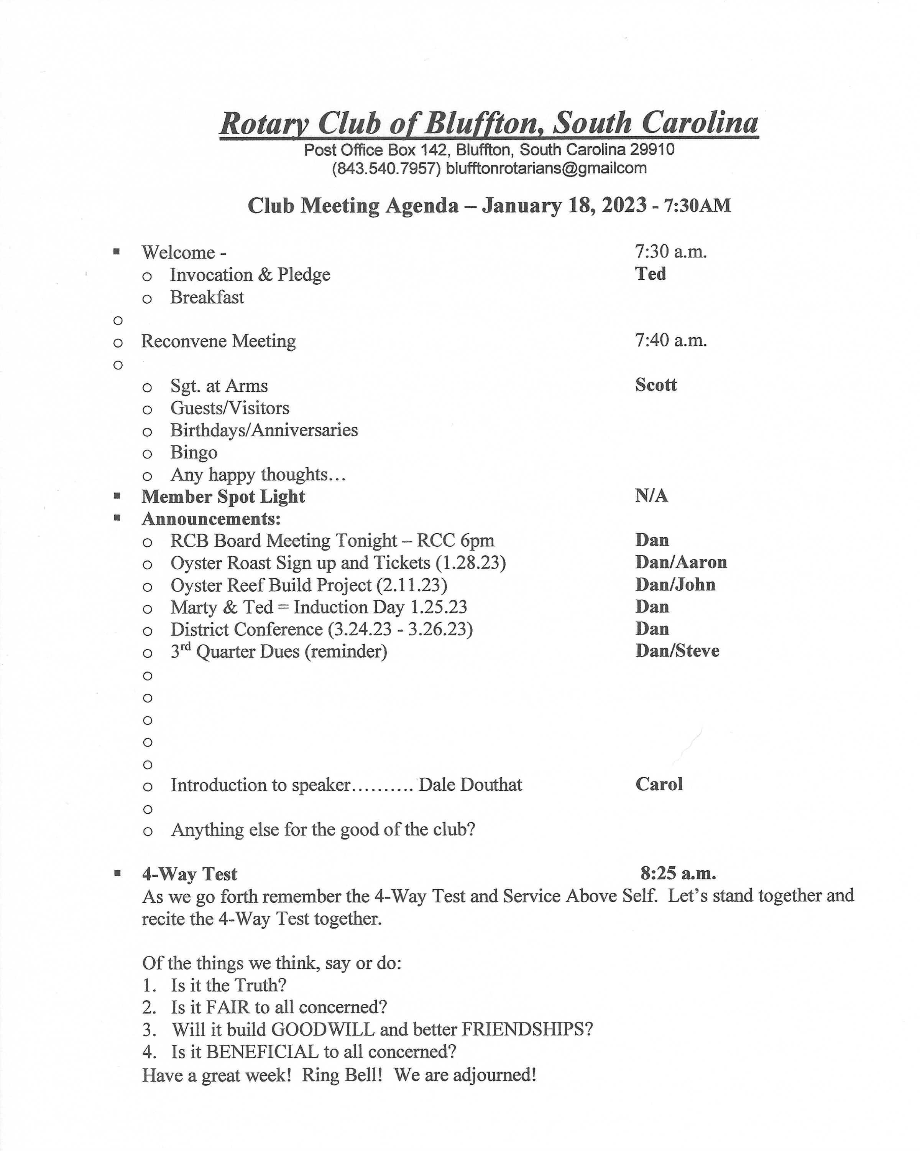
Rotary Club of Bluffton Weekly Agenda

Slide 6
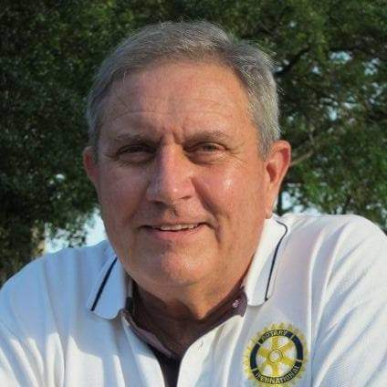
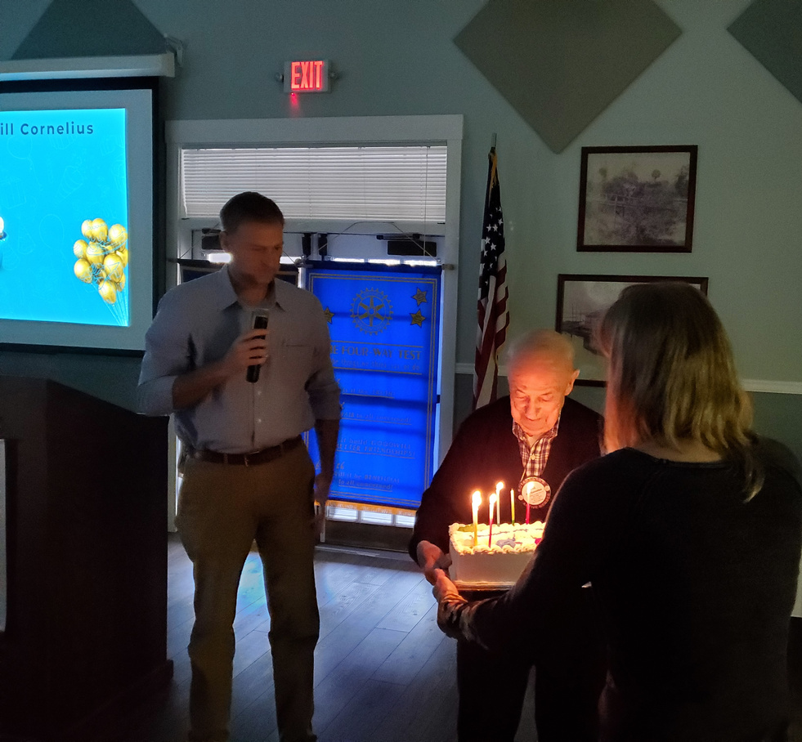
Keeping it interesting!
Be Interactive With Your Members & Highlight Special Events
Change "The Norm"
Remember Your Themes
Don't Be Afraid to Add a Picture...or Two
Meeting Types:
Theme Meeting
Interactive Meeting
Educational Fun
Business Meeting.

Slide 7
Table Talk Time!

Slide 8
Answer Me this....
Question One:
How Would You Make Members Feel Connected & Avoid “Cliques”?
Question Two:
How Would You Make Member(s) Feel Special On A Weekly Basis?
Question Three:
How Would You Handle A Conflict During A Meeting?
Bonus Fun:
What Are Some of The Best Ways to Keep Your Meeting Interesting and Fun?

Slide 9
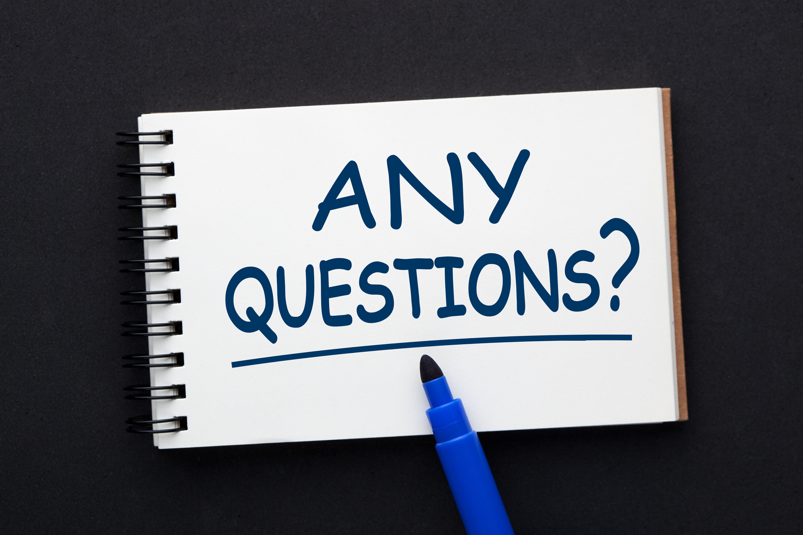

Slide 10
Contact:
Dan Ciuffreda
570.656.8867
dan460@rocketmail.com

