Slide 1
Club Service Projects

Slide 2
Why Service Projects
Impact Communities
Engage Members
Retain Members
Attract New Members

Slide 3
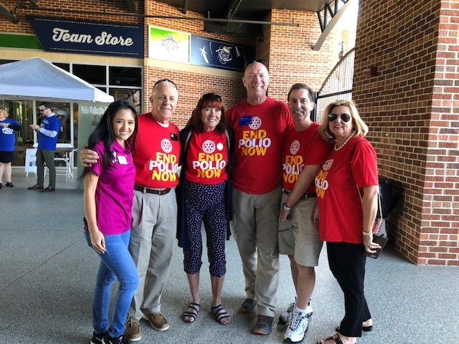

Slide 4
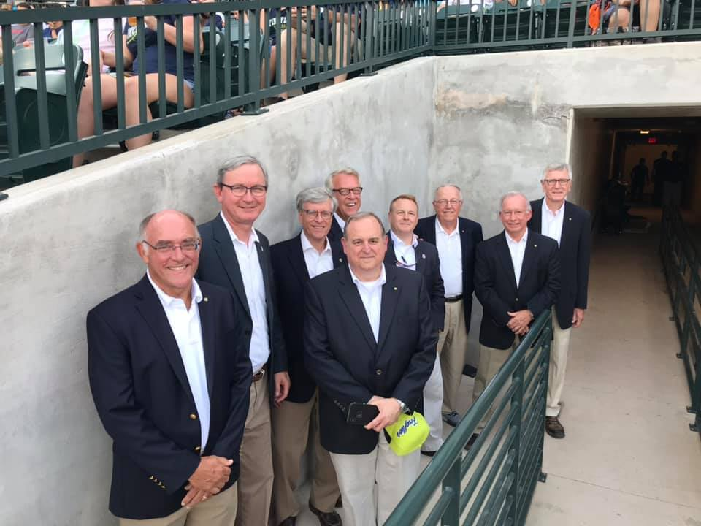

Slide 6
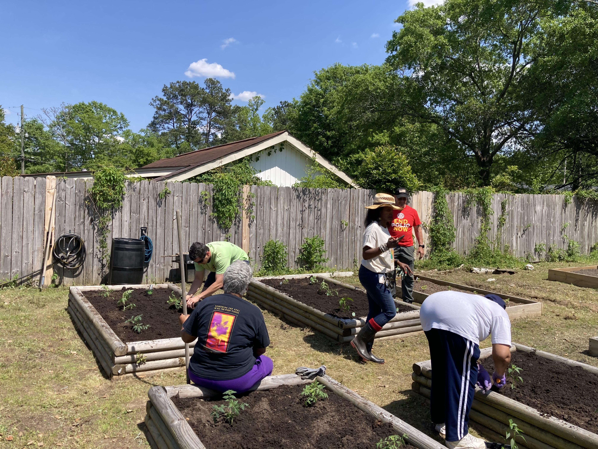

Slide 7
How do your club service projects address current concerns and involve community residents?
How does your club conduct an assessment to determine the needs and resources available for the club project?

Slide 8
As Club President how will you insure your service projects help engage members and attract potential members?

Slide 9
As Club President how will you insure the club service projects include a public image plan? What are some examples of public image tools that can be used?

