Slide 1
Catherine Glen
Rotary Global Grant Scholar, District 7770
Title Page Option

Slide 2
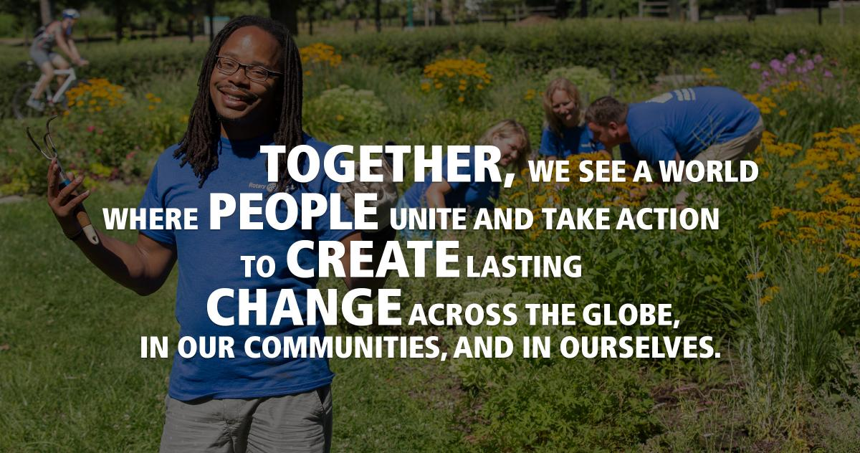
Rotary Vision Statement

Slide 3



In Partnership with Rotary

Slide 4
From Spartanburg, SC
Graduated from USC - Columbia
BA in Psychology and Neuroscience
Worked at MUSC
Background

Slide 5
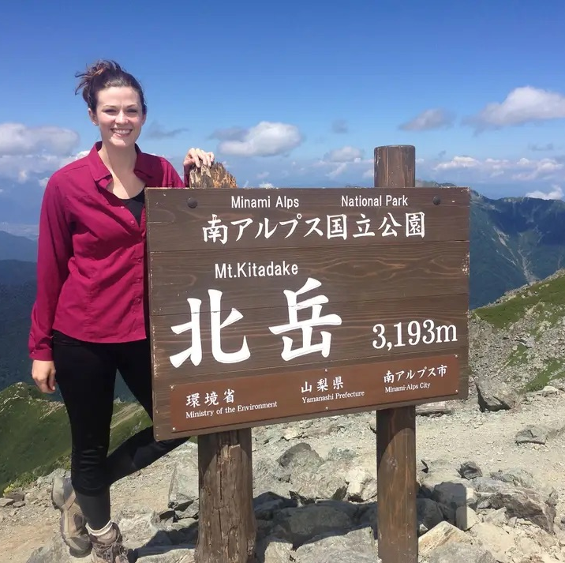
Japan
Japan exchange and Teaching Program (JET)
Yamanashi, Japan
2013-2016

Slide 6
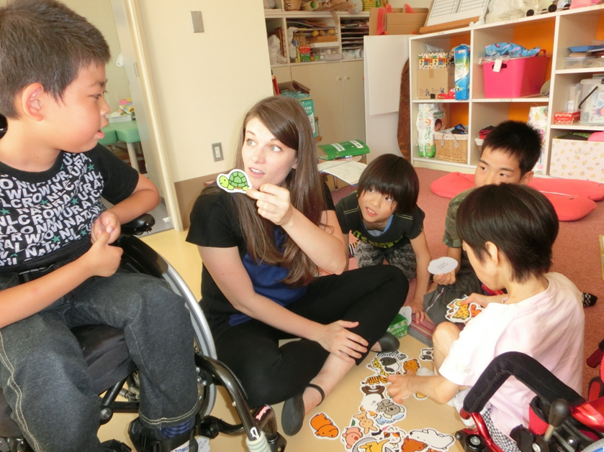
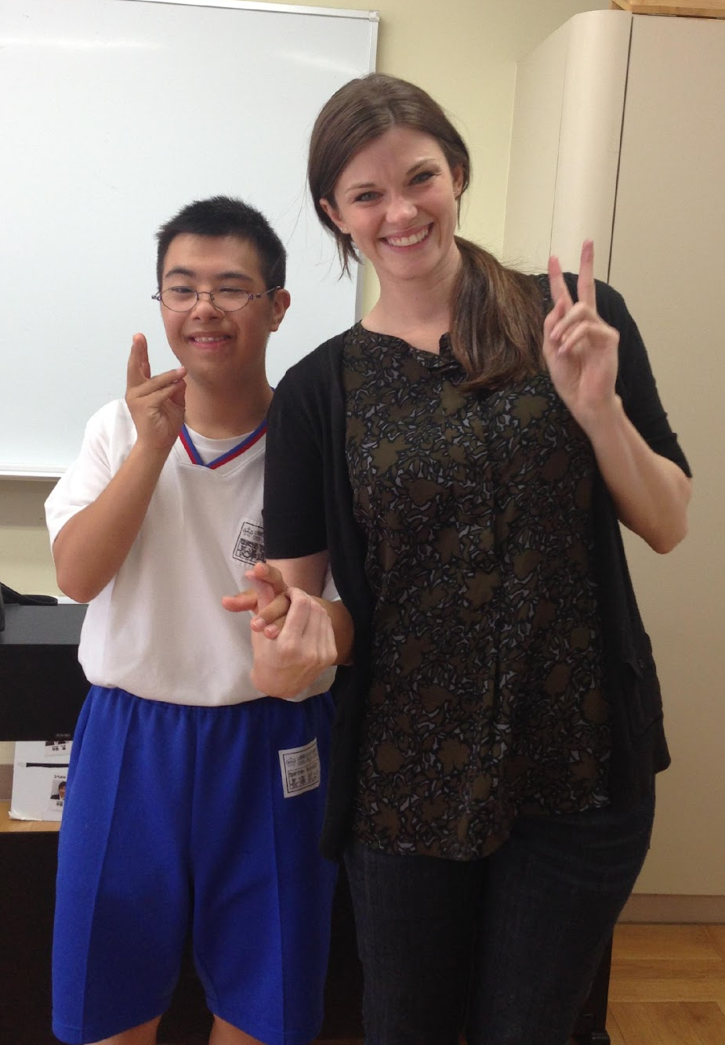
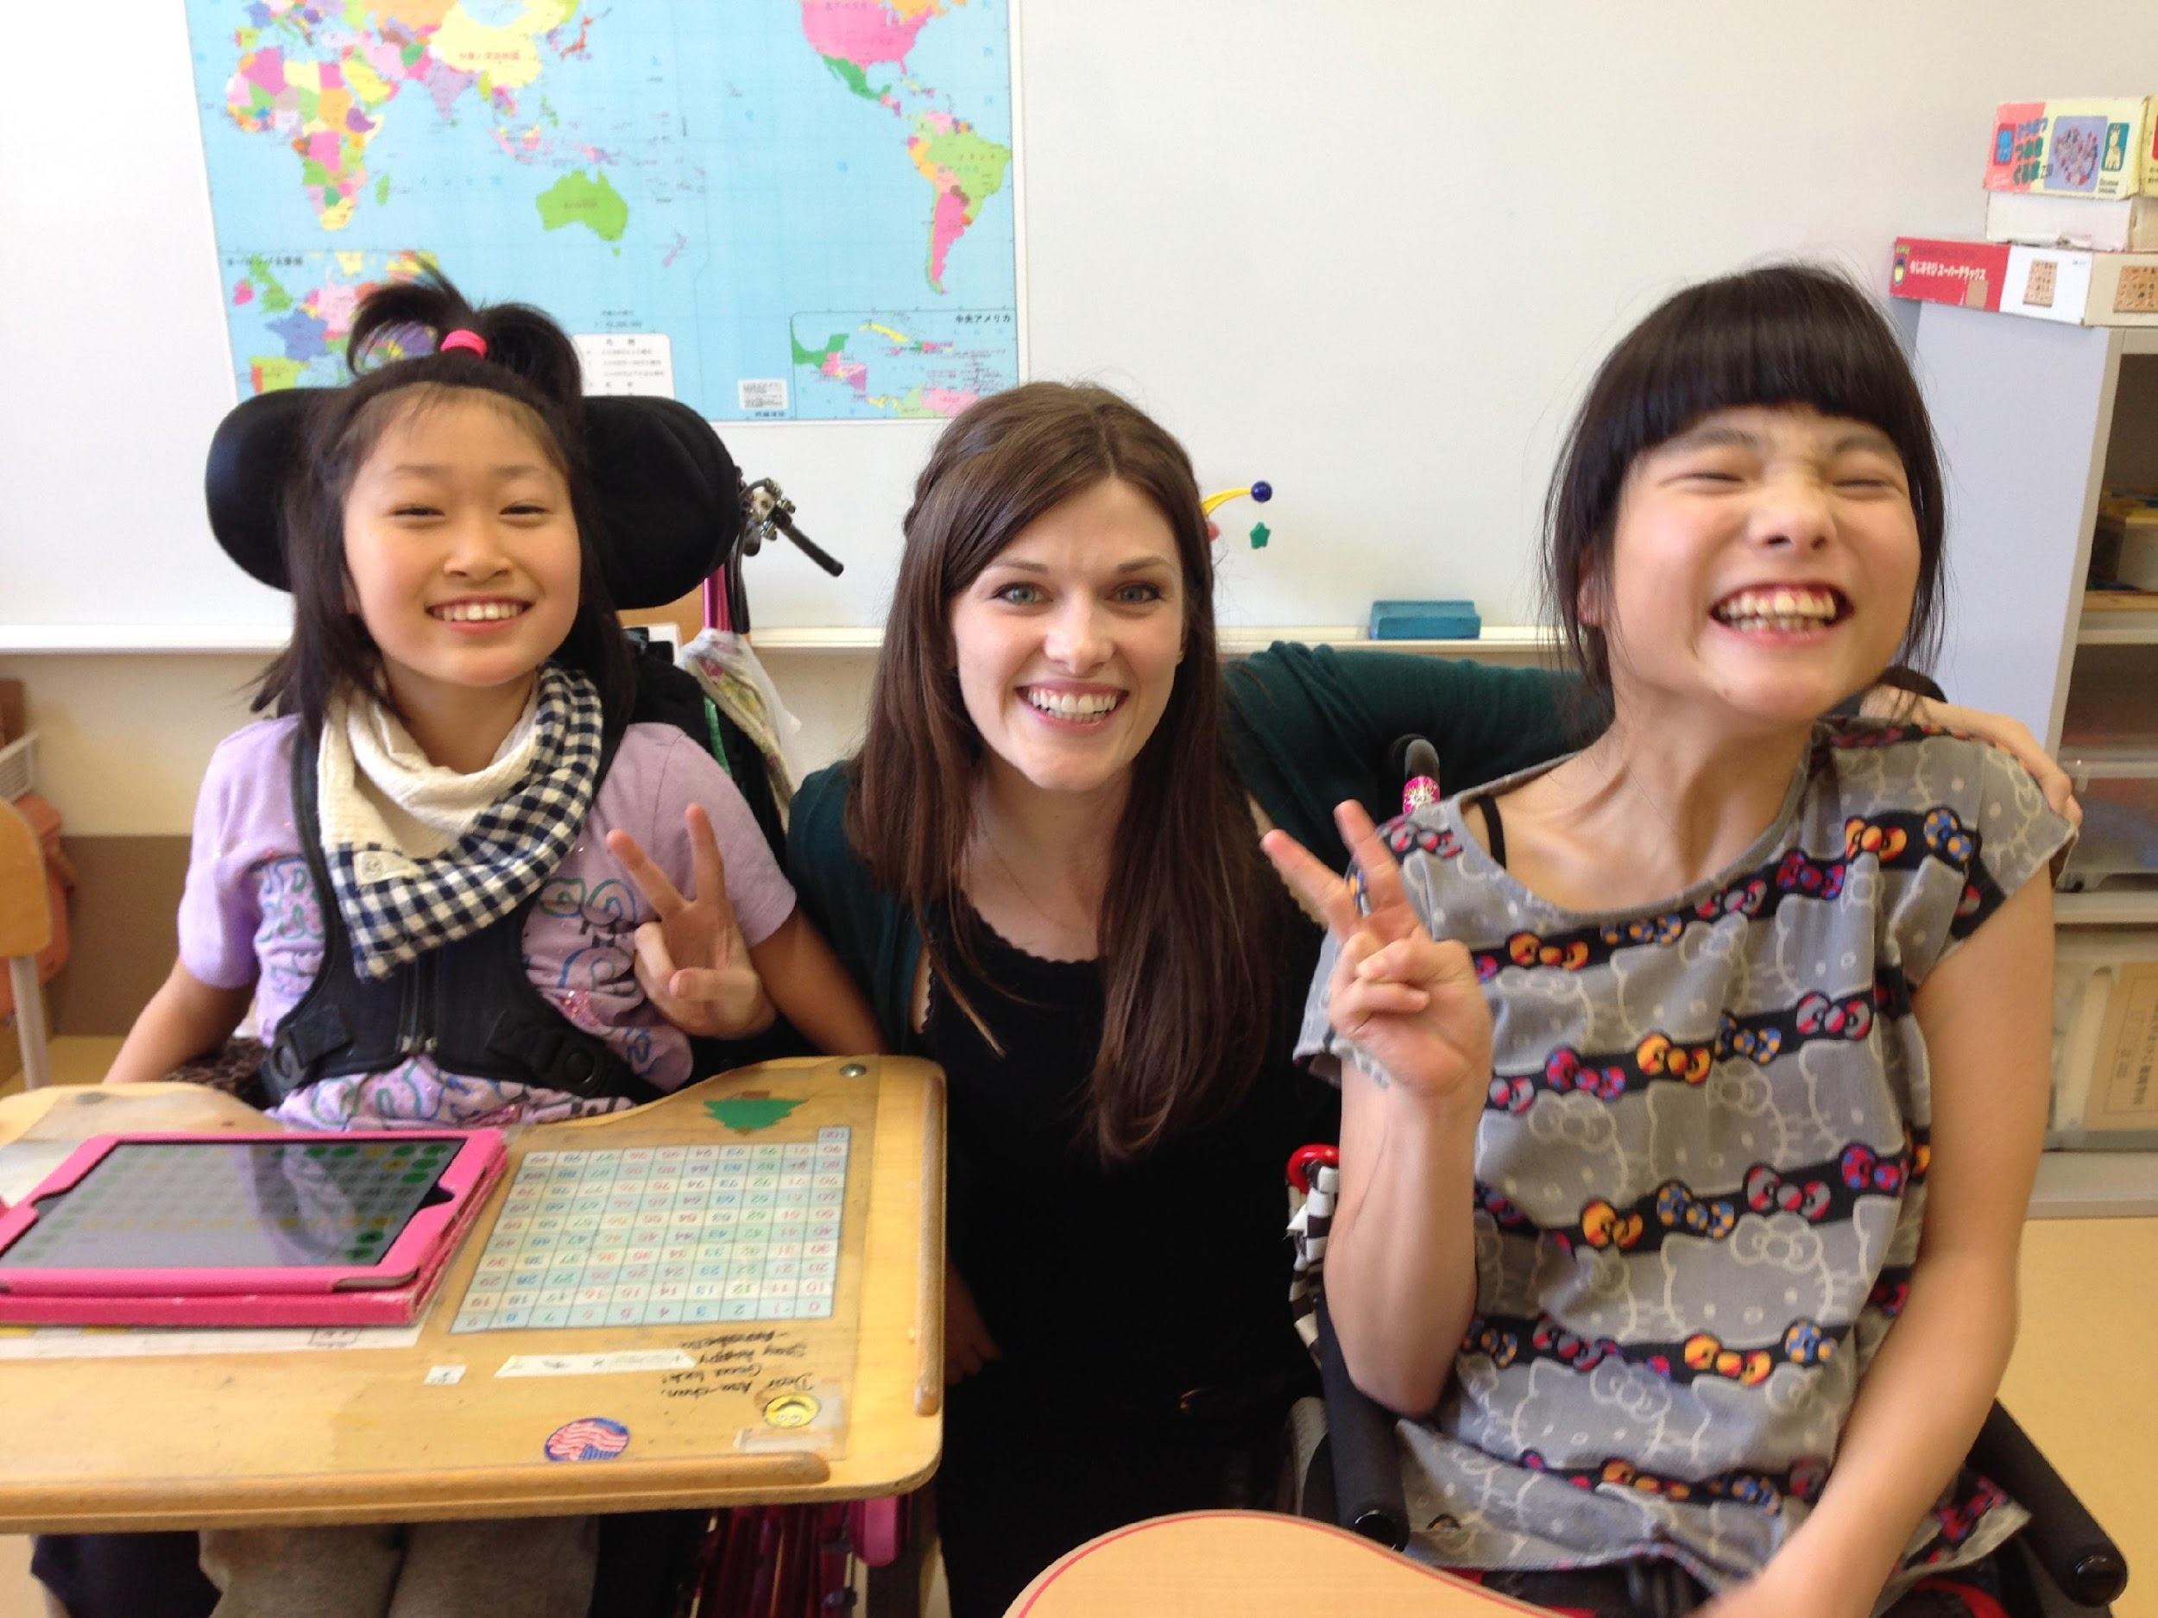
Japan – Special Education Teacher

Slide 7
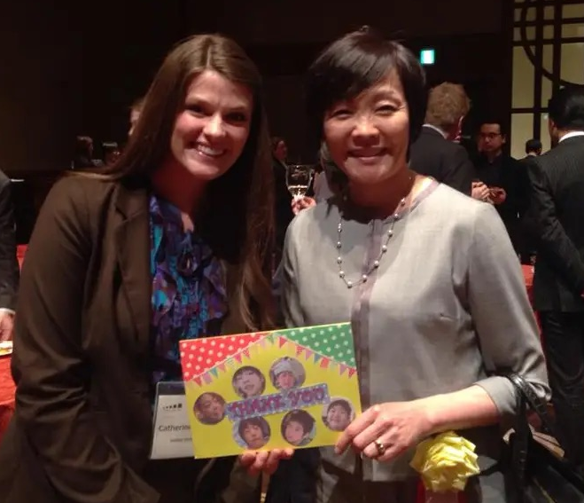
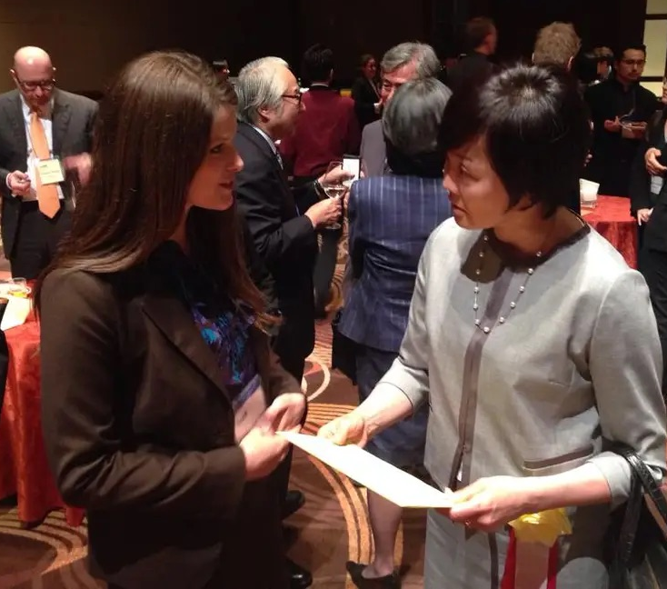
Japan – Diplomacy and Advocacy

Slide 8
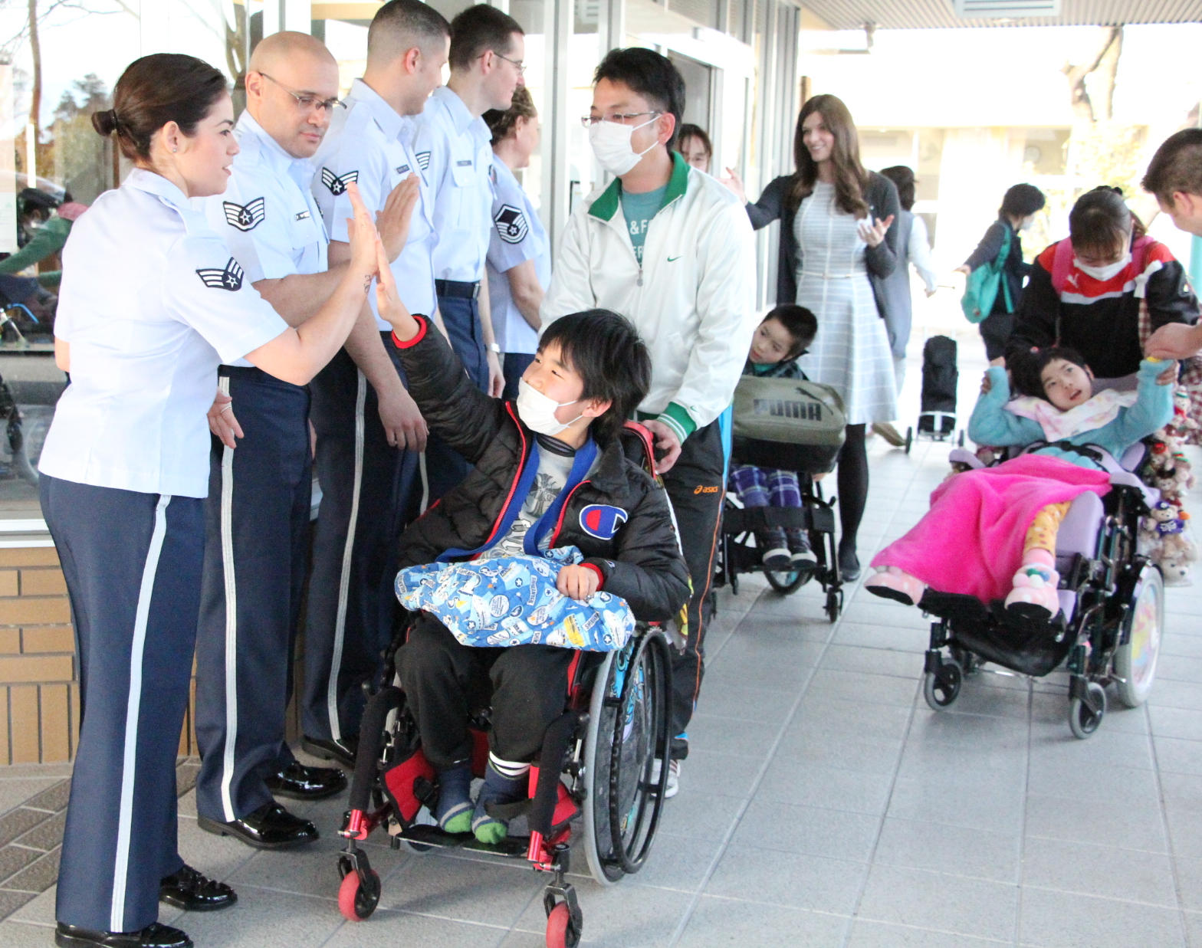
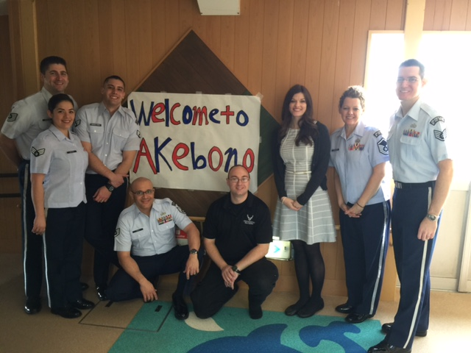
Japan – US Air Force

Slide 9
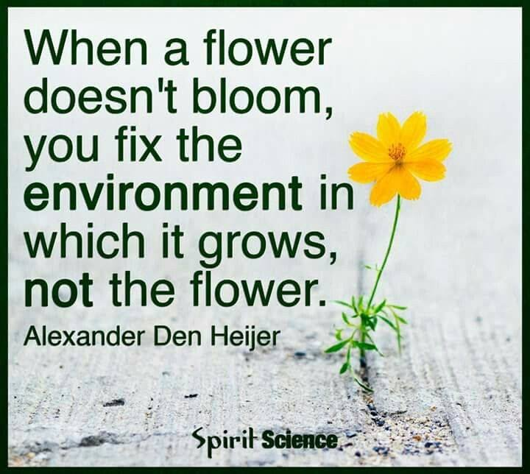

Slide 10
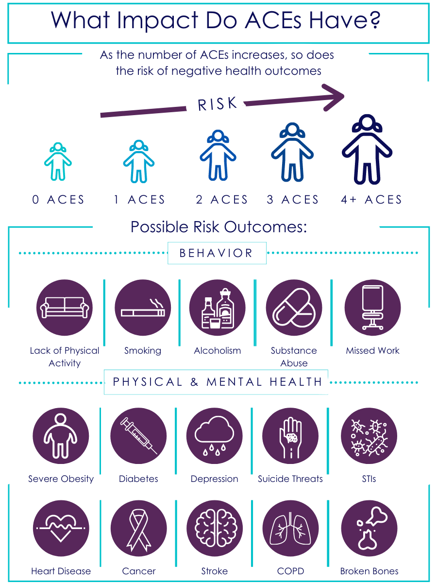
ACEs:
Adverse Childhood Experiences

Slide 11
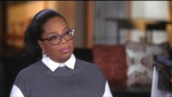
Childhood Adversity

Slide 12
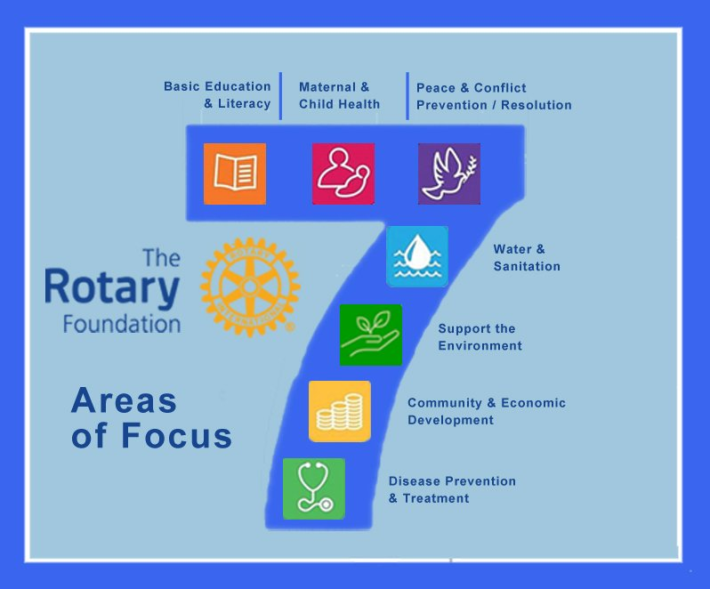
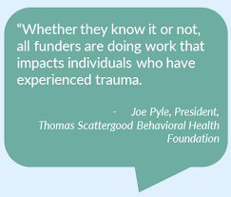
Seeking Partnership In Rotary

Slide 13
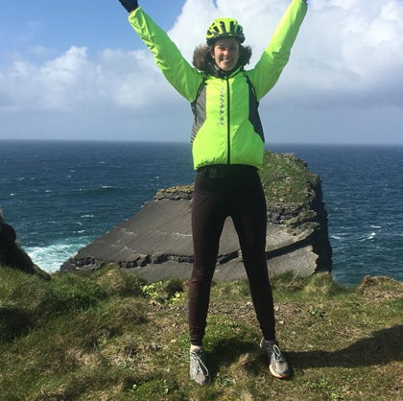
Rotary Global Grant
Scholar
Queen’s University Belfast
2016-2017

Slide 14
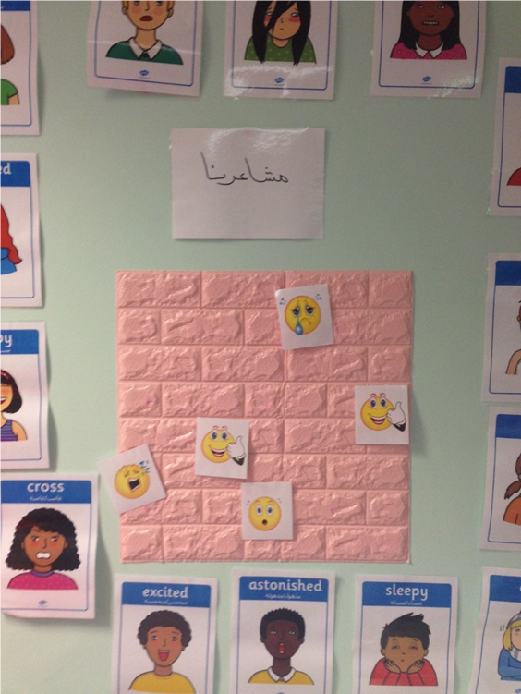
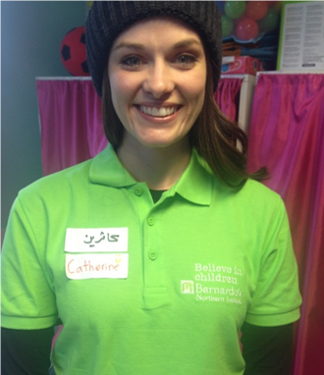
Global Scholar -
Study and program Development
MSc Psychology of Childhood Adversity
‘Play Room Leader’ for Syrian Refugee Education Program

Slide 15
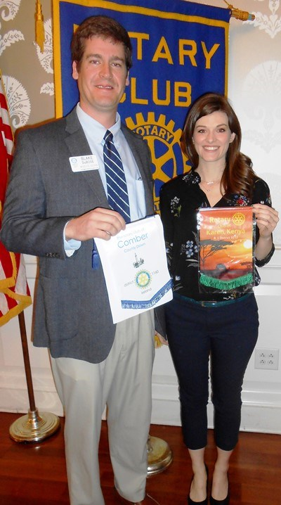
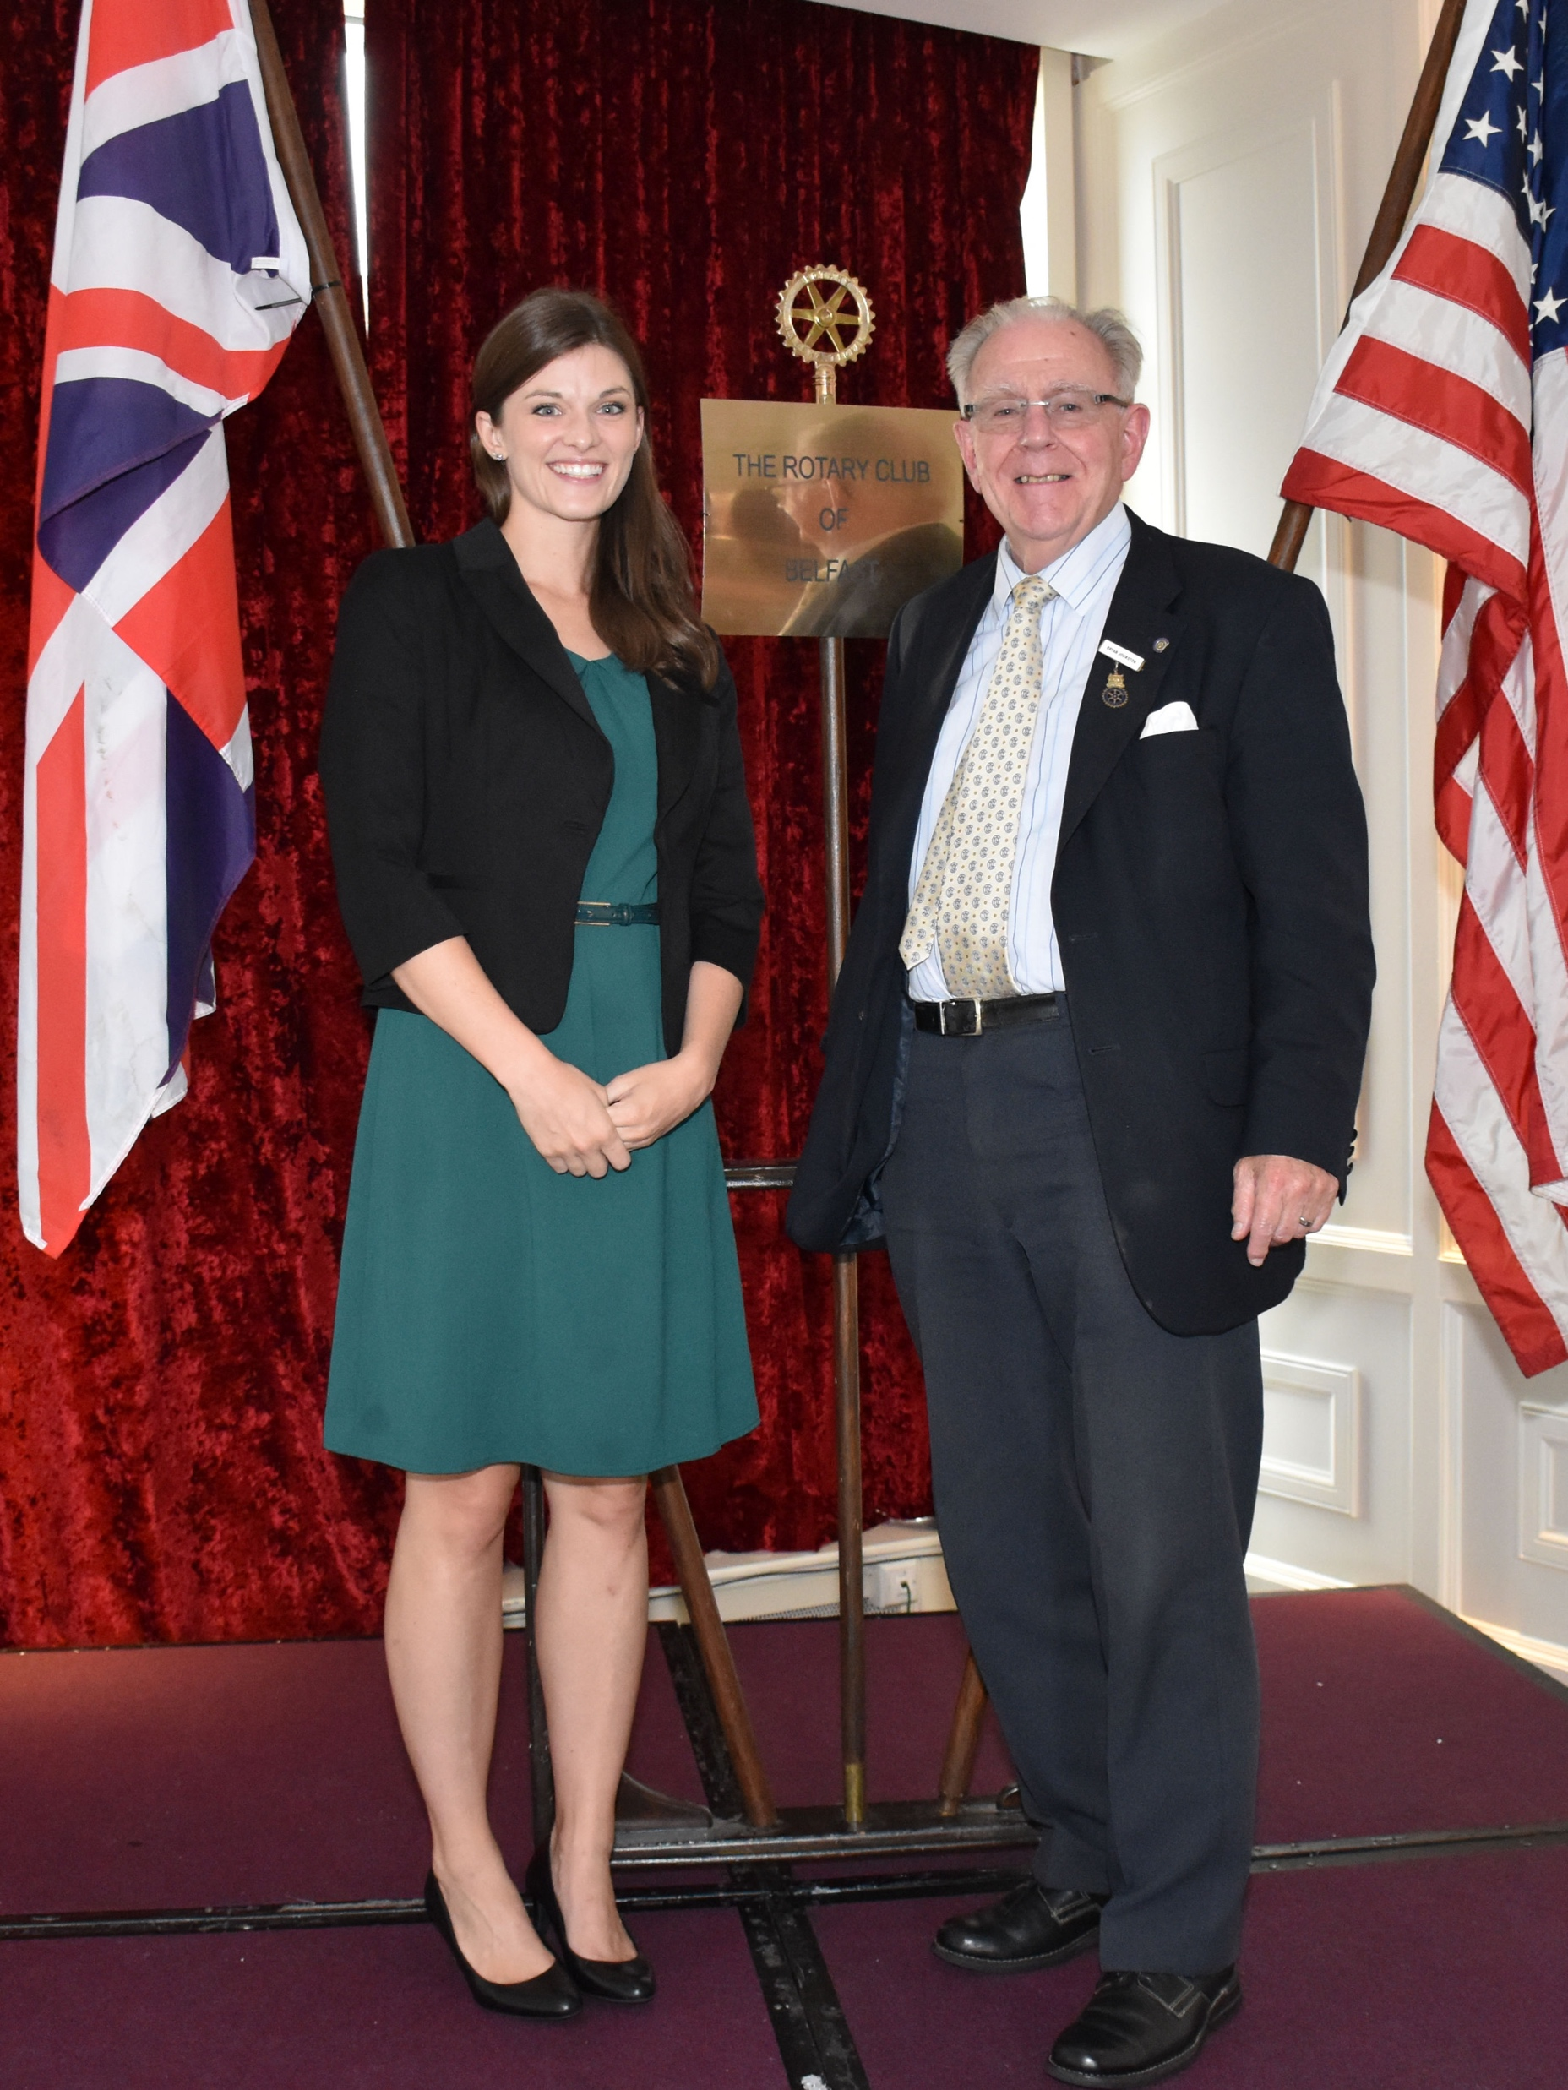
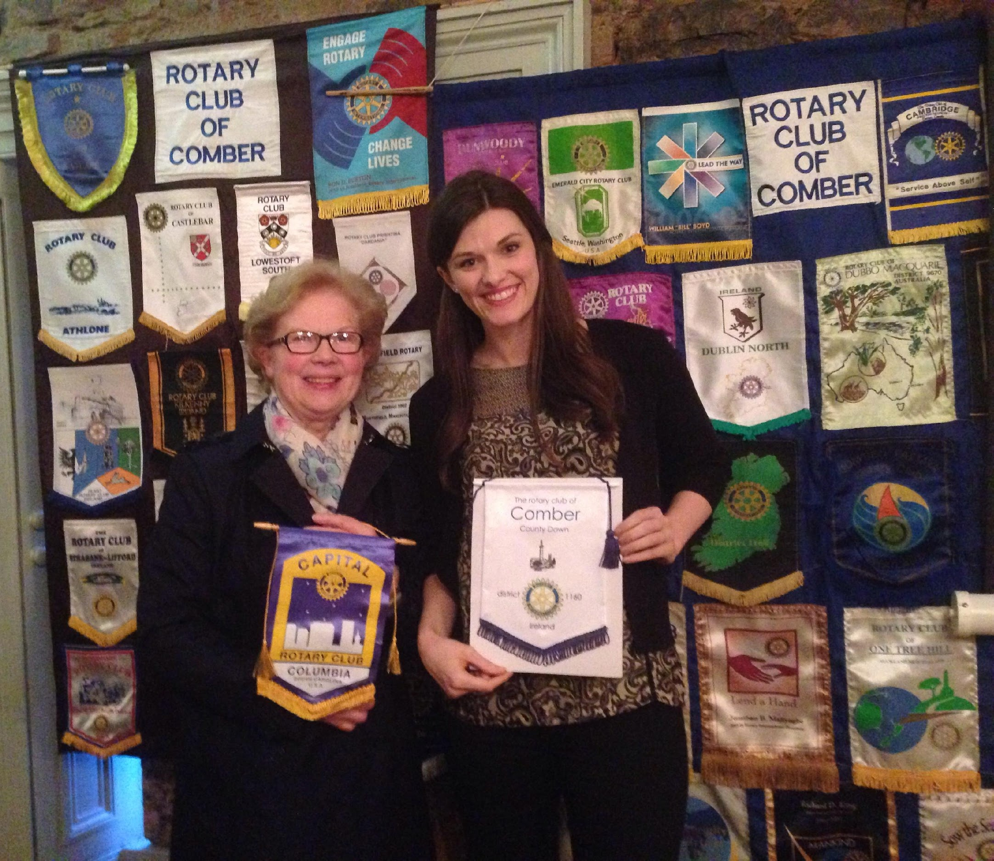

Slide 16
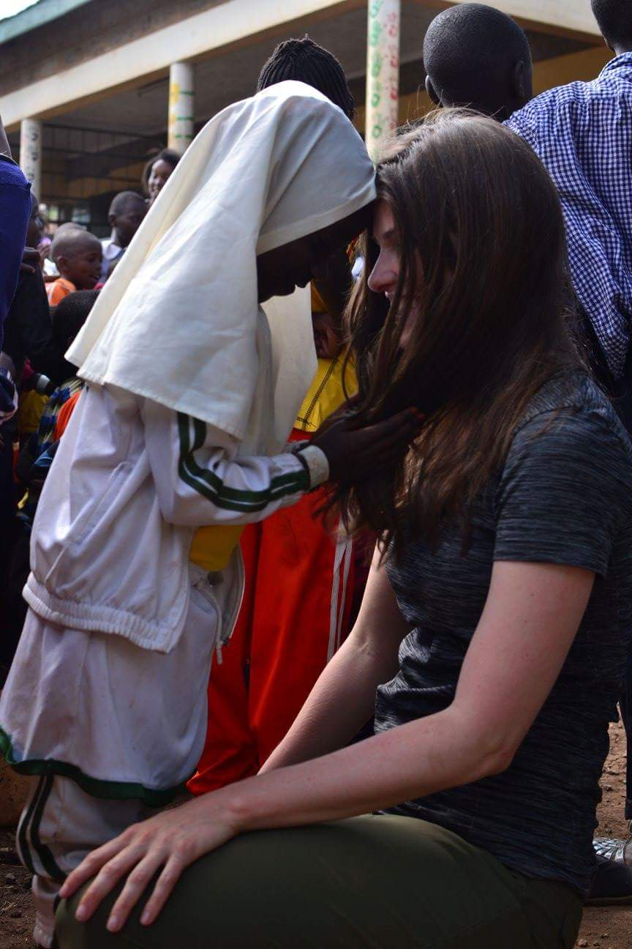
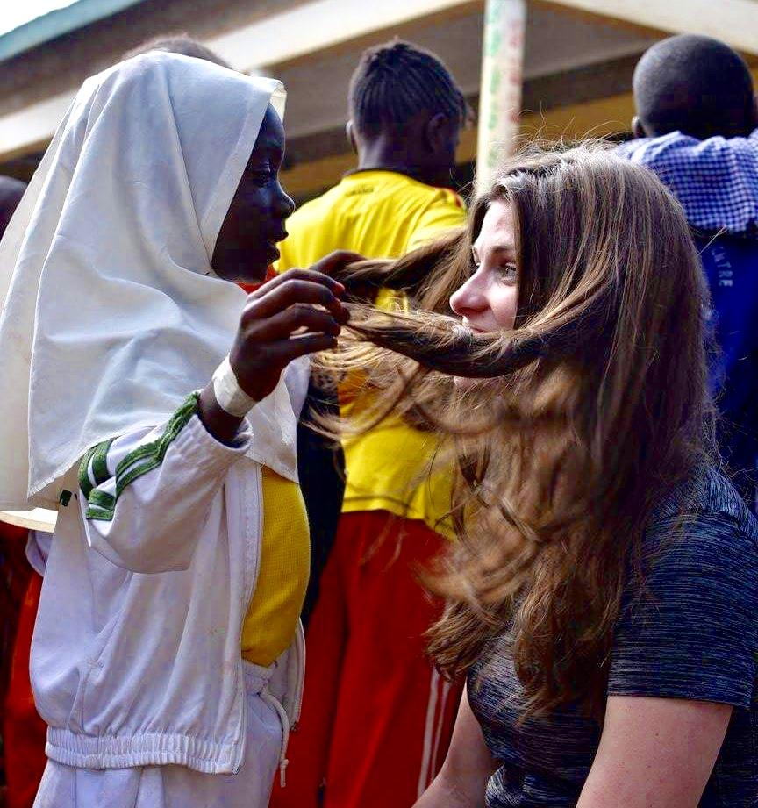
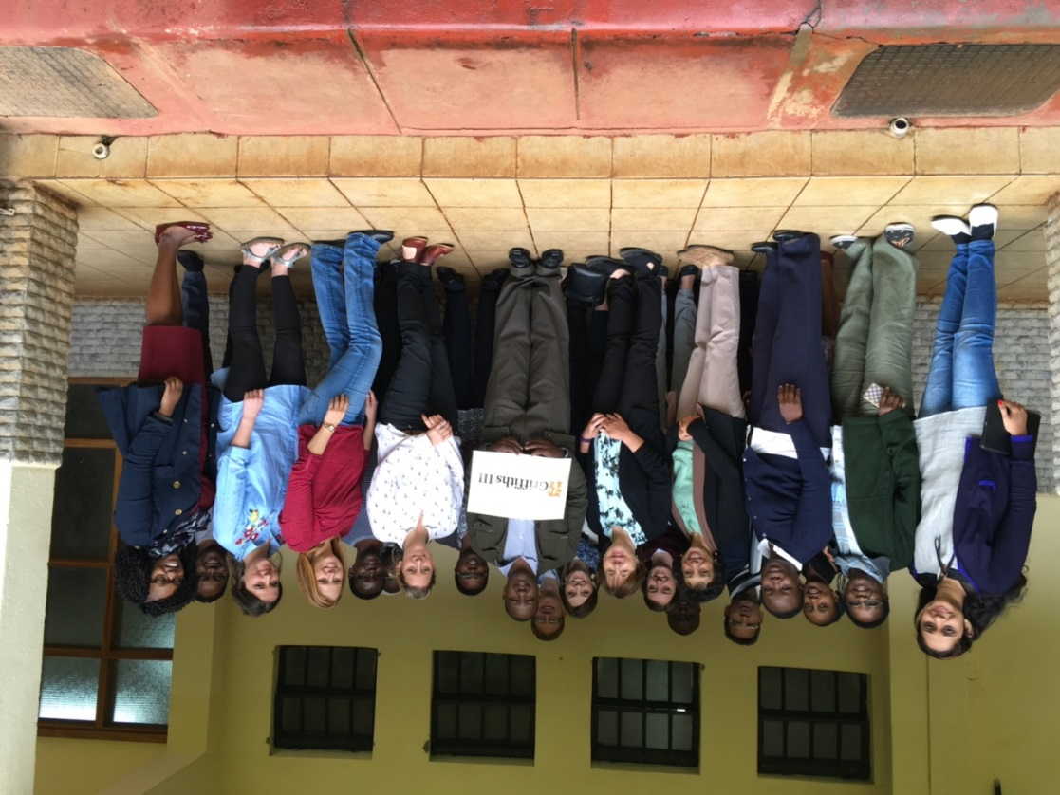
Global Scholar - Internship

Slide 17
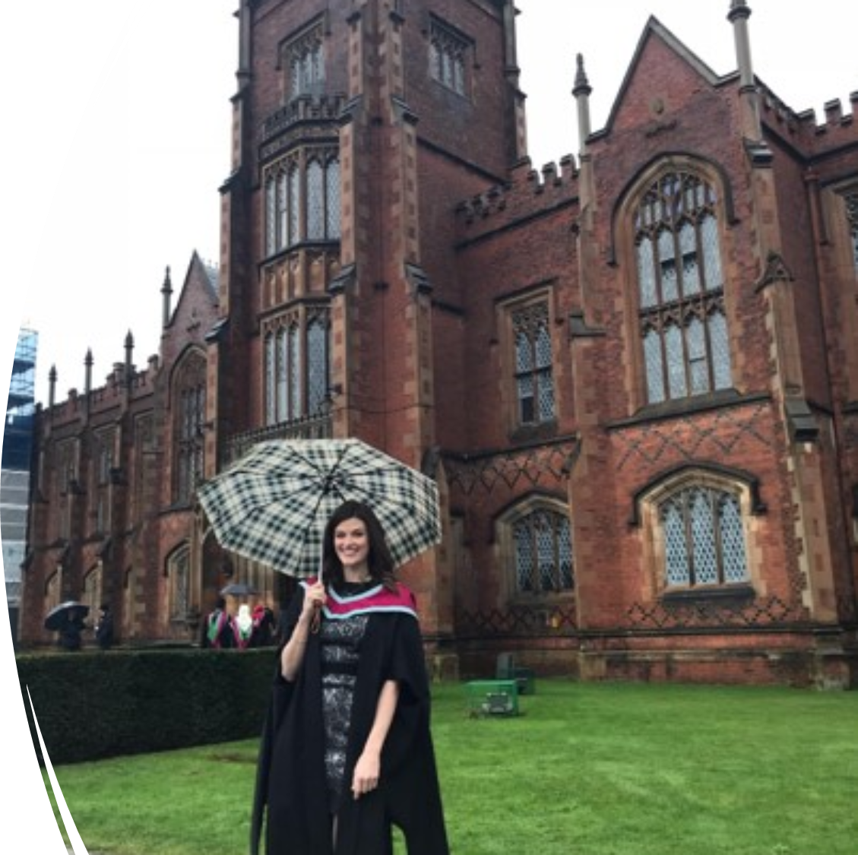

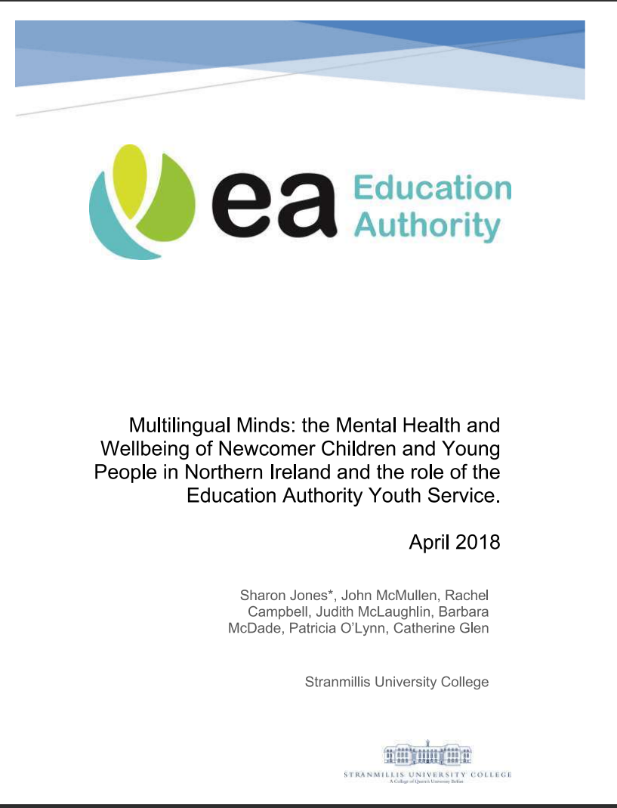
Rotary Sponsored Researcher

Slide 18
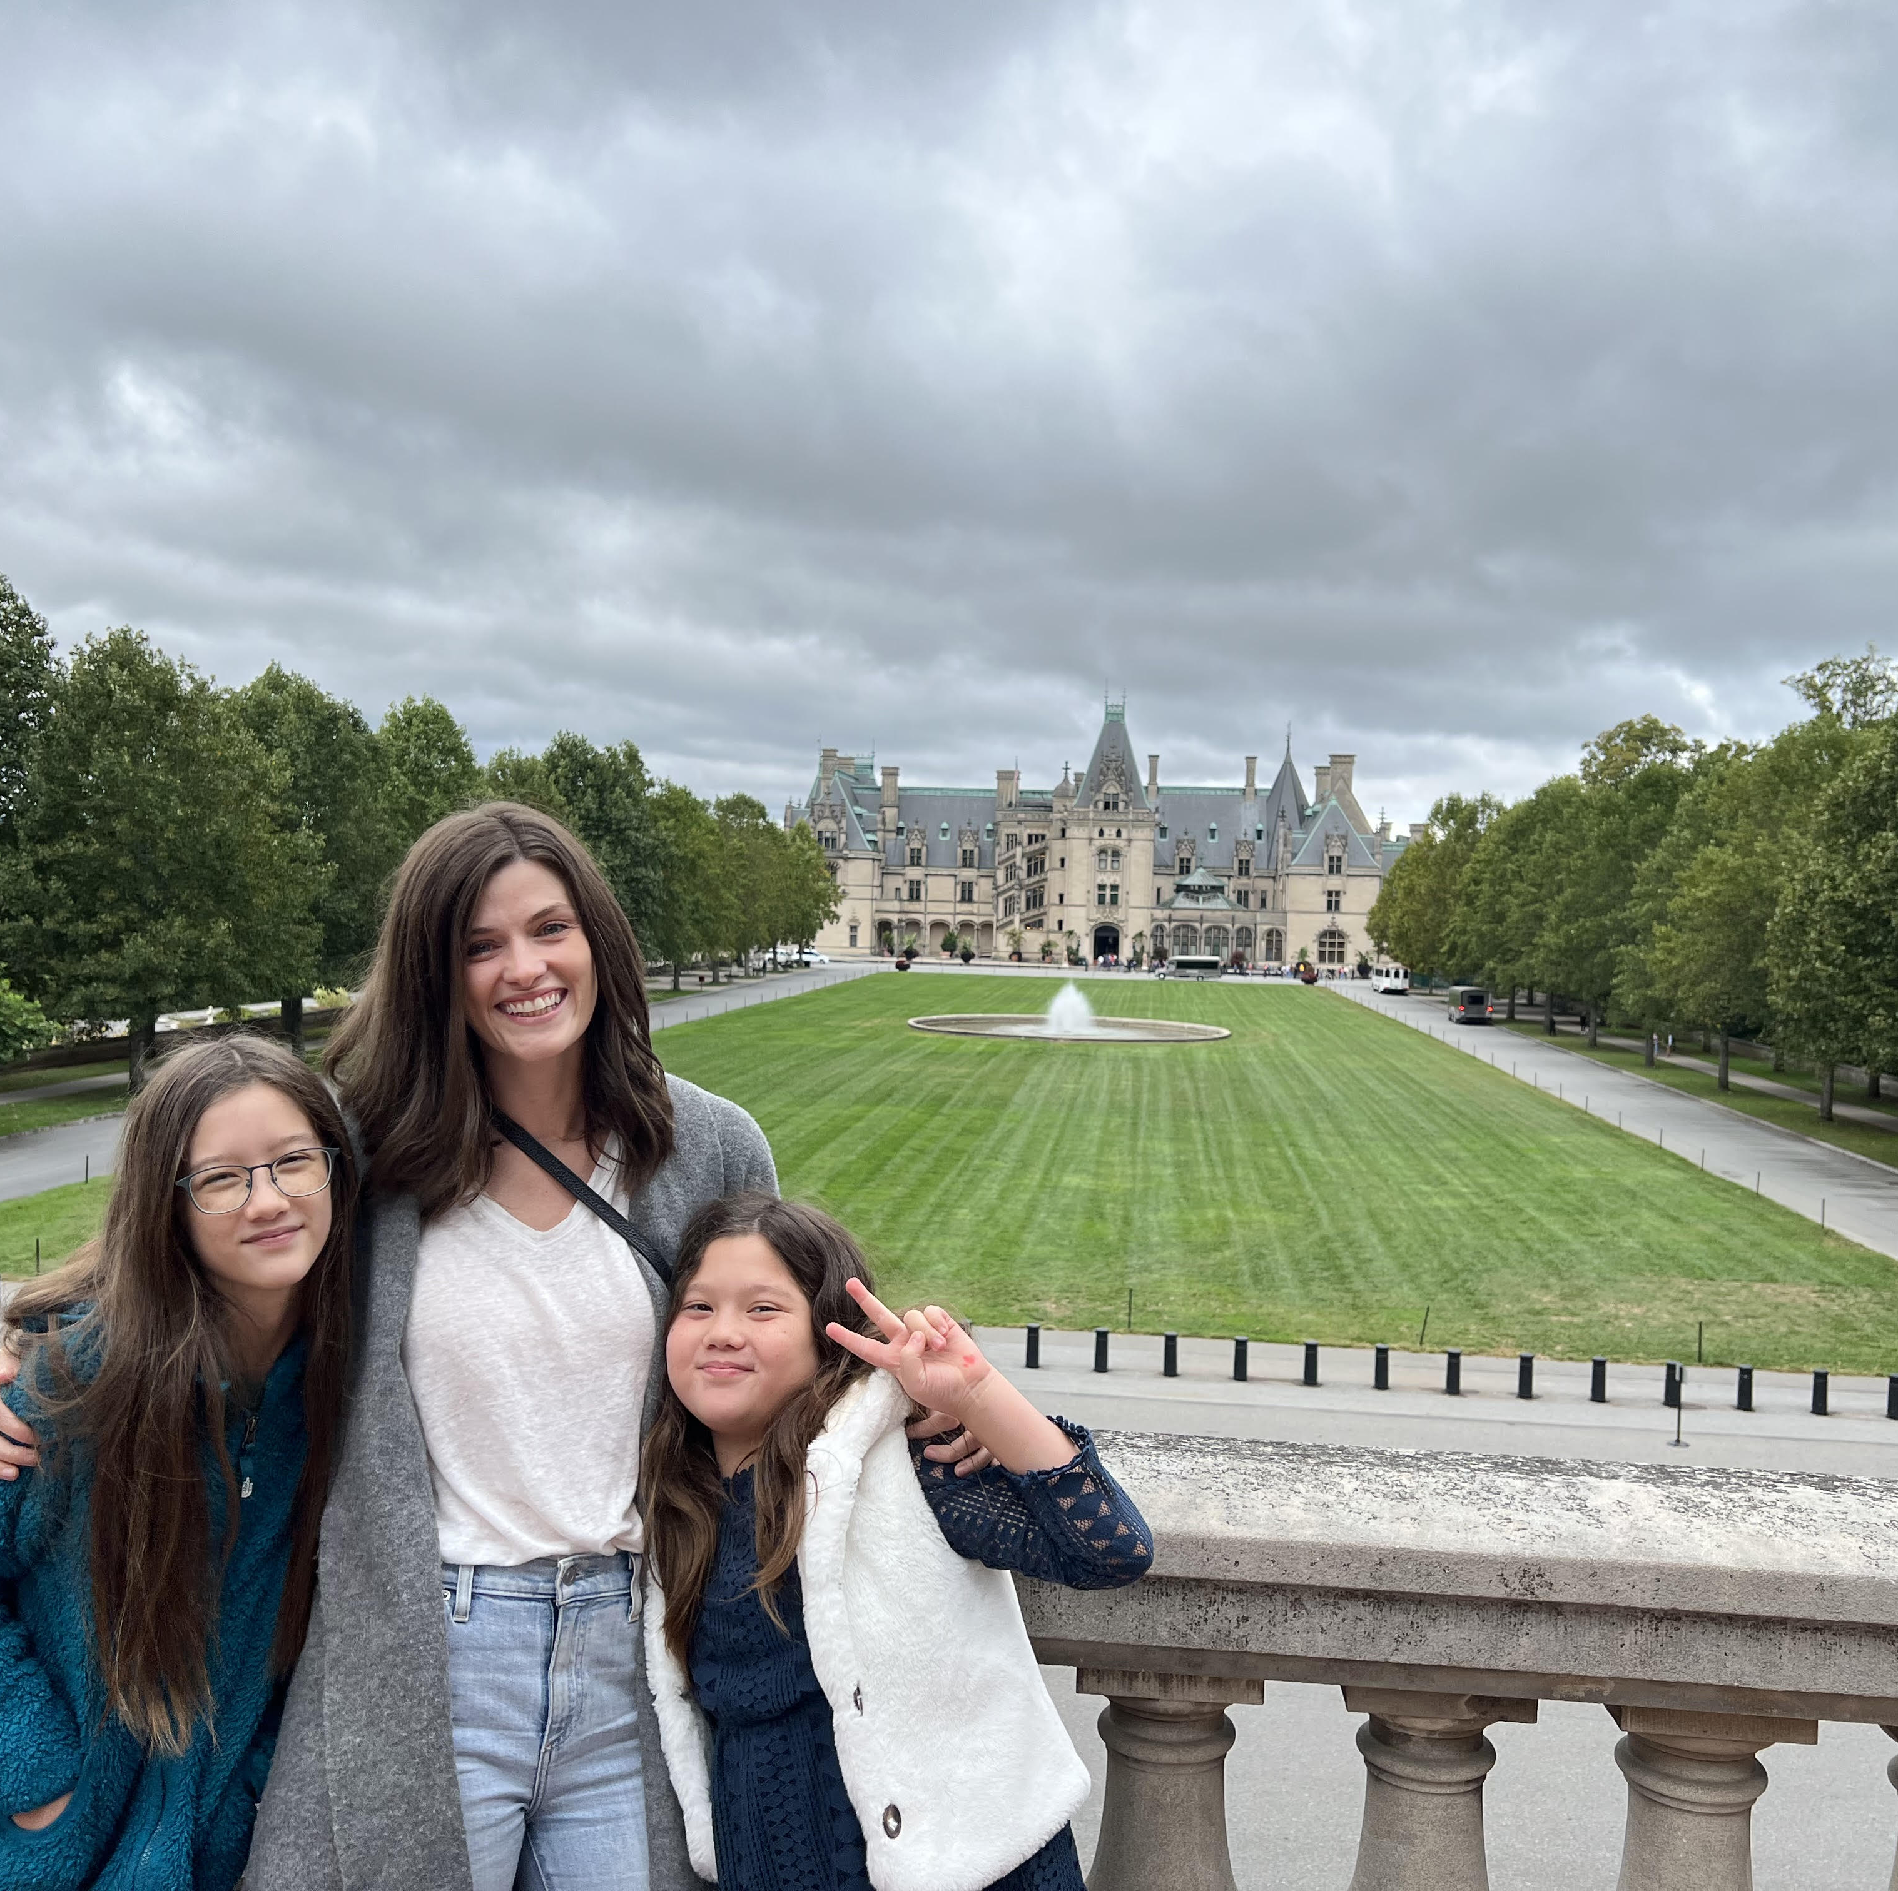
Return to America

Slide 19

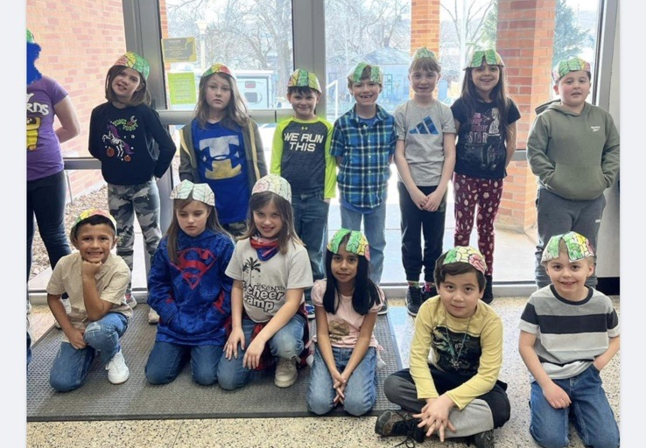
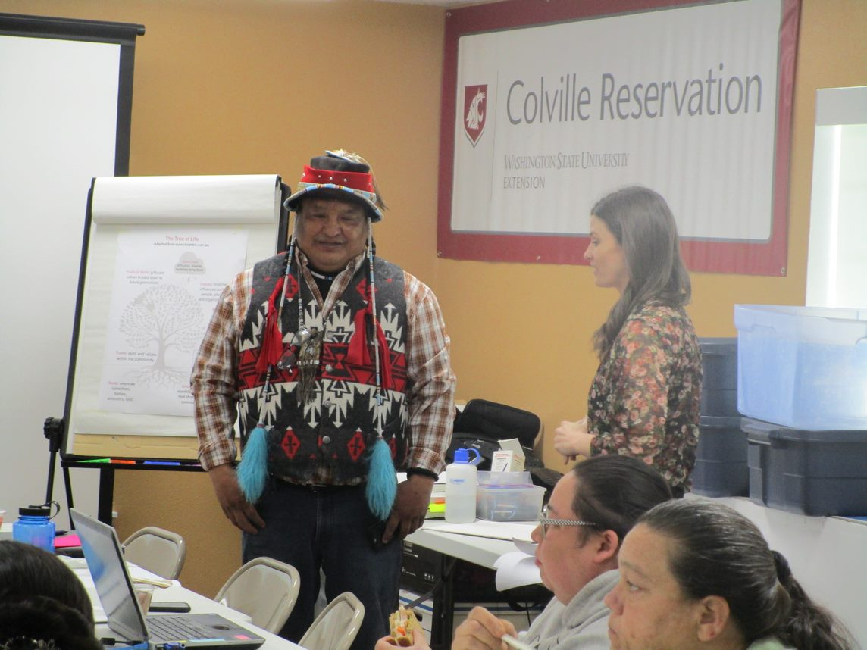
Trauma-Informed Education

Slide 20
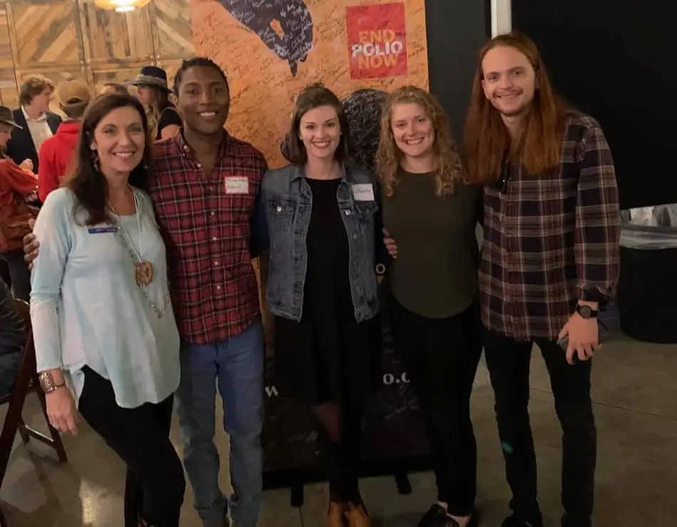
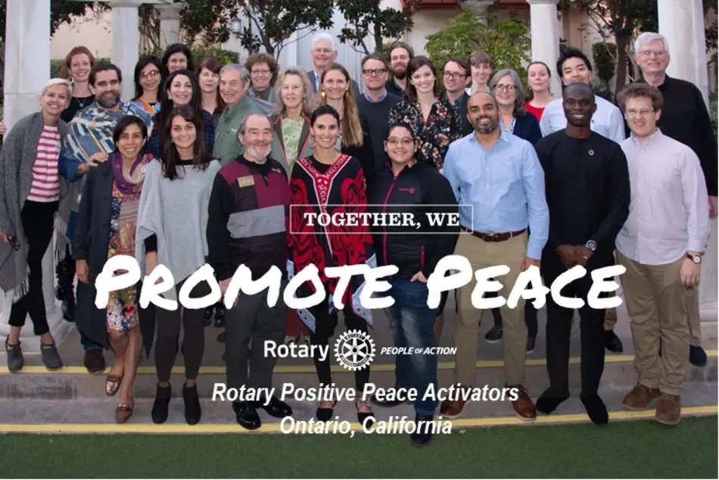
Lasting Rotary Relationships
Co-Founded
Rotaract Asheville
Rotary Positive
Peace Activator

Slide 21
Rotaract Award
https://wlos.com/news/local/asheville-duo-rallies-young-professionals-to-give-back-forge-friendships

Slide 22


Looking Forward
PHD, Counseling Psychology
Fall 2023

Slide 23
Rotary Vision Statement

Slide 24
Contact
Catherine Glen
glen.catherine@gmail.com

