Slide 1
Don’t screw up!!

Slide 2
Your Tool Belt.....

Slide 3
..................Don’t Forget Your Themes:
July: Maternal and Child Health Month
August: Membership & Extension
September: Basic Education and Literacy Month

Slide 4
July 1, 2024:
Semi-Annual Rotary International Dues to RI Enter
How to:
DACDB: https://www.dacdb.com/SecLogin3.cfm

Slide 5
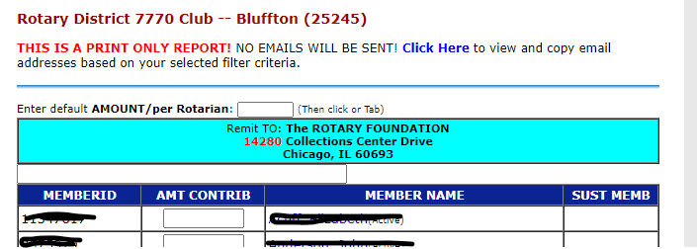
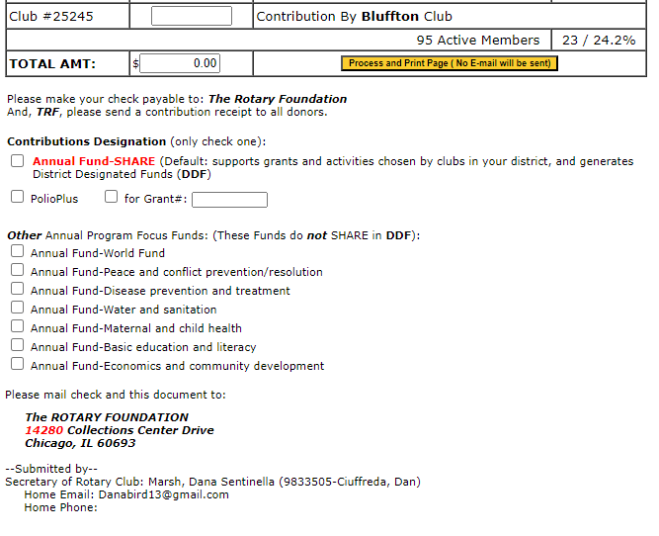

Slide 7
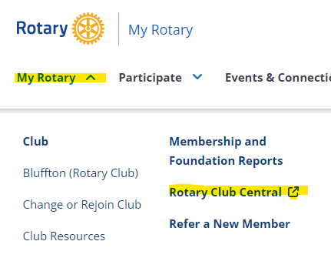
July 1, 2024: 2024-2025 Club Goals in RI
How To: https://my.rotary.org/en

Slide 8
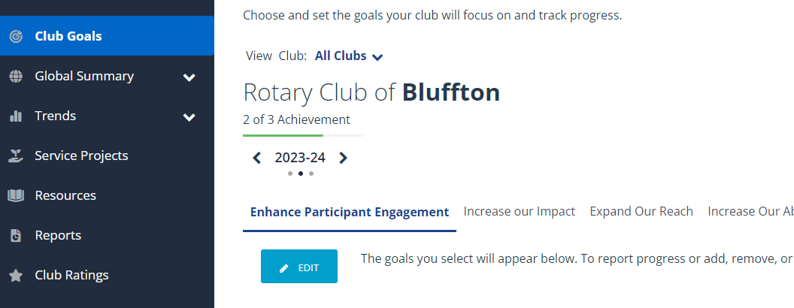

Slide 9
Sponsor clubs submit Ambassadorial Scholarship Applications Due to District Scholarship Committee How To: https://www.dacdb.com/SecLogin3.cfm
July 1, 2024:

Slide 10
August 2024:
Ambassadorial Scholar District Reception
Ambassadorial Scholar District Interviews
August 30, 2024:
Youth Exchange Preliminary Application Due to District Youth Exchange Chair

Slide 11
September 15, 2024:
Submit Quarterly Foundation Contributions to Rotary Foundation
DACDB: https://www.dacdb.com/SecLogin3.cfm

Slide 14
.....................and now

Slide 15
.............How to Run a Meeting

Slide 16
How to Prepare...
01
Create an Agenda
Throughout the week keep notes: special events/member spotlights/etc
02
Be Sure Your Club Administrator and Public Relations Director Are Aware Of Any Changes

Slide 17
How to Prepare...
03
Communicate With Your Sergeant at Arms Prior To The Meeting To Discuss The Club Meeting
04
Create Your Meeting Presentation or Discussion
05
Show Up & Be Happy!

Slide 18
....THe Day of
Be the First One There and the Last One Out
Be Welcoming
Start and End On Time Every Time
Allow Your Speaker Enough Time & Ensure They Felt Welcomed With a Thank You Gift
Allow Time for Q&A and Interaction Between the Speaker and Club
Be Ready....

Slide 19
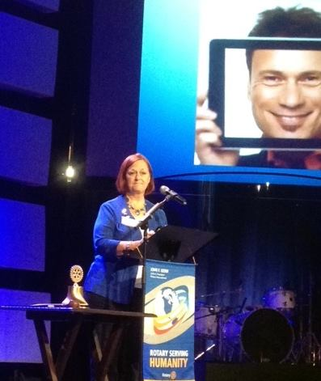
Keeping it interesting!
Be Interactive With Your Members & Highlight Special Events
Change "The Norm"
Remember Your Themes
Don't Be Afraid to Add a Picture...or Two
Meeting
Educational Fun
Business Meeting. Theme Meeting
Interactive

Slide 21
Contact Info:
Dan Ciuffreda
dan460@rocketmail.com
570.656.8867

