Slide 1
“Your Presidency Will Self-Destruct In…”
Dr. Regina H. Moore
Rotary Club of Forest Acres, Immediate Past President
Membership Success Advocate for Areas 1 & 3

Slide 3
Review Goals and Progress: Evaluate the club's progress towards its annual goals and objectives set at the beginning of the Rotary year. Determine what has been achieved and what still needs to be completed.

Slide 4
Encourage Member Engagement: Encourage active participation from club members in remaining projects, events, and initiatives. Motivate members to contribute their time, skills, and resources to accomplish the club's goals.

Slide 5
Plan End-of-Year Celebrations: Organize and plan end-of-year celebrations and recognition events to acknowledge the contributions of members, volunteers, and partners. This could include an awards ceremony, a special dinner, or a social gathering.

Slide 6
Complete Administrative Tasks: Ensure all administrative tasks are completed before the end of the Rotary year. This includes finalizing financial reports, submitting necessary paperwork to Rotary International, and updating club records.

Slide 7
Prepare for Leadership Transition
Work closely with the incoming president to facilitate a smooth transition of leadership. Provide guidance, support, and necessary information to help the incoming president prepare for their term.

Slide 8
Evaluate Club Activities: Reflect on the club's activities and projects throughout the year. Identify successes, challenges, and areas for improvement. Use this feedback to inform future planning and decision-making.

Slide 9
Promote Rotary Values: Reinforce the importance of Rotary's core values of service, fellowship, diversity, integrity, and leadership. Encourage members to uphold these values in their interactions and activities.

Slide 10
Communicate with Members: Keep members informed about upcoming events, deadlines, and club initiatives. Maintain open communication channels to address any questions or concerns members may have.

Slide 11
Express Gratitude: Express gratitude to club members, volunteers, sponsors, and partners for their support and dedication throughout the year. Recognize their contributions and the impact they have made in the community.

Slide 12
Set the Stage for the Next Year: Lay the groundwork for the next Rotary year by outlining goals, priorities, and objectives for the incoming leadership team. Provide guidance and support to ensure a successful start to the new Rotary year.

Slide 13
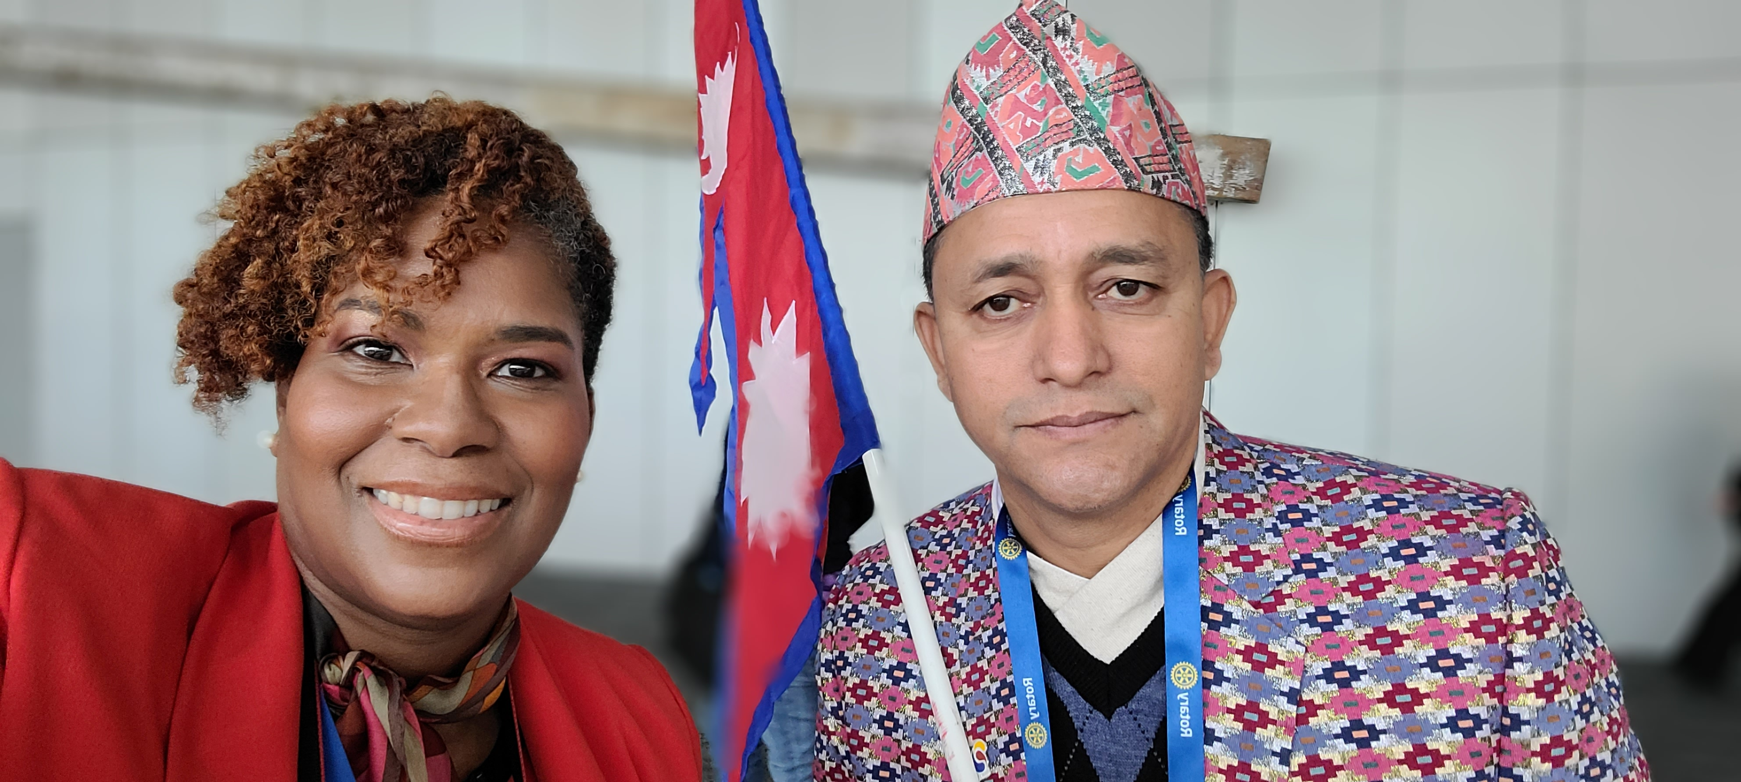
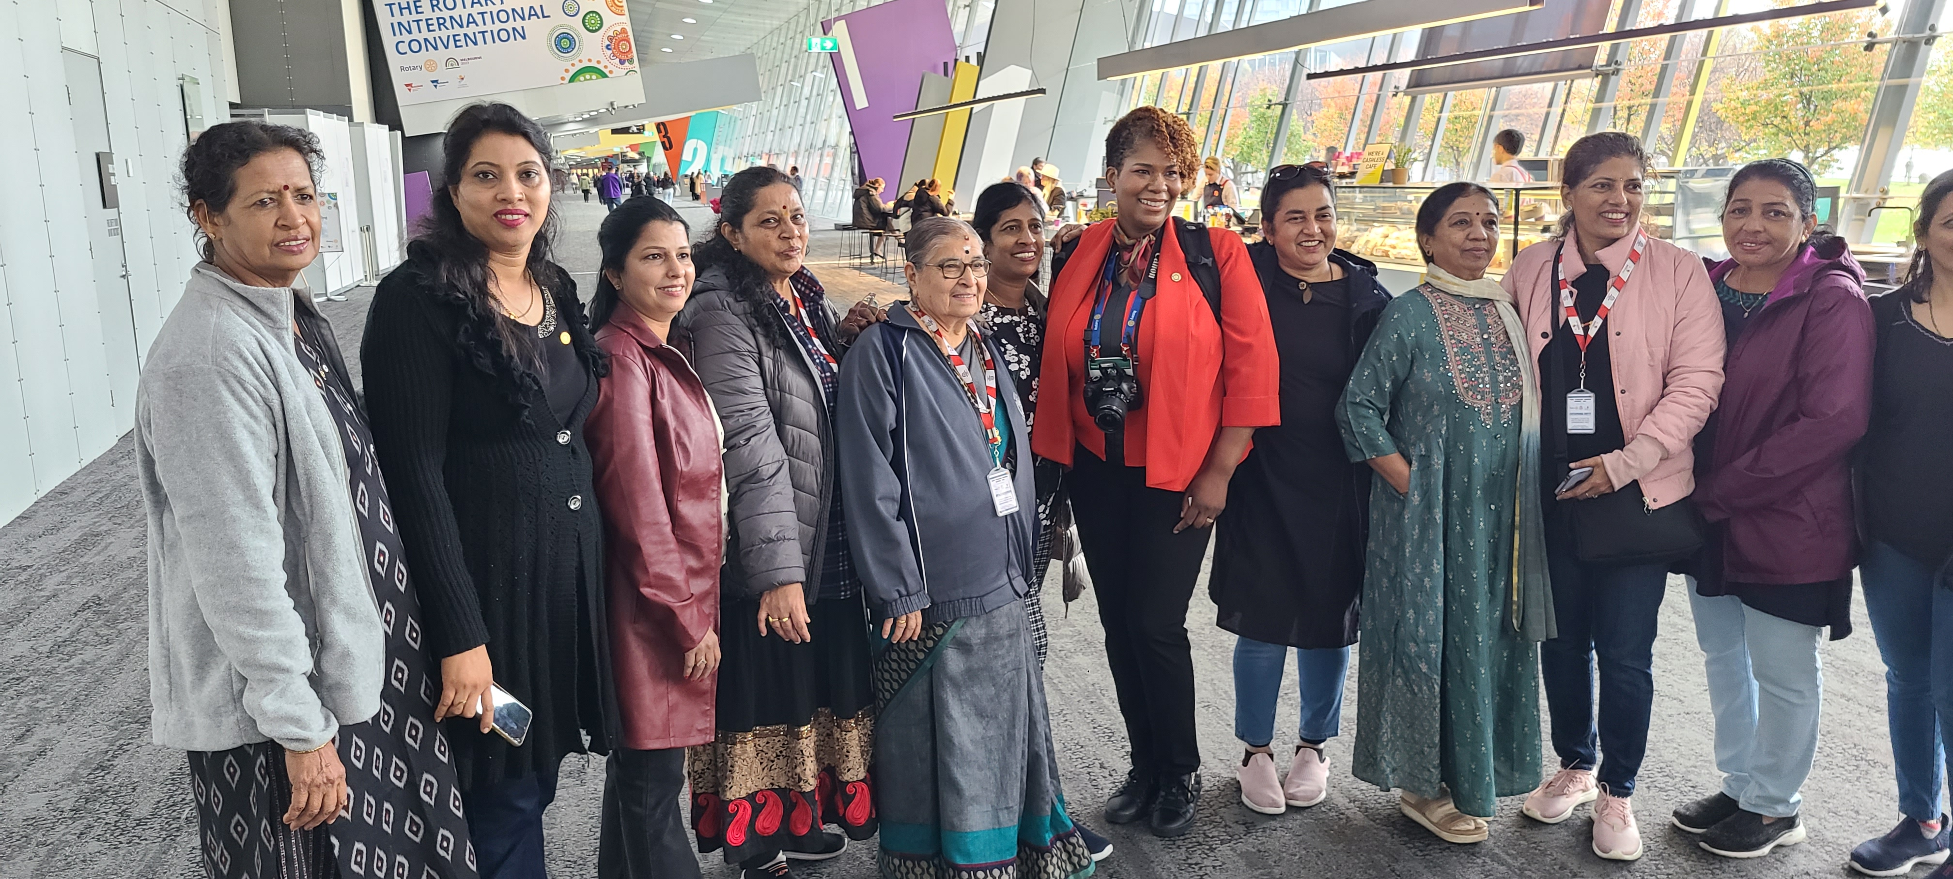
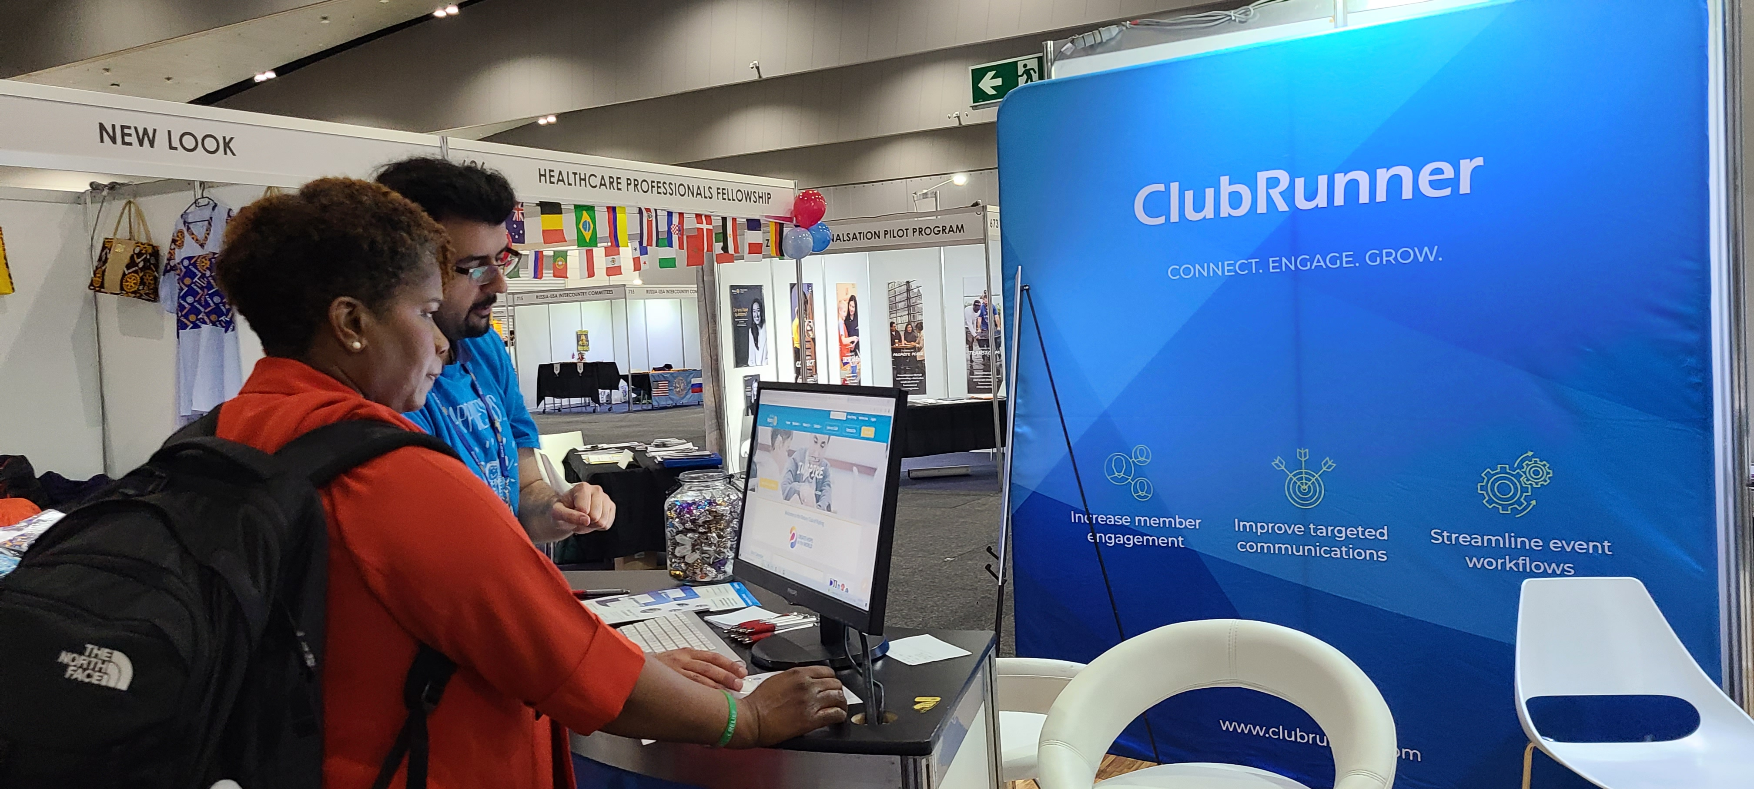
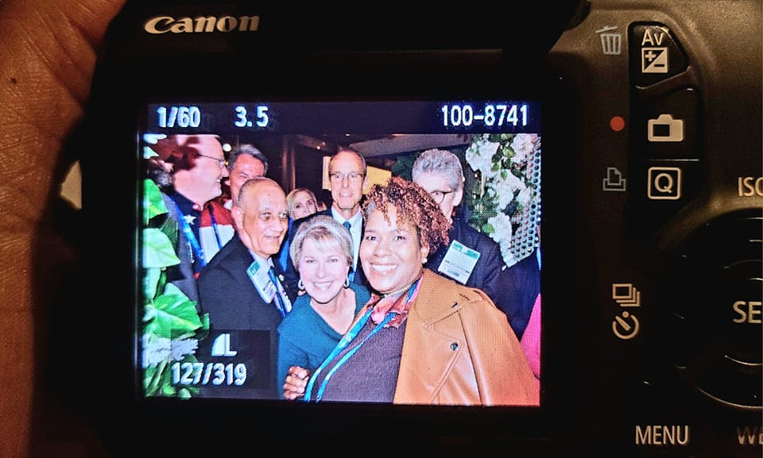

Slide 14
