Slide 1
Leveraging AI in Business
Matthew Stratton

Slide 2
Benefits of using AI Chatbots Like ChatGPT in business
Time-Saving: AI chatbots like ChatGPT can swiftly generate content, ideas, and responses, saving valuable time.
Creative Support: It can serve as a creative partner, providing fresh perspectives and ideas for various business aspects.
Improved Customer Engagement: Implementing chatbots like ChatGPT in customer interactions can help to enhance responsiveness and support.
Notes:
ChatGPT, powered by advanced AI technology, is a versatile language model developed by OpenAI. It excels in natural language processing, making it capable of understanding and generating human-like text responses. By harnessing ChatGPT's capabilities, businesses can enhance creativity, streamline tasks, and improve customer interactions.

Slide 3
How Do You Use an AI Chatbot Like ChatGPT?
First go to the chatbots website, in this case we will use ChatGPT
https://chat.openai.com
Create a free account
Start Prompting...

Slide 4
What is a Prompt?
Definition of a Prompt:
A prompt is a specific instruction or question given to an AI chatbot like ChatGPT to guide its response.
It serves as the input to the AI language model, shaping the type of output it generates.
How Prompts Work:
Users provide prompts in natural language, instructing AI chatbots like ChatGPT on the desired task or information they seek.
The AI model processes the prompt and generates text-based responses accordingly.
Importance of Clear and Specific Prompts:
Clear prompts yield more accurate and relevant results.
Specific prompts help AI chatbots like ChatGPT understand the context and produce more targeted responses.
Notes:
Prompt Example:
Mary had a little

Slide 5
Persona Pattern
Act as Persona X
Perform task Y
Examples:
Act as a professional marketing agency and create a weeks' worth of social media posts for my business.
Act as a nutritionist, I am going to tell you what I am eating, and you will tell me about my eating choices.
Act as a customer service representative and help me respond to customer comments on my reviews page.
Notes:
Prompt Example:
Act as a professional marketing agency and create a weeks' worth of social media posts for my business.
Law Firm that deals with real estate law. Our target audience is real estate agents and customers purchasing or selling their homes. No events or promotions right now.
Can you add in my business, it is Matts Law Firm. Also, I would like more emojis to help engage customers of all ages
Can you give more hashtags to be more engaged

Slide 6
Flipped Interaction Pattern
I would like you to ask me questions to achieve X
You should ask questions until condition Y is met or to achieve this goal (alternatively, forever)
Examples:
I would like you to ask me questions to help me create variations of my marketing materials. You should ask questions until you have sufficient information about my current business, audience, and goals. Ask me the first question.
I would like you to ask me questions to help me diagnose a problem with my Internet. Ask me questions until you have enough information to identify the two most likely causes. Ask me one question at a time. Ask me the first question.
Notes:
Prompt Example:
I would like you to ask me questions to help me create variations of my marketing materials. You should ask questions until you have sufficient information about my current business, audience, and goals. Ask me the first question.
See questions curated and answer as needed to make the prompt more relevant to their business needs

Slide 7
AI Chatbots
ChatGPT: https://chat.openai.com/
Anthropic Claude 2: https://www.anthropic.com/index/claude-2
Google Bard: https://bard.google.com/
Microsoft's Bing Chat: https://chat.bing.com/
Notes:
ChatGPT: https://chat.openai.com/
Anthropic Claude 2: https://www.anthropic.com/index/claude-2
Google Bard: https://bard.google.com/
Microsoft's Bing Chat: https://chat.bing.com/

Slide 8
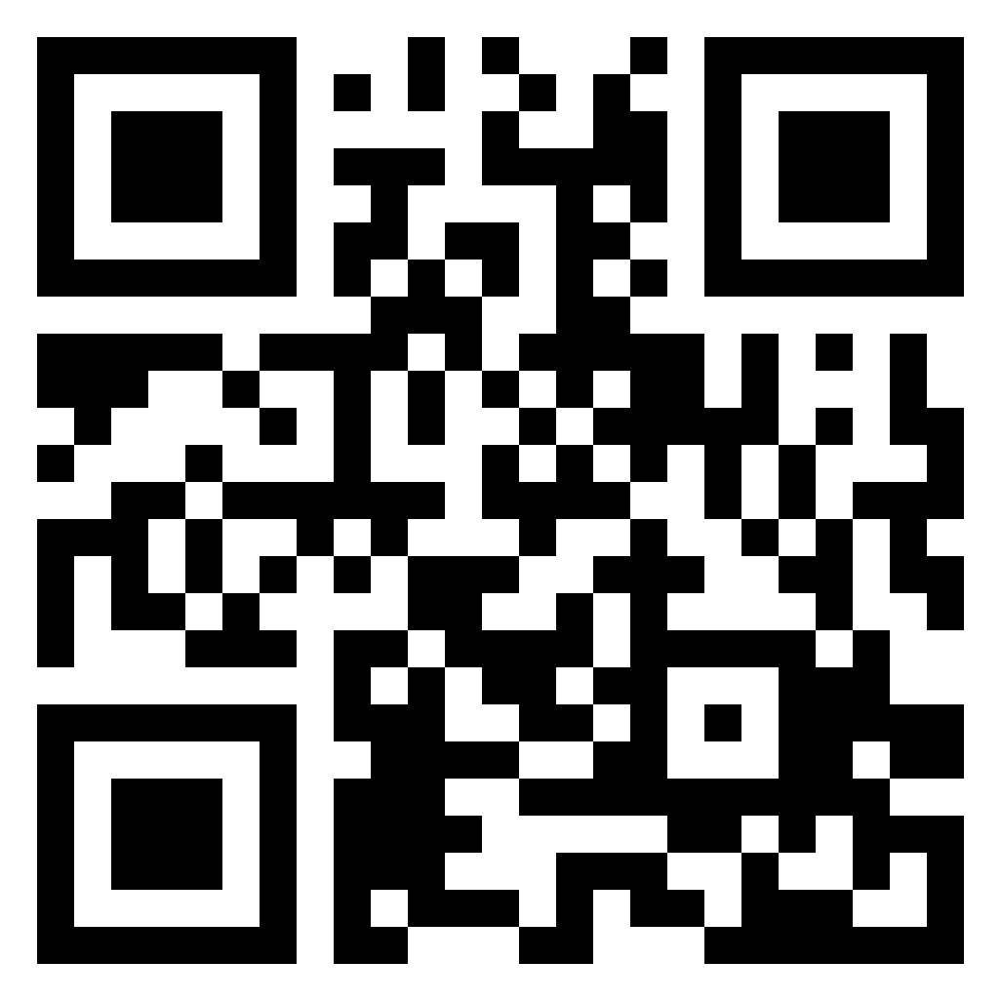
Business Prompt Cheat sheet
http://bit.ly/gptbusiness
Notes:
Prompt Cheat Sheet:
http://bit.ly/gptbusiness

